Slide 1
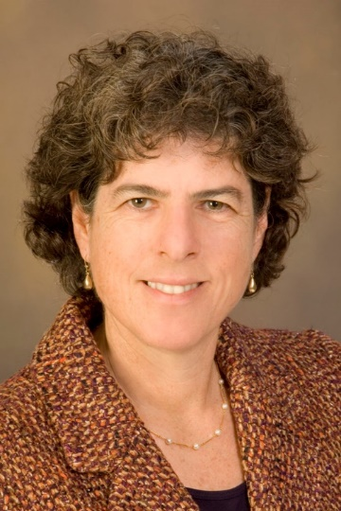
University Center for Excellence in
Developmental Disabilities presents:
Leslie J. Cohen, JD.
Thursday, October 19, 2017
Healthy Weight & Individuals with Developmental and Intellectual Disabilities (IDD): Challenges and Opportunities
12:00pm-1:30pm Room 145 CSB, UO Campus (light refreshments provided)
People with intellectual and developmental disabilities are twice as likely to be obese or overweight than the typical population. They have higher rates of heart disease, diabetes, and earlier mortality.
This talk will explore these health disparities, describe barriers to healthy weight for people with IDD and address promising research and community practices in achieving healthy weight for people with IDD.
Leslie Cohen is the Director of the Sonoran University Center for Excellence in Disabilities at the University of Arizona College of Medicine. She is currently working with Special Olympics International and the Association of University Centers on Disabilities on a CDC funded project addressing inclusive health for people with intellectual disabilities.
Questions: Patty Hamel 541-346-3591Email: phamel@uoregon.edu
uoucedd.org
Please join us!
Questions: Patty Hamel 541-346-3591 Email: phamel@uoregon.edu

Slide 2

Healthy Weight and Individuals with Developmental and Intellectual Disabilities (IDD): Disabilities (IDD): Challenges and Opportunities 12:00-1:30pm Room 145 CSB, UO Campus (light refreshments provided)
University Center for Excellence in
Developmental Disabilities presents:
Leslie J. Cohen, JD
Thursday, October 19, 2017
People with intellectual and developmental disabilities are twice as likely to be obese or overweight than the typical population. They have higher rates of heart disease, diabetes, and earlier mortality.
This talk will explore these health disparities, describe barriers to healthy weight for people with IDD and address promising research and community practices for achieving healthy weight for people with IDD.
Leslie is the Director of the Sonoran University Center for Excellence in Disabilities at the University of Arizona College of Medicine. She is currently working with Special Olympics International and the Association of University Centers on Disabilities on a CDC funded project addressing inclusive health for people with intellectual disabilities.
uoucedd.org
Please join us!
Questions: Patty Hamel 541-346-3591 Email: phamel@uoregon.edu

