Slide 1
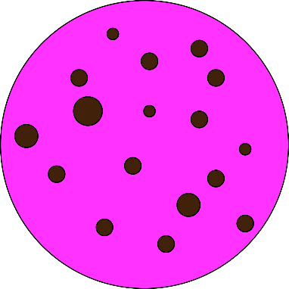
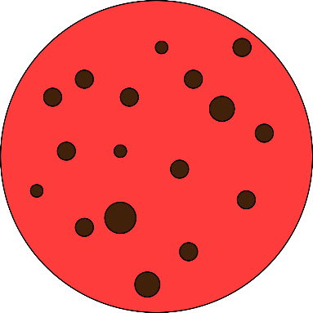
Greetings space trucker! Your mission today is to get as many diamonds as possible from a distant planet. These diamonds can be exchanged for real money at the end of the experiment.
The diamonds are kept by two aliens. In order to get the diamonds you’ll need to give ‘special cookies’ to these aliens. You have plenty of these cookies…
These are the two cookies. Although they look similar, their taste is very different!
Press any key to continue

Slide 2

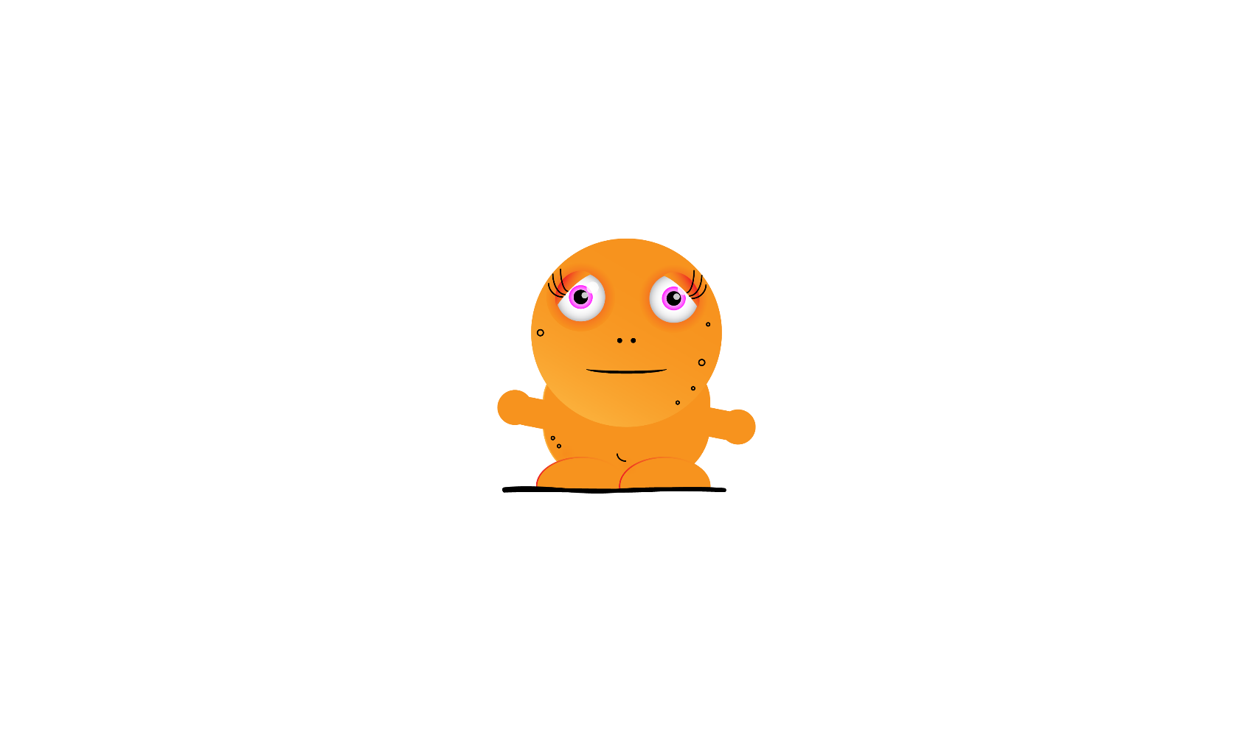
Each type of alien only likes one type of cookie. If you give an alien a cookie that they like, they will give you one diamond – not a bad deal! However, if you give them a cookie that they don’t like, you’ll get nothing.
YOU HAVE TO LEARN which type of alien likes which type of cookie. It is a trial-and-error task. Learning from your errors is the only way to know which type of cookie each alien likes.
To which alien should you give this cookie? You’ll have to learn about their likes if you want diamonds
Press any key to continue

Slide 3


If you want to give a cookie to the alien on the left of screen, press the <Q> key. If you want to give a cookie to the alien on the right, press the <P> key. Please use your right hand for pressing the <P> key, and your left for the <Q> key. Please respond with your index fingers on each hand.
You’ll have only two seconds to make your response.
“I will give this cookie to the orange alien. So I press the key <P> with my right index finger”
Press any key to continue

Slide 4


These aliens can give you two types of diamonds: blue or yellow. One type of diamond is worth 100 times more than the other!
In order to keep track of your profits, you’ll be shown the relative value of each diamond during the task (either 1 or 100 ‘points’). Each 1000 points can be exchanged for AUD$1.
One of these worth 100 points!!
Press any key to continue

Slide 5
On some occasions, when the aliens are distracted, you can take a diamond. But you only have time to get one. Press the <Q> or<P> keys in order to choose which diamond you want.
Q
Press any key to continue

Slide 6
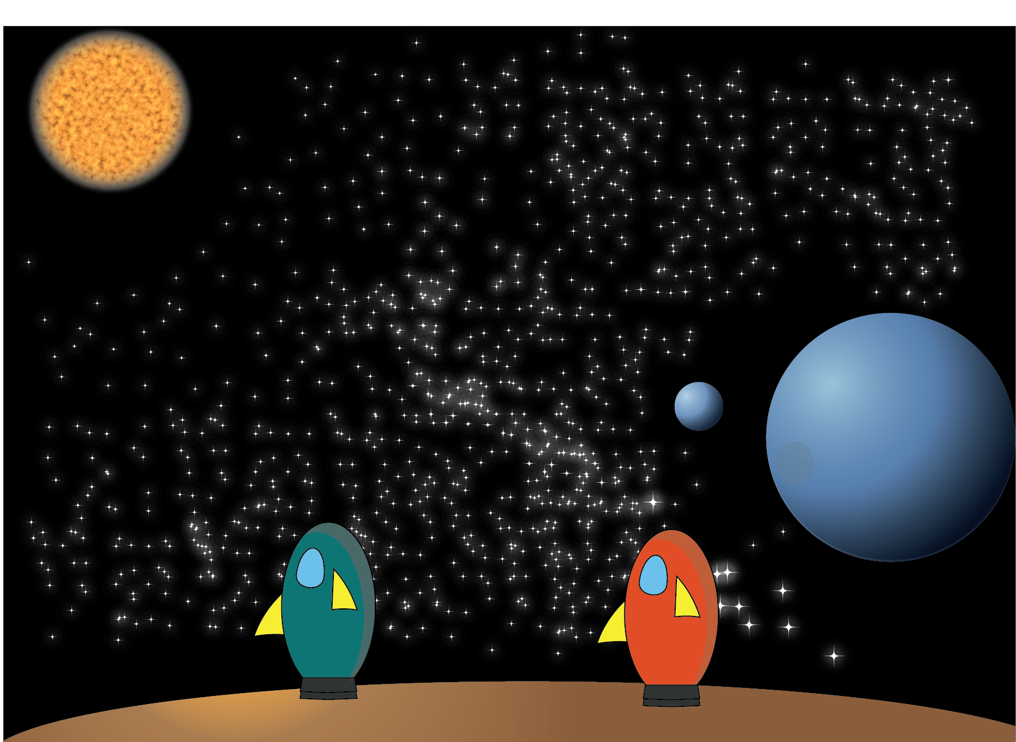
Information about a diamond’s value can sometimes be missed due to solar interference. You have two spaceships on the planet which protect your systems from interference. But when one spaceship is away, the sign ‘??’ will follow the image of the diamond instead of its value. But don’t worry, the value of the diamond has not changed and will be added to your total points as usual!
You can sell your diamonds in these two spaceships – one spaceship for each type of diamond. However, when a spaceship departs to Earth, you cannot sell or keep these diamonds until the spaceship has returned. That is, while the spaceship is away this type of diamond is worth 0 points.
Keep this in mind in order to maximize your earnings.
The information about your spaceships’ availability will be displayed on the screen.
Press any key to continue

Slide 7
Have you understood the instructions? Let’s see:
How many different types of diamonds can you get from the aliens? What’s the relative value of each diamond?
If the spaceship for one diamond has returned to Earth, what is the value for this type of diamond while the spaceship is away? How about for the other type of diamond?
If you see the symbol ‘??’ after obtaining a diamond, does this mean that you will gain 0 points for this diamond? If not, what does this symbol actually mean?
Press any key to start the experiment

