Slide 1
Big Data Analytics:
Needs and Solutions

Slide 2
Contents
Hadoop Cluster Architecture
Hadoop Cluster Configuration files
Hadoop Cluster Modes

Slide 3
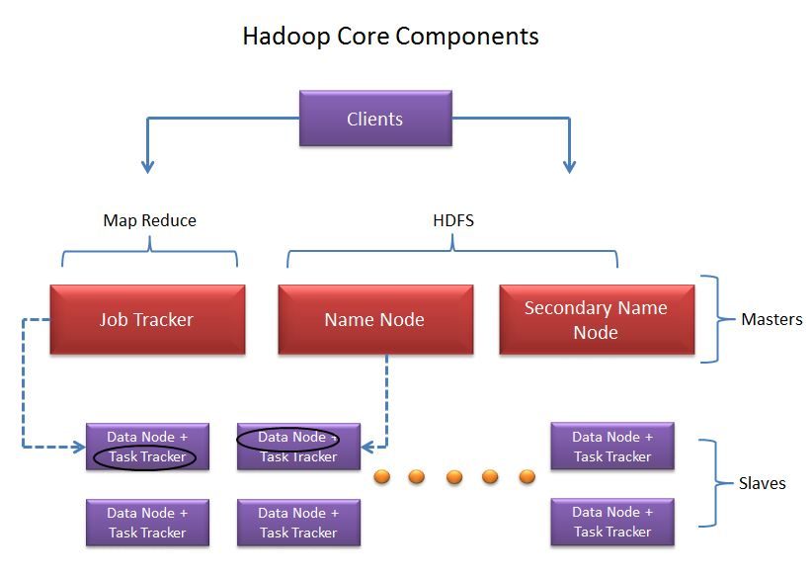
Hadoop Cluster – Core Components
Core Components of Hadoop Cluster:-
Hadoop cluster has 3 components:
Client.
Master.
Slave.
The role of each components are shown in the below image.

Slide 4
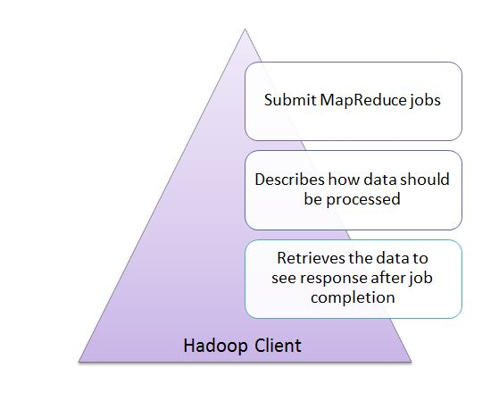
Hadoop Cluster – Core Components
Client:-
It is neither master nor slave, rather play a role of loading the data into cluster, submit MapReduce jobs describing how the data should be processed and then retrieve the data to see the response after job completion.

Slide 5
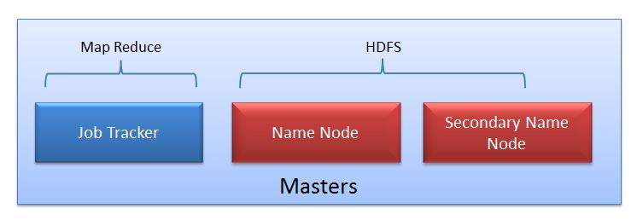
Hadoop Cluster – Core Components
Masters:-
The Masters consists of 3 components
NameNode
Secondary Namenode
JobTracker.

Slide 6
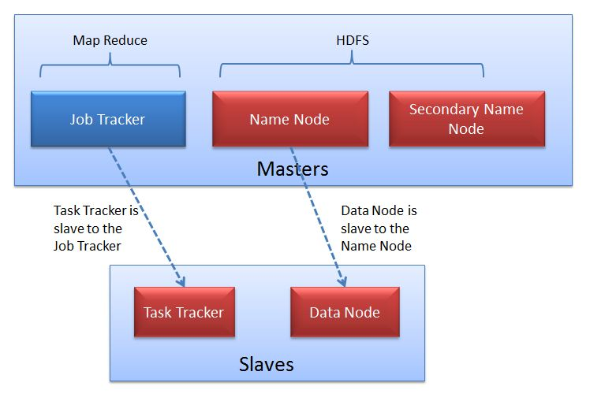
Hadoop Cluster – Core Components
Slaves:-
Slave nodes are the majority of machines in Hadoop Cluster and are responsible to
Store the data
Process the computation
Each slave runs both a DataNode and Task Tracker daemon which communicates to their masters. The Task Tracker daemon is a slave to the JobTracker and the DataNode daemon a slave to the NameNode.

Slide 7
Hadoop Cluster Files
Changes that needs to be done in the files core-site.xml
Go to /opt/hadoop-2.2.0/etc/hadoop directory and open core-site.xml. Enter the following properties in it: <configuration> <property> <name>fs.defaultFS</name> <value>hdfs://localhost:8020</value> <final>true</final> </property> </configuration>

Slide 8
Hadoop Cluster Files
Changes that needs to be done in the files hdfs-site.xml
Go to /opt/hadoop-2.2.0/etc/hadoop directory and open hdfs-site.xml. Enter the following properties in it: <configuration> <property> <name>dfs.namenode.name.dir</name> <value>file:///opt/hadoop-2.2.0/hadoop_data/dfs/name</value> </property> <property> <name>dfs.blocksize</name> <value>268435456</value> </property> <property> <name>dfs.datanode.data.dir</name> <value>file:///opt/hadoop-2.2.0/hadoop_data/dfs/data</value> </property> </configuration>

Slide 9
Hadoop Cluster Files
Changes that needs to be done in the files mapred-site.xml
Go to /opt/hadoop-2.2.0/etc/hadoop directory and open yarn-site.xml. Enter following properties in it: <configuration> <property> <name>yarn.resourcemanager.address</name> <value>localhost:8032</value> </property> <property> <name>yarn.resourcemanager.scheduler.address</name> <value>localhost:8030</value> </property> <property> <name>yarn.resourcemanager.resource-tracker.address</name> <value>localhost:8031</value> </property> <property> <name>yarn.resourcemanager.admin.address</name> <value>localhost:8033</value> </property> <property> <name>yarn.resourcemanager.webapp.address</name> <value>localhost:8088</value> </property> <property> <name>yarn.resourcemanager.scheduler.class</name> <value>org.apache.hadoop.yarn.server.resourcemanager.scheduler.capacity.CapacityScheduler</value> </property>

Slide 10
Hadoop Cluster Files cont.
<property>
<name>yarn.nodemanager.aux-services</name>
<value>mapreduce_shuffle</value>
</property>
<property>
<name>yarn.nodemanager.local-dirs</name>
<value>file:///opt/hadoop/hadoop_data/yarn/yarn.nodemanager.local-dirs</value>
</property>
<property>
<name>yarn.nodemanager.log-dirs</name>
<value>file:///opt/hadoop/hadoop_data/yarn/logs</value>
</property>
<property>
<name>yarn.nodemanager.aux-services.mapreduce.shuffle.class</name>
<value>org.apache.hadoop.mapred.ShuffleHandler</value>
</property>
</configuration>

Slide 11
Hadoop Cluster Modes
Different modes of hadoop:-
Standalone Mode
Pseudo Distributed Mode(Single Node Cluster)
Fully distributed mode (or multiple node cluster)
Standalone Mode
Default mode of Hadoop
HDFS is not utilized in this mode.
Local file system is used for input and output
Used for debugging purpose
No Custom Configuration is required in 3 hadoop(mapred-site.xml,core-site.xml, hdfs-site.xml) files.
Standalone mode is much faster than Pseudo-distributed mode.

Slide 12
Hadoop Cluster Modes
Pseudo Distributed Mode(Single Node Cluster)
Configuration is required in given 3 files for this mode
Replication factory is one for HDFS.
Here one node will be used as Master Node / Data Node / Job Tracker / Task Tracker
Used for Real Code to test in HDFS.
Pseudo distributed cluster is a cluster where all daemons are
Running on one node itself.
Fully distributed mode (or multiple node cluster)
This is a Production Phase
Data are used and distributed across many nodes.
Different Nodes will be used as Master Node / Data Node / Job Tracker / Task Tracker
Read more at http://javabeginnerstutorial.com/hadoop/different-modes-of-hadoop/#w3uoEDGtZPozU4h6.99

Slide 13
THANK YOU !

