Slide 1
FLUME

Slide 2
Apache Flume is a tool used to collect streaming data such as log files, events from various sources
Data which is to be collected will be produced by various sources like applications servers, social networking sites and various others. This data will be in the form of log files and events.
Log file − In general, a log file is a file that lists events/actions that occur in an operating system. For example, web servers list every request made to the server in the log files.
Processing the log files produces info:: −
Understanding the application performance and various software and hardware failures.
the user behavior and derive better business insights.
An event is the basic unit of the data transported inside Flume.
When the rate of incoming data exceeds the rate at which data can be written to the destination, Flume acts as a mediator between data producers and the centralized stores and provides a steady flow of data between them

Slide 3
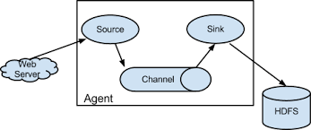
Flume Agent
Flume deploys as one or more agents, each contained within its own instance of the Java Virtual Machine (JVM).
Agents consist of three components: sources, sinks, and channels. An agent must have at least one of each in order to run. Sources collect incoming data as events. Sinks write events out, and channels provide a queue to connect the source and sink

Slide 4
Sources
Put simply, Flume sources listen for and consume events. Events can range from newline-terminated strings in stdout to HTTP POSTs and RPC calls — it all depends on what sources the agent is configured to use. Flume agents may have more than one source, but must have at least one. Sources require a name and a type; the type then dictates additional configuration parameters.
On consuming an event, Flume sources write the event to a channel. Importantly, sources write to their channels as transactions. By dealing in events and transactions, Flume agents maintain end-to-end flow reliability. Events are not dropped inside a Flume agent unless the channel is explicitly allowed to discard them due to a full queue
Channels
Channels are the mechanism by which Flume agents transfer events from their sources to their sinks. Events written to the channel by a source are not removed from the channel until a sink removes that event in a transaction. This allows Flume sinks to retry writes in the event of a failure in the external repository (such as HDFS or an outgoing network connection). For example, if the network between a Flume agent and a Hadoop cluster goes down, the channel will keep all events queued until the sink can correctly write to the cluster and close its transactions with the channel.
Channels are typically of two types: in-memory queues and durable disk-backed queues. In-memory channels provide high throughput but no recovery if an agent fails. File or database-backed channels, on the other hand, are durable. They support full recovery and event replay in the case of agent failure.

Slide 5
Sinks
Sinks provide Flume agents output capability — if you need to write to a new type storage, just write a Java class that implements the necessary classes. Like sources, sinks correspond to a type of output: writes to HDFS or HBase, remote procedure calls to other agents, or any number of other external repositories. Sinks remove events from the channel in transactions and write them to output. Transactions close when the event is successfully written, ensuring that all events are committed to their final destination.

Slide 6
Modify the flume.conf in conf directory and add required to it. Also comment the existing properties.
Go to /usr/local/work/flume/conf by typing following command:
mishra@mishra-VirtualBox:$ cd /usr/local/work/flume/conf
then open the file flume.conf using:::::::
mishra@mishra-VirtualBox:/usr/local/work/flume/conf$ sudo nano flume.conf
(comment all the lines with # and paste)

Slide 7
anand.sources = mis anand.sinks = his anand.channels = c # Describe/configure the source anand.sources.mis.type = netcat anand.sources.mis.bind = localhost anand.sources.mis.port = 44444 # Describe the sink anand.sinks.his.type = logger # Use a channel which buffers events in memory anand.channels.c.type = memory anand.channels.c.capacity = 1000 anand.channels.c.transactionCapacity = 100
# Bind the source and sink to the channel anand.sources.mis.channels = c anand.sinks.his.channel = c

Slide 8
This configuration defines a single agent named anand. anand has a source that listens for data on port 44444, a channel that buffers event data in memory, and a sink that logs event data to the console.

Slide 9
Now close the flume.conf file and type the following on the terminal
mishra@mishra-VirtualBox:/usr/local/work/flume/conf$ flume-ng agent --conf conf --conf-file flume.conf --name anand -Dflume.root.logger=INFO,console
now open another terminal and do the following (do not close this terminal)
From a separate terminal, we can then telnet port 44444 and send Flume an event:
mishra@mishra-VirtualBox:~$ telnet localhost 44444 you will get the following on your screen::: Trying 127.0.0.1... Connected to localhost. Escape character is '^]'. now type anything which you want as your streaming data communicating through telnet port
like:: hello andy....how r u??? now check on the terminal on which flume is running..you will find same output

Slide 10
a brief of what we are doing here::::: what is netcat? netcat:: functions it can do various other things like creating socket servers to listen for incoming connections on ports, transfer files from the terminal etc. Netcat is a computer networking service for reading from and writing network connections using TCP or UDP More technically speaking, netcat can act as a socket server or client and interact with other programs at the same time sending and receiving data through the network. Ncat is a feature-packed networking utility which reads and writes data across networks from the command line what is telnet? a network protocol that allows a user on one computer to log into another computer that is part of the same network Telnet is a user command and an underlying TCP/IP protocol for accessing remote computers. Telnet is most likely to be used by program developers and anyone who has a need to use specific applications or data located at a particular host computer.

Slide 11
IN case when you want your data in hdfs:::: open flume.conf file and paste:::::: mishra@mishra-VirtualBox:/usr/local/work/flume/conf$ sudo nano flume.conf comment all lines with # and paste::::: agent.sources = mis agent.sinks = his agent.channels = c # Describe/configure the source agent.sources.mis.type = netcat agent.sources.mis.bind = localhost agent.sources.mis.port = 44444 # Define a sink that outputs to logger. agent.sinks.his.type = hdfs agent.sinks.his.hdfs.path =hdfs://localhost:8020/flumedata/ agent.sinks.his.hdfs.fileType = DataStream agent.sinks.his.hdfs.writeFormat = Text agent.channels.c.type = memory agent.channels.c.capacity = 1000 agent.channels.c.transactionCapacity = 100 # Bind the source and sink to the channel agent.sources.mis.channels = c agent.sinks.his.channel = c

Slide 12
now run the command mishra@mishra-VirtualBox:/usr/local/work/flume/conf$ flume-ng agent --conf conf --conf-file flume.conf --name agent -Dflume.root.logger=INFO,console From a separate terminal, we can then telnet port 44444 and send Flume an event:
mishra@mishra-VirtualBox:~$ telnet localhost 44444
write anything here
hii
How are you

Slide 13
You can now open the browser and type:
https://localhost:50070
This will open Hadoop admin page.
Then go to Utilities>Browse Filesystem.
Here you can see flume data.

Slide 14
TWITTER DATA COLLECTION USING FLUME

Slide 15
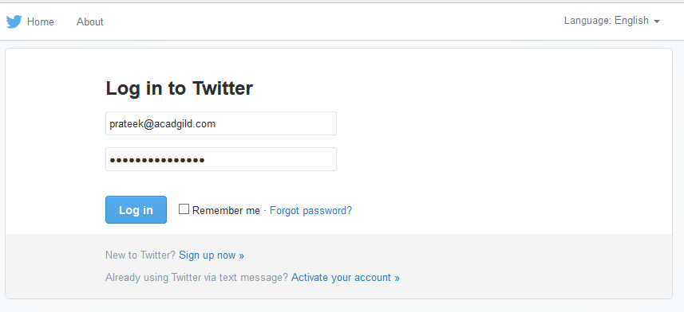
Step 1: Login to the twitter account (or create twitter account)

Slide 16
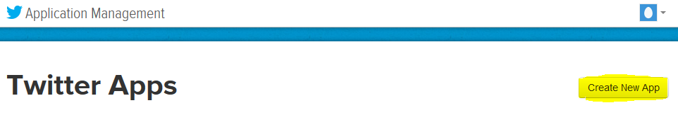
Step 2: Go to the following link and click the ‘create new app’ button. https://apps.twitter.com/app

Slide 17
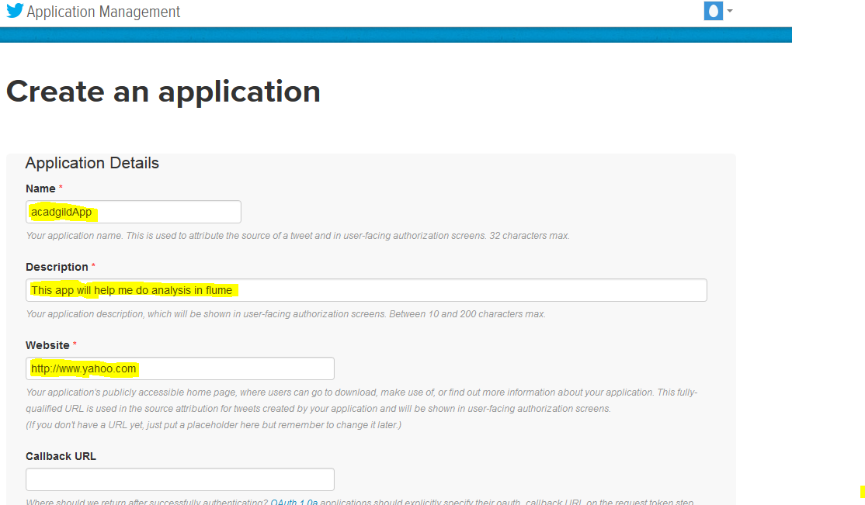
Step 3: Apply for an developer account. Once its created then Enter the necessary details.

Slide 18
Step 4: Accept the developer agreement and select the ‘create your Twitter application’ button.

Slide 19
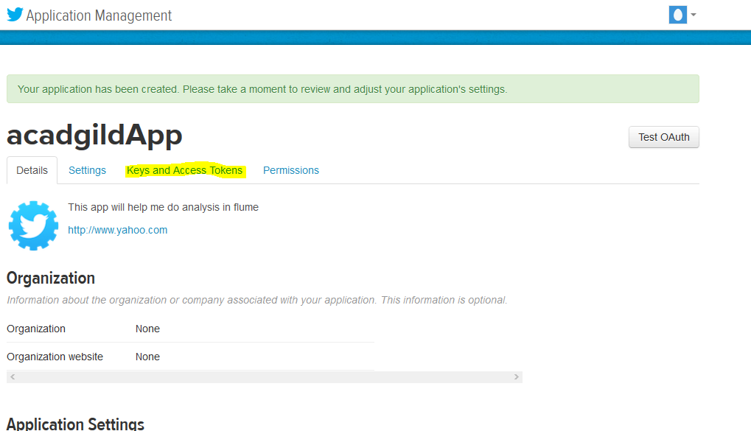
Step 5: Select the ‘Keys and Access Token’ tab.

Slide 20
Step 6: Copy the consumer key and the consumer secret code.

Slide 21
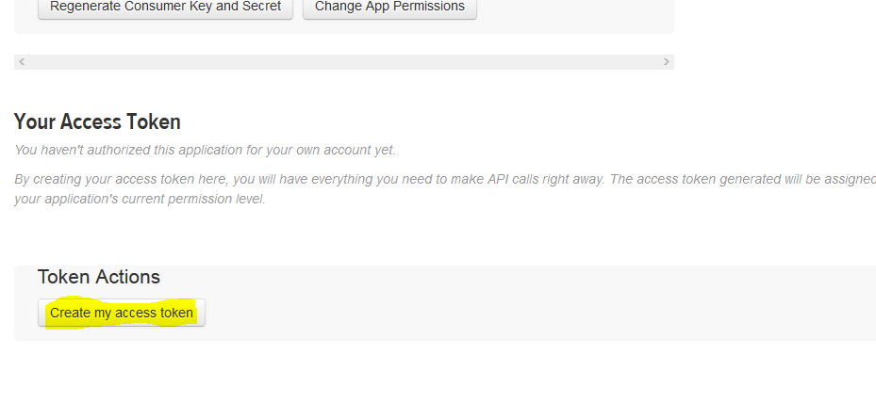
Step 7: Scroll down further and select the ‘create my access token’ button.

Slide 22
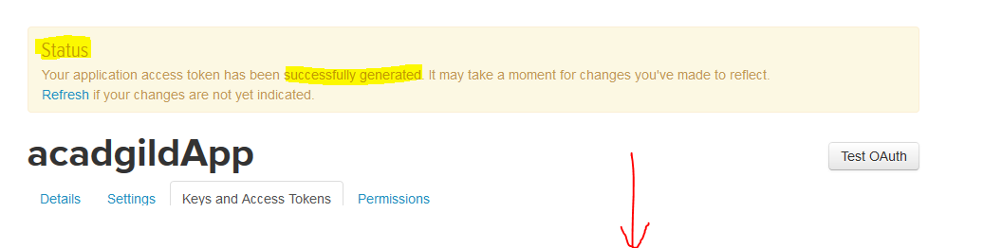
Now, you will receive a message stating “that you have successfully generated your application access token”

Slide 23
Step 8: Copy the Access Token and Access token Secret code for further use.

Slide 24
open flume.conf file ::::::
mishra@mishra-VirtualBox:$ cd usr/local/work/flume/conf
mishra@mishra-VirtualBox:/usr/local/work/flume/conf$ sudo nano flume.conf
comment all lines with # and paste:::::

Slide 25
TwitterAgent.sources = Twitter TwitterAgent.channels = MemChannel TwitterAgent.sinks = HDFS TwitterAgent.sources.Twitter.type = org.apache.flume.source.twitter.TwitterSource TwitterAgent.sources.Twitter.channels = MemChannel TwitterAgent.sources.Twitter.consumerKey = tB TwitterAgent.sources.Twitter.consumerSecret = tcI TwitterAgent.sources.Twitter.accessToken = 11685 TwitterAgent.sources.Twitter.accessTokenSecret = IHk TwitterAgent.sources.Twitter.keywords = NMIMS ################## SINK #type = logger################################ TwitterAgent.sinks.HDFS.channel = MemChannel TwitterAgent.sinks.HDFS.type = hdfs TwitterAgent.sinks.HDFS.hdfs.path =hdfs://localhost:8020/flumedata/ TwitterAgent.sinks.HDFS.hdfs.fileType = DataStream TwitterAgent.sinks.HDFS.hdfs.writeFormat = Text #################### CHANNEL ######################### TwitterAgent.channels.MemChannel.type = memory TwitterAgent.channels.MemChannel.capacity = 100 #default - TwitterAgent.channels.MemChannel.capacity = 100 TwitterAgent.channels.MemChannel.transactionCapacity = 100

Slide 26
NOTE: Change the twitter api keys with the keys generated as shown in the step no 6 and step number 8.
The keys in the previous code are just for display purpose. Please replace them with the keys you have generated

Slide 27
Close the file.
Open terminal and type the following command.

Slide 28
mishra@mishra-VirtualBox:$ flume-ng agent --conf conf --conf-file flume.conf --name TwitterAgent -Dflume.root.logger=INFO,console

Slide 29
You can now open the browser and type:
https://localhost:50070
This will open Hadoop admin page.
Then go to Utilities>Browse Filesystem.
Here you can see flume data.

Slide 30
Thank you!!!!!

