Slide 1
SPARK

Slide 2
SPARK
Apache Spark is a lightning-fast cluster computing designed for fast computation. It was built on top of Hadoop MapReduce and it extends the MapReduce model to efficiently use more types of computations
prepared for professionals aspiring to learn the basics of Big Data Analytics using Spark Framework and become a Spark Developer. In addition, it would be useful for Analytics Professionals
Industries are using Hadoop extensively to analyze their data sets. The reason is that Hadoop framework is based on a simple programming model (MapReduce) and it enables a computing solution that is scalable, flexible, fault-tolerant and cost effective. Here, the main concern is to maintain speed in processing large datasets in terms of waiting time between queries and waiting time to run the program.
Spark was introduced by Apache Software Foundation for speeding up the Hadoop computational computing software process.
As against a common belief, Spark is not a modified version of Hadoop and is not, really, dependent on Hadoop because it has its own cluster management. Hadoop is just one of the ways to implement Spark.
Spark uses Hadoop in two ways – one is storage and second is processing. Since Spark has its own cluster management computation, it uses Hadoop for storage purpose only.

Slide 3
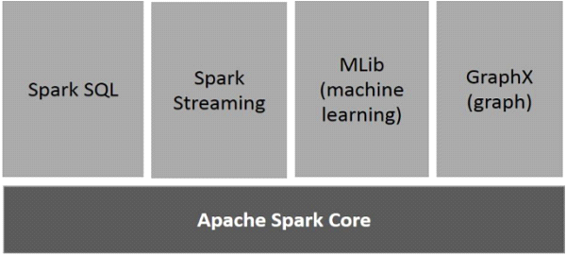
Components of Spark
The following illustration depicts the different components of Spark.
Spark Core is the underlying general execution engine for spark platform that all other functionality is built upon. It provides In-Memory computing and referencing datasets in external storage systems.
MLlib is a distributed machine learning framework above Spark because of the distributed memory-based Spark architecture.
GraphX is a distributed graph-processing framework on top of Spark. It provides an API for expressing graph computation that can model the user-defined graphs

Slide 4
Resilient Distributed Datasets
Resilient Distributed Datasets (RDD) is a fundamental data structure of Spark. It is an immutable distributed collection of objects. Each dataset in RDD is divided into logical partitions, which may be computed on different nodes of the cluster. RDDs can contain any type of Python, Java, or Scala objects, including user-defined classes.
Formally, an RDD is a read-only, partitioned collection of records. RDDs can be created through deterministic operations on either data on stable storage or other RDDs. RDD is a fault-tolerant collection of elements that can be operated on in parallel.
Spark makes use of the concept of RDD to achieve faster and efficient MapReduce operations.
Data Sharing is Slow in MapReduce
MapReduce is widely adopted for processing and generating large datasets with a parallel, distributed algorithm on a cluster. It allows users to write parallel computations, using a set of high-level operators, without having to worry about work distribution and fault tolerance.
Unfortunately, in most current frameworks, the only way to reuse data between computations (Ex − between two MapReduce jobs) is to write it to an external stable storage system (Ex − HDFS). Although this framework provides numerous abstractions for accessing a cluster’s computational resources, users still want more.
. Regarding storage system, most of the Hadoop applications, they spend more than 90% of the time doing HDFS read-write operations.

Slide 5
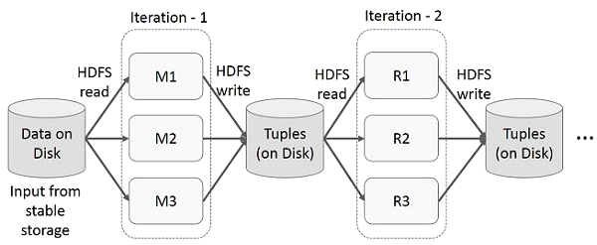
Data Sharing using Spark RDD
Data sharing is slow in MapReduce due to serialization, and disk IO. Most of the Hadoop applications, they spend more than 90% of the time doing HDFS read-write operations.
Recognizing this problem, researchers developed a specialized framework called Apache Spark. The key idea of spark is Resilient Distributed Datasets (RDD); it supports in-memory processing computation. This means, it stores the state of memory as an object across the jobs and the object is sharable between those jobs. Data sharing in memory is 10 to 100 times faster than network and Disk.

Slide 6
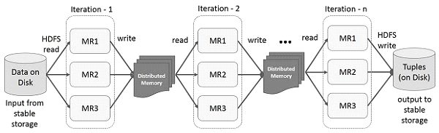
Spark Core is the base of the whole project. It provides distributed task dispatching, scheduling, and basic I/O functionalities. Spark uses a specialized fundamental data structure known as RDD (Resilient Distributed Datasets) that is a logical collection of data partitioned across machines. RDDs can be created in two ways; one is by referencing datasets in external storage systems and second is by applying transformations on existing RDDs.
Spark is lazy, so nothing will be executed unless you call some transformation or action that will trigger job creation and execution. Look at the following snippet of the word-count example.

Slide 7
mapPartitions(func)
Similar to map, but runs separately on each partition (block) of the RDD, so func must be of type Iterator<T> ⇒ Iterator<U> when running on an RDD of type T.
What is scala?
Scala is a general purpose programming language. Scala has full support for functional programming.

Slide 8
To run spark, type the following on the command prompt.
spark-shell

Slide 9
Create an RDD
First, we have to read the input file using Spark-Scala API and create an RDD.
The following command is used for reading a file from given location. Here, new RDD is created with the name of inputfile. The String which is given as an argument in the textFile(“”) method is absolute path for the input file name. However, if only the file name is given, then it means that the input file is in the current location.
scala> val inputfile = sc.textFile("input.txt")
Execute Word count Transformation
Our aim is to count the words in a file. Create a flat map for splitting each line into words (flatMap(line ⇒ line.split(“ ”)).
Next, read each word as a key with a value ‘1’ (<key, value> = <word,1>)using map function (map(word ⇒ (word, 1)).
Finally, reduce those keys by adding values of similar keys (reduceByKey(_+_)).
The following command is used for executing word count logic. After executing this, you will not find any output because this is not an action, this is a transformation; pointing a new RDD or tell spark to what to do with the given data)
scala> val counts = inputfile.flatMap(line => line.split(" ")).map(word => (word, 1)).reduceByKey(_+_);
scala> counts.cache()

Slide 10
Applying the Action
Applying an action, like store all the transformations, results into a text file. The String argument for saveAsTextFile(“ ”) method is the absolute path of output folder. Try the following command to save the output in a text file. In the following example, ‘output’ folder is in current location.
scala> counts.saveAsTextFile("output")
Checking the Output
Open another terminal to go to home directory (where spark is executed in the other terminal). Use the following commands for checking output directory.
[hadoop@localhost ~]$ cd output/
[hadoop@localhost output]$ ls -1
part-00000
part-00001
_SUCCESS
The following command is used to see output from Part-00000 files.
[hadoop@localhost output]$ cat part-00000

Slide 11
Thank you!!!

