Slide 1
YARN

Slide 2
Contents
Hadoop Architecture
        YARN Infrastructure
Hadoop Ecosystem Components
        Core Hadoop.
        Data Access.
        Data Storage.
        Data Integration.
        Data Management & Monitoring .
Hadoop Storage : HDFS
        HDFS Architecture

Slide 3

.
In MR2, the functions of the JobTracker are divided into three services.
1:The ResourceManager is a YARN service that receives and runs applications (a MapReduce job is an application) on the cluster. It contains the scheduler, which, as in MR1, is pluggable.
2:The MapReduce-specific capabilities of the JobTracker have moved into the MapReduce Application Master, one of which is started to manage each MapReduce job and terminated when the job completes.
3:The JobTracker’s function of serving information about completed jobs has been moved to the JobHistoryServer.
YARN currently defines two resources, vcores and memory. Each NodeManager tracks its own local resources and communicates its resource configuration to the ResourceManager, which keeps a running total of the cluster’s available resources. By keeping track of the total, the ResourceManager knows how to allocate resources as they are requested.
The TaskTracker has been replaced with the NodeManager, a YARN service that manages resources and deployment on a node.

Slide 4
The general concept is that an application submission client submits an application to the YARN ResourceManager (RM). This can be done through setting up a YarnClient object. After YarnClient is started, the client can then set up application context, prepare the very first container of the application that contains the ApplicationMaster (AM), and then submit the application.
The YARN ResourceManager will then launch the ApplicationMaster (as specified) on an allocated container. The ApplicationMaster communicates with YARN cluster, and handles application execution. It performs operations in an asynchronous fashion. During application launch time, the main tasks of the ApplicationMaster are: a) communicating with the ResourceManager to negotiate and allocate resources for future containers, and b) after container allocation, communicating YARN *NodeManager*s (NMs) to launch application containers on them.

Slide 5
A container is an abstract notion in YARN platform.
It represents a collection of physical resources. Also could mean CPU cores, disk along with RAM.
When an application is about to get submitted into the YARN platform, the YarnClient allocates a container from the ResourceManager, where its ApplicationMaster will run (container 0).
After the ApplicationMaster gets started, it should request for more containers to deploy the tasks and to actually start the application.
A MapReduce task has a specific (built in) ApplicationMaster (called MRAppMaster), which runs on a specific container, called container 0, and each mapper and reducer runs on its own container to be accurate! The MRAppMaster allocates these containers for the mappers and reducers as it sees fit.
Launching a Container: Based on allocated resources (containers) ApplicationMaster request NodeManager to start Containers, resulting in executing task on a node

Slide 6
Job Initialization Steps
1. Resource Manager receives request for a new application
2. Resource Manager delegates to its internal component – Scheduler – There are various schedulers available
3. Scheduler requests a container for an Application Master process – MapReduce’s Application Master is MRAppMaster
4. MRAppMaster initializes its internal objects and executes a job by negotiating with Resource Manager (scheduler).
MRAppMaster Initialization Steps
1. Creates internal bookkeeping objects to monitor progress
2. Retrieves Input Splits – These were created by the client and copied onto HDFS
3. Creates tasks – Map tasks per split – Reduce tasks based on mapreduce.job.reduces property
4. Decides how to run the tasks – In case of a small job, it will run all tasks in MRAppMaster’s JVM.
5. Execute the tasks

Slide 7
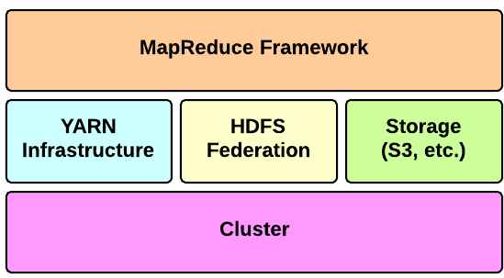
Hadoop Architecture
Apache Hadoop is an open-source software framework for storage and large-scale processing of data-sets on clusters of commodity hardware. There are mainly five building blocks inside this runtime envinroment (from bottom to top):
The cluster is the set of host machines (nodes). Nodes may be partitioned in racks. This is the hardware part of the infrastructure.
The YARN Infrastructure (Yet Another Resource Negotiator) is the framework responsible for providing the computational resources (e.g., CPUs, memory, etc.) needed for application executions. Two important elements are:-
      Resource Manager
      Node Manager

Slide 8
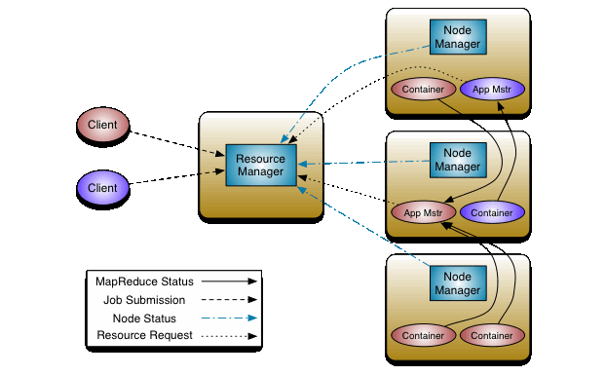
The fundamental idea of YARN is to split up the functionalities of resource management and job monitoring into separate daemons. The idea is to have a global ResourceManager (RM) and per-application ApplicationMaster (AM). An application is a single job .
The ResourceManager and the NodeManager form the data-computation framework. The ResourceManager is the ultimate authority that arbitrates resources among all the applications in the system. The NodeManager is the per-machine framework agent who is responsible for containers, monitoring their resource usage (cpu, memory, disk, network) and reporting the same to the ResourceManager/Scheduler.
The per-application ApplicationMaster is tasked with negotiating resources from the ResourceManager and working with the NodeManager(s) to execute and monitor the tasks.

Slide 9
The ResourceManager has two main components: Scheduler and ApplicationsManager.
The Scheduler is responsible for allocating resources to the various running applications subject to familiar constraints of capacities, queues etc. The Scheduler is pure scheduler in the sense that it performs no monitoring or tracking of status for the application. Also, it offers no guarantees about restarting failed tasks either due to application failure or hardware failures. The Scheduler performs its scheduling function based the resource requirements of the applications; it does so based on the abstract notion of a resource Container which incorporates elements such as memory, cpu, disk, network etc.
The Scheduler has a policy which is responsible for partitioning the cluster resources among the various queues, applications etc. The current schedulers such as the Capacity Scheduler and the FairScheduler would be some examples .
The ApplicationsManager is responsible for accepting job-submissions.

Slide 10
YARN is designed to allow individual applications (via the ApplicationMaster) to utilize cluster resources in a shared, secure and multi-tenant manner. Also, it remains aware of cluster topology in order to efficiently schedule and optimize data access i.e. reduce data motion for applications to the extent possible.
In order to meet those goals, the central Scheduler (in the ResourceManager) has extensive information about an application’s resource needs, which allows it to make better scheduling decisions across all applications in the cluster. This leads us to the ResourceRequest and the resulting Container.
Essentially an application can ask for specific resource requests via the ApplicationMaster to satisfy its resource needs.

Slide 11
Let’s walk through an application execution sequence (steps are illustrated in the diagram):
A client program submits the application, including the necessary specifications to launch the application-specific ApplicationMaster itself.
The ResourceManager assumes the responsibility to negotiate a specified container in which to start the ApplicationMaster and then launches the ApplicationMaster.
The ApplicationMaster, on boot-up, registers with the ResourceManager – the registration allows the client program to query the ResourceManager for details, which allow it to directly communicate with its own ApplicationMaster.
During normal operation the ApplicationMaster negotiates appropriate resource containers via the resource-request protocol.
On successful container allocations, the ApplicationMaster launches the container by providing the container launch specification to the NodeManager. The launch specification, typically, includes the necessary information to allow the container to communicate with the ApplicationMaster itself.
The application code executing within the container then provides necessary information (progress, status etc.) to its ApplicationMaster via an application-specific protocol.
During the application execution, the client that submitted the program communicates directly with the ApplicationMaster to get status, progress updates etc. via an application-specific protocol.
Once the application is complete, and all necessary work has been finished, the ApplicationMaster deregisters with the ResourceManager and shuts down, allowing its own container to be repurposed.

Slide 12
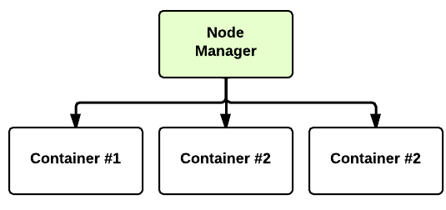
Hadoop Architecture- YARN Infrastructure
The Node Manager (many per cluster) is the slave of the infrastructure. When it starts, it announces
himself to the Resource Manager. Periodically, it sends an heartbeat to the Resource Manager.
Each Node Manager offers some resources to the cluster. Its resource capacity is the amount of
memory and the number of vcores. At run-time, the Resource Scheduler will decide how to use this
capacity: a Container is a fraction of the NM capacity and it is used by the client for running a program.
Note :- The YARN infrastructure and the HDFS federation are completely decoupled and independent: the
first one provides resources for running an application while the second one provides storage. The MapReduce
framework is only one of many possible framework which runs on top of YARN (although currently is the only
one implemented).

Slide 13
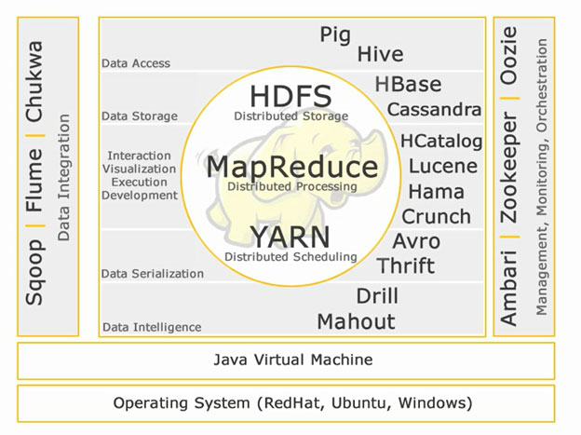
Hadoop EcoSystem Components
Hadoop EcoSystem Components

Slide 15
Hadoop EcoSystem Components – Core Hadoop
Core Hadoop:
HDFS - HDFS stands for Hadoop Distributed File System for managing big data sets with High Volume, Velocity and Variety. HDFS implements master slave architecture. Master is Name node and slave is data node.
Features:-
• Scalable
• Reliable
• Commodity Hardware
Note :- HDFS is the well known for Big Data storage.
Map Reduce - Map Reduce is a programming model designed to process high volume distributed data. Platform is built using Java for better exception handling. Map Reduce includes two deamons,
Job tracker
Task Tracker.
Features:-
• Functional Programming.
• Works very well on Big Data.
• Can process large datasets.
Note :-Map Reduce is the main component known for processing big data.

Slide 16

Hadoop EcoSystem Components – Data Access
YARN - YARN stands for Yet Another Resource Negotiator. It is also called as MapReduce 2(MRv2). The two major functionalities of Job Tracker in MRv1, resource management and job scheduling/ monitoring are split into separate daemons which are :-
ResourceManager
NodeManager
ApplicationMaster.
Features:-
• Better resource management.
• Scalability
• Dynamic allocation of cluster resources.
Data Access:
Pig - Apache Pig is a high level language built on top of MapReduce for analyzing large datasets with simple adhoc data analysis programs. Pig is also known as Data Flow language. It is very well integrated with python. It is initially developed by yahoo.
Salient features of pig:
• Ease of programming
• Optimization opportunities
• Extensibility.
Note :- Pig scripts internally will be converted to map reduce programs.

Slide 17

Hadoop EcoSystem Components – Data Access
Hive - Apache Hive is another high level query language and data warehouse infrastructure built on top of Hadoop for providing data summarization, query and analysis. It is initially developed by yahoo and made open source.
Salient features of hive:-
• SQL like query language called HQL.
• Partitioning and bucketing for faster data processing.
• Integration with visualization tools like Tableau.
Note :- Hive queries internally will be converted to map reduce programs.
If you want to become a big data analyst, these two high level languages are a must know!!

Slide 18
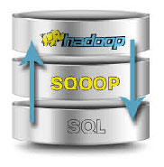

Hadoop EcoSystem Components – Data Integration
Data Integration:
Apache Sqoop - Apache Sqoop is a tool designed for bulk data transfers between relational databases and Hadoop.
Features:-
• Import and export to and from HDFS.
• Import and export to and from Hive.
• Import and export to Hbase.
Apache Flume - Flume is a distributed, reliable, and available service for efficiently collecting, aggregating, and moving large amounts of log data.
Features:
• Robust
• Fault tolerant
• Simple and flexible Architecture based on streaming data flows.

Slide 19

Hadoop EcoSystem Components – Data Management & Monitoring
Management and Monitoring :-
Apache Zookeeper - Zookeeper is a centralized service designed for maintaining configuration information, naming, providing distributed synchronization, and providing group services.
Features:-
• Serialization
• Atomicity
• Reliability
• Simple API

Slide 20
Hadoop Storage – HDFS
Hadoop File System was developed using distributed file system design. It is run on commodity hardware. Unlike other distributed systems, HDFS is highly faulttolerant and designed using low-cost hardware.
HDFS holds very large amount of data and provides easier access. To store such huge data, the files are stored across multiple machines. These files are stored in redundant fashion to rescue the system from possible data losses in case of failure. HDFS also makes applications available to parallel processing.
Features of HDFS
It is suitable for the distributed storage and processing.
Hadoop provides a command interface to interact with HDFS.
The built-in servers of namenode and datanode help users to easily check the status of cluster.
Streaming access to file system data.
HDFS provides file permissions and authentication.
Goals of HDFS
Fault detection and recovery : Since HDFS includes a large number of commodity hardware, failure of components is frequent. Therefore HDFS should have mechanisms for quick and automatic fault detection and recovery.
Huge datasets : HDFS should have hundreds of nodes per cluster to manage the applications having huge datasets.
Hardware at data : A requested task can be done efficiently, when the computation takes place near the data. Especially where huge datasets are involved, it reduces the network traffic and increases the throughput.

Slide 21
Hadoop Storage – HDFS Architecture
HDFS follows the Master-Slave architecture and it has the following elements.
Namenode - The namenode is the commodity hardware that contains the GNU/Linux operating system and the namenode software. It is a software that can be run on commodity hardware. The system having the namenode acts as the master server and it does the following tasks:
Manages the file system namespace.
Regulates client’s access to files.
It also executes file system operations such as renaming, closing, and opening files and directories.
Datanode - The datanode is a commodity hardware having the GNU/Linux operating system and datanode software. For every node (Commodity hardware/System) in a cluster, there will be a datanode. These nodes manage the data storage of their system.
Datanodes perform read-write operations on the file systems, as per client request.
They also perform operations such as block creation, deletion, and replication according to the instructions of the namenode.
Block - Generally the user data is stored in the files of HDFS. The file in a file system will be divided into one or more segments and/or stored in individual data nodes. These file segments are called as blocks. In other words, the minimum amount of data that HDFS can read or write is called a Block. The default block size is 64MB, but it can be increased as per the need to change in HDFS configuration.

Slide 22
  THANK YOU !

