Slide 1

Presentation on CO2 emission by vehicles
NAME- SNEH SHAH(30)
DATA SCIENCE
NAME – HIMANSHU THAKKAR(33)
DATA SCIENCE
Department of emerging science and technology

Slide 2
OUTLINE
Problem Definition
Objective
Introduction
Methodology
Result
Conclusion
Reference

Slide 3
PROBLEM DEFINITION
CO2 emissions are considered one of the leading causes of environmental impact in megacities and their dangerous effects on human health. Between 1990 and 2019, emissions increased by 21.4%. Canada's emissions growth over this period was driven primarily by increased emissions from oil extraction as well as transport. In 2019, the oil and gas sector accounted for 191 megatons of carbon dioxide equivalent (Mt CO₂ eq) (26% of total emissions), followed closely by the transport sector, which emitted 186 Mt CO₂ eq (25%). Therefore, it becomes imperative for us to deeply understand and analyze the causes of air pollution in our surroundings So, we will analyse the CO2 emissions (g/km) from a vehicle in Canada depending on the fuel consumption and other describing features of a vehicle.

Slide 4
OBJECTIVES
Variation in CO2 emissions with Vehicle Companies
Variation in CO2 emissions with Vehicle Class
Variation in CO2 emissions with Fuel Type
Variation in CO2 emissions with Cylinders
Variation in CO2 emissions with Engine Size(L)
Variation in CO2 emissions with Fuel Consumption Comb (L/100 km)

Slide 5
INTRODUCTION
The average Canadian car will burn 21 tones of gasoline over its lifespan that's equal to around 130 barrels of gasoline.As Emission of CO2 is a very serious problem , We will explore the features by statistical distributions to find any outliers or skewness. From the EDA, we get to know which features will be relevant ,we will try to find the relationship between vehicles and CO2 emission , Fuel consumption by vehicles and CO2 emission, and many more comparison with CO2 emission with the help of charts and data visualization techniques

Slide 6
METHODOLOGY
LIBRARIES AND PLOTS USED
DATA INFORMATION
DATA PREPROCESSING

Slide 7
Libraries And Plot Used
LIBRARY USED:
PLOTS:
NumPy
Pandas
Seaborn
Matplotlib
Potly
Bar chart
Line chart
Pie chart
Scatter plot
Box plot

Slide 8
Data information
Make= Company of the vehicle
Model= Car model
Vehicle Class= Class of vehicle depending on their utility, capacity and weight
Engine Size = Size of engine used in Litre
Cylinders= Number of cylinders, Generally, the more cylinders your engine has, the more power is produced.

Slide 9
Data information
Transmission = Transmission type with number of gears
Fuel type =Type of Fuel used
Fuel Consumption City=Fuel consumption in city roads (L/100 km)
Fuel Consumption Hwy=Fuel consumption in Hwy roads (L/100 km)
Fuel Consumption Comb=The combined fuel consumption (55% city, 45% highway) is shown in L/100 km
Fuel Consumption Comb mpg =The combined fuel consumption in both city and highway is shown in mile per gallon(mpg)

Slide 10
Data information
Transmission
A = Automatic
AM = Automated manual
AS = Automatic with select shift
AV = Continuously variable
M = Manual
3 - 10 = Number of gears
Fuel type
X = Regular gasoline
Z = Premium gasoline
D = Diesel
E = Ethanol (E85)
N = Natural gas

Slide 11
Data pre-processing
Data preprocessing is the process of transforming raw data into an understandable format. It is also an important step in data mining as we cannot work with raw data. The quality of the data should be checked before applying machine learning or data visualizations.
We have removed the null values as well as the duplicate values in the data set which help to increase the quality of data

Slide 12
RESULT
We have compared the different charts to find the reason behind emission of CO2 which are shown in upcoming slides

Slide 13

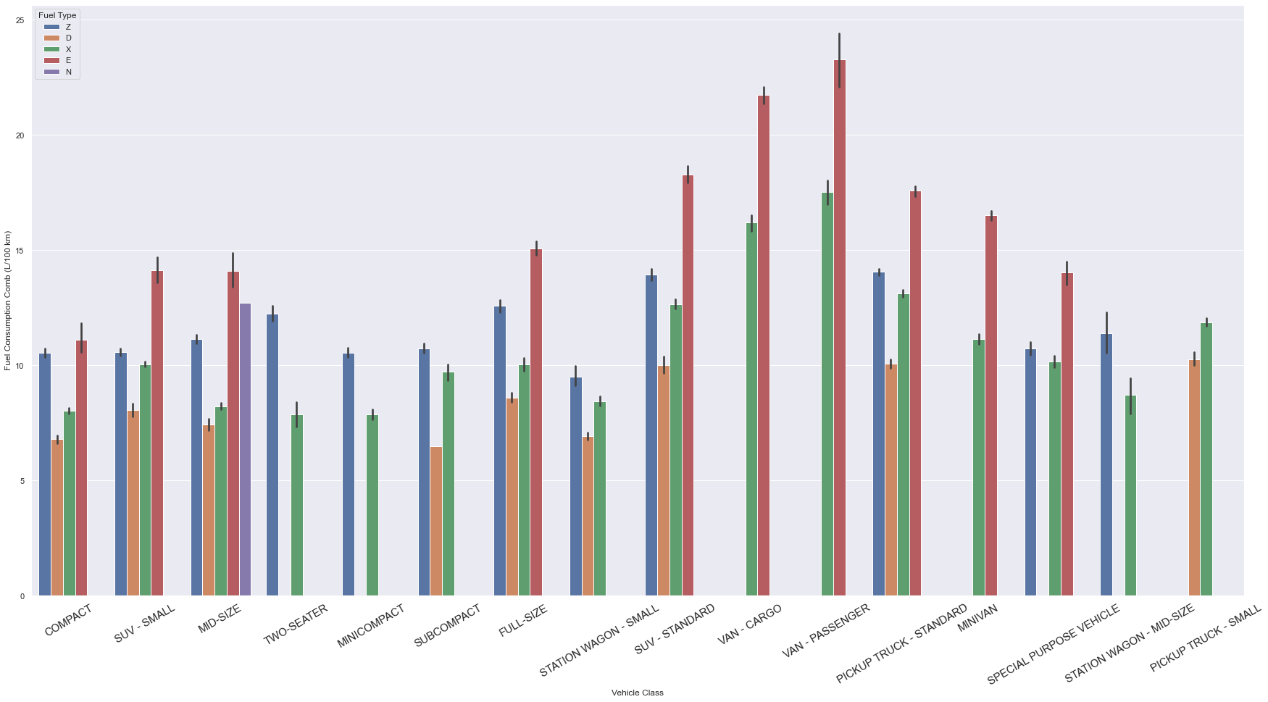

Slide 14
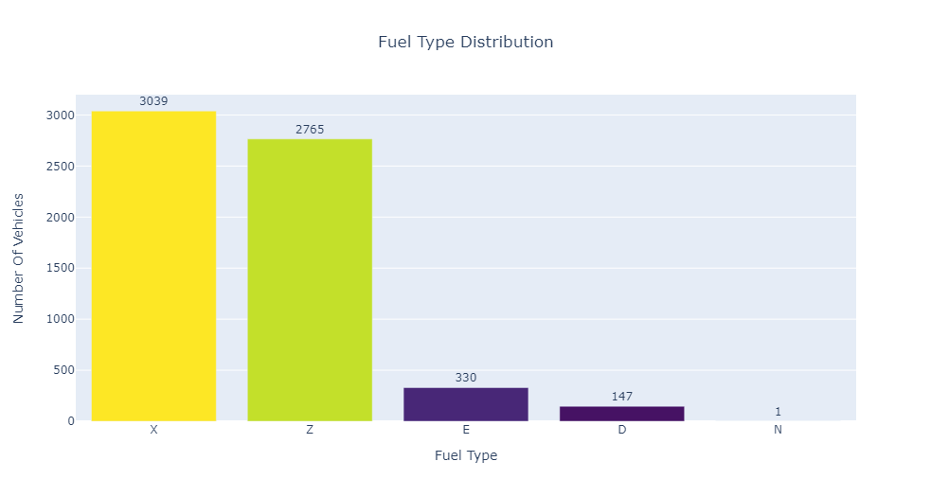

Slide 15
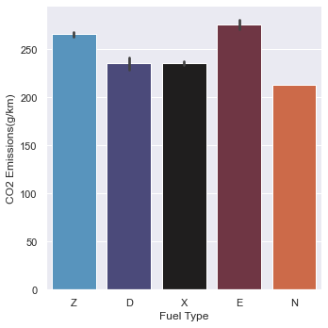

Slide 16
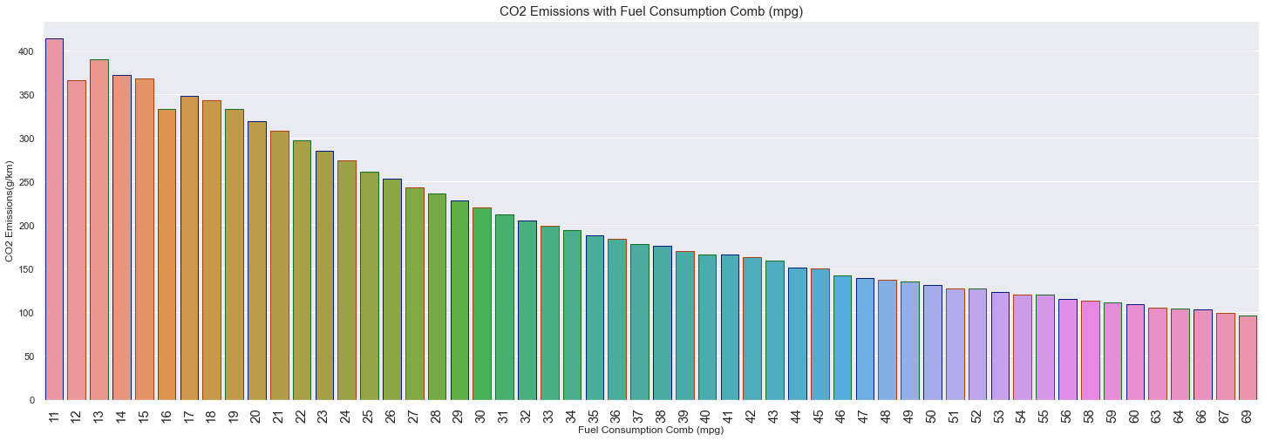

Slide 17
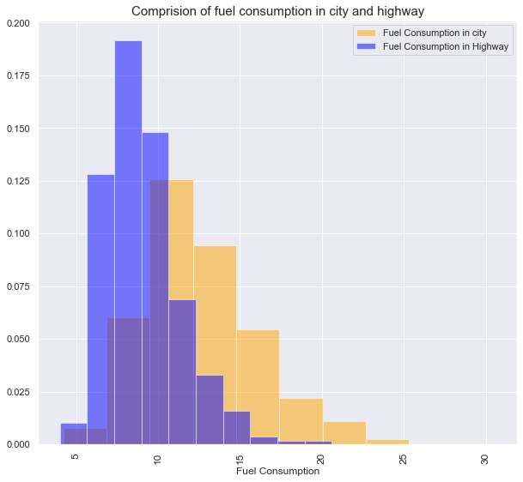

Slide 18
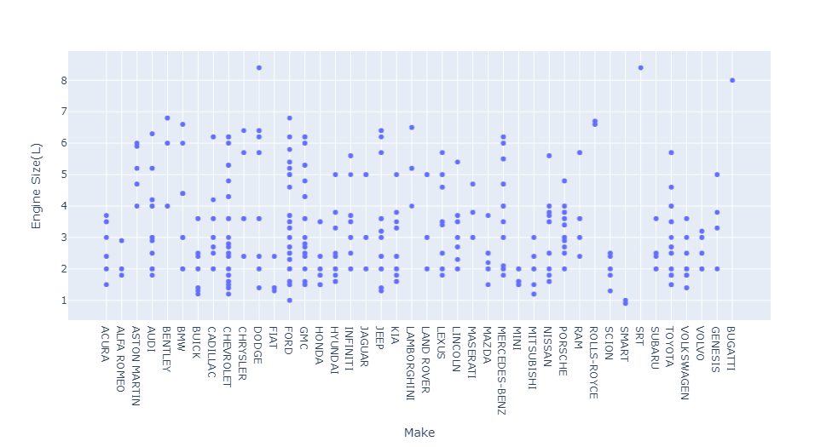

Slide 19
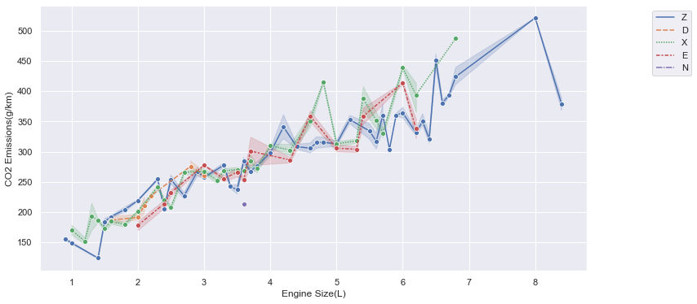

Slide 20
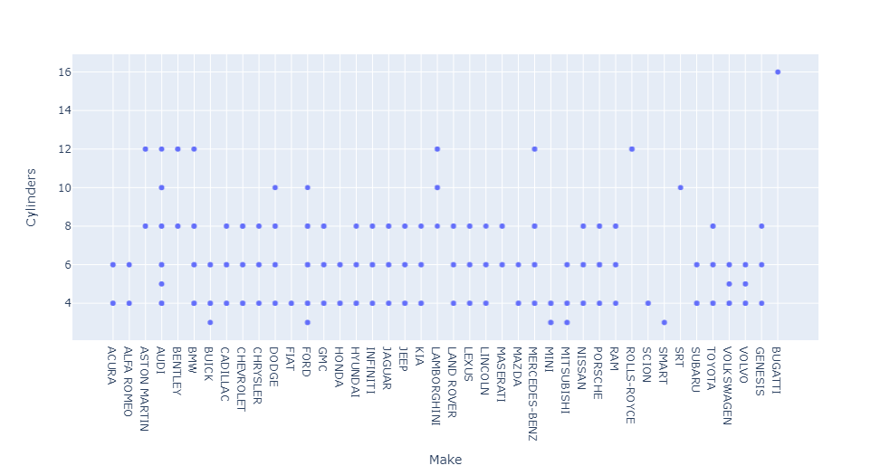

Slide 21
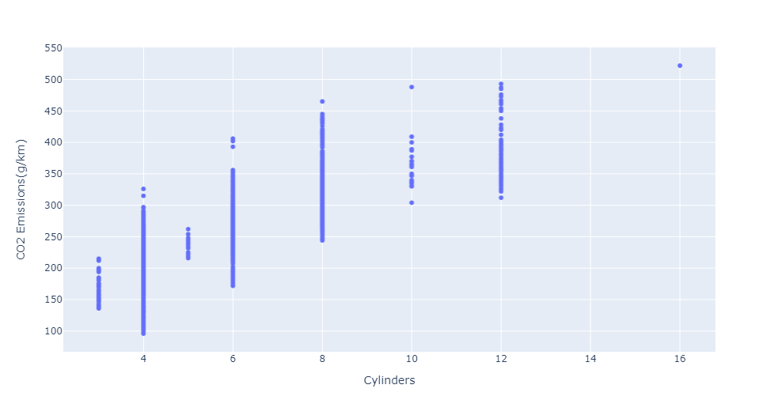

Slide 22
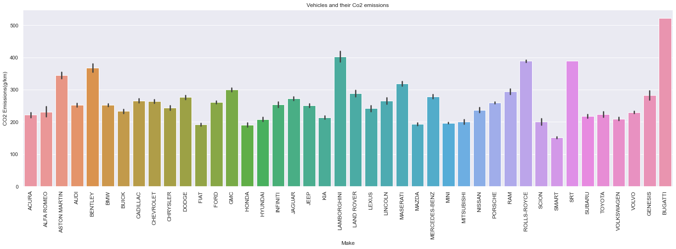

Slide 23
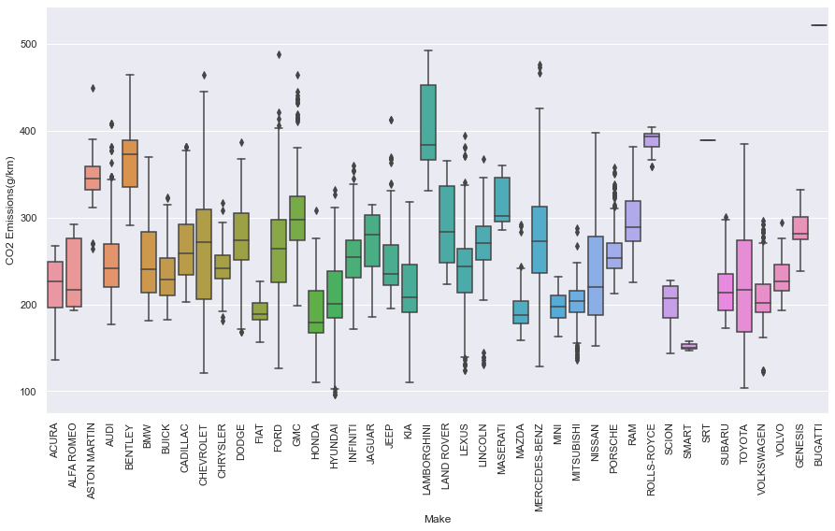

Slide 24
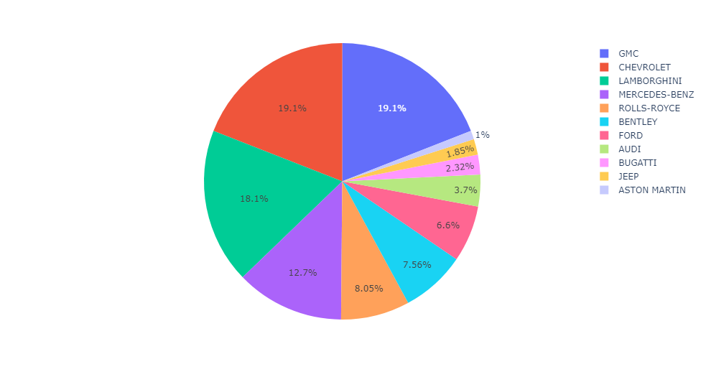

Slide 25
CONCLUSION
From both the bar graph and the box plot it can be inferred that average CO2 emissions of cars belonging to the brand Bugatti is the highest and cars of SMART has the lowest emissions. Almost 50% of the brand has their median CO2 emissions less than the sample median of CO2 emissions by all the cars.
The vehicle of class VAN-Passenger followed by VAN-Cargo has the highest CO2 emissions among all and Station Wagon-Small has the lowest CO2 emissions. There are 8 types of vehicle class out of 16 which has a median CO2 emissions less than sample median of CO2 emissions and the other 8 has a higher median

Slide 26
CONCLUSION
Cars running on Ethanol(E85) has the highest CO2 emissions with almost all the values higher than the sample median CO2 emissions. Natural Gas has the lowest CO2 emissions, but there is only one vehicle that use it as fuel. Other than that Regular Gasoline has the lowest CO2 emissions with almost 75% values less than sample median.
With increase in number of Cylinders, CO2 emissions also increase proportionally.
With increase in Engine Size, CO2 emissions also increases.
From the plots we can see almost a linear increase in CO2 emissions with Fuel Consumption, as they are highly positively correlated.

Slide 27
REFERENCE
https://www.nationalobserver.com/2019/09/04/analysis/canadian-cars-are-worlds-dirtiest-ev-age-essential
https://www.canada.ca/en/environment-climate-change/services/environmental-indicators/greenhouse-gas-emissions.html
https://open.canada.ca/data/en/dataset/98f1a129-f628-4ce4-b24d-6f16bf24dd64#wb-auto-6
https://www.kaggle.com/debajyotipodder/co2-emission-by-vehicles

Slide 28
THANK YOU

