Slide 1

MTA Ridership Analysis Post-Pandemic
Project Summary and Key Insights
- Sneha Shailesh Khandizode Data Analyst

Slide 2
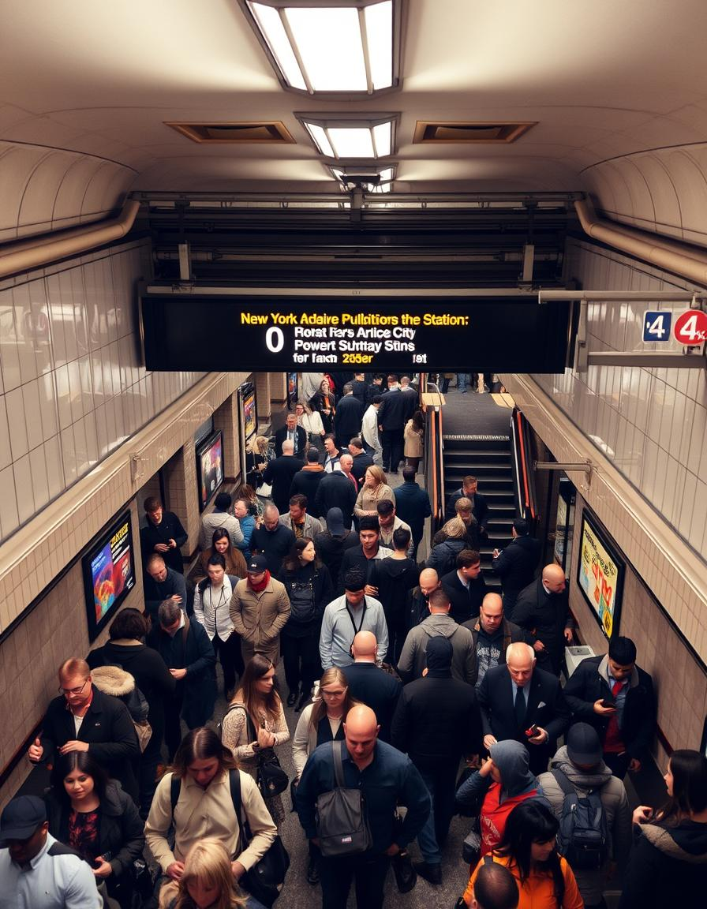
Metropolitan Transportation
Authority (MTA)
Ridership Analysis
Post-Pandemic
This presentation analyzes MTA ridership trends since the start of the pandemic, providing insights into the recovery of the transportation system and future opportunities.

Slide 3
Project Objectives
Objective
Identify highest ridership days for each transportation mode.
Analyze recovery trends compared to pre-pandemic levels.
Calculate averages and totals for long-term trends.
Provide actionable insights for strategic planning.
Identify key factors
Explore factors influencing ridership recovery, such as economic conditions, public health guidelines, and service disruptions.
Develop insights and recommendations
Provide data-driven insights to inform MTA policies and strategies for future ridership growth.

Slide 4
Project Overview
By using SQL, this project will help in extracting some really valuable insights into the operations of MTA Ridership.
The COVID-19 pandemic has significantly impacted public transportation systems worldwide. The Metropolitan Transportation Authority (MTA) in New York City saw a drastic drop in ridership during the peak of the pandemic.
As the city began to recover, understanding how ridership patterns evolved became crucial for decision-makers to optimize services, allocate resources, and plan for future needs.
This project aims to analyze the MTA daily ridership data to track recovery trends across different transportation modes, including subways, buses, Long Island Rail Road (LIRR), Metro-North, and bridges/tunnels.

Slide 5
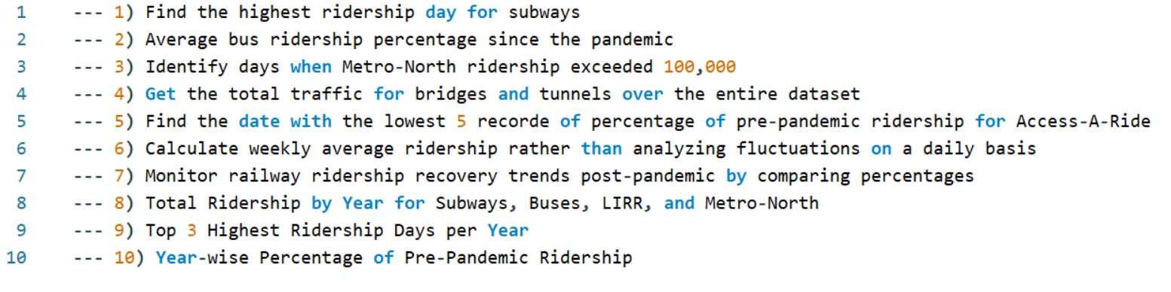
SQL Analysis Problem Statement

Slide 6
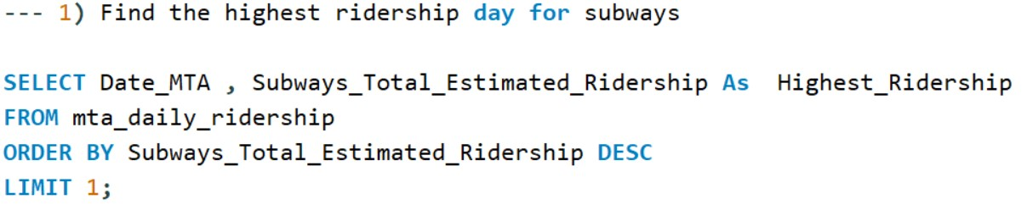
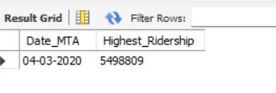
This query retrieves the date (Date_MTA) and ridership count for the day with the highest subway ridership.
The ORDER BY ... DESC clause sorts the rows in descending order based on Subways_Total_Estimated_Ridership.
The LIMIT 1 ensures that only the top record (highest ridership) is returned.

Slide 7
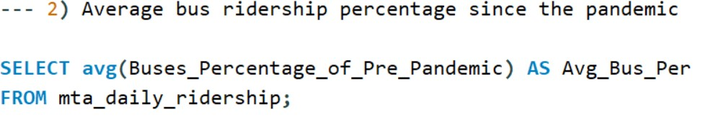

Calculates the average percentage of pre-pandemic bus ridership across the entire dataset.
The AVG() function computes the average of all values in the Buses_Percentage_of_Pre_Pandemic column.

Slide 8
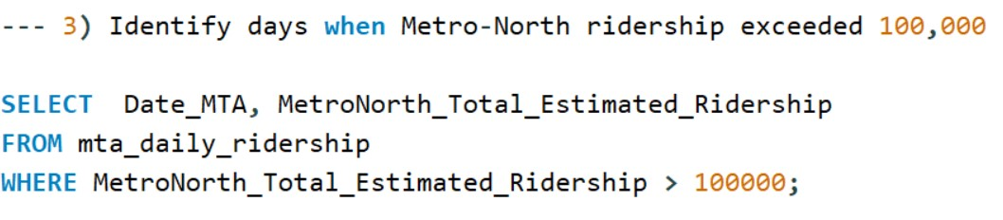
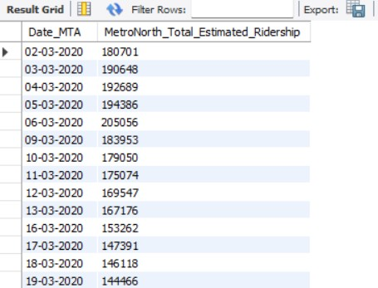
This query filters records to find all
dates (Date_MTA)
when Metro-North ridership was
greater than 100,000.
The WHERE clause specifies the
condition for filtering rows.

Slide 9
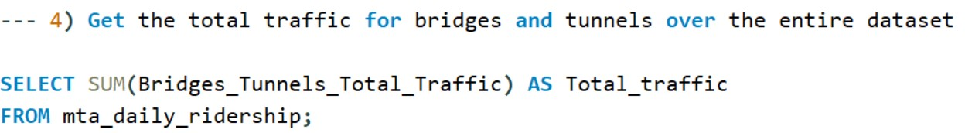
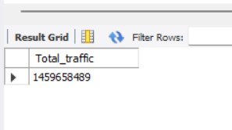
Computes the total traffic across bridges and tunnels
using the SUM() function,
which adds up all values in the Bridges_Tunnels_Total_Traffic column.

Slide 10
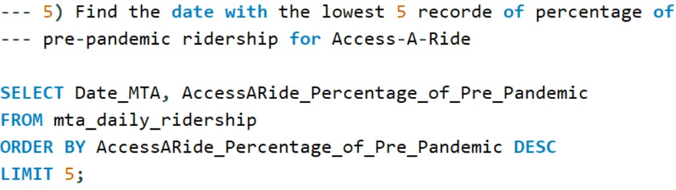
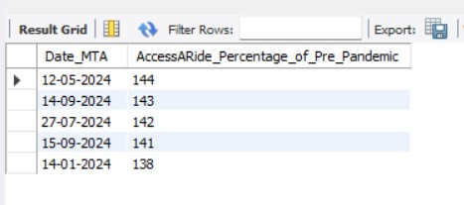
Retrieves the 5 lowest percentages of pre-pandemic ridership for Access-A-Ride.
The ORDER BY ... ASC clause sorts
rows in ascending order based on the
AccessARide_Percentage_of_Pre_Pandemic.
LIMIT 5 ensures that only the 5 lowest records are returned.

Slide 11
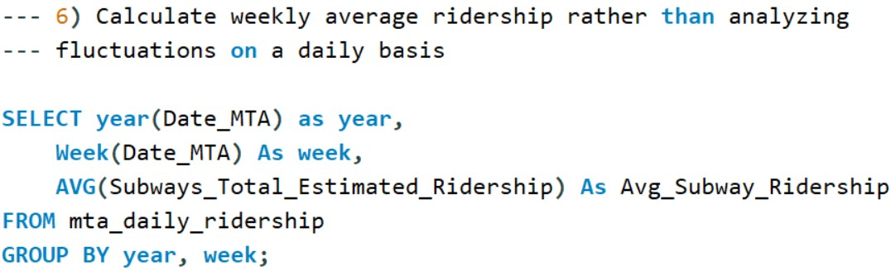
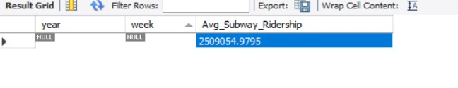
Groups data by year and week to calculate the weekly average subway ridership using AVG().
YEAR() and WEEK() extract the year and week from the Date_MTA.
The GROUP BY clause ensures averages are calculated for each unique combination of year and week.

Slide 12
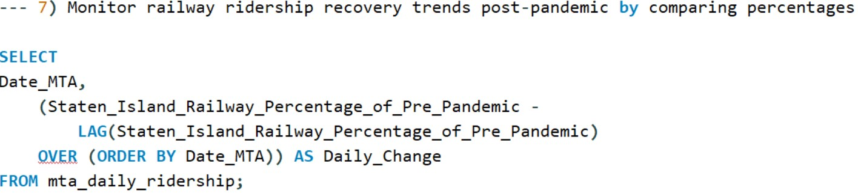
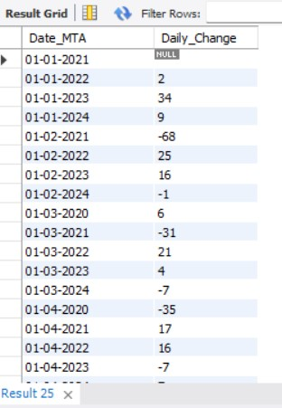
Tracks daily changes in Staten Island Railway's percentage of pre-pandemic ridership.
The LAG() function calculates the previous day's percentage for comparison.
OVER (ORDER BY Date_MTA) ensures that the records are processed in chronological order.

Slide 13
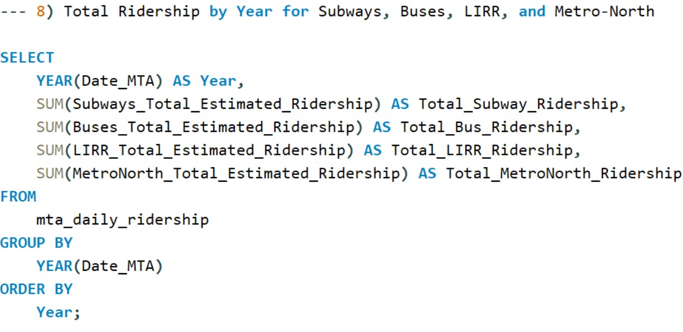
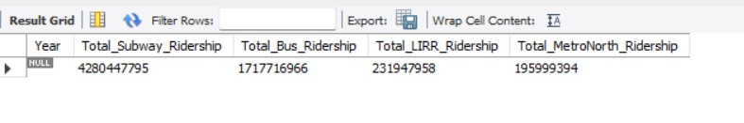
Aggregates total yearly ridership for subways, buses, LIRR, and Metro-North using SUM().
YEAR() extracts the year from the Date_MTA.
GROUP BY YEAR(Date_MTA) groups data by year, ensuring totals are calculated per year.

Slide 14
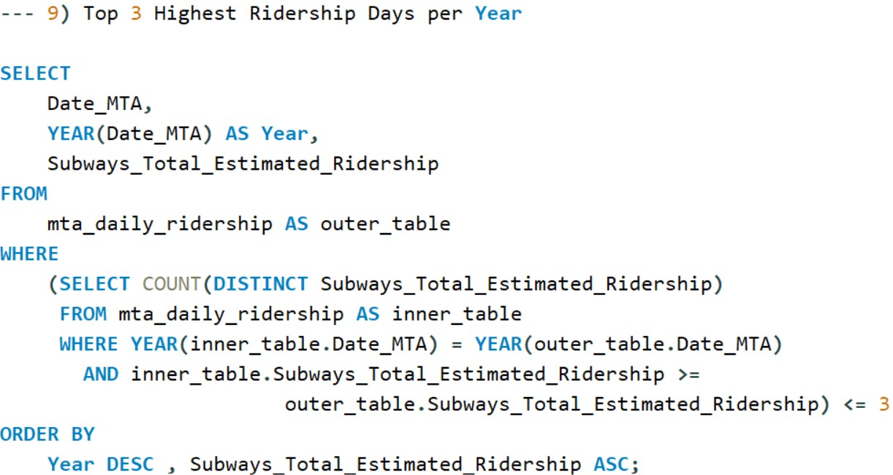
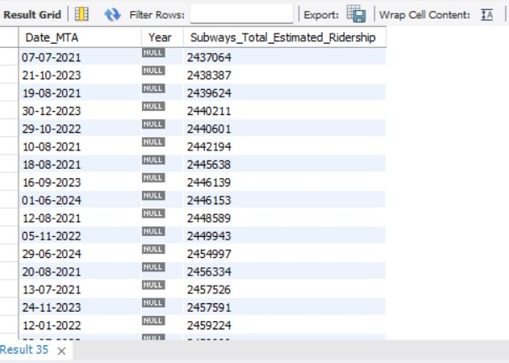
Finds the top 3 subway ridership days for each year.
Uses a correlated subquery to count the number of ridership days in the same year with equal or greater ridership.
Ensures only the top 3 days per year are returned.

Slide 15
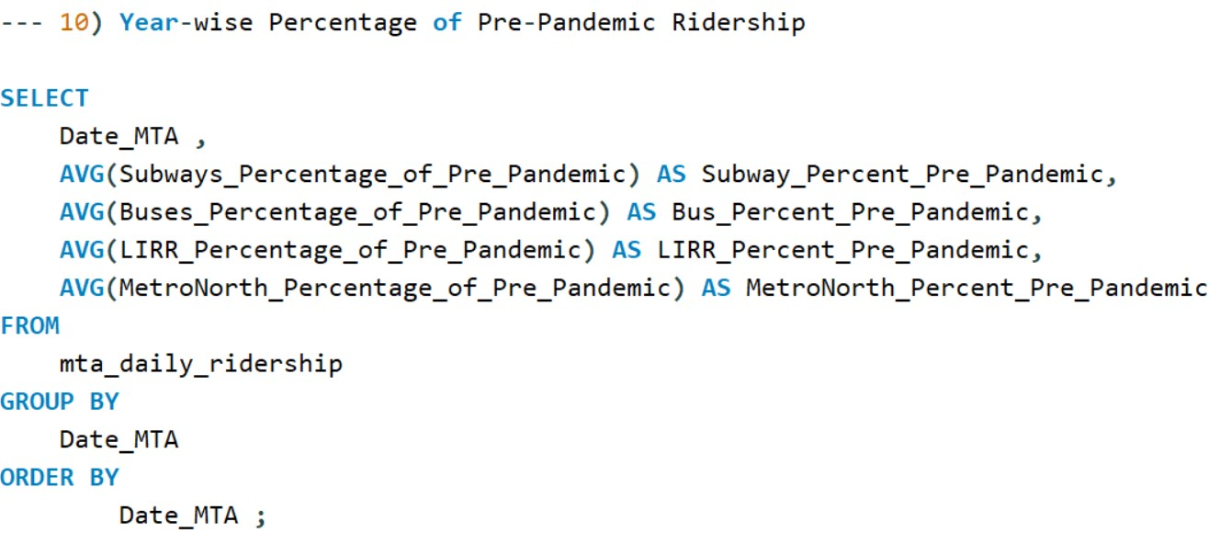
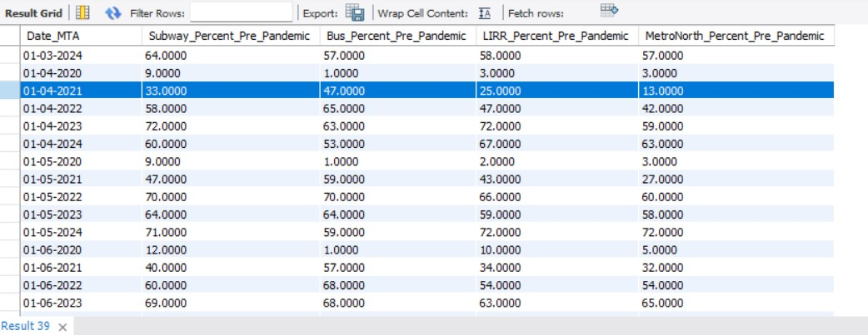
Calculates the average percentage of pre-pandemic ridership for subways, buses, LIRR, and Metro-North for each day.
Groups data by Date_MTA using GROUP BY.
Results are sorted by Date_MTA.

Slide 16
Key Insights and Findings
Subways and Buses: Subways have shown a faster recovery compared to buses, with ridership levels approaching nearly Z% of pre-pandemic levels.
Bridges and Tunnels: Traffic through bridges and tunnels has almost fully recovered, indicating a shift toward private vehicle usage.
Access-A-Ride: Recovery for Access-A-Ride services was slower, indicating that vulnerable populations may still face mobility challenges.

Slide 17
Conclusion
The analysis of MTA ridership data provides valuable insights into post-pandemic recovery patterns across different transportation modes.
Understanding these trends can help policymakers and transportation authorities optimize services and plan for future needs.
Subways and railroads, being critical to New York City's public transportation network, have shown a resilient recovery, while buses and specialized services like Access-A-Ride continue to face challenges.

Slide 18
Future Enhancements
Data Enrichment: Integrate weather data, events, or COVID-19 case rates to understand external factors affecting ridership.
Predictive Analysis: Use machine learning to forecast future ridership trends based on historical data.
Dashboard Visualization: Develop interactive dashboards using tools like Power BI or Tableau for real-time monitoring of ridership data.

Slide 19
Thank You

