Slide 1
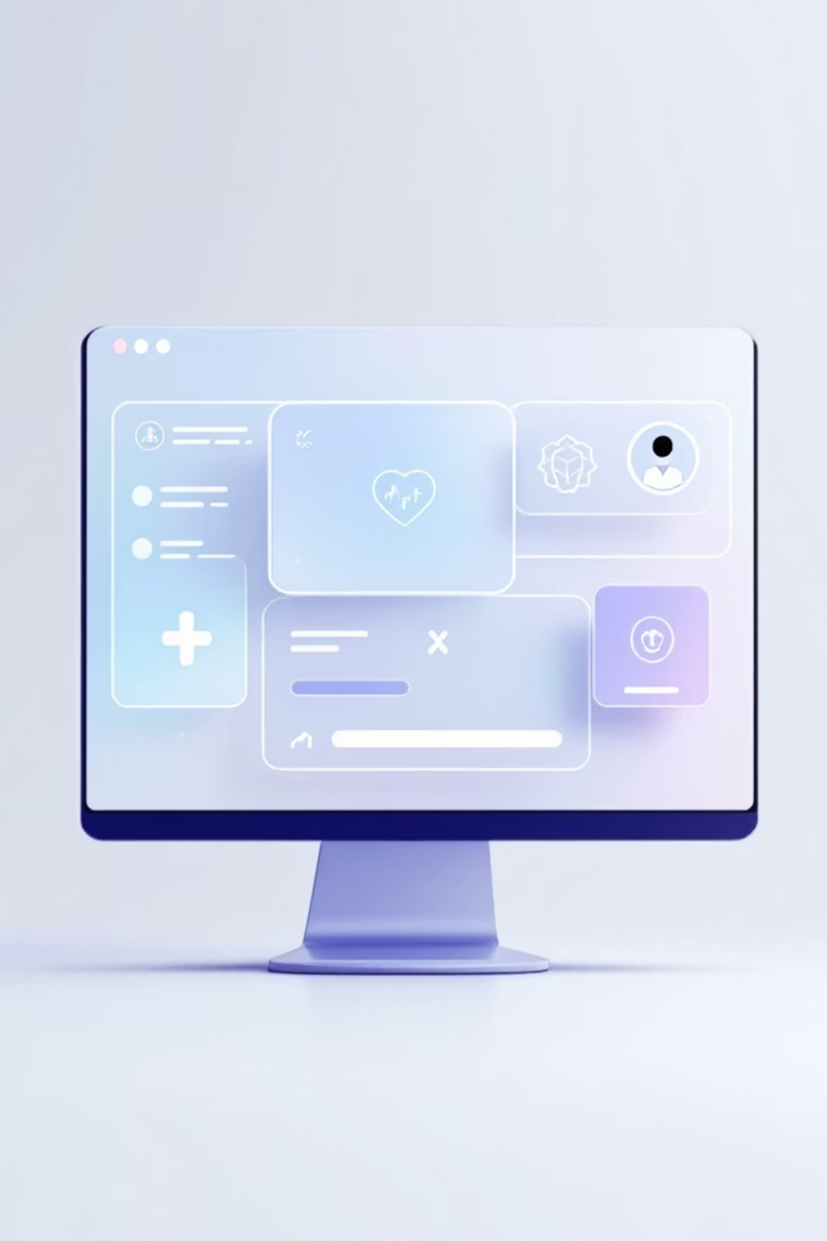
Building a Medical Chatbot
A production-grade medical chatbot leveraging LangChain's RAG capabilities and Groq's lightning-fast LLM inference to deliver accurate, context-aware responses to healthcare queries through an intuitive web interface.

Slide 2
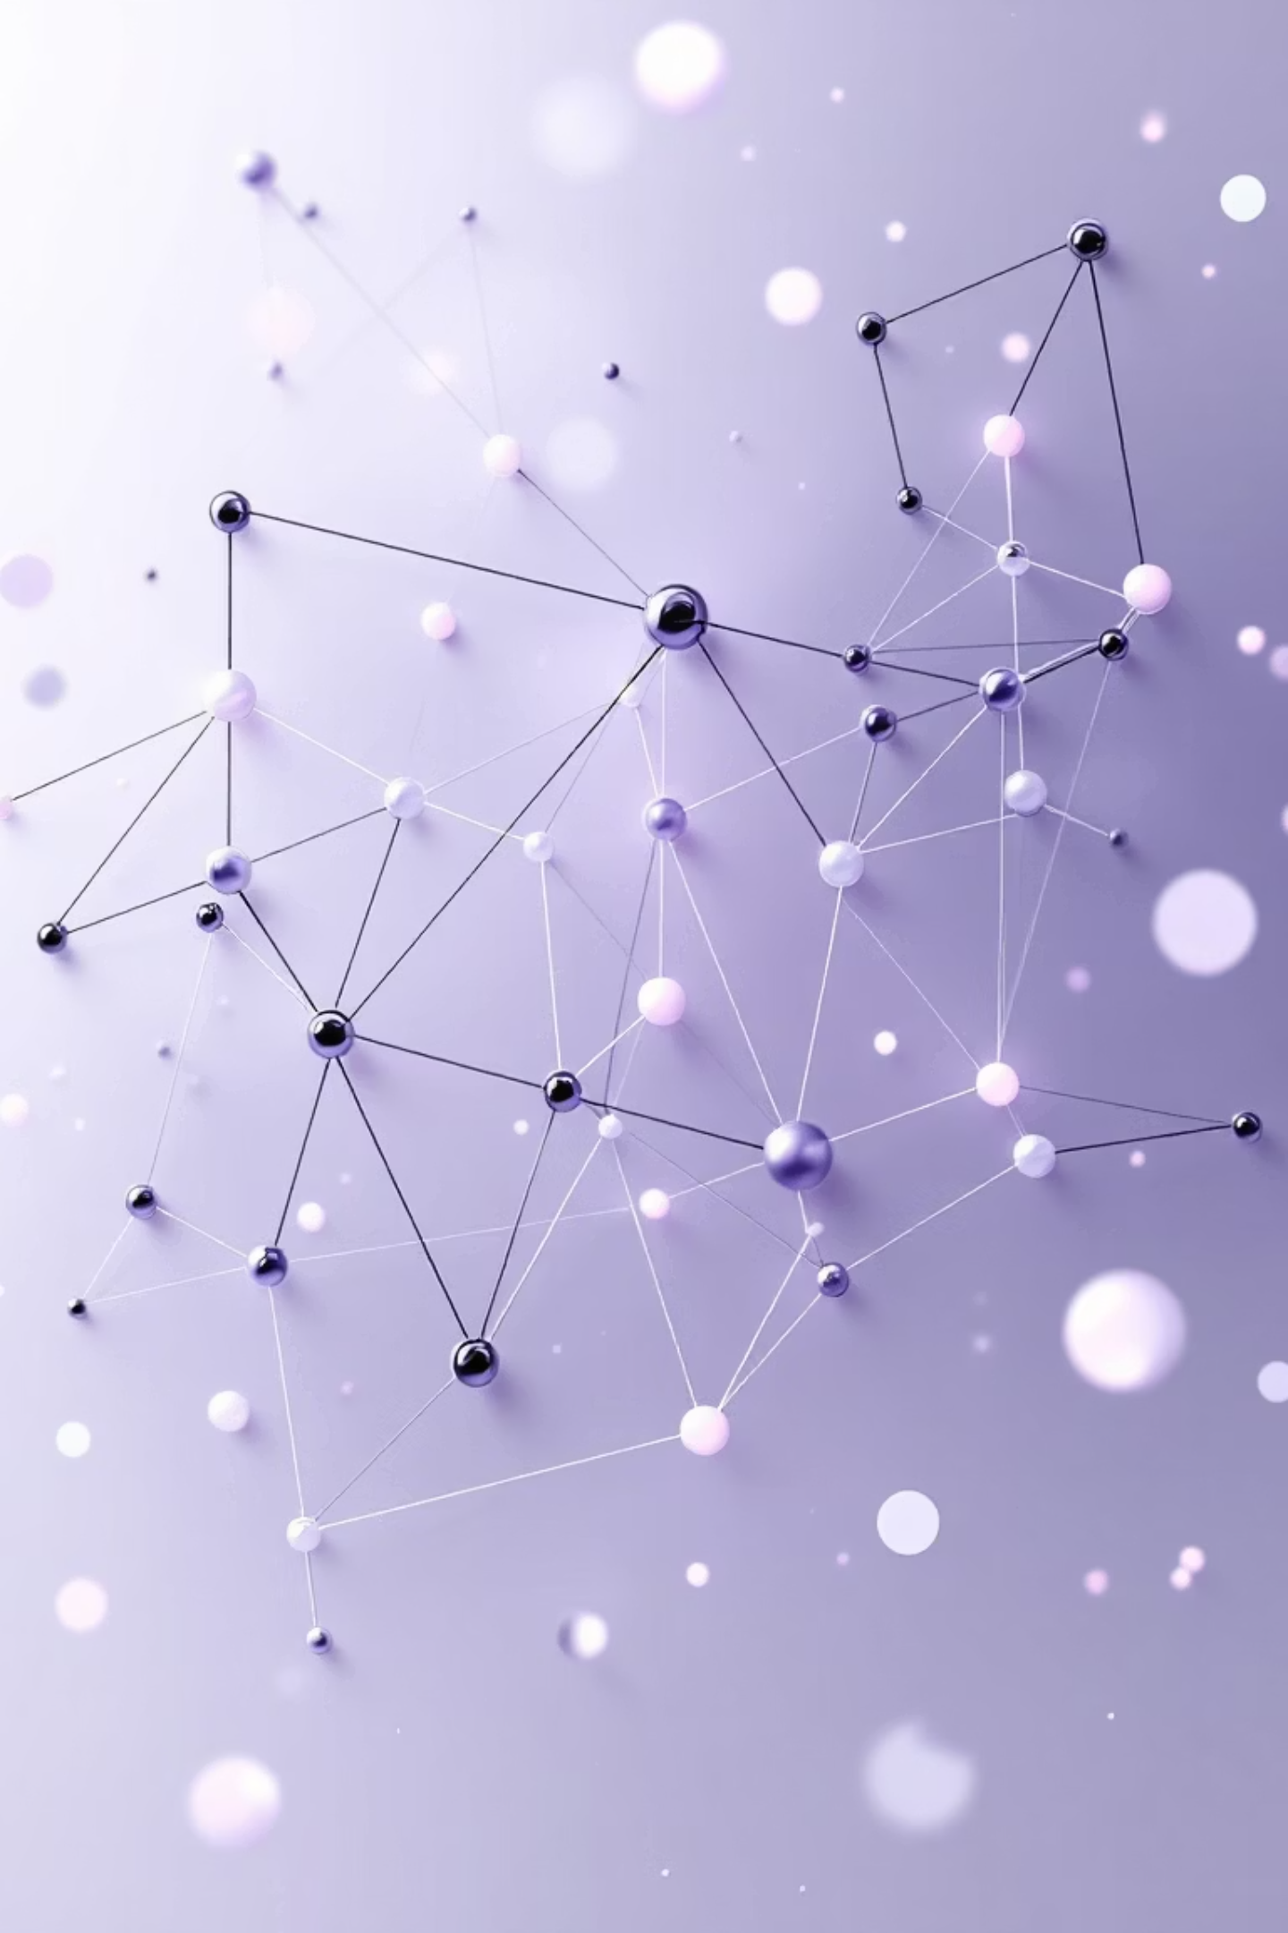






Project Overview
Medical Query Assistant
Flask Web Application
Intelligent chatbot designed to answer medical questions using advanced LLM technology and document-based context retrieval.
Full-stack solution with responsive web interface, backend API integration, and real-time query processing.
LangChain Framework
Implements Retrieval-Augmented Generation (RAG) architecture for contextually accurate medical information retrieval.

Slide 3


Core Technology Stack
Backend & AI Infrastructure
Frontend & Development
Python - Core programming language
HTML/CSS - User interface design
LangChain - RAG orchestration framework
JavaScript - Client-side interactions
Groq LLM API - Fast inference engine
GitHub - Version control and collaboration
HuggingFace Embeddings - Vector representations
Environment Variables - Secure API key management
Flask - Web server and API

Slide 4




Groq API Integration
Secure Authentication
API keys loaded via environment variables, ensuring sensitive credentials never appear in code repositories.
Fast Inference
Groq's specialized hardware delivers sub-second response times for complex medical queries and document retrieval.
Reliable Responses
Consistent, high-quality outputs from state-of-the-art language models with built-in error handling.

Slide 5
LangChain Architecture
01
02
Document Loading
Embedding Creation
Ingest medical knowledge bases, PDFs, and text documents into the system for context retrieval.
Transform documents into high-dimensional vector representations using HuggingFace models.
03
04
Similarity Search
Contextual Answer Generation
Perform efficient nearest-neighbor search to find relevant document chunks matching user queries.
Feed retrieved context to Groq LLM to generate accurate, grounded responses to medical questions.

Slide 6
RAG Pipeline Flow
User Query Input
1
Medical question entered through web interface
2
Query Embedding
HuggingFace model converts text to vector representation
Document Retrieval
3
Vector similarity search finds most relevant context
4
LLM Processing
Groq generates contextually-aware answer using retrieved documents
Response Display
5
Formatted answer rendered on web UI for user

Slide 7
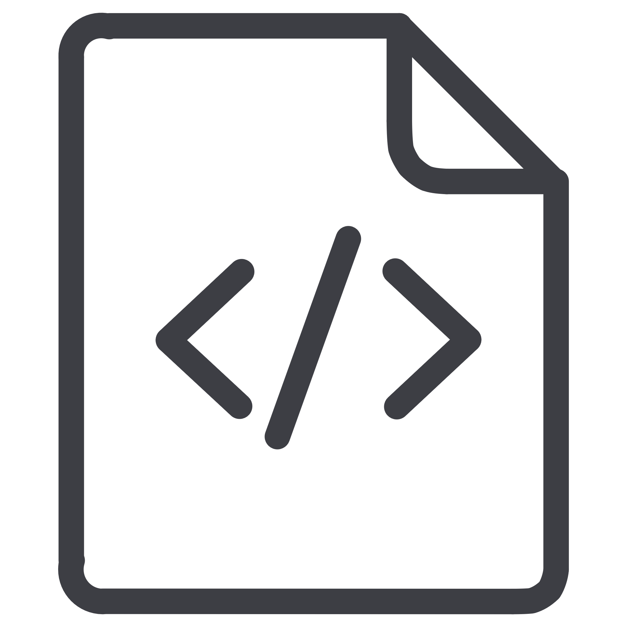




Project Structure
app.py
Main Flask application handling routes, request processing, and response rendering for the web interface.
src/helper.py
Utility functions for embeddings generation, document loading, and vector database operations.
src/prompt.py
Engineered prompt templates optimized for medical domain queries and response formatting.
templates/index.html
Frontend user interface with input forms, chat display, and interactive elements.
static/style.css
Styling and layout definitions ensuring responsive, professional appearance across devices.

Slide 8
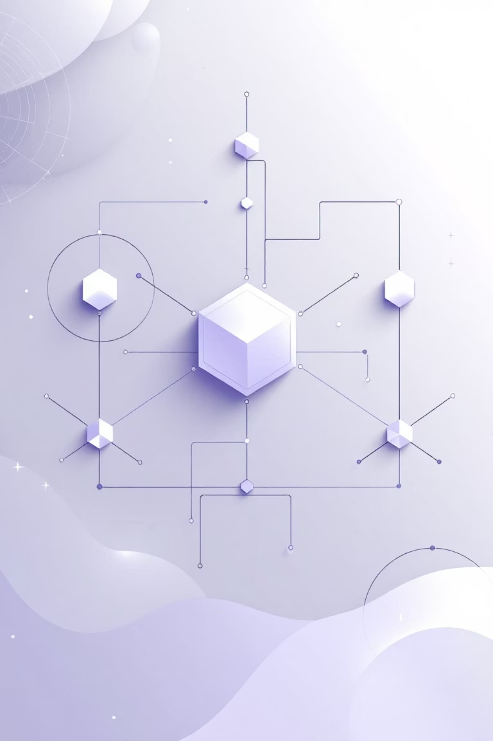
Key Implementation Highlights
RAG Architecture
Production-Ready
Extensible Design
Implements retrieval-augmented generation for grounded, factual responses rather than hallucinated content.
Modular codebase allows easy integration of new features and model upgrades.
Secure API key management, error handling, and scalable Flask deployment structure.
3
5
100%
Core Components
Pipeline Steps
Context-Aware
LangChain, Groq, HuggingFace
From query to response
Answers grounded in documents

Slide 9
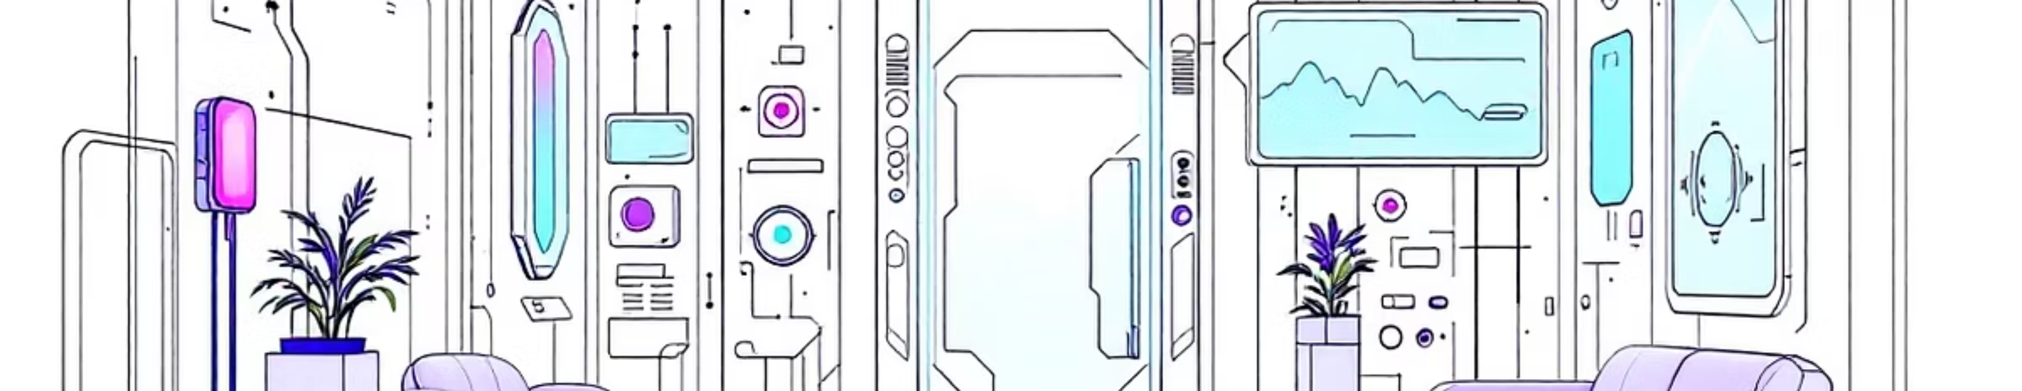
Future Enhancements
Voice Input Integration
Cloud Deployment
Multi-Language Support
Add speech-to-text capabilities for hands-free querying, making the chatbot accessible for healthcare professionals during patient interactions.
Deploy to AWS, Azure, or GCP with containerization using Docker for scalability and high availability in production environments.
Implement multilingual embeddings and translation layers to serve global audiences and diverse patient populations.

Slide 10

Project Outcomes & Learning
LangChain Mastery
LLM API Integration
Practical implementation of document loaders, vector stores, and chain composition for production RAG systems.
Hands-on experience with Groq's inference API, including authentication, prompt engineering, and response handling.
RAG System Design
End-to-end architecture for retrieval-augmented generation, from embeddings to contextual answer generation.
Ready for production: This chatbot demonstrates enterprise-grade patterns for building reliable, context-aware AI assistants that can be adapted to various domains beyond healthcare.

Slide 11
