Slide 1
Disease Prediction Analysis
FOUNDATION OF DATA ANALYTICS

Slide 2
Team Members:
Sneha M 19MIS1103
Vaishnavi G 19MIS1135

Slide 3
Problem Statement:
Disease can be managed effectively with a combination of lifestyle changes, medicine and in some cases surgery also. With the right treatment, the symptoms of disease can be reduced and the functioning of the body will also get improved. In disease prediction the predicted results can be used to prevent and thus reduced cost for surgical treatment and other expensive.
Accurate and on-time analysis of any health-related problem is important for the prevention and treatment of illness. The traditional way may not be sufficient. Developing a Disease Prediction Analysis system based on machine learning(ML) algorithm for prediction of any disease can help in more accurate diagnosis than the conventional method. So, our disease prediction model can act as a doctor for the early diagnosis of a disease to ensure the treatment can take place on time.

Slide 4
Objective:
The main objective of the project is improvise the disease prediction analysis. The System can discover and extract hidden knowledge associated with diseases from a historical dataset. It aims to exploit Machine Learning on medical dataset to assist in prediction of the diseases.
(i) Provides new approach to concealed patterns in the data.
(ii) Helps to avoid human bias ness.
(iii) Reduce the cost of medical issues.
(iv) It classifies the disease as per the input of the user.

Slide 5
Materials and Methods:
Decision Tree:
Gradient Boosting:
Naive Bayes:
Random Forest:
Random Forest works in two-phase first is to create the random forest by combining N decision tree, and second is to make predictions for each tree created in the first phase.
Naive Bayes calculates the possibility of whether a data point belongs within a certain category or does not.
A decision tree is a supervised learning algorithm that is perfect for classification problems, as it’s able to order classes on a precise level.
The main idea behind this algorithm is to build models sequentially and these subsequent models try to reduce the errors of the previous model.

Slide 6
Literature Review:
Designing Disease Prediction Model Using Machine Learning Approach
Dhiraj Dahiwade, Prof. Gajanan Patle, Prof. Ektaa Meshram-March 2019
People face various diseases due to the environmental condition and their living habits. So the prediction of disease at earlier stage becomes important task. But the accurate prediction on the basis of symptoms becomes too difficult for doctor. The correct prediction of disease is the most challenging task. To overcome this problem data mining plays an important role to predict the disease. Medical science has large amount of data growth per year. Due to increase amount of data growth in medical and healthcare field the accurate analysis on medical data which has been benefits from early patient care. With the help of disease data, data mining finds hidden pattern information in the huge amount of medical data. disease prediction based on symptoms of the patient.

Slide 7
. For disease prediction required disease symptoms dataset. In this general disease prediction the living habits of person and checkup information consider for the accurate prediction. The accuracy of general disease prediction by using CNN is 84.5% which is more than KNN algorithm. And the time and the memory requirement is also more in KNN than CNN. After general disease prediction, this system able to gives the risk associated with general disease which is lower risk of general disease or higher.

Slide 8
Disease Prediction by Machine Learning Over Big Data From Healthcare Communities
M. Chen, Y. Hao, K. Hwang, L. Wang, and L. Wang, 2017.
With big data growth in biomedical and healthcare communities, accurate analysis of medical data benefits early disease detection, patient care, and community services. However, the analysis accuracy is reduced when the quality of medical data is incomplete. Moreover, different regions exhibit unique characteristics of certain regional diseases, which may weaken the prediction of disease outbreaks. In this paper, we streamline machine learning algorithms for effective prediction of chronic disease outbreak in disease-frequent communities. To overcome the difficulty of incomplete data, we use a latent factor model to reconstruct the missing data. We experiment on a regional chronic disease of cerebral infarction. We propose a new convolutional neural network (CNN)-based multimodal disease risk prediction algorithm using structured and unstructured data from hospital. To the best of our knowledge, none of the existing work focused on both data types in the area of medical big data analytics. Compared with several typical prediction algorithms, the prediction accuracy of our proposed algorithm reaches 94.8% with a convergence speed, which is faster than that of the CNN-based unimodal disease risk prediction algorithm

Slide 9
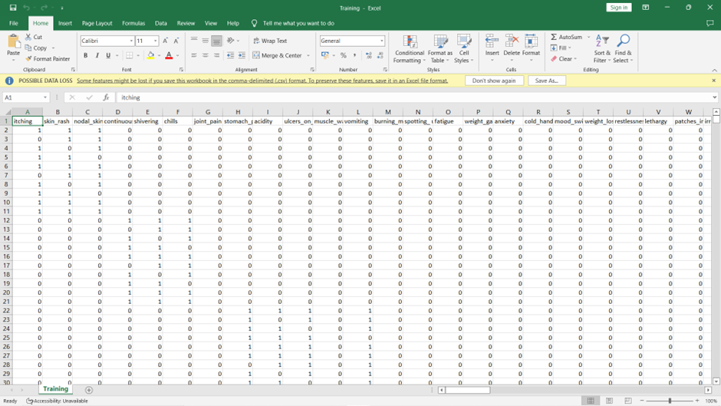
Dataset:

Slide 10
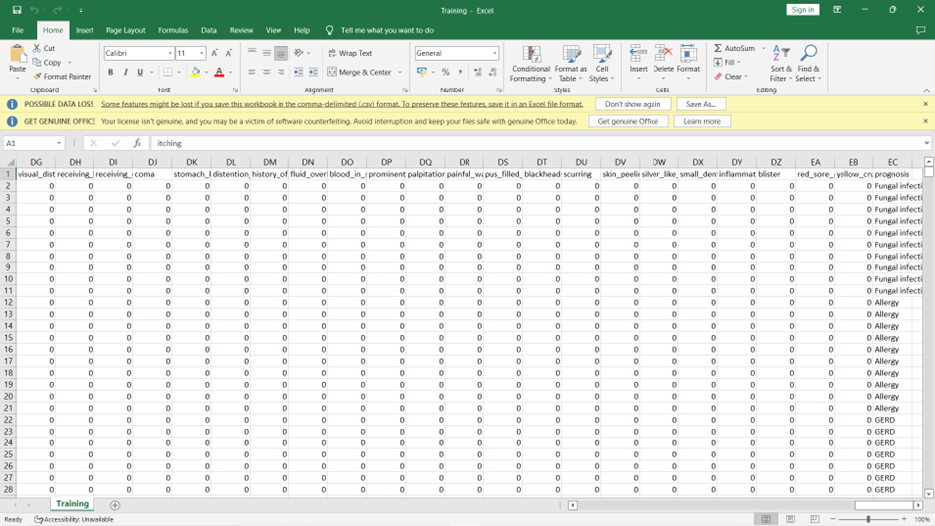

Slide 11
Software design

Slide 12
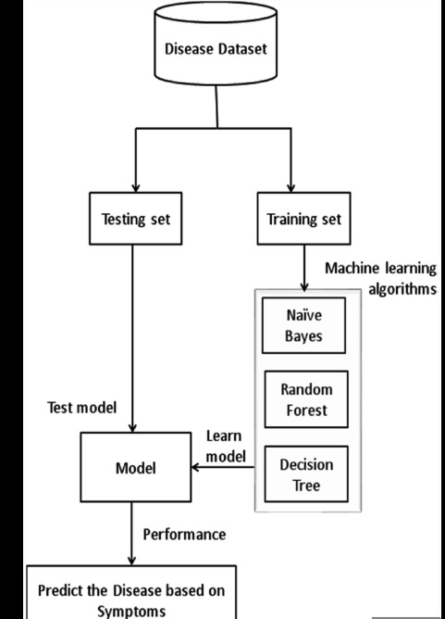

Slide 13
CORRELATION

Slide 14
VISUALIZATION

Slide 15
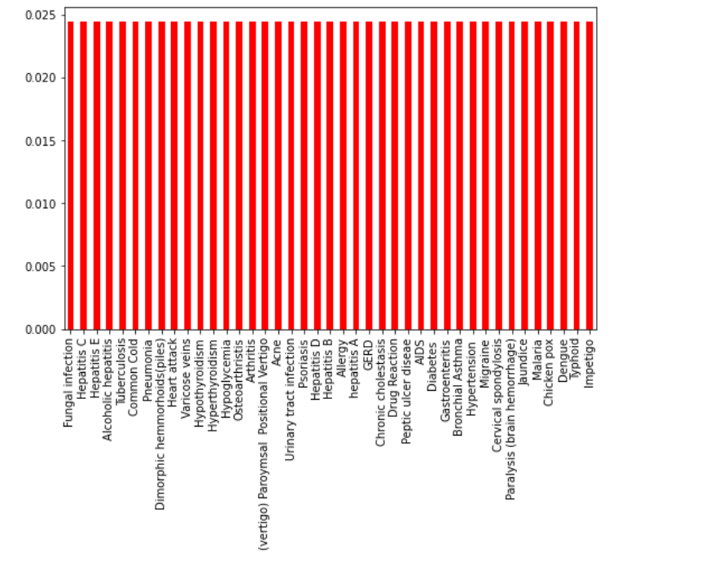

Slide 16
PERFORMANCE MESURES

Slide 17
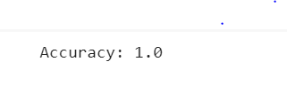
DECISION TREE

Slide 18
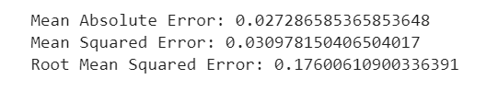

Random Forest

Slide 19
NAIVE BAYES

Slide 20
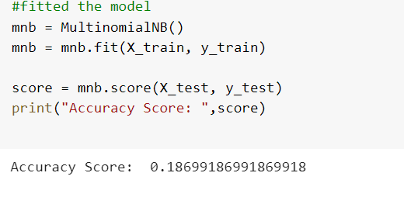
MUTINOMINAL

Slide 21
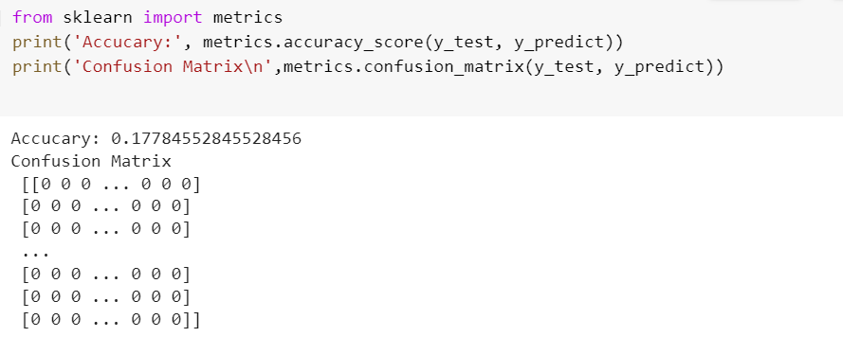
CategoricalNB

Slide 22

GaussianNB

Slide 23
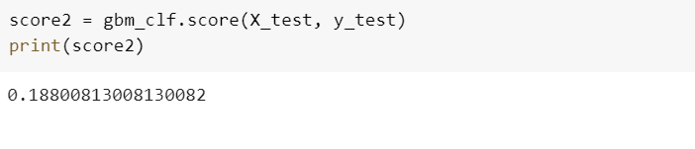
GRADIENT BOOST

Slide 24
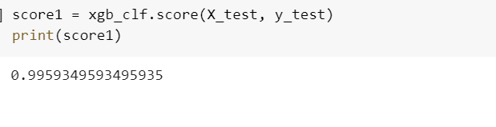
XGBClassifier

Slide 25
Conclusion:
The System is providing the initial diagnostics in time. It can also provide the purpose of medical tool for medical students and will be a soft diagnostic tool for physician. It is user-friendly, scalable, reliable and an expandable system. As we have developed a generalized system, in future we can use this system for the analysis of different data sets. Once the disease is predicted, we would easily manage the medicine resources required for the treatment and this model would help in lowering the cost required in dealing with the disease and also improve the recovery process.

