Slide 1
Replicating “End-to-End Text to Speech Synthesis”
SVR, a simple neural network and Seq2Seq with attention: text to wav, end to end
CS 229 replication project
Member 1
NAME- SUJAY NAYAK
SRN: PES2UG24CS533
Member 2
NAME-SNEHA PANINI
SRN: PES2UG24CS508
[Date : 11-10-2026]
Original paper: Xiao Wang, Yahan Yang, Ye Li (Stanford CS 229, Autumn 2018)
Notes:
Title slide. Fill in team names and date. Credit the original authors.

Slide 2
Motivation: speech straight from text
Traditional TTS
Text normalisation
→
Encoder
→
Decoder
→
Vocoder
End-to-end
Text
→
One learned model
→
Speech (wav)
Our question: how far do simple models and a small Seq2Seq get?
Notes:
Traditional TTS chains several hand-built stages. End-to-end systems (Tacotron, Char2Wav, Deep Voice) learn the mapping in one model. We ask how far simple models and a small Seq2Seq can get.

Slide 3
The original paper and what we replicated
1.0
1.7
2.5
SVR (paper MOS)
Simple NN (paper MOS)
Seq2Seq (paper MOS)
Same three models, same pipeline, same MOS survey
Same data source: LJ Speech, 200 training sentences
Our change: clips capped at 5 s
Wang, Yang & Li, “End-to-End Text to Speech Synthesis”, CS 229, Autumn 2018
Notes:
Paper's MOS from 10 Stanford students: SVR 1.0, NN 1.7, Seq2Seq 2.5. Tacotron's 3.82 is quoted from the Tacotron paper for reference.

Slide 4
Dataset: LJ Speech and our subset
13,100
200
20
≤ 5 s
clips in LJ Speech (1 speaker)
training sentences
dev sentences (dev loss only)
clip cap (not in the paper)
Public domain audiobook clips · keithito.com/LJ-Speech-Dataset
Notes:
220 sentences are drawn at random with seed 42, skipping clips longer than 5 s: 200 train, 20 dev. The dataset itself is not in the repo.

Slide 5
Text preprocessing
Words
(CMU dictionary)
Per word: phonemes or letters (p = 0.5)
Integer IDs
(vocab 73)
Zero-pad to longest sentence
→
→
→
Example: “bit” → @B @IH @T or b i t
Output: X = 220 sentences × 88 symbols
Notes:
Each word is looked up in the CMU dictionary and, with probability 0.5, mapped to phonemes; otherwise letters. The mapping is random and recomputed every run, as in the paper.

Slide 6
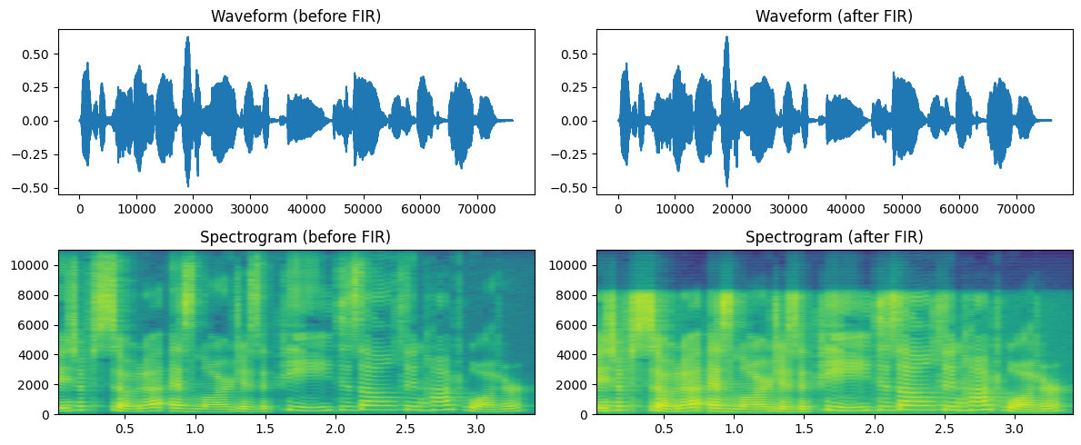
Audio preprocessing
FIR filter
→
STFT (2048 pt)
→
1025 bins, magnitude only
→
Zero-pad to 109 frames
Y = 220 × 109 × 1025
Raw amplitude, no log scaling
Max 0.199, mean 0.00026
Before / after FIR filter (notebook Figure 1)
Notes:
FIR filter (101 taps, 8 kHz low-pass) then STFT with a 2048-point window gives 1025 bins. Only the magnitude is kept, so phase is discarded. Figure from the notebook (one training clip).

Slide 7
Three models
SVR
Simple NN
Seq2Seq
One poly-kernel SVR per time step and bin
scikit-learn defaults
CPU only, slow
Embedding → Flatten → Dense (sigmoid)
Output: T × 1025, stretched
39.6 M parameters
Bidirectional LSTM encoder (512)
LSTM decoder with attention
Generates frame by frame
Notes:
SVR: one regressor per time step and frequency bin, trained on CPU (88 s in our run). NN: 39.6M parameters, 38 s. Seq2Seq: 93 s on a T4.

Slide 8
Postprocessing: spectrogram to wav
Predicted magnitude
Inverse STFT (zero phase)
Inverse FIR
Normalise, save wav
→
→
→
Zero phase makes everything sound robotic.
Even the ground-truth reconstruction is buzzy: that is the best this pipeline can do.
Notes:
Only magnitude is predicted, so the inverse STFT has zero phase. Even the real clip pushed through this pipeline sounds buzzy and robotic, which sets the ceiling for every model here.

Slide 9
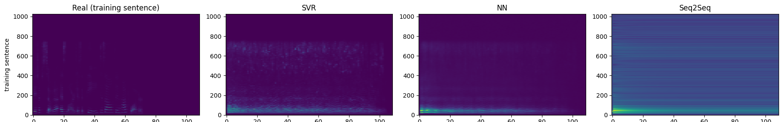
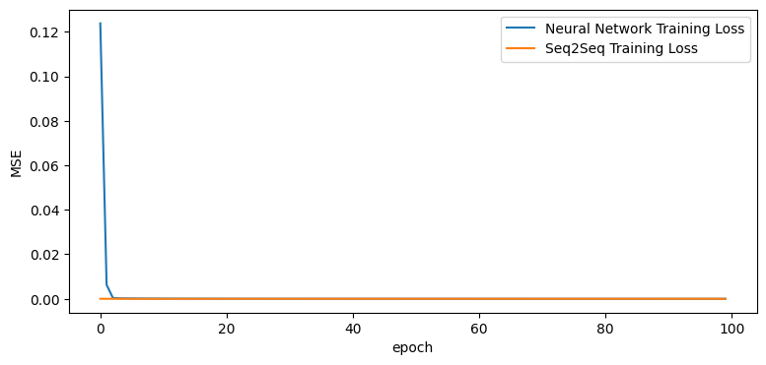
Results: spectrograms, loss and MOS
Real vs SVR vs NN vs Seq2Seq (training sentence)
Model | Paper MOS | Our MOS | Std | Listeners
SVR | 1.0 | 1.0 | 0.00 | 5
NN | 1.7 | 1.4 | 0.49 | 5
Seq2Seq | 2.5 | 1.6 | 0.49 | 5
Training loss (MSE) per epoch
Same ordering as the paper; with 5 listeners the gaps are small.
Notes:
MOS from 5 listeners (ratings dict in the notebook). Ordering SVR < NN < Seq2Seq matches the paper, but gaps are small with n = 5, so we do not claim the same numbers. Top: real vs SVR vs NN vs Seq2Seq on a training sentence. Bottom left: training loss (MSE) per epoch.

Slide 10
Discussion: why each model failed
SVR
Near-constant output: default ε is larger than the amplitudes
NN
Smears toward an average spectrum
Seq2Seq
Feeds its output back and loops, giving a repeating beat
All
Magnitude only: phase is lost
No model beats predicting all zeros
Notes:
Dev MSE (x1e-6) from the notebook: all-zeros 2.37, SVR 30.6, NN 8.57, Seq2Seq free-running 2.42. Amplitudes are tiny, so a small training loss is misleading: no model beats predicting zeros.

Slide 11
Differences from the paper and assumptions
What we changed
What we had to guess
Clips capped at 5 s (paper: no cap)
20 extra dev sentences
Bidirectional LSTM, as on the poster
FIR: 101 taps, 8 kHz low-pass
STFT hop: scipy default (50%)
Phoneme probability 0.5; Adam, MSE
SVR: scikit-learn defaults
Small training set (200 sentences). Model ordering matches the paper; numbers do not.
Notes:
The paper does not specify many details; every choice here is ours and is listed in the notebook's assumptions table.

Slide 12
Conclusion and future work
Seq2Seq scored highest (1.6) but no model sounds like speech
Zero phase and a small training set limit every model
Next: deeper Tacotron-style model, more data, Griffin-Lim or a neural vocoder
Reference: Wang, Yang & Li, “End-to-End Text to Speech Synthesis”, CS 229, Autumn 2018
Notes:
Fill in team contributions. Credit the original authors.

