Slide 1
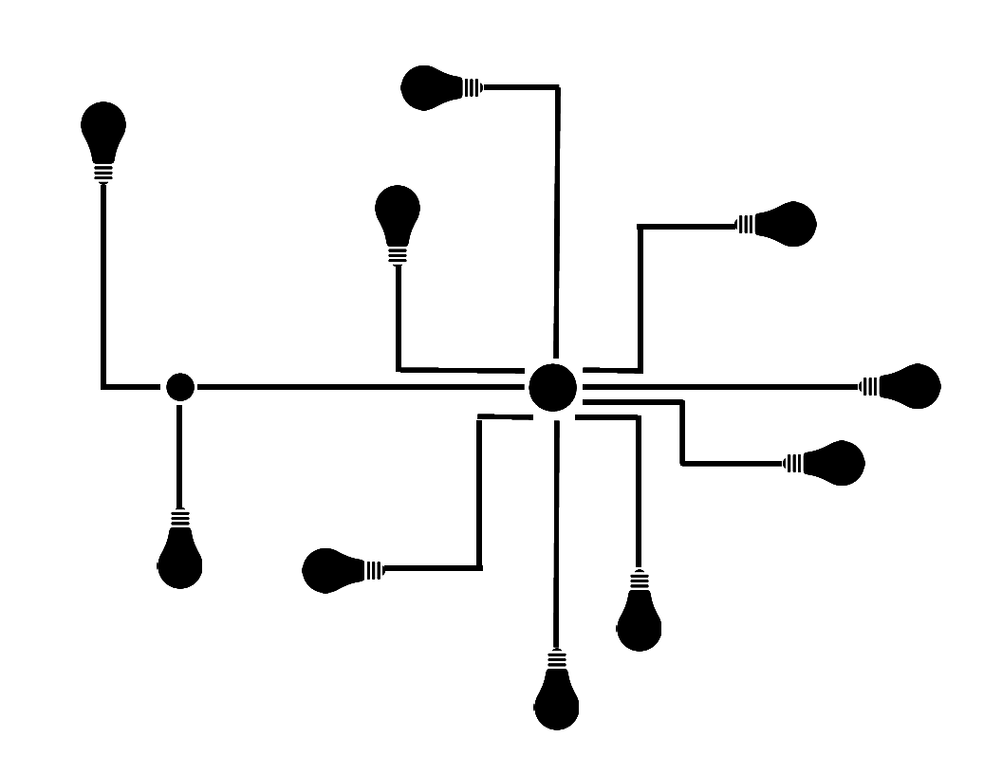

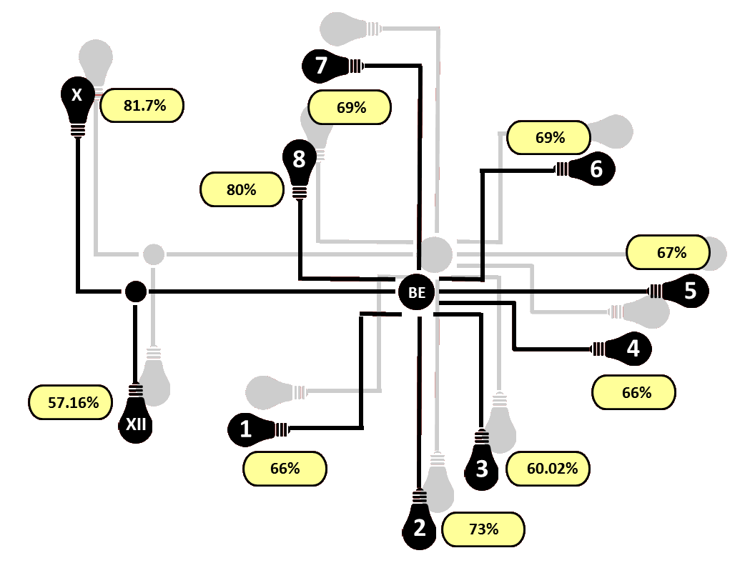
7
81.7%
69%
X
69%
8
6
80%
67%
BE
5
4
57.16%
66%
XII
1
66%
3
60.02%
2
73%

Slide 4


