Slide 1
MindGraph
Nobody burns out overnight. It's written in your data for weeks first.
DARK PULSE · HACKHAZARDS '26 · HUMAN EXPERIENCE & PRODUCTIVITY TRACK MANOJ H.G (LEAD) · DILEEP MK · SNEHA · CHINMAY J C

Slide 2
We stopped noticing ourselves a long time ago.
The signs were there. We just built apps that don't talk to each other.
77%
SLEEP TRACKER
REPORT BURNOUT SYMPTOMS
MOVEMENT LOG
Your sleep tracker knows you slept five hours. Your fitness app knows you didn't move. Your calendar knows six back-to-back calls. None of them know that together, that's the third week running.
CALENDAR APP
The data to predict this already exists. It's just scattered across four apps that don't speak.

Slide 3
What if your habits could tell on each other?
MindGraph treats your life like it actually is — one connected system, not four separate apps.
01 / IN
02 / GRAPH
03 / OUT
30 seconds
A 30-second daily log: sleep, mood, energy. Offline-first client cache ensures entries are preserved.
Connected Node Graph
Every entry becomes a node. Not stored — related, to yesterday, to your patterns.
Burnout Risk — Live
Output: a live Burnout Risk Gauge, running BIS Score, and coaching notes that remember history.

Slide 4
Nothing about this is a toy demo.
The stack exists because relationships need a database built for relationships.
INTELLIGENCE LAYER
GPT-4 Wellness OS
Intelligence — GPT-4 reads the graph itself, not a single entry — a coaching note can reference three weeks of continuous data, not just today's mood.
openai-api · gpt-4 · gpt-3.5-turbo
GRAPH ENGINE
Node.js + Neo4j AuraDB
Engine — Node.js/Express backend writing directly into Neo4j AuraDB in Cypher. Habits aren't rows in a table. They're edges.
neo4j-auradb · cypher-query-language · express.js
CLIENT INTERFACE
Expo + React Native
Client — Expo + React Native 0.85, TypeScript 6.0. Offline-first: log a bad day with no signal, sync later through AsyncStorage.
expo-sdk-56 · react-native-0.85 · async-storage · typescript-6

Slide 5
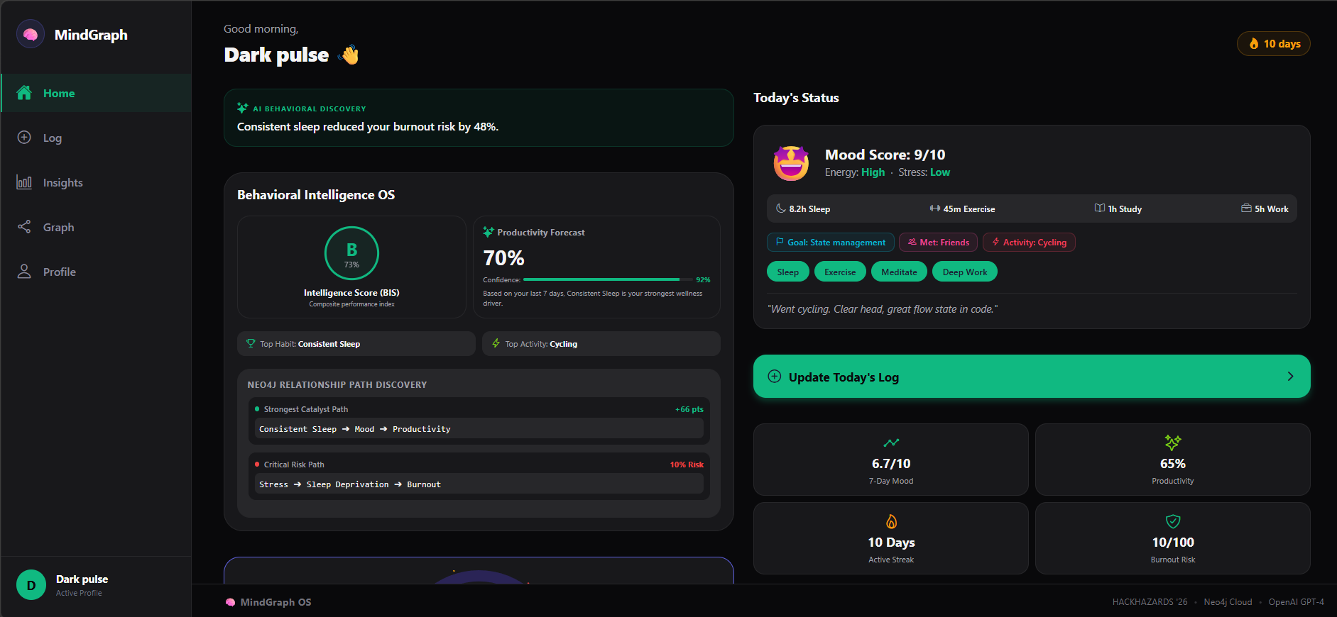
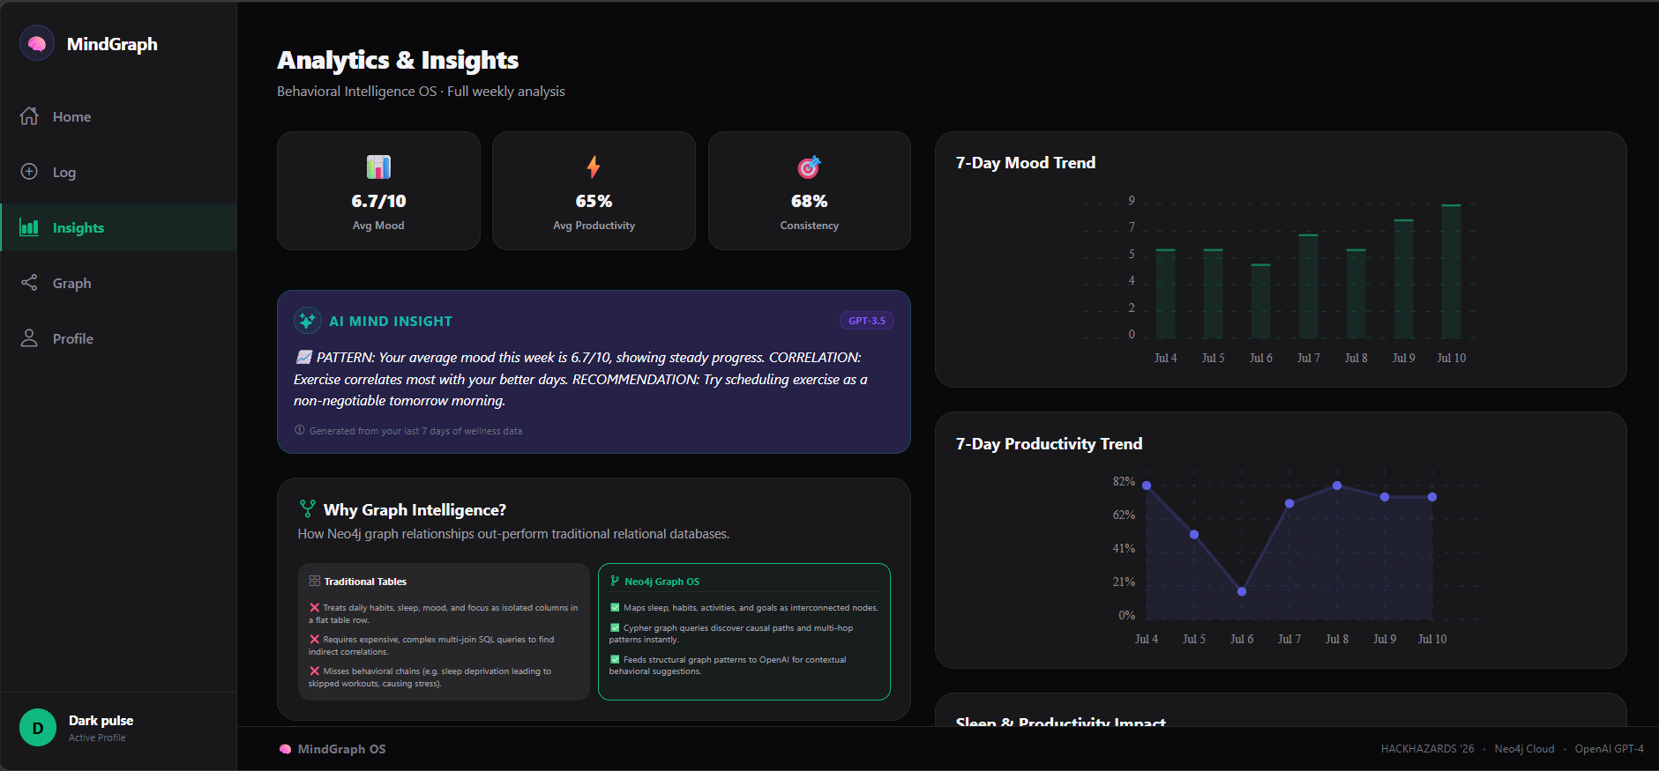
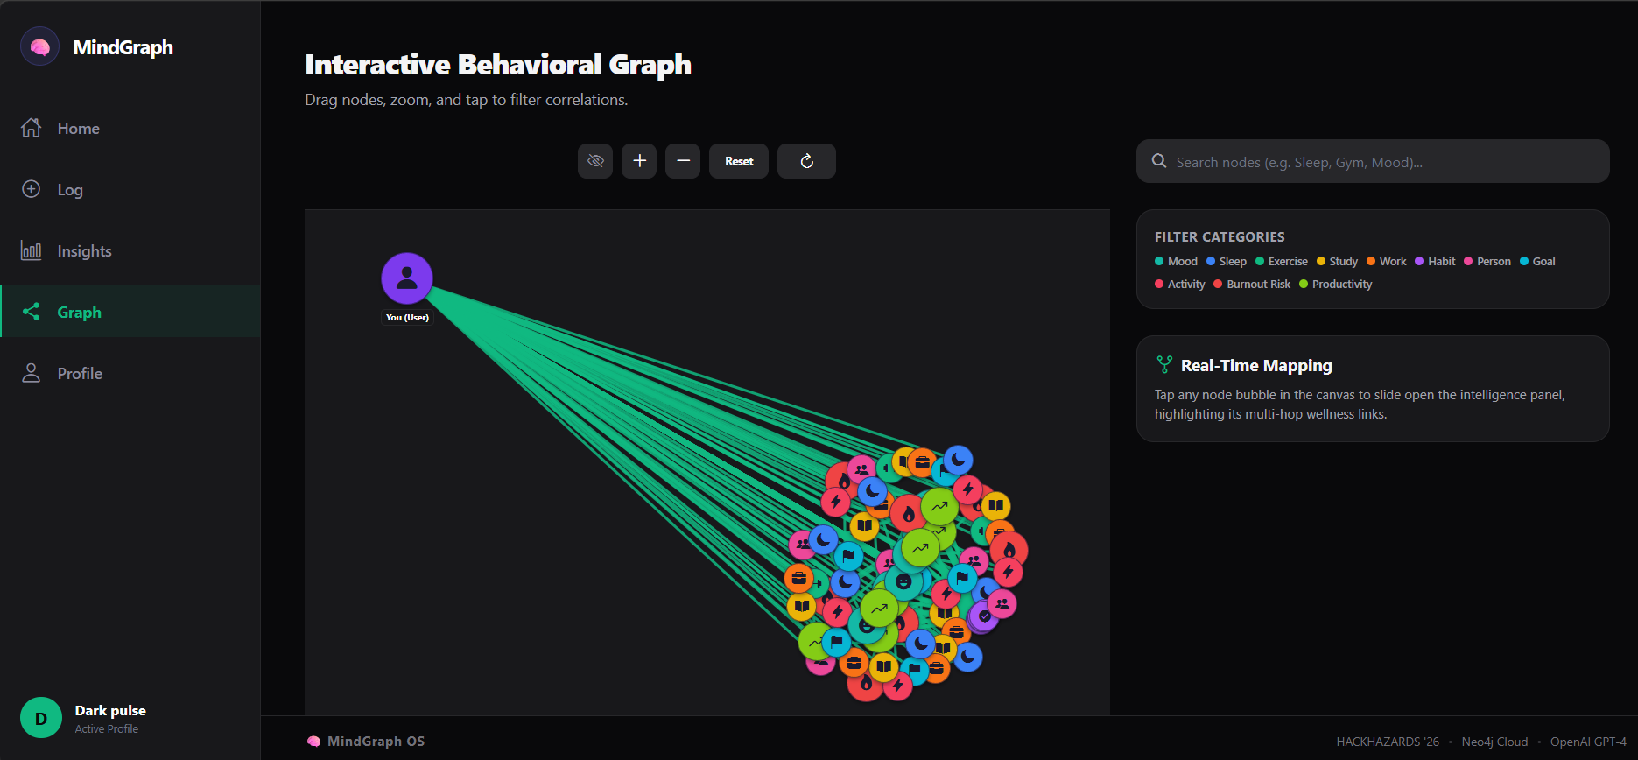
This is what a pattern looks like once you can see it.
A real query, running against a real graph.
OS ENGINE
NEO4J PATHS
BIS Grade: B (Score: 73%)
Sleep ➔ Mood ➔ Productivity (+66 pts) Stress ➔ Sleep Deprivation ➔ Burnout
Formula: 20% Mood + 20% Sleep (vs 8h) + 20% Consistency + 20% Productivity + 20% Stress. Recalculated live to warn before physical burnout.
Three weeks of bad sleep doesn't sit in a table row. It traces a path straight to the score.
MATCH (u:User)-[:SLEPT]->(s:Sleep) MATCH (u)-[:LOGGED]->(m:Mood {date: s.date})

Slide 6
Intercept burnout before it peaks.
The twelve weeks of warning nobody currently gets.
Sleep
Mood
TEAM DARK PULSE
Manoj H.G (Lead) · manojhg321@gmail.com
Dileep MK · dileep.m.k126@gmail.com
Sneha · acharyasneha2005@gmail.com
Chinmay J C · chinmaychoudhari620@gmail.com
REPOSITORY: github.com/sneha-s2005/MindGraph
LIVE DEPLOYMENT: mindgraph-app.onrender.com
Mind Graph
Stress
Habits
Nobody burns out overnight. It's written in your data for weeks first.

