Slide 1
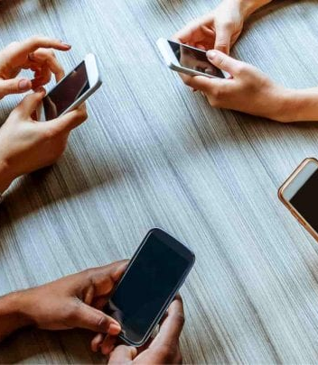
The Silent Addiction
A Dive into Digital App Usage Patterns

Slide 2
Agenda
Problem Statement
Aim
Overview
Findings and Insights
Conclusion
Solutions

Slide 3
Problem Statement
Is our screen time productive or just passive consumption?

Slide 4
Problem Statement
In today's hyperconnected world, smartphones have become indispensable companions. From waking up with a digital alarm to winding down with late-night reels, our lives are deeply intertwined with apps. But as convenience grows, so does dependency.
Meet Aarav, a 21-year-old university student with ambitious goals. He starts his day intending to revise for his exams using note-taking and scheduling apps. But before long, one notification leads to another, and Aarav finds himself scrolling through social media, watching videos, and endlessly switching between entertainment platforms. The productivity apps gather dust in a corner of his digital drawer.
Aarav's story isn't unique—millions like him struggle daily with managing screen time effectively. This project seeks to track app usage trends across diverse users.

Slide 5
Dataset & Tech Stack
Dataset: Screen Time and App Usage (iOS & Android) – Kaggle
Tools Used: MS SQL Server, Power BI
Records: 3,000 rows, 101 distinct users, 11 columns
Fields: User ID, App Name, Category, Screen Time, Interactions, Productivity Tag, Launches

Slide 6
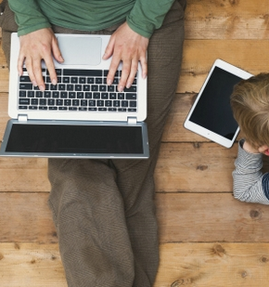
Aim
Uncover app usage habits across different categories
Compare time spent on productive vs. unproductive apps
Identify user behavior trends and their impact on focus
Promote digital awareness and better screen habits
6

Slide 7
Overview
Revealing hidden patterns behind screen time habits.

Slide 8
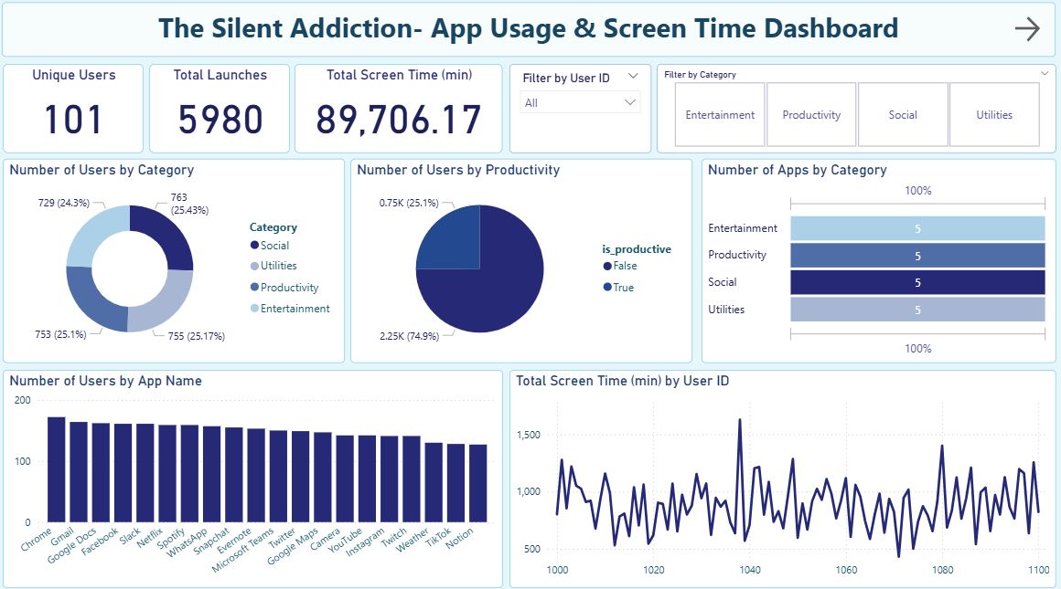
8

Slide 9
Overview
Most Used App by Time:
Spotify leads with 5,175 mins, closely followed by WhatsApp and Slack.
High Launch Frequency Apps:
Slack, Chrome, and Gmail show high usage cycles with 350+ launches each.
Productivity Apps with Strong Presence:
Google Docs, Microsoft Teams, and Notion appear frequently—used by 120+ users each with high engagement.
Entertainment vs Productivity:
Apps like Netflix and YouTube have similar screen time as productive tools, indicating the thin line between usage and distraction.

Slide 10
Key Findings & Insights
Unproductivity Dominates: 74.9% of total screen time is on non-productive apps.
Only 25.1% is Productive Time: Apps like Gmail, Docs, and Zoom have low usage.
Spotify (5,175 mins), WhatsApp (5,146 mins), and Slack (4,671 mins) lead in total screen time.
Chrome and Gmail dominate Utility app usage, showing consistent productivity tool reliance.
Slack, Gmail, Facebook, and Chrome have the most launches, indicating frequent but possibly short sessions.
Even social apps like Snapchat and WhatsApp show high launch counts (800+), reflecting habitual usage.
We can filter it by User ID to check each user’s journey.
We have another filter category to analyze the data deeply, in each category 5 apps are there.

Slide 11
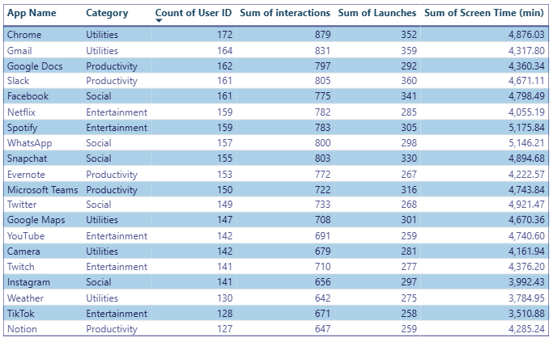
App Usage Snapshot
The data shows that while productivity apps are widely used, entertainment and social apps often dominate in total screen time, suggesting an underlying habit-forming usage pattern."

Slide 12
Conclusion
Our devices aren't the problem — our habits are.

Slide 13
What this dashboard reveals:
Most screen time is consumed passively, not productively.
Entertainment and social apps dominate user attention.
High number of launches doesn’t always mean high screen time—some apps are opened frequently for short durations.
Social apps like WhatsApp and Snapchat are both highly launched and heavily used—signaling potential digital distractions.
13

Slide 14
Conclusion
"You can’t improve what you don’t measure."
This dashboard isn’t just a data project—it’s a mirror into our modern habits. By measuring screen time and app usage behavior, we get valuable insights that can help individuals reclaim their time and make informed digital choices.
- Simple tracking can inspire real behavior change.
14

Slide 15
Thank you
Sneha Singh
snehasingh9268@gmail.com
https://www.linkedin.com/in/sneha-singh-71aa5a268/
Dashboard link: link

