Slide 1
BLUESTOCK
Mutual Fund Analytics
Capstone Project Presentation | June 2026
Rohit Moningi • Vardhan Chennamsetty • Rudra Pawar • S.N. Thakur
Notes:
Welcome. Today we present the Bluestock MF Analytics capstone — end-to-end pipeline covering 40 mutual fund schemes.

Slide 2
Problem & Objective
The Problem
Our Objective
1,900+ MF schemes with inconsistent, scattered data
No unified view linking NAV, risk & investor behaviour
Manual comparison is slow and error-prone
Build automated ETL pipeline for 10 datasets
Compute CAGR, Sharpe, VaR, Alpha/Beta for 40 funds
Deliver interactive 4-page Tableau dashboard
Risk-based fund recommendation engine
2/12

Slide 3
Data Sources
10 structured datasets — Jan 2022 to Dec 2025
Dataset | Rows | Description
Fund Master | 40 | Scheme metadata, expense ratio, risk grade
NAV History | 46,000 | Daily NAV → 64,320 after weekend ffill
AUM by Fund House | 90 | Quarterly AUM per AMC
Monthly SIP Inflows | 48 | Industry SIP inflow trend
Category Inflows | 144 | Net inflow by fund category
Investor Transactions | 32,778 | SIP / Lumpsum / Redemption records
Portfolio Holdings | 322 | Equity holdings & sector weights
Benchmark Indices | 8,050 | NIFTY 50 & NIFTY 100 daily values
Live API
mfapi.in — live NAV for 5 flagship schemes
Validates static dataset in real-time
3/12

Slide 4
Technical Architecture
Raw CSVs → ETL → SQLite → Analysis → Tableau
Extract
Transform
Load
Analyze
Visualize
10 CSVs +
Live API
Clean, ffill
validate
SQLite
star schema
5 Jupyter
notebooks
Tableau
Public
Stack:
Python (pandas, numpy, scipy) • SQLAlchemy + SQLite • matplotlib / seaborn / plotly • Tableau Public • Git + GitHub
4/12

Slide 5
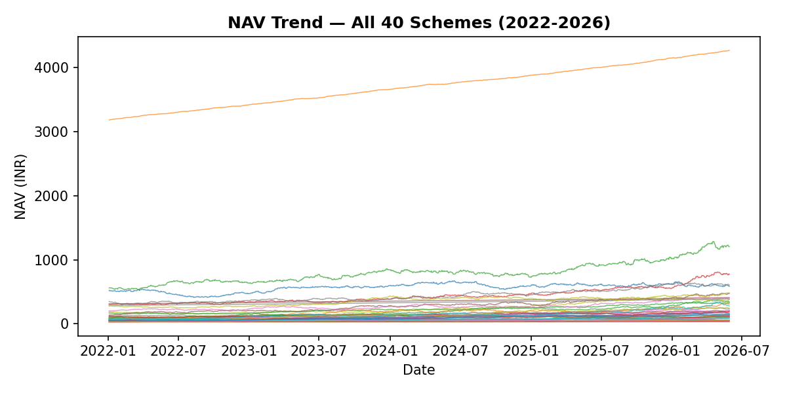
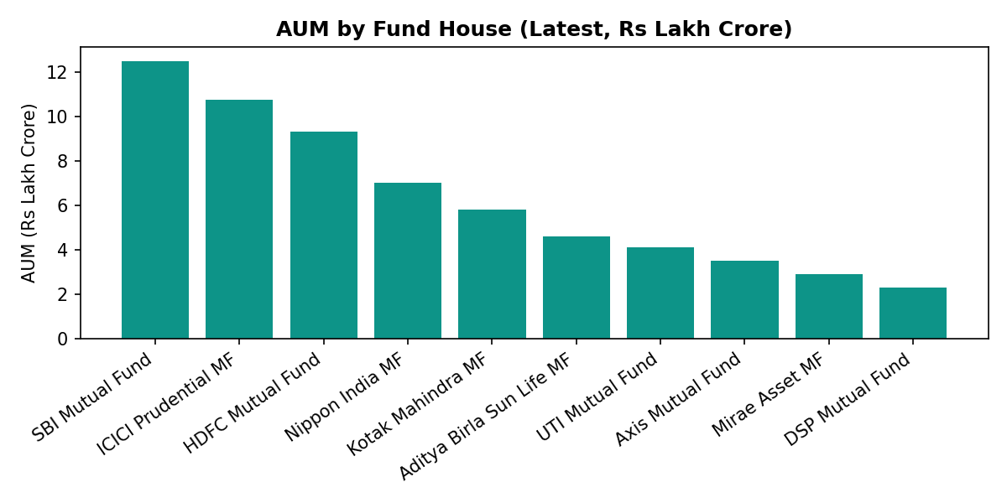
EDA Highlights: NAV & AUM Trends
2023 bull run lifted average equity NAV ~35%; 2024 correction of 12-15% visible across all schemes
SBI Mutual Fund leads at ₹12.5 lakh crore — total tracked industry AUM: ₹62.74 lakh crore
Folio count nearly doubled: 13.26 Cr (Jan 2022) → 26.12 Cr (Dec 2025)
5/12

Slide 6
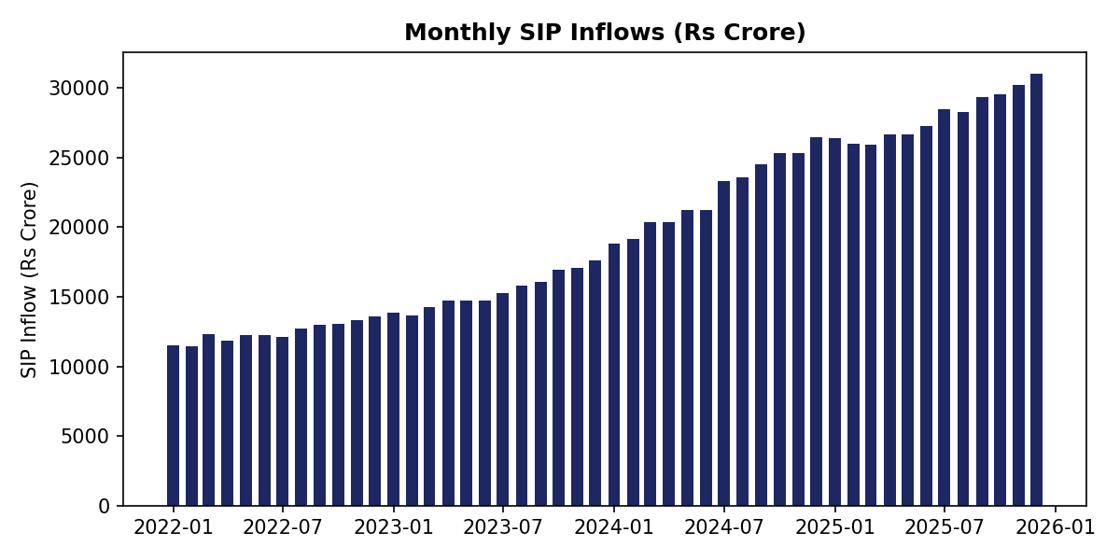
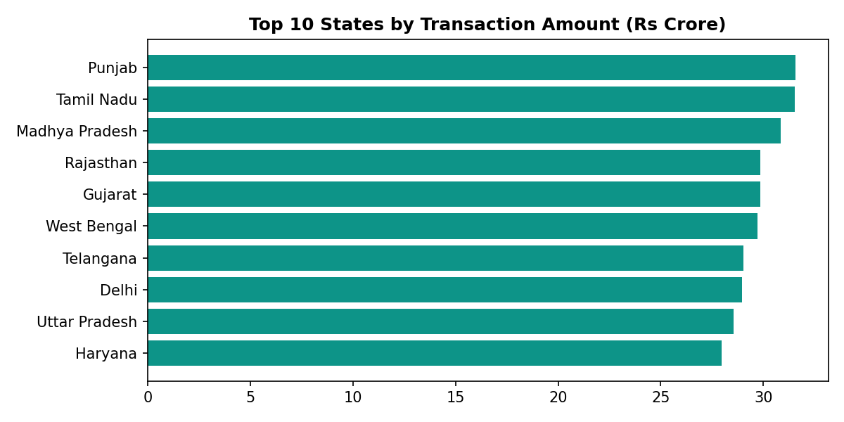
EDA Highlights: SIP Flows & Investor Geography
SIP inflows grew 169%: ₹11,517 Cr (Jan 2022) → ₹31,002 Cr all-time high (Dec 2025)
Punjab, Tamil Nadu & Madhya Pradesh lead state-wise value — participation beyond traditional metros
26-35 age group drives max SIP transactions; Direct plans save 0.5-1% TER annually vs Regular
6/12

Slide 7
Performance Metrics: Methodology
Metric | Formula
CAGR | (NAV_end/NAV_start)^(1/years) − 1 · annualised on 252 trading days
Sharpe Ratio | (Rp − Rf) / σ(Rp) × √252, Rf = 6.5%
Sortino Ratio | (Rp − Rf) / downside_σ × √252
Alpha / Beta | OLS regression vs NIFTY 100 daily returns
Max Drawdown | min(NAV / running_max − 1)
VaR 95% | 5th percentile of daily return distribution
CVaR 95% | Mean of returns below VaR threshold
Scorecard
Weights
30% — 3yr return rank
25% — Sharpe rank
20% — Alpha rank
15% — Expense (inv.)
10% — Max DD (inv.)
7/12

Slide 8
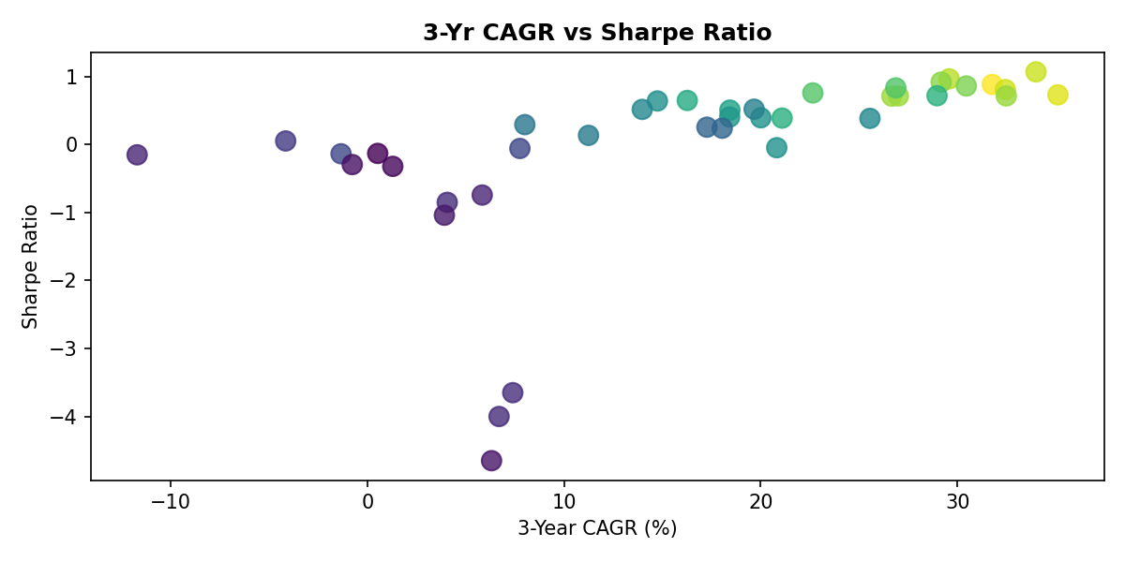
Performance Metrics: Top Funds
Scheme | 3Yr CAGR | Sharpe
ICICI Pru Midcap | 31.8% | 0.88
Axis Midcap Fund | 35.1% | 0.73
HDFC Mid-Cap Opp. | 32.4% | 0.81
Mirae Asset Large Cap | 34.0% | 1.07
Kotak Flexicap Fund | 29.6% | 0.97
ICICI Prudential Midcap Fund tops the composite scorecard at 85.1/100 — upper-right quadrant represents the best risk-adjusted performers combining high returns with high Sharpe ratio.
8/12

Slide 9
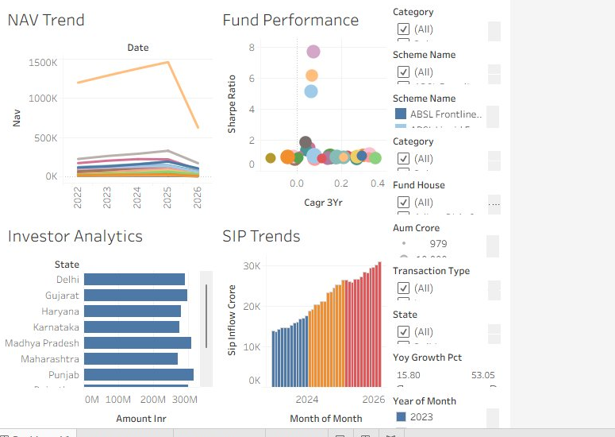
Interactive Dashboard — Live on Tableau Public
https://public.tableau.com/app/profile/sneha.thakur4375/viz/tableau_mf/Dashboard1
9/12
Notes:
This is the actual live dashboard at Tableau Public — all 4 pages visible: NAV Trend, Fund Performance, Investor Analytics, SIP Trends.

Slide 10
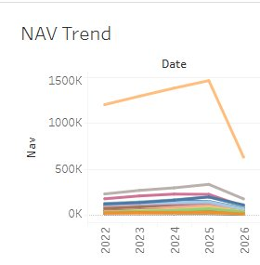
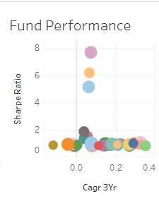
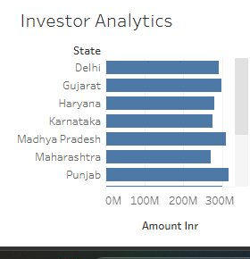
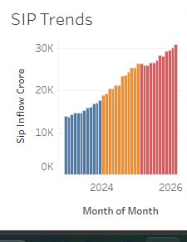
Dashboard: 4 Pages & Interactive Filters
Page 1
NAV Trend
Page 2
Fund Performance
Page 3
Investor Analytics
Page 4
SIP Trends
Multi-line: all 40 funds
2022-2026
Filters: Category, Scheme
Bubble chart: CAGR vs Sharpe
Coloured by scorecard
Filters: Fund House, Category
Bar: amount by state
Filters: State, Transaction Type
Bar: monthly SIP inflows
Filters: Month, YoY Growth
10/12

Slide 11
Key Findings
₹62.74L Cr
169%
26.12 Cr
Total industry AUM tracked
SIP inflow growth, 2022-2025
Investor folios, Dec 2025
85.1/100
2.39%
18/20
Top fund score (ICICI Pru Midcap)
Highest daily VaR — Small Cap
Tableau best-practice checks passed
11/12

Slide 12
Thank You
Questions & Discussion
GitHub: github.com/sneha-work/bluestock_mf_capstone
Dashboard: public.tableau.com/app/profile/sneha.thakur4375/viz/tableau_mf/Dashboard1
12/12

