Slide 1



Superstore US Power BI Report
By: Sneha

Slide 2

Learning Objectives
The primary goal of this project is to analyze sales data using Power BI and extract valuable insights that can drive business decisions. The key learning objectives are:
Understanding Data Visualization in Sales Analysis : Learn how to present complex sales data in an easy-to-understand format using charts, tables, and interactive dashboards. Gain skills in selecting the best visualization techniques for different types of data.
Using Power BI for Data Analysis and Business Intelligence: Learn how to import, clean, and transform raw data into a structured format. Understand how to build dynamic dashboards with real-time filters and slicers.
Exploring Regional & Product-based Sales Trends: Identify high and low-performing regions, cities, and states based on sales and profit. Analyze how different product categories perform in terms of revenue and profitability.
Evaluating Customer Segments & Shipping Performance: Identify which customer segments contribute the most to sales. Understand how different shipping modes impact total costs and delivery efficiency.
Developing Data-driven Decision-Making Skills: Learn how to derive insights from sales data to improve business strategies. Understand the role of KPIs (Key Performance Indicators) in evaluating business performance.
GOAL

Slide 3
Tools and Technology used :
In this project, several tools and technologies were used to analyze, clean, model, and visualize sales data efficiently. Below is a breakdown of the essential tools and their roles:
🔹 Power BI –
Power BI is a business intelligence and data visualization tool used to create interactive dashboards and reports. It enables users to:
✅ Import and transform large datasets
✅ Establish relationships between tables
✅ Create custom calculations using DAX (Data Analysis Expressions)
✅ Build real-time interactive dashboards
✅ Apply conditional formatting to highlight insights
🔹 Microsoft Excel / CSV Data Source – The dataset used (Superstore US-2015) is in Excel format and contains key sales-related fields.
🔹 Power Query Editor – Used for data transformation, such as handling missing values, changing data types, and creating calculated columns.
🔹 DAX (Data Analysis Expressions) – Used for writing formulas and creating custom measures like Total Sales, Profit Margin, etc.
🔹 Power BI Relationships Model – Used to establish connections between tables, enabling in-depth analysis.
Data Source: Superstore US-2015 CSV file containing 25 columns related to sales data.
Data Analysis and Visualization Tool: Microsoft Power BI
Data Transformation: Power Query Editor in Power BI
Data Modelling: Power BI Data Model for establishing relationships and creating measures.

Slide 4
Methodology:
Data Collection:
Imported the Superstore US-2015 dataset into Power BI.
Verified that the dataset contains necessary information, such as sales, profit, product details, customer segments, and shipping information.
Data Cleaning and Transformation:
Checked for missing values and inconsistent data (e.g., incorrect date formats, duplicate entries).Formatted fields properly (e.g., Order Date,
Ship Date, Region, etc.).
Created calculated columns and custom measures (e.g., Total Sales, Profit Margin, Average Unit Price).
Data Modeling and Relationships:
Established one-to-many relationships between tables (e.g., connecting "Orders" and "Products" tables using Product ID).
Ensured data integrity and optimized performance by setting appropriate cardinality in relationships.
Visualization & Dashboard Development:
Created two Power BI dashboards:
1. Sales & Profit Overview
2. Product & Customer Insights
Used bar charts, pie charts, line charts, stacked column charts, tree maps, and slicers for better data analysis.
Analysis & Insights:
Explored regional sales patterns and identified top-performing cities and states.
Evaluated customer behavior trends and identified which segments contribute the most to revenue.
Assessed the impact of discounts, shipping costs, and product categories on overall profitability.

Slide 5
Problem Statement:
While analyzing sales data, several challenges were identified. Here are the top 10 key problems faced in the dataset:
Declining Sales in Certain Regions: Some regions show decreasing sales trends over time, impacting overall revenue.
Low-Profit Margins on Certain Products: Some products generate high sales but have low profit margins, reducing profitability.
High Shipping Costs Affecting Profitability: Certain orders have high shipping costs, reducing net profits and affecting customer satisfaction.
Uneven Product Category Performance: Some product categories contribute significantly to sales, while others remain underperforming.
Unbalanced Customer Segment Contribution: Certain customer segments account for a large portion of sales, while others contribute very little.
State-wise Sales Variability: Some states drive major revenue, while others have low sales numbers.
Seasonal Variations in Sales and Profitability: Sales fluctuate month-over-month, affecting inventory planning and decision-making.
Impact of Discounts on Revenue: Some high-discounted products result in low-profit margins, leading to potential revenue losses.
Identifying Best-selling Products: Some products generate huge sales, while others remain unsold or slow-moving.
Slow Delivery Times in Some Ship Modes: Certain shipping methods take longer than expected, leading to customer dissatisfaction.

Slide 6
Solution:
Data Import and Preparation: Loaded the Superstore US-2015 CSV file into Power BI.
Performed data cleaning to address inconsistencies and missing values.
Data Transformation: Created calculated columns for metrics such as Total Sales, Total Profit, and Profit Margin.
Established relationships between tables to facilitate comprehensive analysis.
Dashboard Development:
Dashboard 1: Sales & Profit Overview
Bar Chart: Total Sales by State
Bar Chart: Total Sales by City
Pie Chart: Total Sales by Region
Pie Chart: Average Profit by Region
Bar Chart: Total Shipping Cost by Ship Mode
Bar Chart: Average Unit Price by Product Category
Line Chart: Month-wise Profit
Card Visuals: Total Sales, Total Profit Total Quantity Ordered
Slicers: Region, State, Ship Mode
Dashboard 2: Product & Customer Insights
Stacked Column Chart: Total Sales & Profit by Product Category
Funnel Chart: Total Sales by Customer Segment
Clustered Bar Chart: Total Sales by Product Name
Treemap: Total Profit by Region
Matrix: State-wise Sales per Month
Slicers: Product Category ,Customer Segment

Slide 7
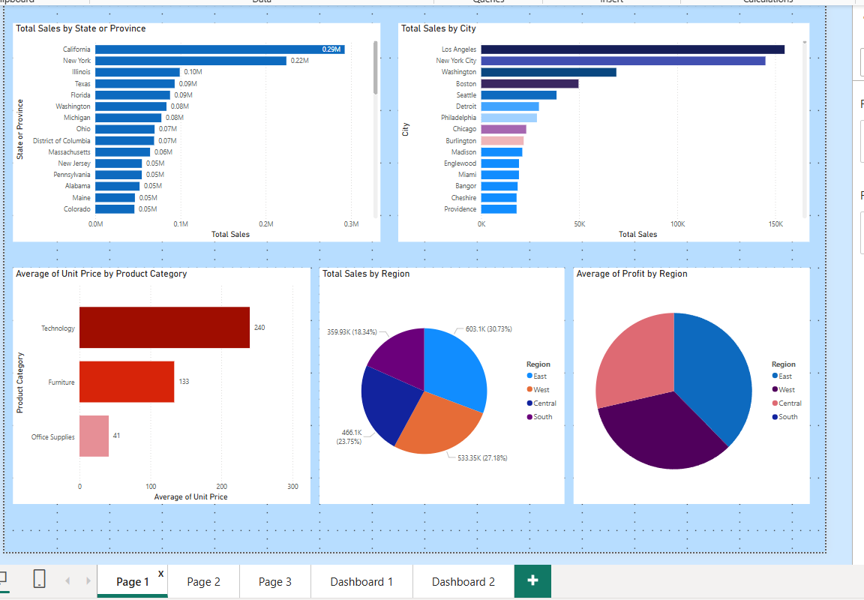
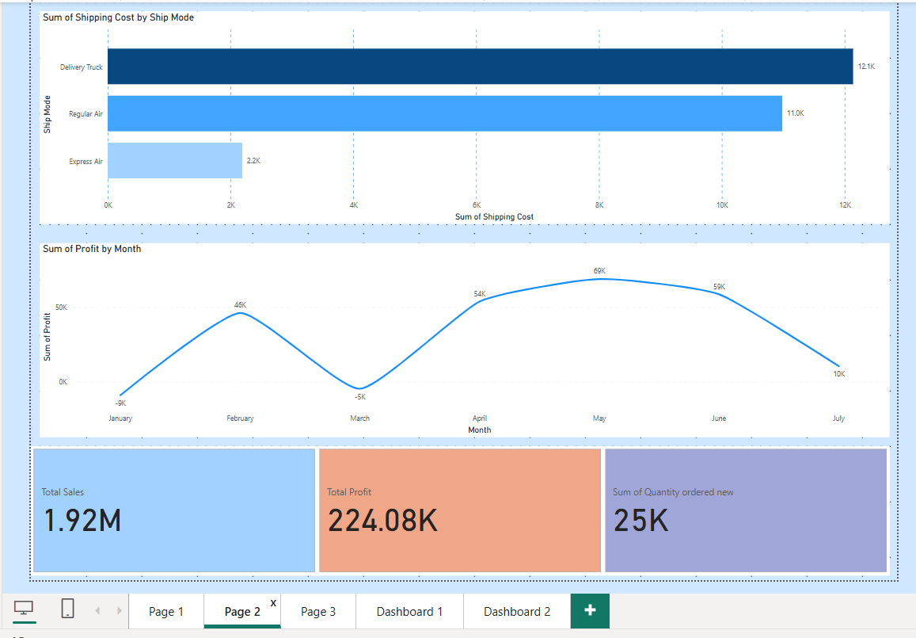
Screenshot of Output:
( Page1) (Page2)

Slide 8
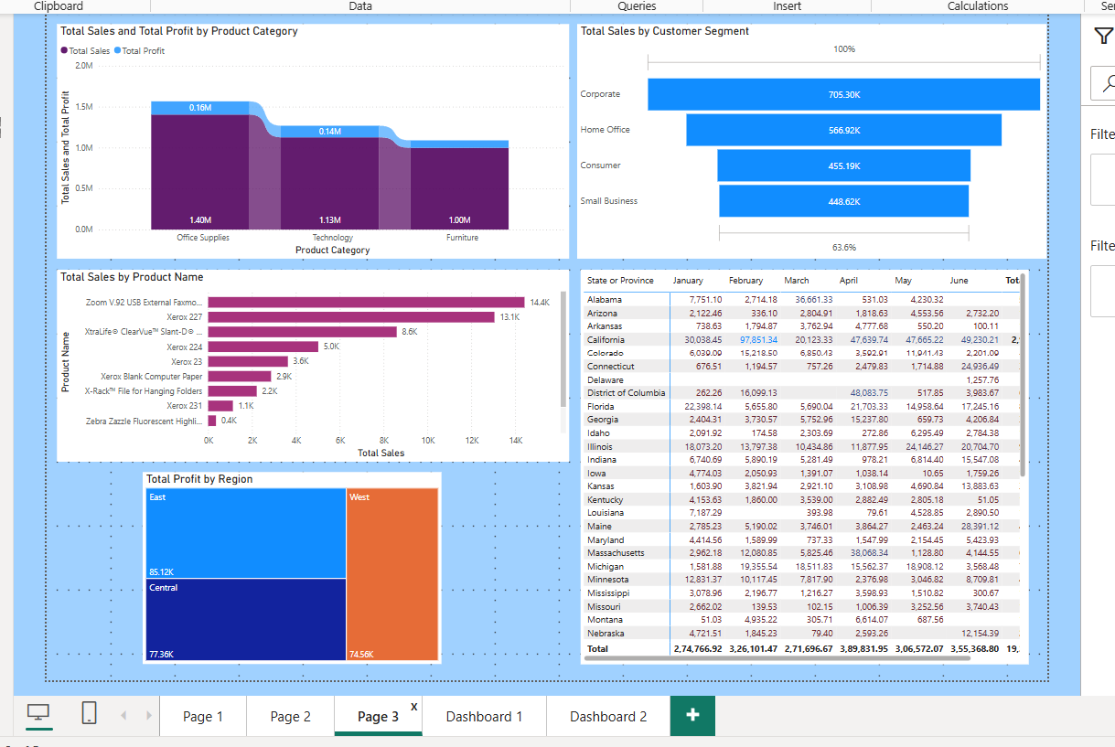
Page3:-

Slide 9
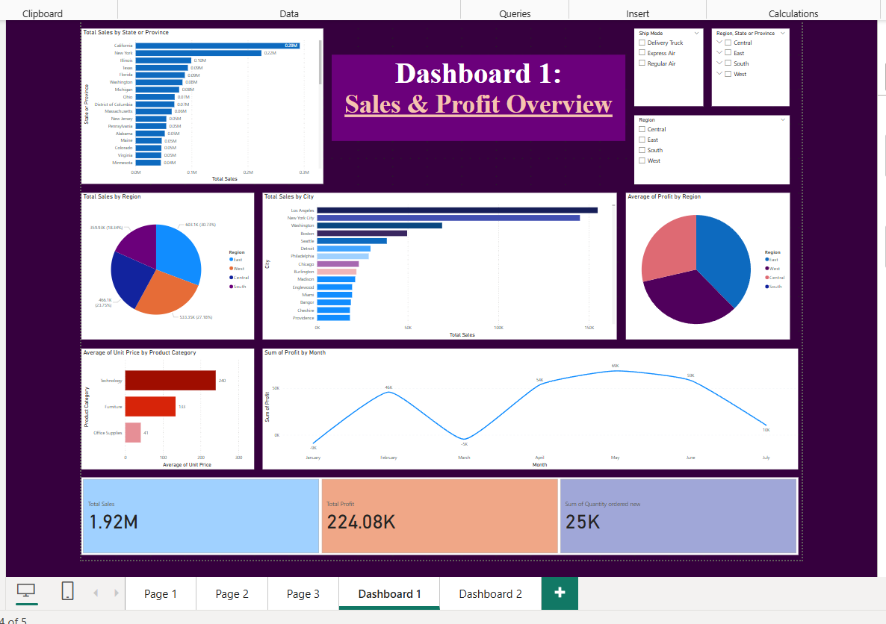
Dashboard 1:-

Slide 10
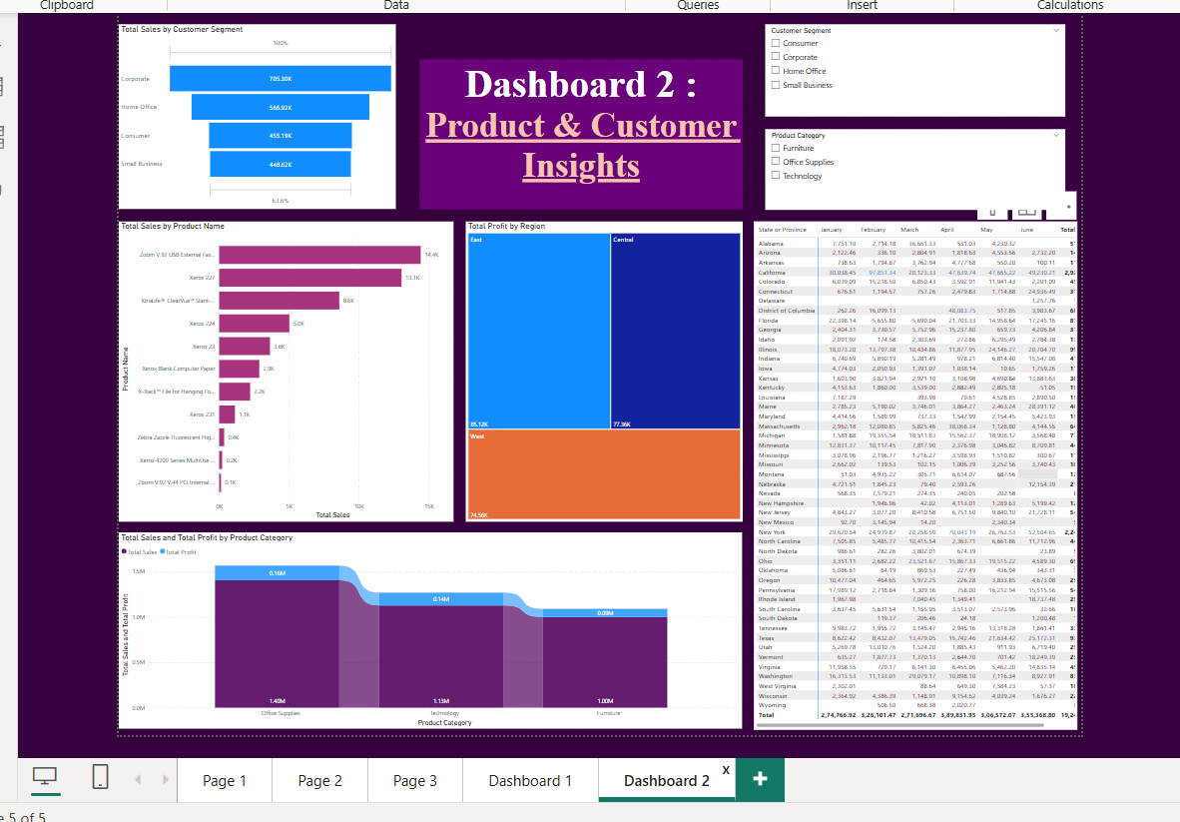
Dashboard 2:-

Slide 11
Conclusion:
In this project, we successfully harnessed the capabilities of Power BI to conduct an in-depth analysis of sales data, leading to actionable insights that can drive strategic decision-making. By creating interactive dashboards, we visualized key metrics across various dimensions such as geography, product categories, and customer segments.
Key Takeaways:
Enhanced Data Visualization: The use of diverse visualizations, including bar charts, pie charts, line charts, and treemaps, facilitated a comprehensive understanding of sales performance and trends.
Interactive Analysis: Incorporating slicers allowed for dynamic filtering, enabling stakeholders to explore data from multiple perspectives and granularities.
Data-Driven Insights: The analysis identified top-performing regions, products, and customer segments, as well as areas needing attention, such as regions with declining sales or products with lower profit margins.
Future Recommendations:
Continuous Monitoring: Regularly update the dashboards with new data to monitor ongoing performance and swiftly identify emerging trends.
Deeper Analysis: Explore additional metrics, such as customer lifetime value or sales forecasts, to gain further insights into sales dynamics.
Integration with Other Data Sources: Incorporate data from marketing campaigns, customer feedback, or market trends to enrich the analysis and provide a more holistic view.

