Slide 1
WasRuk
DOMAIN: Web development
MENTOR NAME: Pyuish Gupta Submitted By:
Satyendra singh
Aviral katiyar(2100290120134)
Suryansh Mishra(2100290120171)
Ujjwal Soni(2100290120179)
BATCH:2021-2125

Slide 2
About WasRuk
WasRuk is formed by the combination of two words, Waste and Truck whose moto is to transport the waste to the right place and does not reduce the value of waste by dumping it.
When waste is dumped in the dumping yard its value reduces as the time passes and we can’t use that waste in the future for making something useful.
WasRuk collects the segregated waste from the households and that segregated waste is again segregated into multiple categories and directly sold to the recycling industry and to the biogas plant while we make profit from that waste and try to return some of part of the revenue to each household so that they stay motivated to help us in the cause.
The moto of WasRuk is that people understand the value of waste and build a habit to segregate it into multiple categories and for their segregation WasRuk provide the certificate of appreciation from government of India and also try to return the value of their waste by our website and app.

Slide 3
PROBLEM STATEMENT
A report reveals that the Indian government imports 45 million tons of garbage every year from different countries. Not only this, but this number also increases by 4 percent every year. On the other hand, INDIA produces 65 million tons of waste every year. This waste that accumulates in such a huge quantity is of many types. One is recyclable i.e., plastic the other type being the non-biodegradable waste, and at last bio-medical such as sanitary and hazardous waste. All this waste is being dumped on free land if this continues then in the coming years every city will several numbers of these "WASTE MOUNTAIN"
In a country like India, the biggest problem is Waste Management. India is fifth – largest economy by nominal GDP in the world but still lags in waste management. India is importing around 90000 tons of scrap from other countries despite having its own very huge collection of waste that’s a big problem. The daily waste production in India ranges from about 1,00,000 metric tons. A survey conducted by a verified source states that if this amount of waste production continues like that without its proper management, then each city in India will have its own Heap of Garbage. The main problem that comes across recycling waste is the segregation of the different kinds of waste from such a huge collection. This could be solved at the primary level let us say from the houses if the people get aware of the kinds of waste and segregation is done at the time of collection of waste then this issue can be solved.
As per the data given by INDIAN AGRO & RECYCLED PAPER MILLS ASSOCIATION India imports 60% of its total required raw paper from outside India. Our proposed solution of segregation of waste will help India in making itself ATMANIRBHAR in the field of Paper management.

Slide 4
RESEARCH OBJECTIVES
As per the data given by INDIAN AGRO & RECYCLED PAPER MILLS ASSOCIATION India imports 60% of its total required raw paper from outside India.
A report reveals that the Indian government imports 45 million tons of garbage every year from different countries. Not only this, but this number also increases by 4 percent every year.
Javadekar pointed out that 43 millions tonnes of solid waste are collected annually , out of which 11.9 million (22-28%) are treated and 31 million (72-78%) are dumped at landfill sites . If garbage is dumped at the current rate without any treatment 1,240 hectares of land will be required in the landfill area per year.

Slide 5
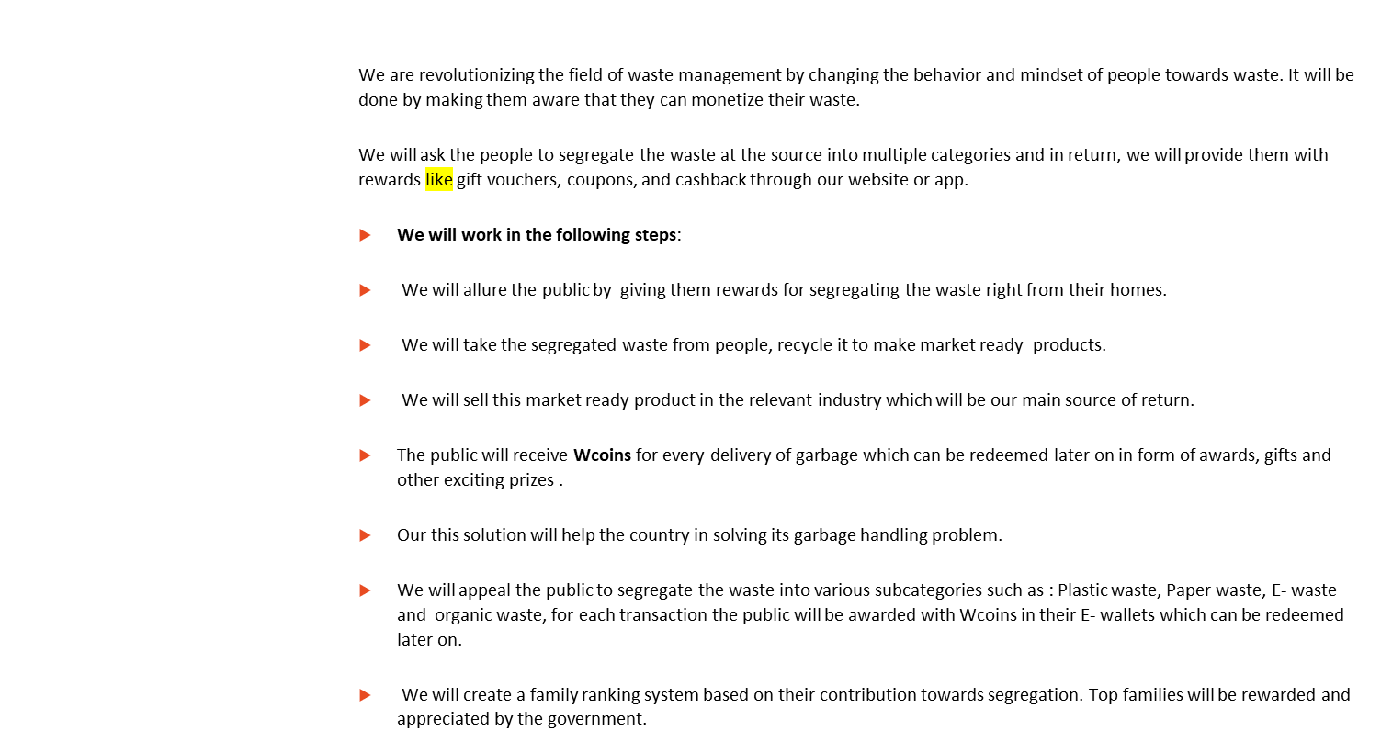
METHODOLOGY

Slide 6
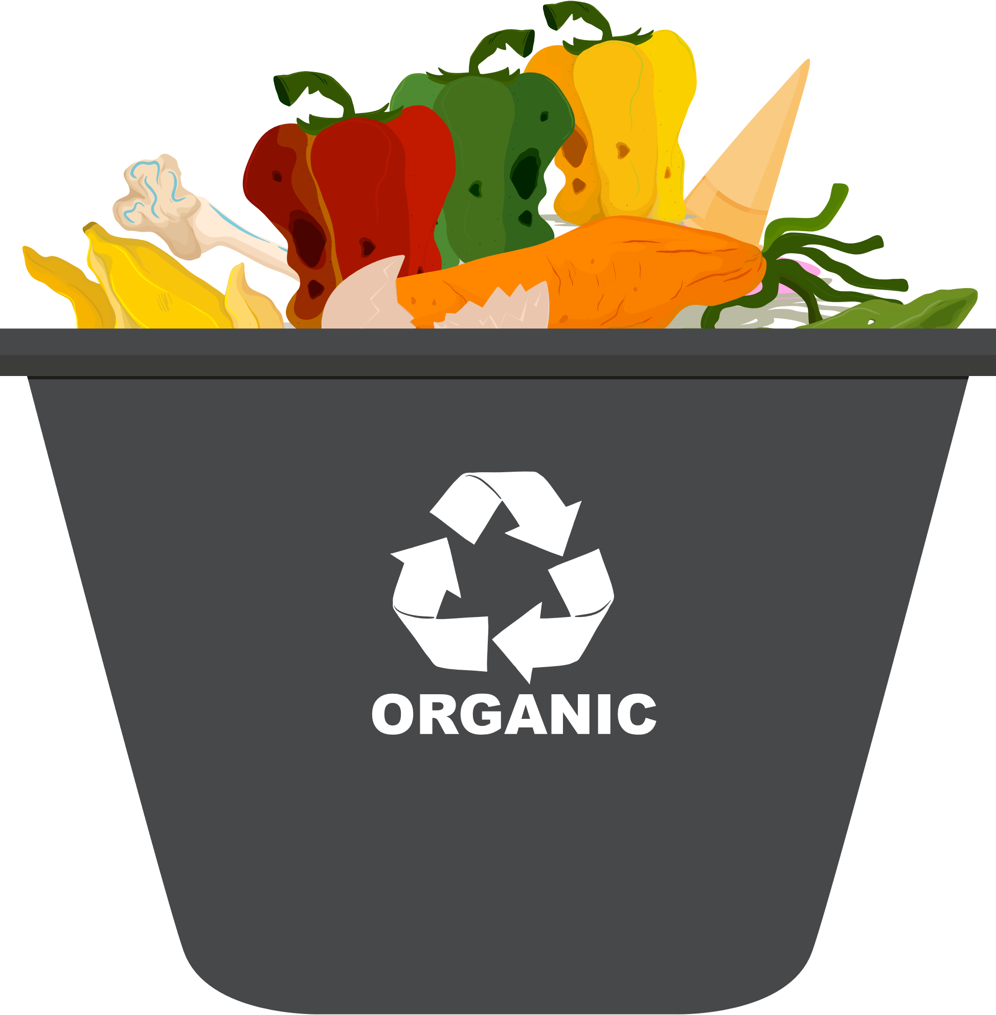
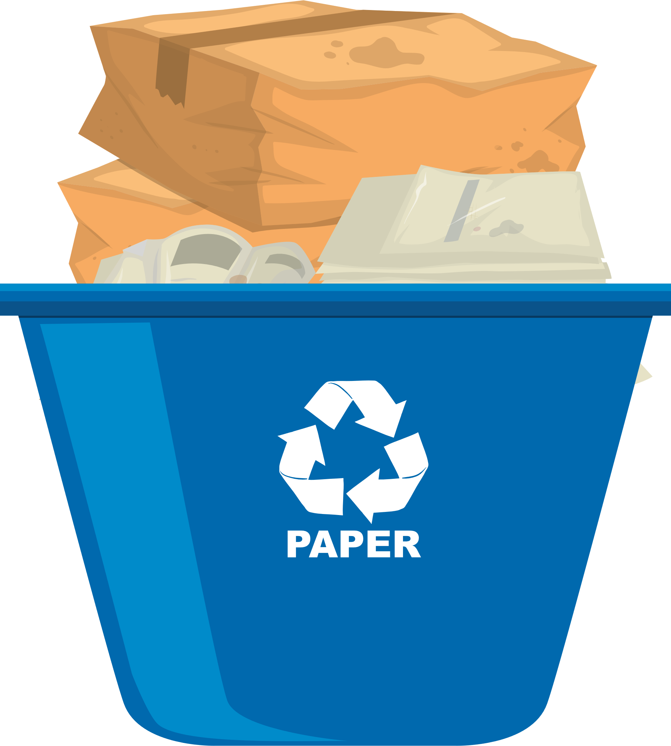


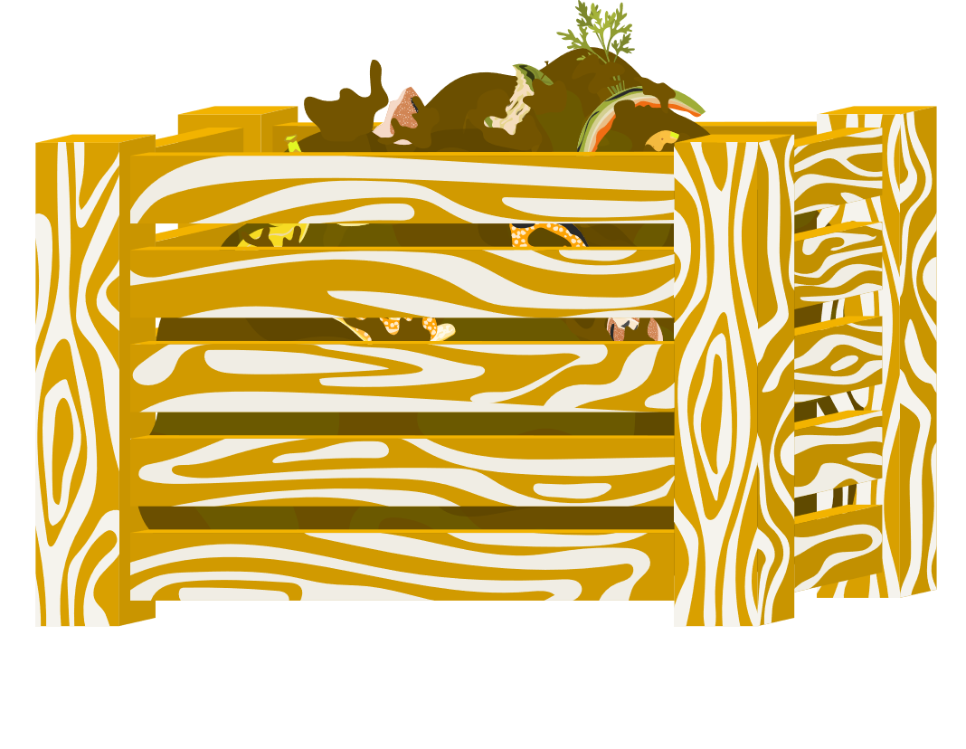
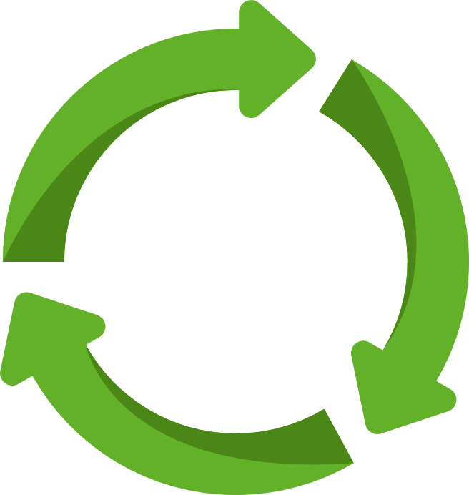
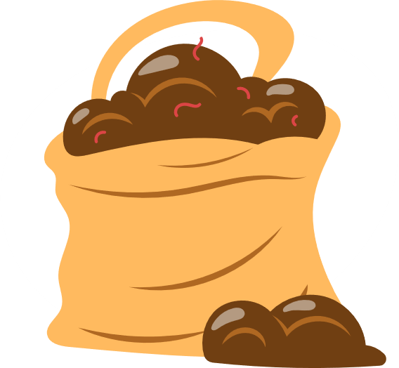


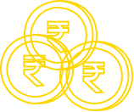

USE CASE DIAGRAM
Organic Waste
Paper Waste
Vermicompost
Biogas
Recycle
Manure
Electricity
Profit
Public
Profit

Slide 7
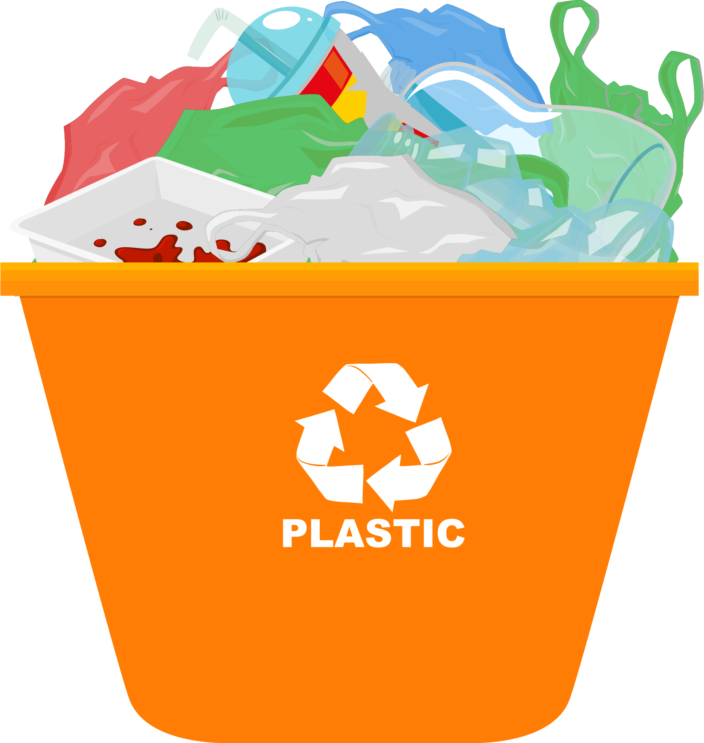
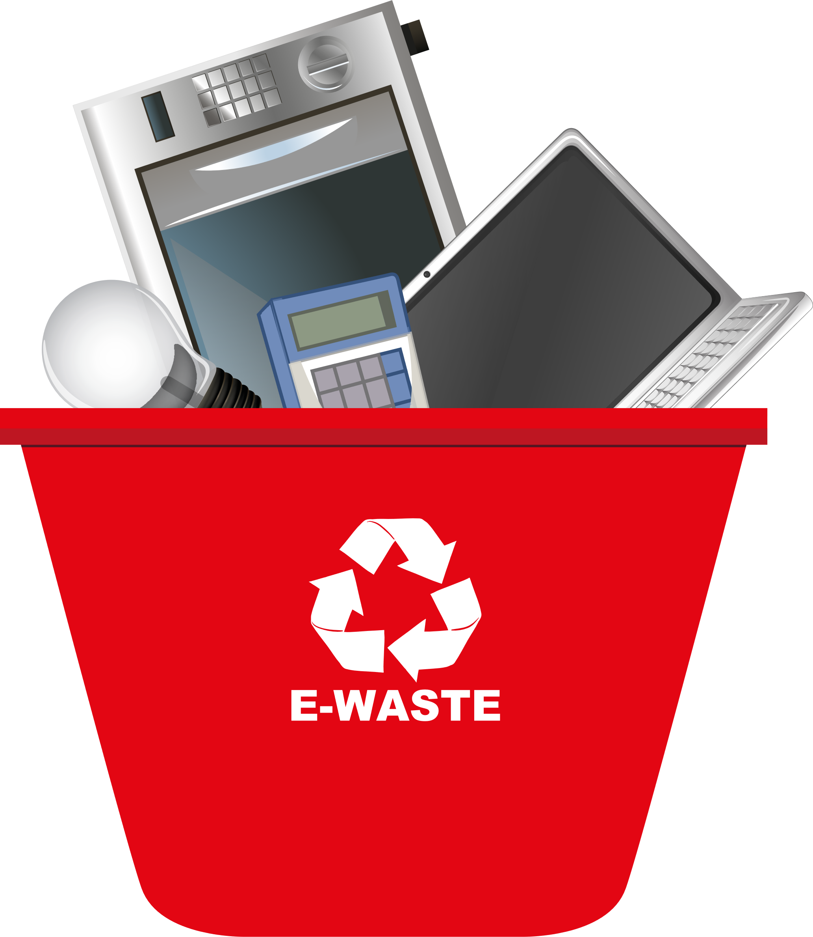
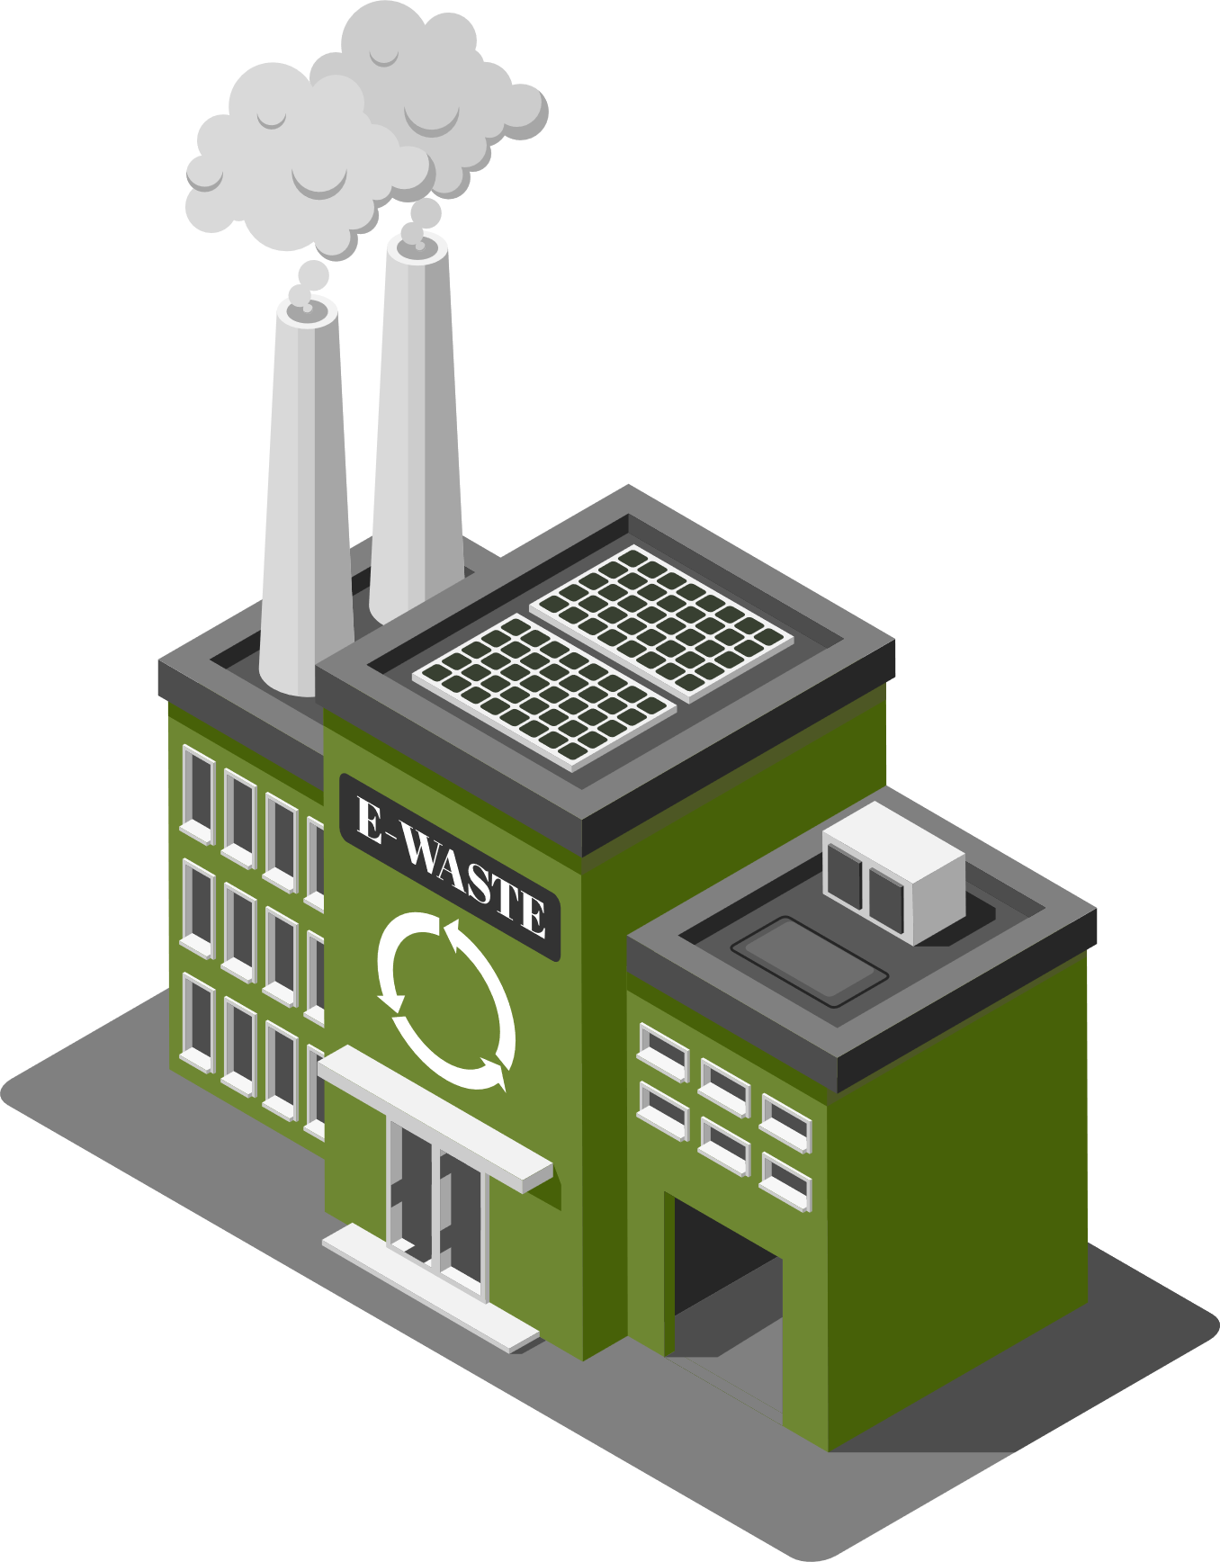
USE CASE DIAGRAM
Plastic waste
E-waste
Recycle
E-waste Industries
Profit
Profit
Public

Slide 8
Tech Stack used
FRONT-END | HTML, CSS, JavaScript,React
FRAMEWORK/LIBRARY | Font Awesome, Google Font, Bootstrap
BACKEND | Python, Django, Machine Learning some other python library
TEXT EDITOR | Visual Studio Code
DATABASE | SQLite3

Slide 9
THANK YOU

