Slide 1
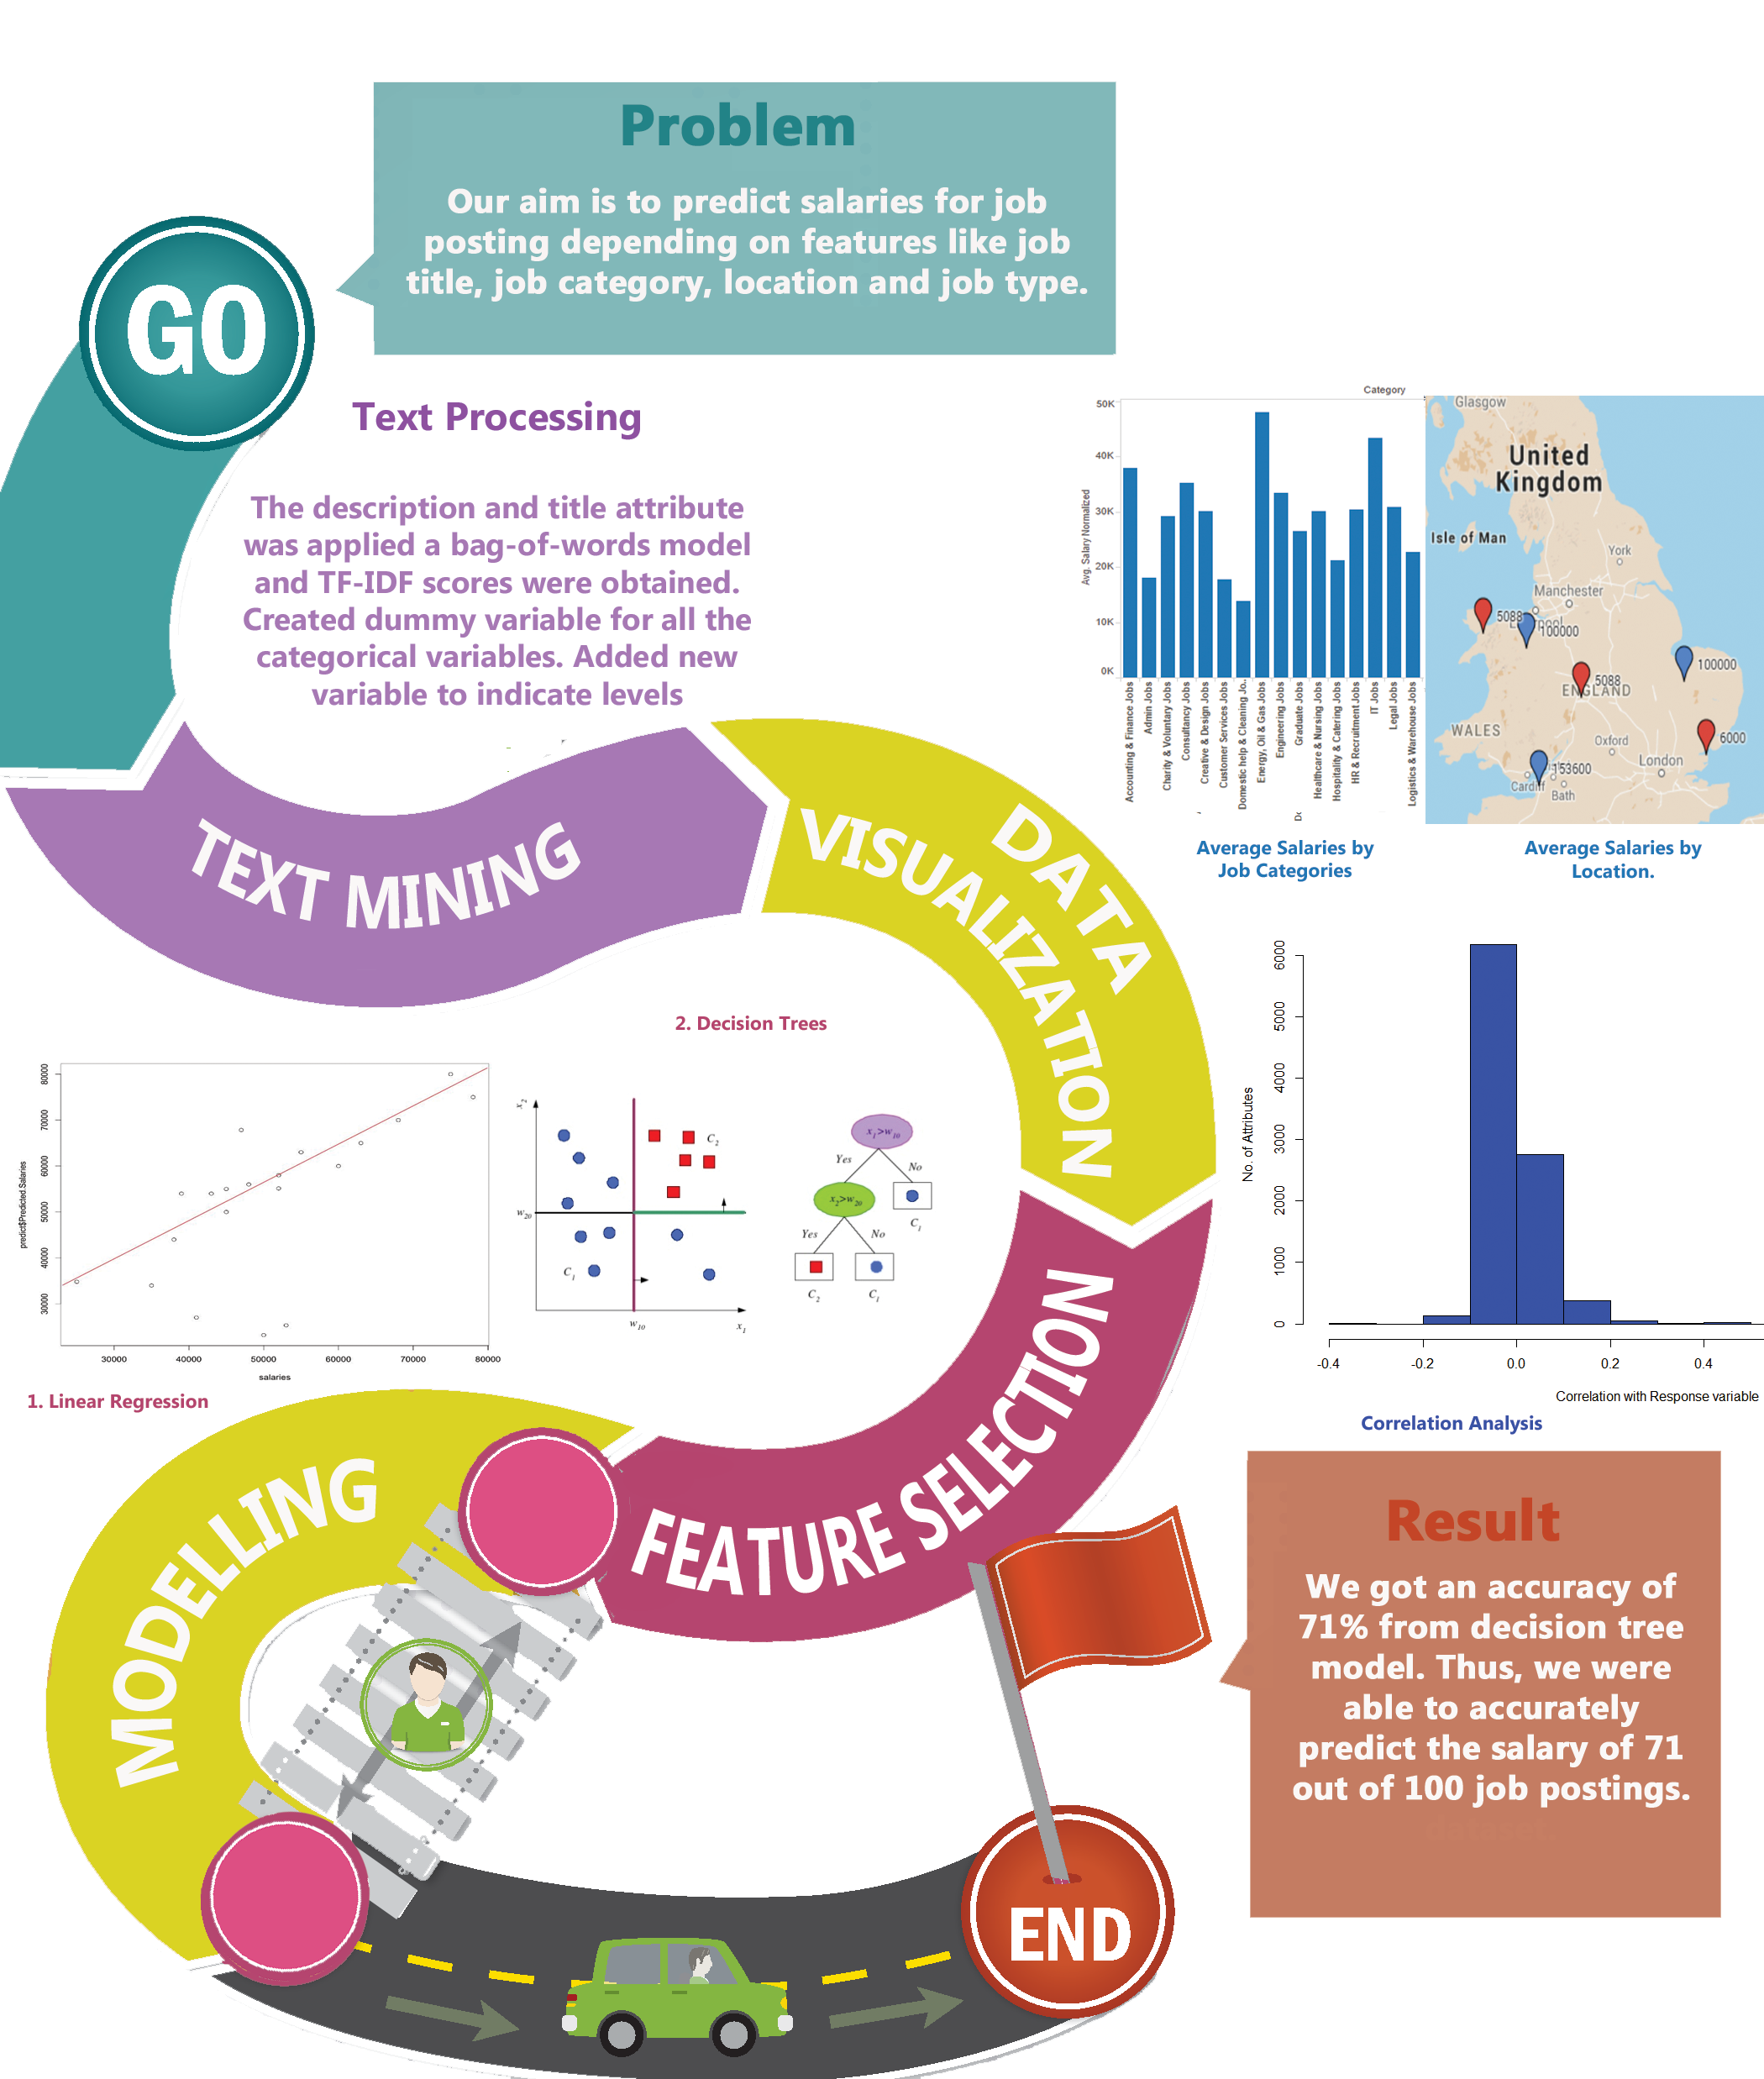
PREDICTING SALARIES FROM JOB POSTINGS

