Slide 1


MINIPROJECT on HOSPITAL MANGEMENT SYSTEM by
Sreekanth(17121a1234)
Malli(17121a1235)
Vamsi(17121a1236)
Lakshmi(17121a1237)
Sainath(17121a1238)
Sneha(17121a1239)
DEPT OF
INFORMATION TECHNOLOGY

Slide 2
Table of content
S.No CONTENT PAGE.NO 1 Abstract 1
2 Introduction 2
3 Analysis 3-9
4 Design 10-11
5 Roles 12
6 References 13
7 Hardware and software components 14
8 Results 15
9 Conclusion 16

Slide 3
ABSTRACT
Hospital Management System is a user friendly application
for hospital which reduces the burden and helps to manage
all sessions of hospital like reception,patient details,billing
etc., which improve the processing efficiency.

Slide 4
INTRODUCTION
HOSPITAL MANAGEMENT SYSTEM want healthy life and do a lot to get it.we exercise and eat healthy foods so that our body is free from fats and stays healthy.if the body is not functioning properly we go to the doctor and provide solution.The services provided are patient record management and bed management,inpatient management,medical management,outpatient management.this mini project comes under public sector.the uses of this mini project are easy acces to patient data,cost effective,improved efficiency,reduce scope of error,improved patient care,improved data security&retrive-ability,better revenue management.

Slide 5
ANALYSIS
The MINIPROJECT will be consisting of 4 modules
Reception
Administration
Billing
Registration.

Slide 6
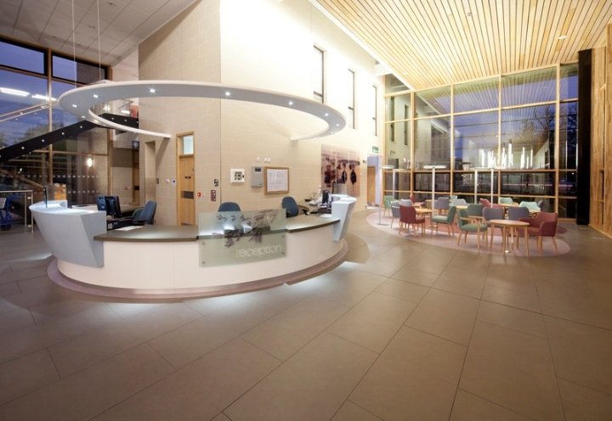
Reception
Objectives:
Patient's details
Doctor's details
Operatons:
Adding patients record
Deleting patients record
Concepts:
structures,functions,loops,files.
Fig:1.1

Slide 7

Administration
Objectives:
patient detail recording
doctor type.
Operations:
registration for doctor
doctor details display
Concepts:
strucutures,functions,files,loops.
fig:1.2

Slide 8
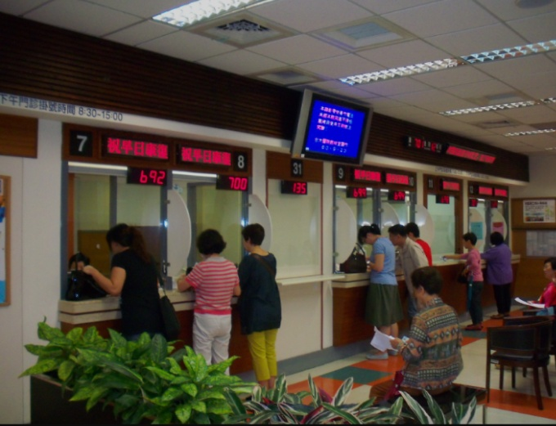
Billing
Objectives:
Patient details diplay
Doctor's details display.
Operations
Billing
Concepts:
Structures,functions,looops,files.
Fig:1.3

Slide 9

Registration
Objectives:
Unique ID
IPP and OPD patient's query.
Operations:
Billing
Patient details display.
Concepts:
Strucutres,functions,loops,files.
Fig:1.4

Slide 10
Design
start
Registration,PD
new patient
create new PD
N
1
N
Y
create new username and pass
create new blank record
Doctor stations
Login PID

Slide 11
N
1
Require
Test
Financial stations
N
N Y
N
Y
Y
N
Medicine
Medical test stations
Login
PID
Phamacy stations
check
financial
Medical tests
insert
login
patients
Hospitals
and others
Database servers
End

Slide 12
Hardware and Software components required
Minimum Hardware Requirements:
Processor: intel(R) Pentiumn(R)CPU B96ob@2.20GHz
System Type:64-bit operating system
Minimum Software Requirements:
Ubuntu

Slide 13

Results
This system is very simple in design and to implement. This systemrequires very low system resources.
security of data
minimize manual data entry
user friendly and interactive
minimum time required
security of data....

Slide 14
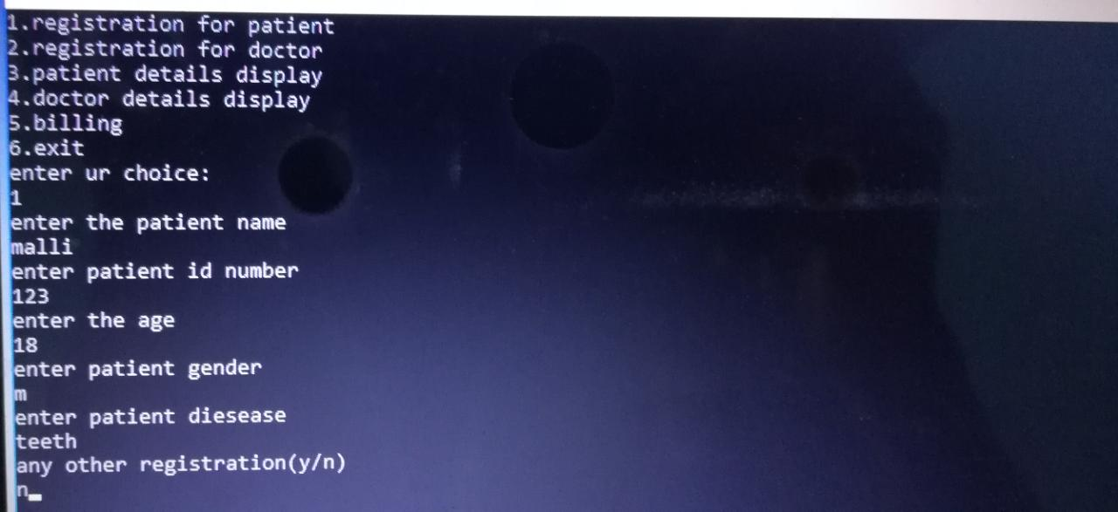
Patient details Entering
FIG 1.5: ENTERING PATIENT DETAILS

Slide 15
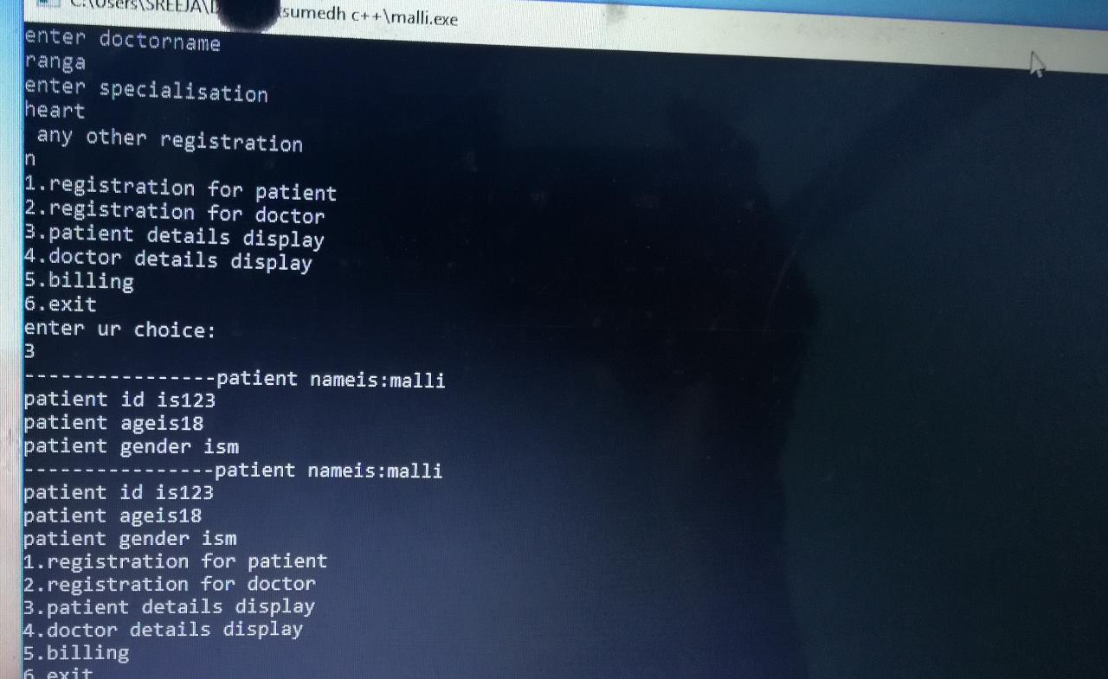
patient details Display
FIG 1.6:DISPLAY PATIENT DETAILS

Slide 16
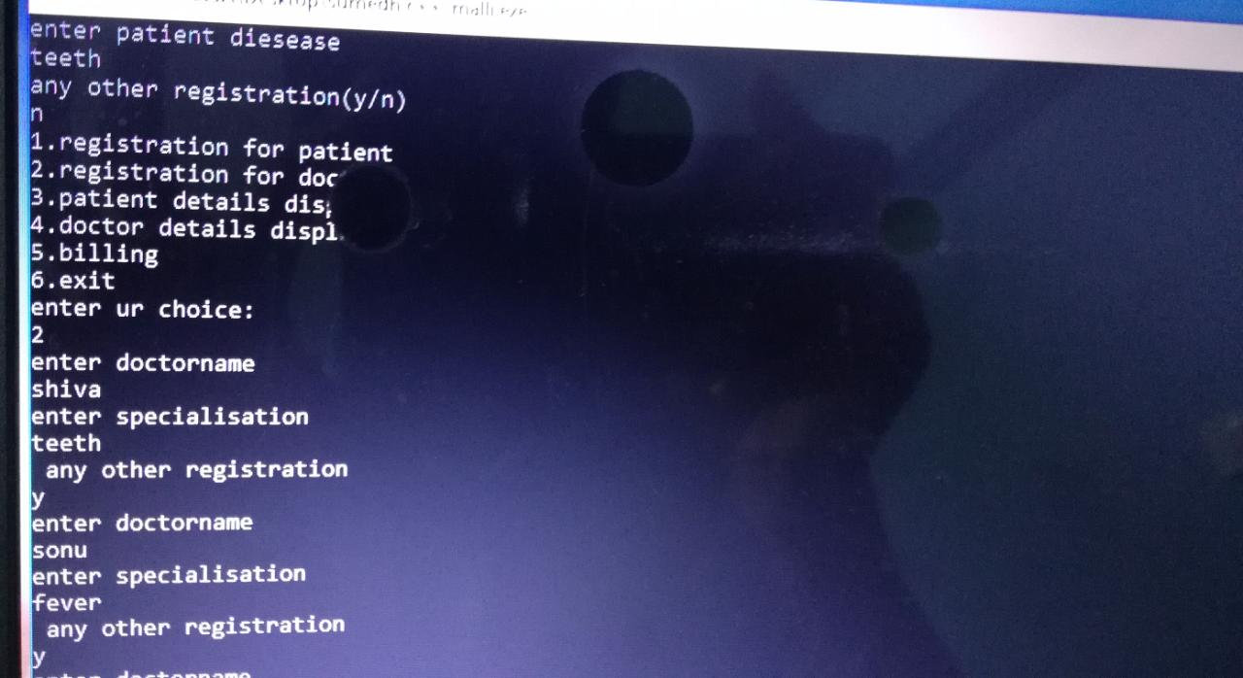
Doctors details Entering
FIG 1.7:ENTERING DOCTER DETAILS

Slide 17
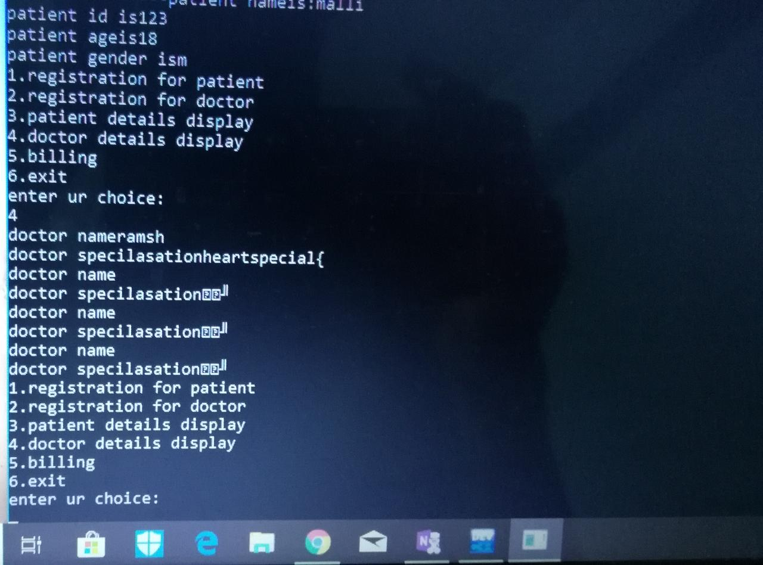
Doctors details Display
FIG 1.8:DISPLAY PATIENT DETAILS

Slide 18
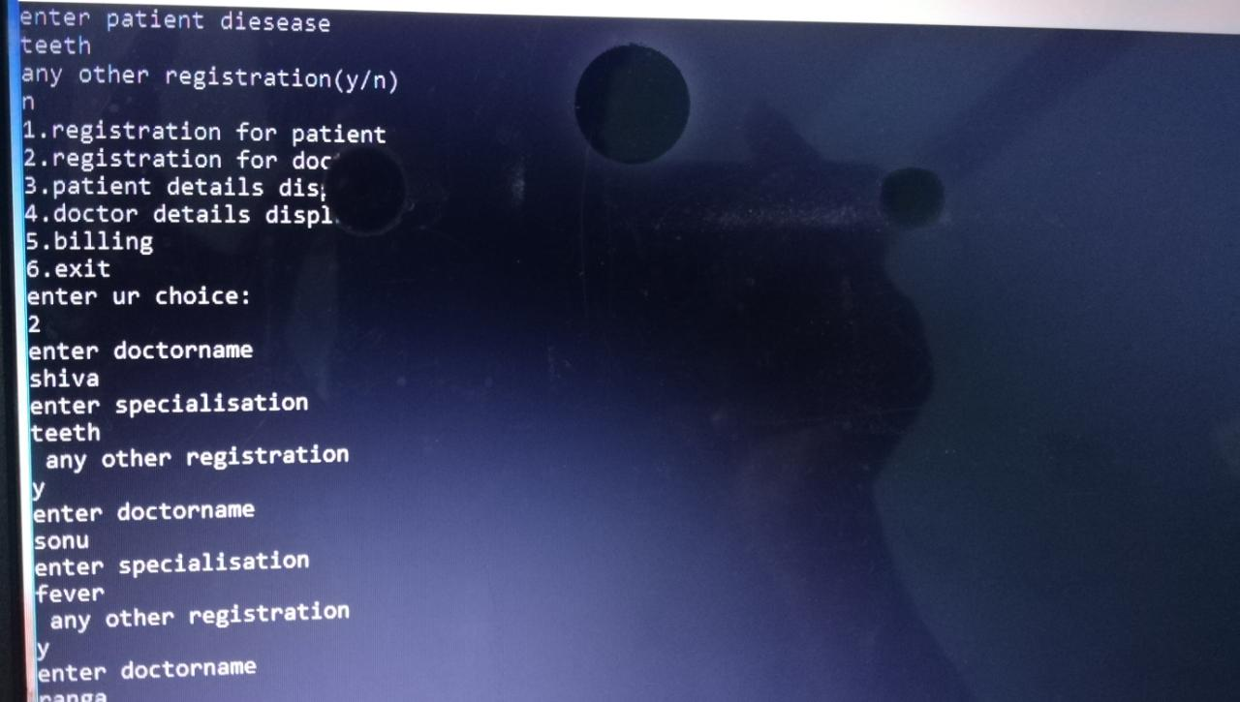
Exit
FIG1.9:EXIT

Slide 19
References
Richard Petersen,linux: The Complete Reference, Tata McGraw-Hill,Sixth Edition,2007.
E.Balagurusamy,”programming in c”,seventh edition, Mc Graw Hill Education(india)Pvt,Ltd,New Delhi,2014.
abstract”https://www.google.co.in/search?q=mini+project+on+hospital+management&oq=mini+project+on+hospital+management&aqs=chrome..69i57.18450j0j7&sourceid=chrome&ie=UTF-8” drafted on 05-10-2018 at 12:00 am.

Slide 20
ROLES
17121A1234: Coding for module 1 and 2
17121A1235: Coding for module 3
17121A1236: Coding for module 4
17121A1237: Coding for module 4 and documentation
17121A1238: Desiging of PPT and presentation
17121A1239: Testing of the code 1

Slide 21

Conclusion
Existing system refers to the system that is being followed till now .presently all hospital functionlaties are done manually the main disadvantageis time consuming.To make this situationeasier the better technology has to be
implemented.This may be the one.....

Slide 22


