Slide 1
Bank Transaction Classification - Task
Mar 8, 2021

Slide 2
Problem Statement
Classify the bank transactions into accounting categories by using the transaction descriptions.

Slide 3
Available Data Sets
2 data sets (.csv files) were provided:
1. bank_transaction_features.csv
2. bank_transaction_labels.csv
“bank_transaction_features.csv” contains data bank_transaction_id, bank_transaction_description, bank_transaction_type, bank_transaction_amount having 12500rows and 4 columns.
“Bank_transaction_labels.csv” contains data bank_transaction_id, bank_transaction_category, bank_transaction_type, bank_transaction_dataset having 12500 rows and 3 columns.

Slide 4
Approach
Importing Data
Imported all required libraries and datasets into Ipython notebook.
Data Preparation
Data Integration
Merged two datasets on unique identifier bank_transaction_id and formed as a single dataset. Analyzed the dataset by checking number of features, datapoints, feature names and it contains any null values.
Data Cleaning
Bank_transaction_description contains 1.04% of Null values, since this value is comparatively less so the null values have been dropped.
In this data set, the bank_transaction_description is Independent variable and bank_transaction_category is dependent variable. A dataframe has been created which contains Independent variable and remaining columns were dropped.

Slide 5
Approach contd..
Text Pre-processing
Following text pre-processing techniques have been performed to clean the text:
converting text into lowercase
removing stop words,
Removing punctuations
stemming using PorterStemmer

Slide 6
EDA
Later EDA has been performed for better understanding of the data as well as comparing training and validation datasets using Bar and Stacked bar plots.

Slide 7
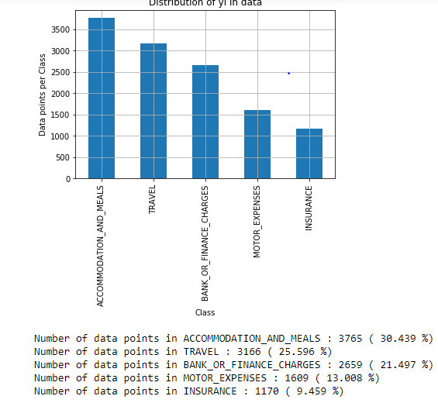
EDA Findings
By visualizing Bar plot on bank_transaction_category it can be observed that top three majority classes are Accommodation and Meals(30.439%), Travel (25.596%) and Bank or Finance charges(21.497%).
While the minority classes are Motor expenses(13.008%) and Insurance(9.459%).
Based on this plot, it can be deducted that the dataset is some what imbalanced.

Slide 8
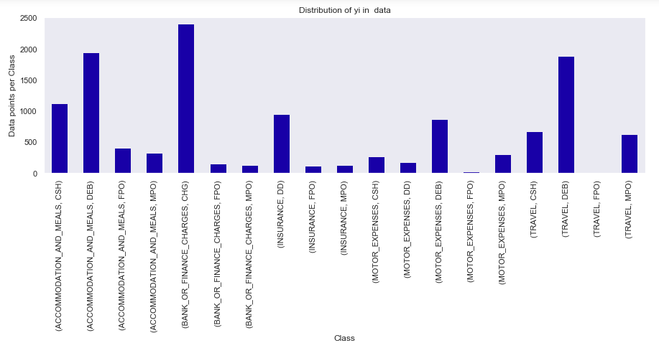
EDA Findings contd…
Based on this plot, it can be said that most of the customers do Debit card transactions for Accommodation and Meals and Travel. Some customers do pay through cash for Accommodation and Meals.
Most of the Insurance transactions are done through Demand Draft.
Majority of the class is CHG where bank charges customers for the transactions.

Slide 9
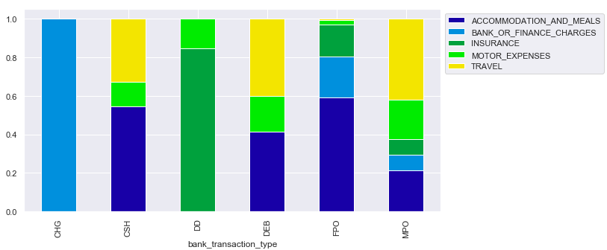
EDA Findings contd…
StackedBar plot on bank_transaction_type, shows that the majority class with 100% is CHG category of Bank or Finance Charges, 59% of FPO(Faster Payment) transactions comes under category of Accomdation and Meals, 85% of DD(Demand Draft) comes under Insurance, 42% of MPO(Mobile Payment) comes under Travel, 18% of DEB(Debit card) and MPO fall under Motor Expenses.

Slide 10
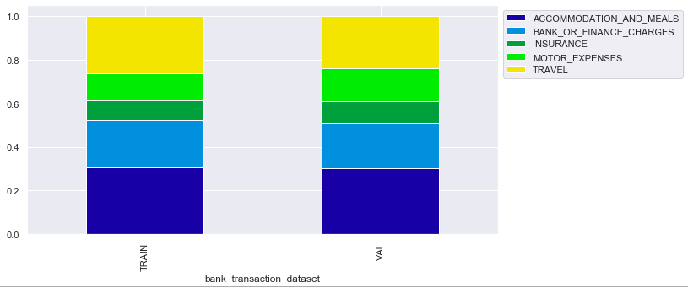
EDA Findings contd…
Comparing Train and Val datasets on StackedBar plots, very little difference has been observed only for Accommodation and meals and Motor expenses.

Slide 11
Model Details
Data has been split into Train and Val as provided. The training dataset contains 9891 rows and Val contains 2478 rows.
Feature Engineering
Implemented TfidfVectorizer on both train and val.
Building a Model
2 algorithms have been used to build the model:
MultiNomialLogistic Regression
MutinomialNaive Bayes

Slide 12
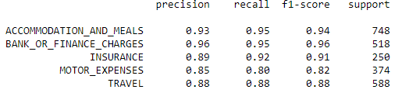
Model Details contd…
Model Evaluation
MultiNomialLogistic Regression performed well with a test accuracy of 92.5%
MultinomialNaive Bayes has given 91% test accuracy
For performance metrics, the following have been applied :
Confusion matrix
Precision, Recall and F1 score (Values for MultiNomialLogistic Regression below)

Slide 13
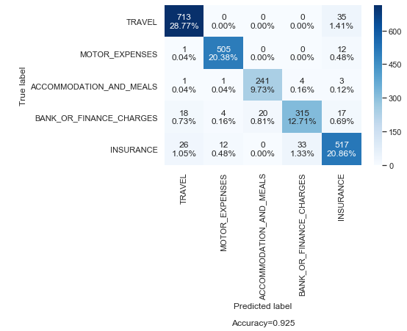
Model Misclassification
The model has misclassified for the following categories:
The true value (0.81%) of Bank_Or_Finance_Charges is being predicted as Accommodation_And_Meals
True value (1.33%) of Insurance is being predicted as Bank_Or_Finance_Charges
And Travel (1.41%) is being predicted as Insurance.

Slide 14
Summary
Classification of Bank transactions into different accounting categories has been performed on the given datasets
Upon EDA analysis, top three majority classes were found to be Accommodation and Meals(30.439%), Travel (25.596%) and Bank or Finance charges(21.497%)
2 algorithms have been used to build the model:
MultiNomialLogistic Regression performed well with a test accuracy of 92.5%
MutinomialNaive Bayes had a test accuracy of 91%
Model mis-classification has been assessed using Confusion matrix

Slide 15
Some Suggestions for Improvements in existing model
As mentioned earlier, the dataset is some what imbalanced, so data resampling techniques might help.
Implementing Deep Learning algorithms might help in better prediction
Business Recommendation
Based on EDA analysis, majority of Accommodation and Meals as well as Travel transactions are done using Debit cards. Incase, the objective is to increase bank revenue, providing more offers on Accommodation and Meals and Travel will be beneficial, while this would also increase the bank transaction charges CHG thereby increasing the revenue of the bank.

