Slide 1
Understanding Data through Visualisation

Slide 2
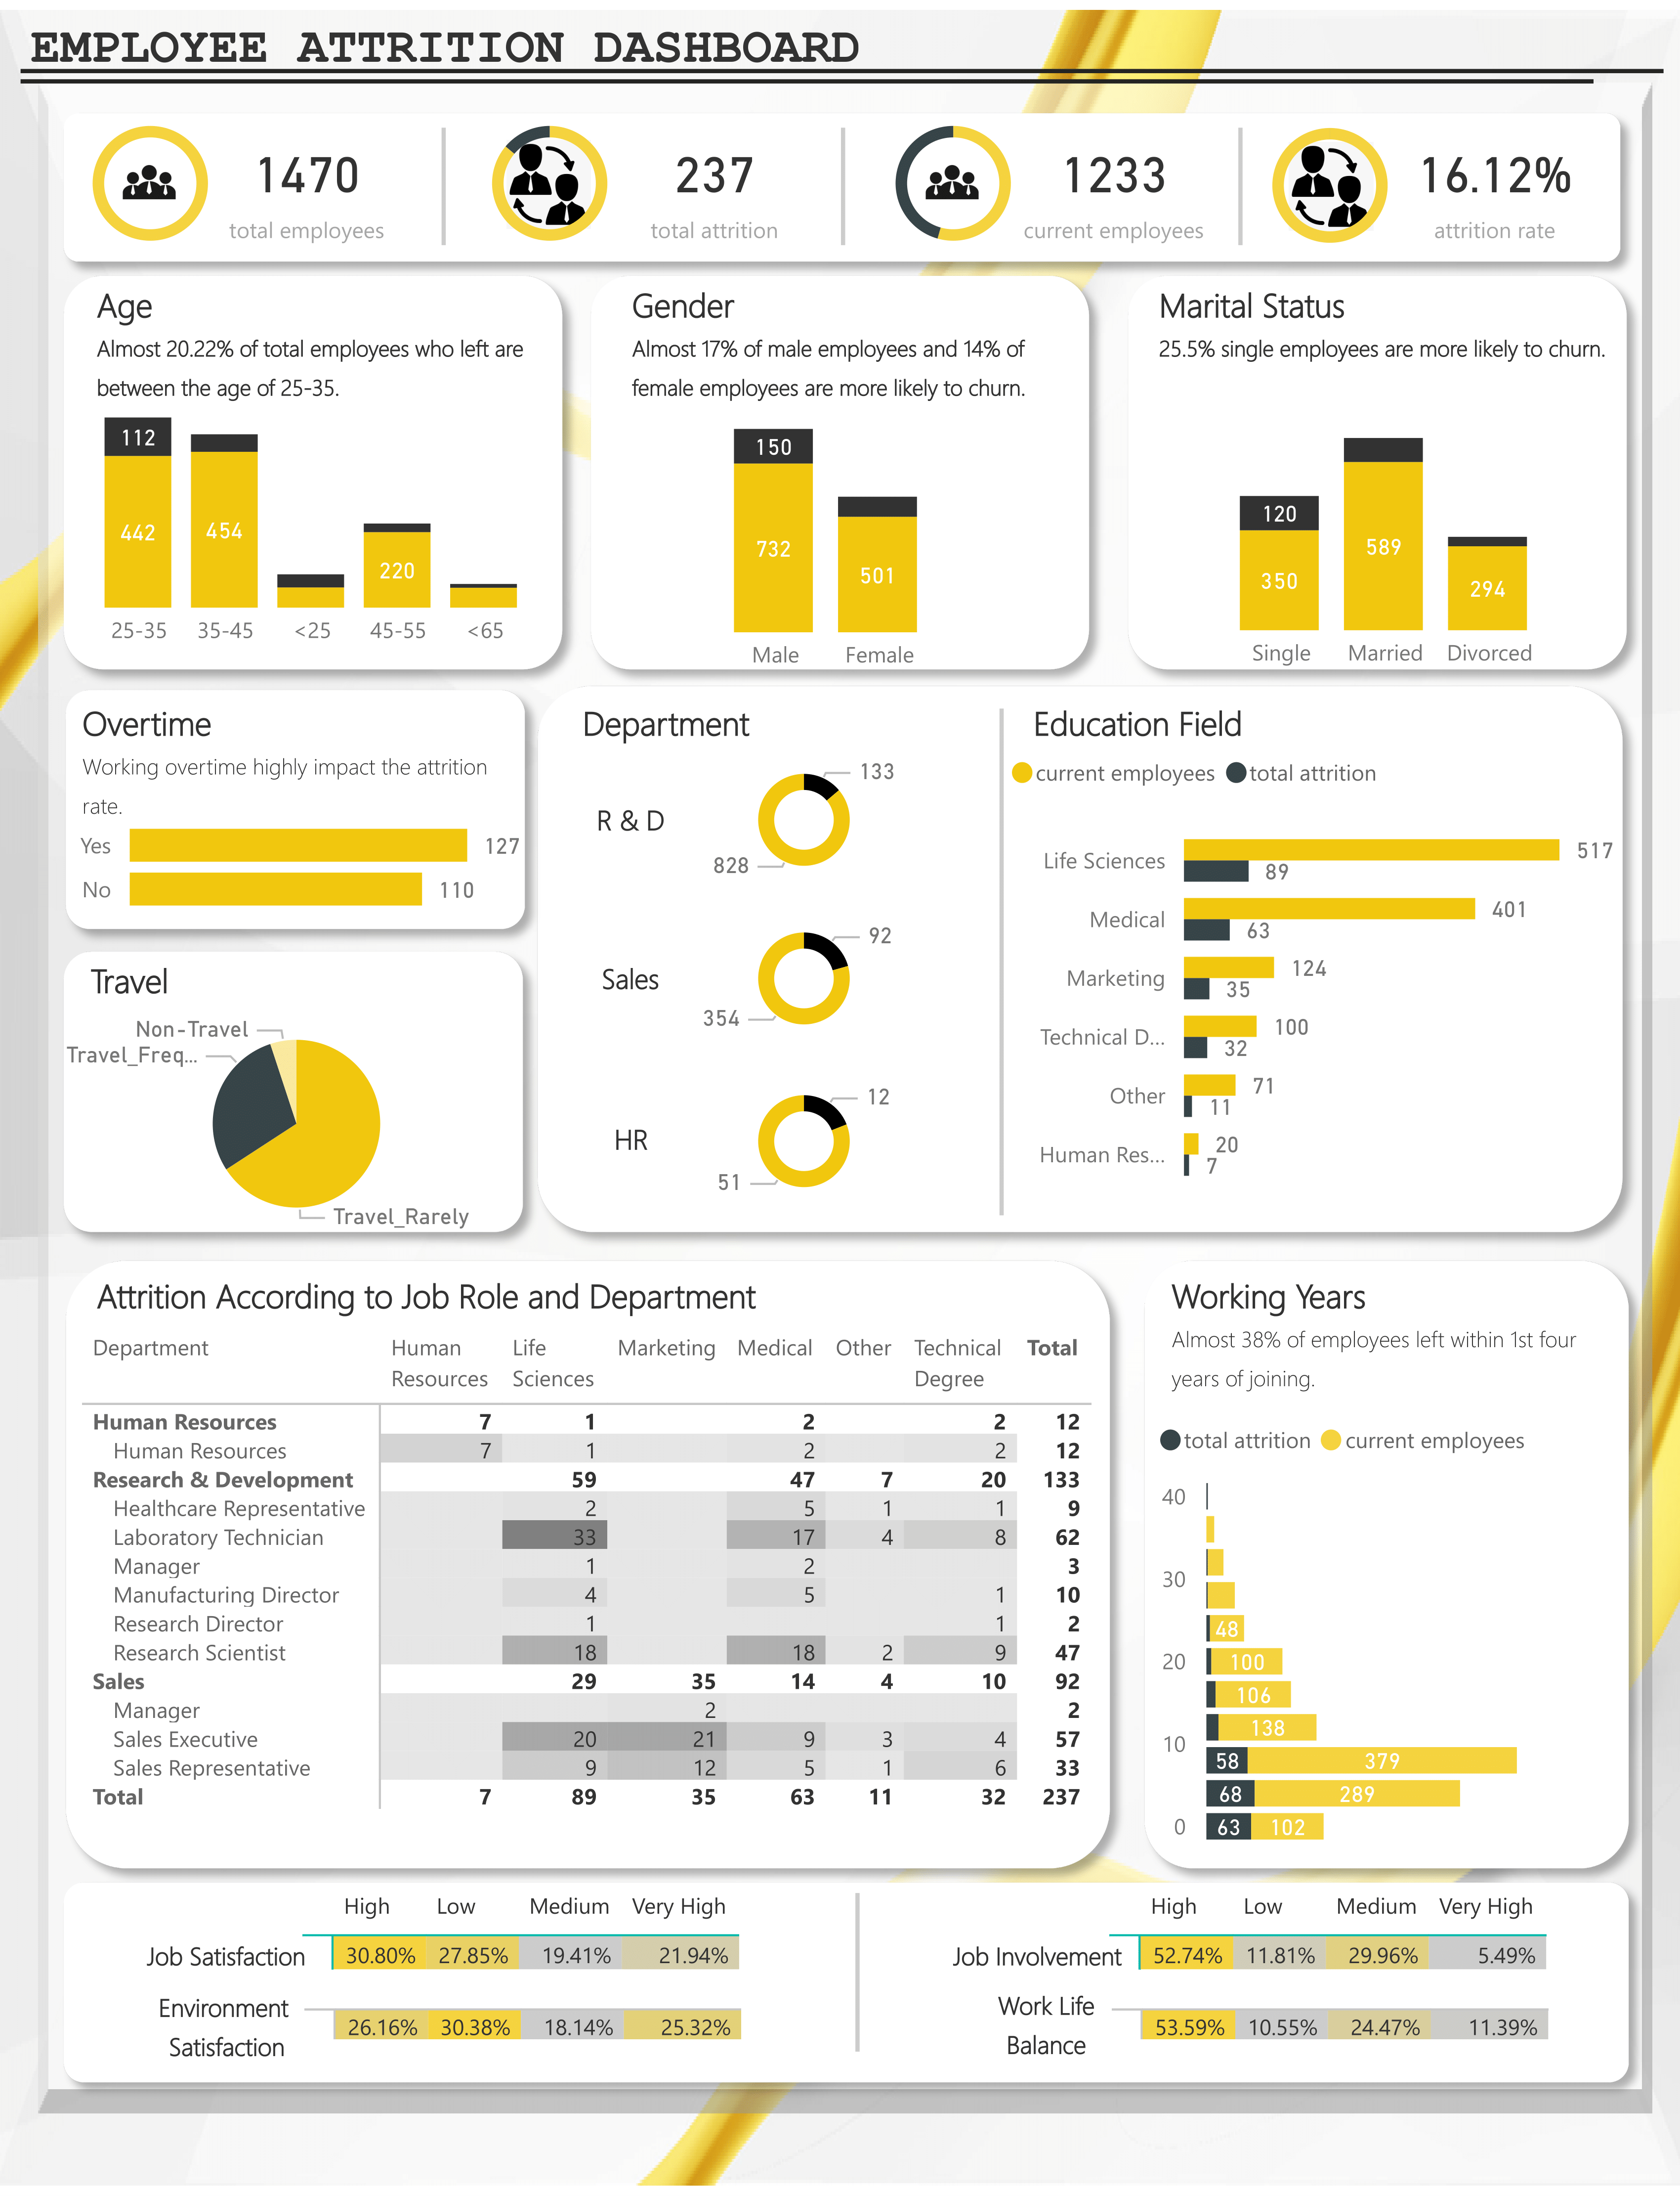
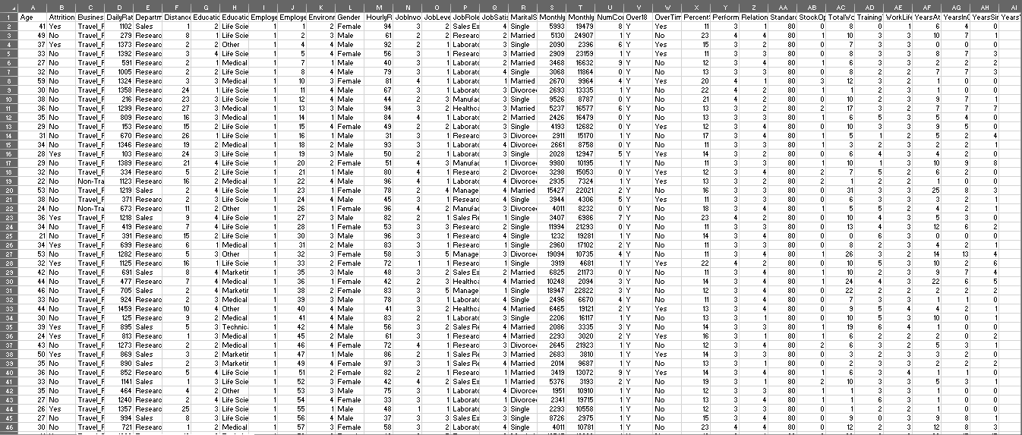

What is Data Visualisation?

Slide 3
Why Visualisation?
1. Visually appealing
2. Interactive
3. Presenting data logically using perfect charts
4. An easy way to understand data

Slide 4
Step
01
DATA COLLECTION
Step
DATA PREPARATION
02
Step
03
VISUALISATION
Step
GENERATING REPORT
04

Slide 5
DATA COLLECTION
Through interviews
Through surveys
From documents and records
Research
Web Scrapping, etc.

Slide 6
DATA PREPARATION
ETL
Extracting the data
Transforming the data
Loading the data

Slide 7
DATA VISUALISATION
Analyzing the data
Selection of proper charts
Univariate Analysis
Bivariate Analysis
Multivariate Analysis

Slide 8

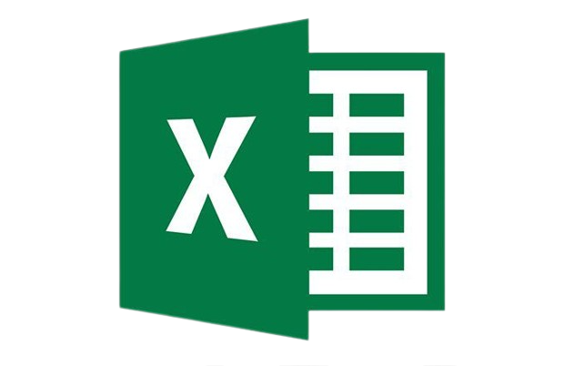

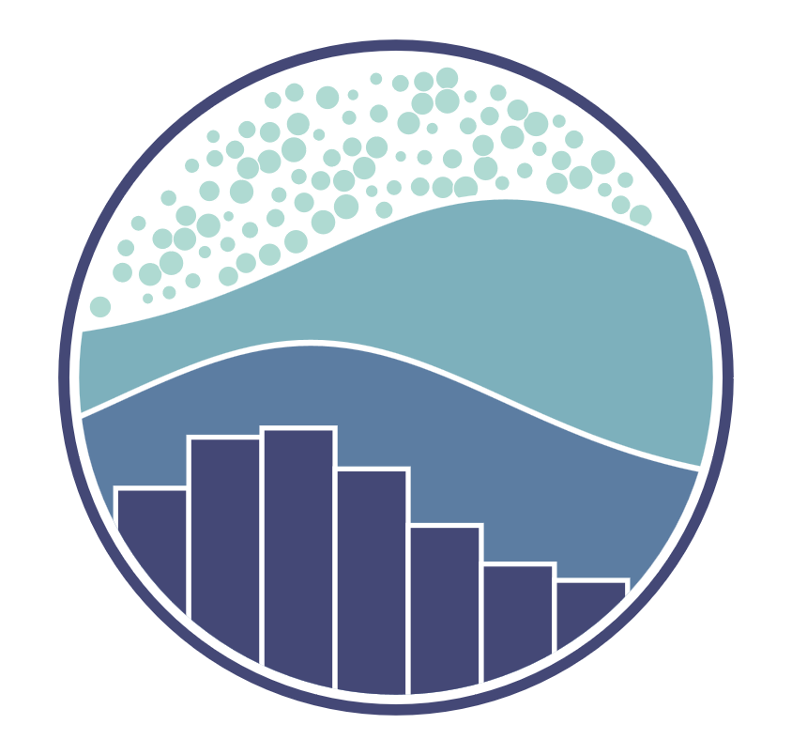
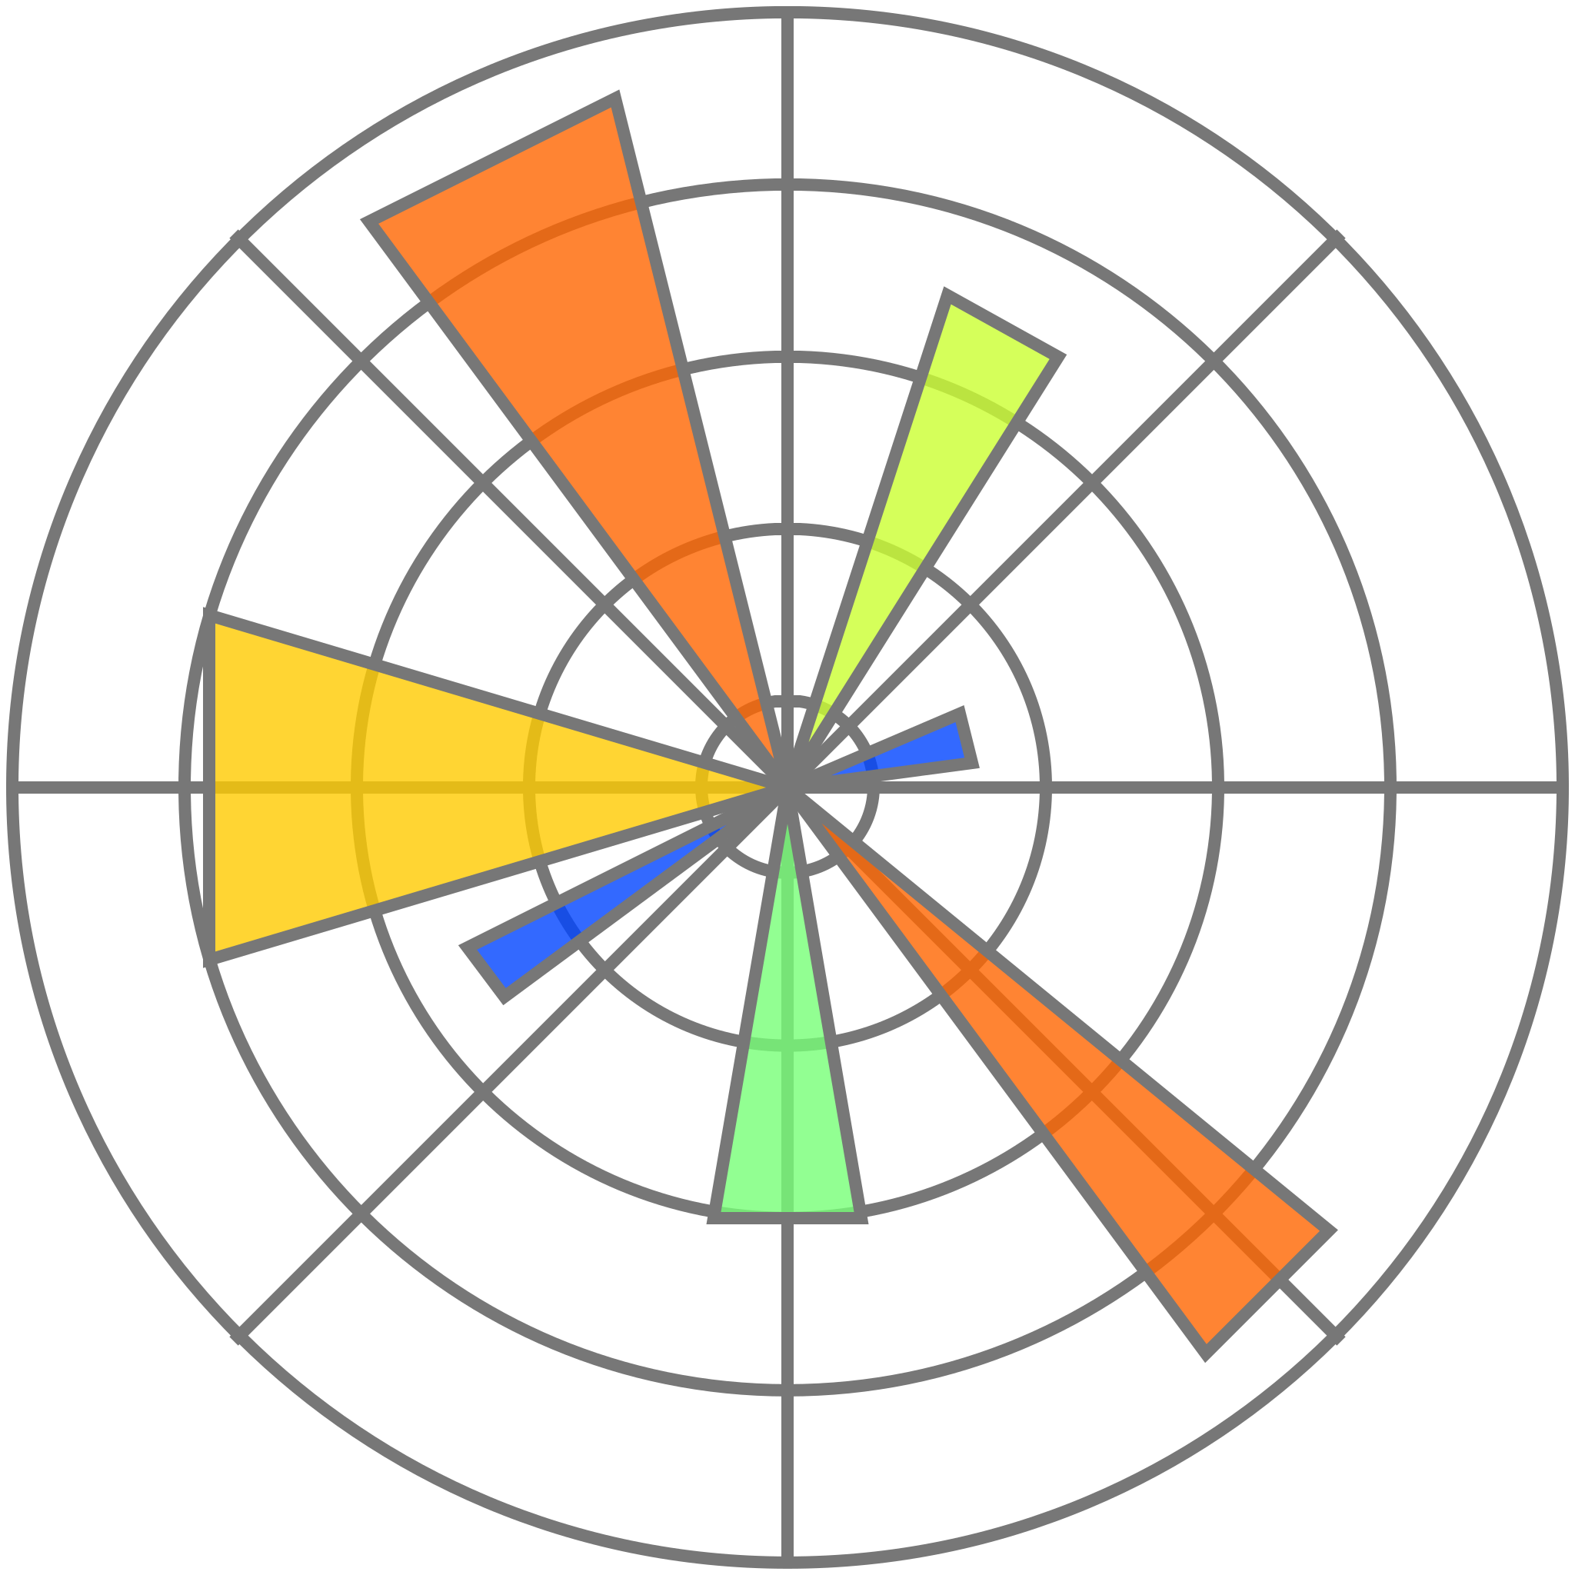

DATA VISUALISATION TOOLS
MICROSOFT EXCEL
PYTHON
TABLEAU
MICROSOFT POWER BI
SEABORN
MATPLOTLIB

Slide 9
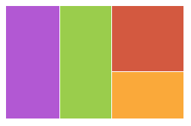
SELECTION OF PROPER CHARTS
Column Chart
Line Chart
Pie Chart
Bar Chart
Combo Chart
Doughnut Chart
Area Chart
Scatter Chart
Tree Map

Slide 10
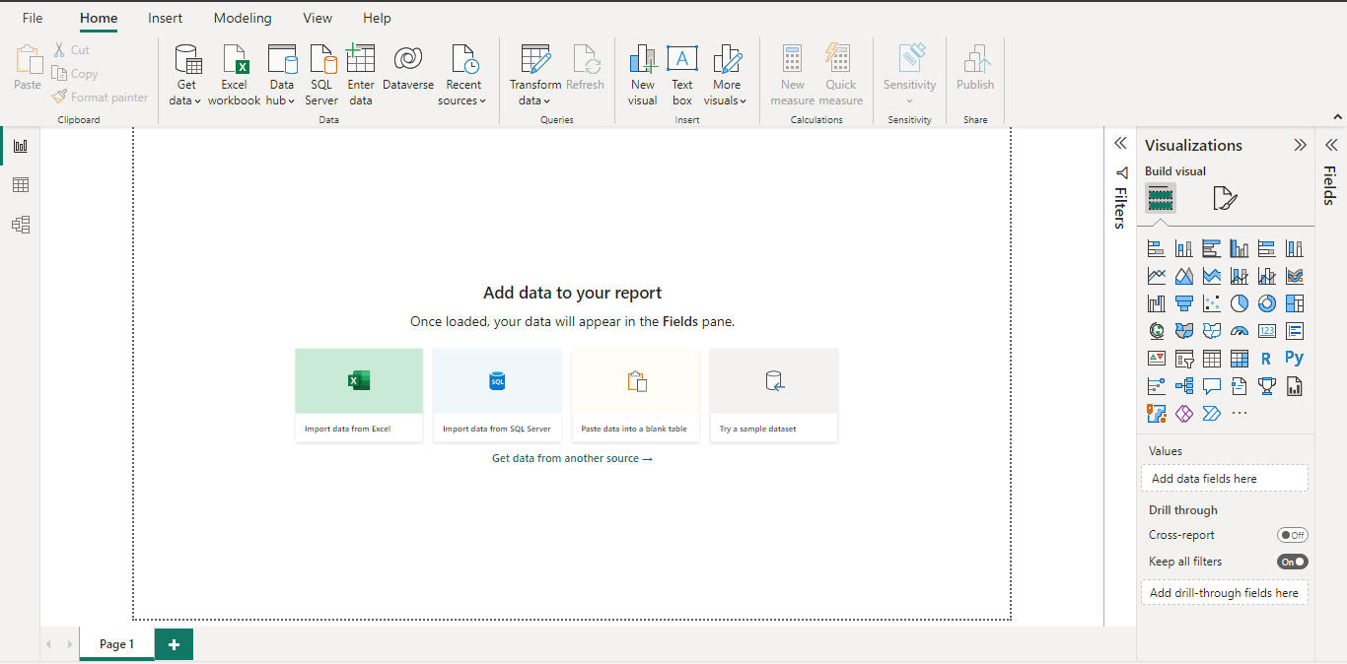
Report View
Data View
Model View
Visualization tools

Slide 11
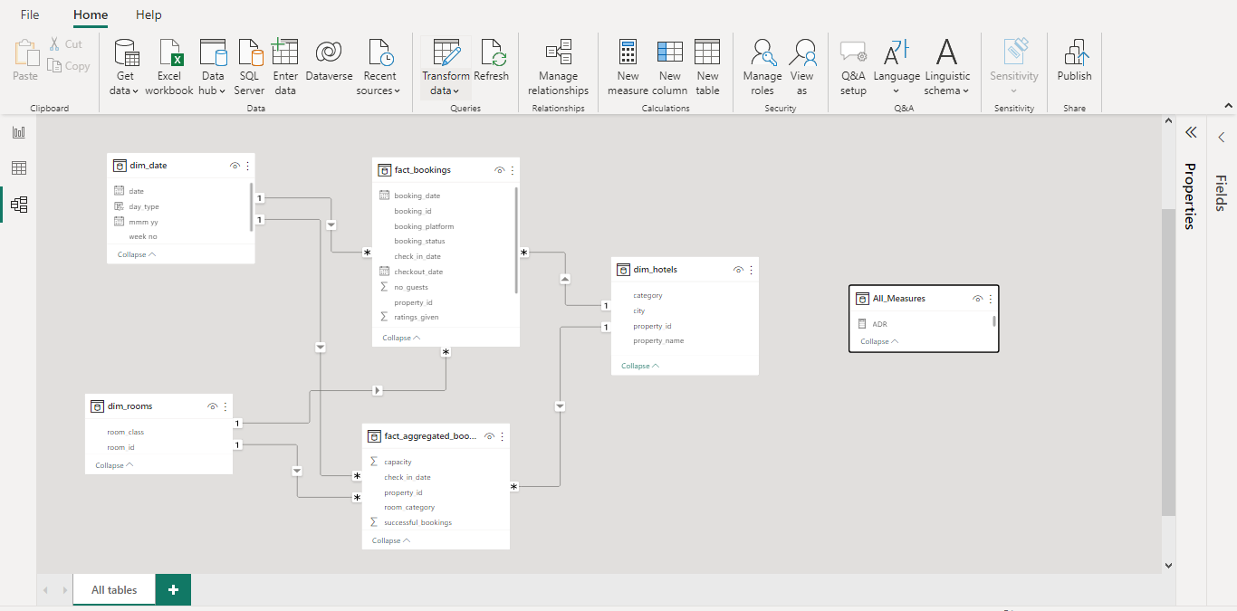


Slide 12
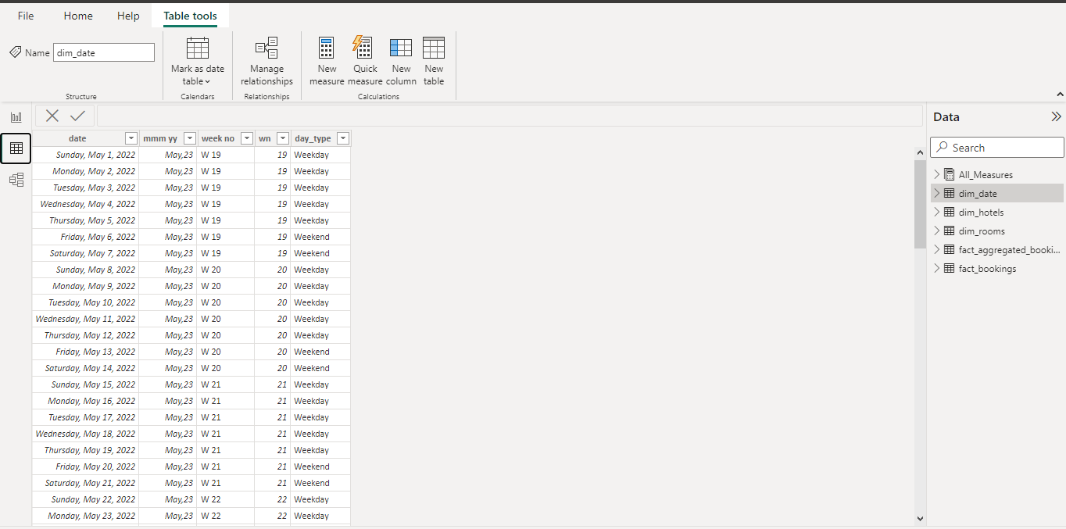

Slide 13
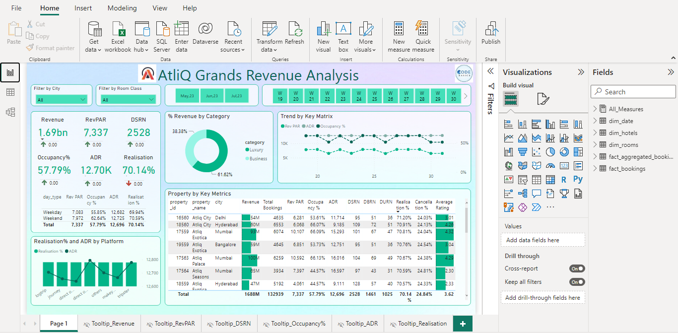

Slide 14
Let’s have a look on one of my dashboard

Slide 15
PYTHON
Matplotlib is a visualization library in Python for 2D plots of arrays.
MATPLOTLIB
Seaborn is a visualization library for statistical graphics plotting in Python.
PYTHON
Distribution Plots
Categorical Plots
SEABORN

Slide 16
Let’s move on to Jupyter notebook for in-depth understanding

Slide 17
That’s all
You can follow me on LinkedIn and connect with me there, I regularly post stuff related to data analytics and visualization…
https://www.linkedin.com/in/sneha-mandal-b503791a1/
I will post all the files in my github repository in case you need :
https://github.com/sneha201997/sessions.git

