Slide 1
Crop Recommendation System
MACHINE LEARNING MINI PROJECT
SUBMITTED BY Sneha Kumari
ROLL NO. 23006501100115
SUBJECT Machine Learning
SUBJECT CODE BOE073
SUBMITTED TO Miss Ashna Kushwaha
Predicting the most suitable crop from soil and weather data using a Decision Tree Classifier
Python • Scikit-learn • Google Colab
Notes:
Good morning Ma'am. Mera naam Sneha Kumari hai, roll number 23006501100115. Aaj main Machine Learning subject ke liye apna mini project present karungi: Crop Recommendation System. Isme maine Decision Tree algorithm use karke ek model train kiya hai jo soil aur weather dekhkar batata hai ki kaun si fasal ugani chahiye.

Slide 2
Introduction
Agriculture is the backbone of India; choosing the wrong crop reduces yield and farmer income.
Crop suitability depends on soil nutrients (N, P, K), soil pH, temperature, humidity and rainfall.
Farmers often decide using experience or guesswork; machine learning can learn the pattern from past data.
This project trains a Decision Tree Classifier that takes 7 inputs and recommends the best-suited crop.
Problem type: supervised, multi-class classification (22 classes).
22
crops (classes)
2,200
records in dataset
7
input features
Notes:
Agriculture India ki backbone hai. Lekin kaun si fasal kahan ugani hai, ye aksar farmer andaze se decide karta hai. Galat fasal chunne se nuksan hota hai. Hamara project data se seekhta hai ki kis soil aur mausam me kaun si fasal best hoti hai. Ye ek supervised multi-class classification problem hai, kyunki hume 22 classes (fasalon) me se ek predict karni hai. Right side ke numbers dataset ka size dikhate hain.

Slide 3
Project Objective & Scope
Objective
Scope & Limitations
Analyse how soil and weather parameters affect crop suitability.
Train a Decision Tree model to predict one of 22 crops.
Evaluate using accuracy, classification report and confusion matrix.
Find the most influential features.
Demonstrate prediction for a new, unseen input.
Covers 22 crops and 7 parameters from a balanced dataset.
Useful for farmers, agri-advisors and students as decision support.
Can be extended into a web or mobile app.
Limitation: advisory only; it does not replace soil testing or expert advice.
Limitation: predicts only the 22 crops present in the dataset.
Notes:
Objective ka matlab hai hum kya achieve karna chahte hain: 7 inputs se fasal predict karna, model ko evaluate karna aur ye samajhna ki kaun sa feature sabse zyada important hai. Scope batata hai ki project kahan tak kaam karta hai: 22 fasalein, 7 parameters. Aur limitation bhi honestly bolna: ye advisory tool hai, asli soil testing aur expert ki salah ka replacement nahi hai.

Slide 4
Platform & Libraries Used
1
Google Colab
2
Python
3
Pandas
Free cloud notebook to write and run Python code; no installation needed.
Main programming language used for the whole project.
Loads the CSV file and handles data in tables (DataFrame).
4
NumPy
5
Scikit-learn
6
Matplotlib & Seaborn
Fast numerical operations and array handling.
Train-test split, Decision Tree model, accuracy and reports.
Graphs: confusion matrix heatmap, feature importance, tree plot.
Notes:
Maine poora project Google Colab pe kiya, jo free cloud notebook hai, kuch install nahi karna padta. Python language hai. Pandas se data load aur analyse kiya, NumPy numerical calculations ke liye hai, Scikit-learn se model banaya, train-test split aur evaluation kiya. Matplotlib aur Seaborn se graphs, confusion matrix aur tree ki picture banayi.

Slide 5
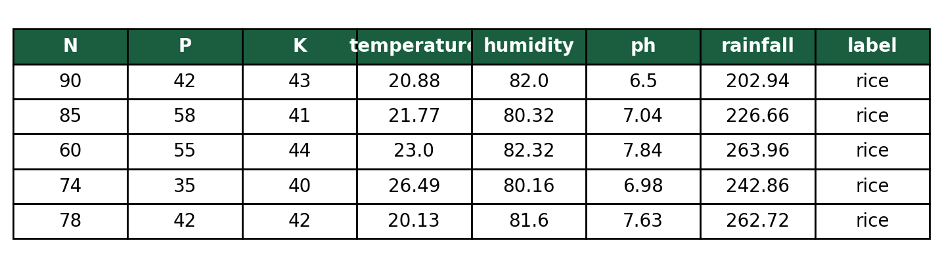
Dataset Analysis
File: Crop_recommendation.csv (loaded with pd.read_csv).
Size: 2,200 rows × 8 columns (7 features + 1 target).
Crops: 22 crops, exactly 100 rows each.
Balanced data: every class has equal samples, so the model is not biased towards any crop.
Quality: no missing values, so no cleaning was required.
Output of df.head()
Feature | Meaning | Unit
N, P, K | Nitrogen, Phosphorus, Potassium in soil | ratio
temperature | Average temperature | °C
humidity | Relative humidity | %
ph | Soil acidity / alkalinity | pH scale
rainfall | Rainfall received | mm
label | Target: recommended crop | 22 classes
Notes:
Dataset ka naam Crop_recommendation.csv hai. Isme 2200 rows aur 8 columns hain: 7 input features aur 1 target, yaani label. 22 fasalein hain aur har ek ki exactly 100 rows, isliye dataset balanced hai. Balanced ka fayda ye hai ki model kisi ek fasal ki taraf biased nahi hota. Dataset me koi missing value nahi hai, isliye cleaning ki zarurat nahi padi. Right side me df.head() ka output hai.

Slide 6
Algorithm: Decision Tree Classifier
Idea: a flowchart-like model that asks a series of yes/no questions on the features.
Nodes: each internal node tests one feature (e.g. rainfall > 150 mm); each leaf gives a crop.
Best split: chosen using Gini Impurity = 1 − Σ pᵢ². Lower Gini means a purer group.
Strengths: easy to interpret, needs no feature scaling, handles many classes.
Weakness: a very deep tree can overfit, so we limit it with max_depth = 8.
Rainfall > 150 mm?
Yes
No
Temp < 25 °C?
Humidity < 40 %?
Rice
Jute
Chickpea
Maize
Simplified illustration of how a tree decides
Notes:
Decision Tree ko aise samjhiye jaise 20 Questions ka game. Har node pe ek sawal poochta hai, jaise rainfall 150 se zyada hai ya nahi. Jawab ke hisaab se left ya right jaata hai, aur last me leaf pe fasal ka naam milta hai. Sawal kaise chunta hai? Gini Impurity se. Jo sawal groups ko sabse pure banaye, wahi chuna jaata hai. Right wala diagram sirf ek illustration hai, asli tree slide 11 pe hai.

Slide 7
Target Variable & Model Training
Target (y): label, the crop name.
Features (X): N, P, K, temperature, humidity, ph, rainfall.
Train-Test Split: data divided 80% / 20% so the model is tested on data it has never seen.
random_state = 42: gives the same split every time (reproducible).
Model: DecisionTreeClassifier(criterion='gini', max_depth=8).
Training: model.fit(X_train, y_train) learns the splitting rules.
Train-Test Split
Train 80% (1,760 rows)
Test 20%
(440 rows)
X = df.drop('label', axis=1)
y = df['label']
X_train, X_test, y_train, y_test =
train_test_split(X, y, test_size=0.2,
random_state=42)
model = DecisionTreeClassifier(
criterion='gini', max_depth=8,
random_state=42)
model.fit(X_train, y_train)
Notes:
Target variable label column hai, yaani fasal ka naam. Baaki 7 columns features X hain. Hamne data ko 80:20 me split kiya: 1760 rows training ke liye aur 440 rows testing ke liye. Train-test split isliye zaruri hai ki model ko un data pe test karein jo usne kabhi dekha nahi, tabhi pata chalta hai ki wo sach me seekha ya sirf ratta maara. random_state=42 se har baar same split milta hai. Model gini criterion aur max_depth 8 ke saath train hua.

Slide 8
Overfitting Check: Effect of max_depth
Too shallow (3, 5): underfitting; the tree cannot separate 22 crops.
Depth 8: 97.3% on unseen test data; simple and easy to explain.
No limit (None): 100% training accuracy means the tree memorises the data (overfitting risk).
Takeaway: limiting max_depth keeps the model general and readable.
Notes:
Maine max_depth ko 3, 5, 8 aur None karke try kiya. Depth 3 me tree bahut chhota hai, 22 fasalon ko alag nahi kar pata, isliye accuracy sirf 18 percent: ye underfitting hai. Depth 5 pe 45 percent. Depth 8 pe 97 percent. Depth None pe training accuracy 100 percent ho jaati hai, matlab tree poora training data ratta maar leta hai. Isliye depth 8 ek balanced choice hai, jo simple aur interpretable rehta hai.

Slide 9
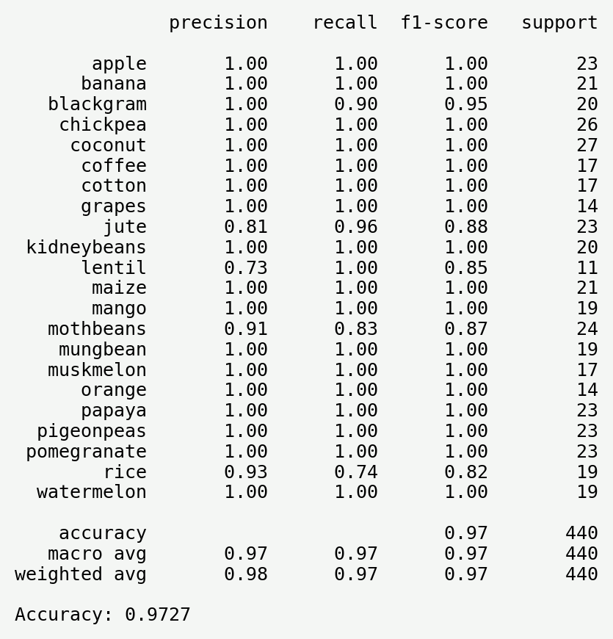
Model Accuracy & Evaluation
97.27%
Test accuracy (428 of 440 correct)
Accuracy: correct predictions ÷ total predictions.
Precision: of all times the model said 'crop X', how often was it right.
Recall: of all real 'crop X' samples, how many the model found.
F1-score: balance of precision and recall.
Weaker crops: rice (recall 0.74), lentil (precision 0.73), jute and mothbeans have similar conditions.
classification_report output
Notes:
Model ki test accuracy 97.27 percent aayi: 440 test samples me se 428 sahi predict hue aur sirf 12 galat. Accuracy ka matlab: kul predictions me se kitne sahi. Precision batata hai jitni baar model ne ek fasal bola, usme se kitni sahi thi. Recall batata hai ki asli me us fasal ke jitne samples the, unme se kitne model ne pakde. F1 dono ka balance hai. Zyadatar fasalon ka score 1.00 hai. Kamzor fasalein rice, jute, lentil aur mothbeans hain, kyunki unke soil aur weather values aapas me milte-julte hain.

Slide 10
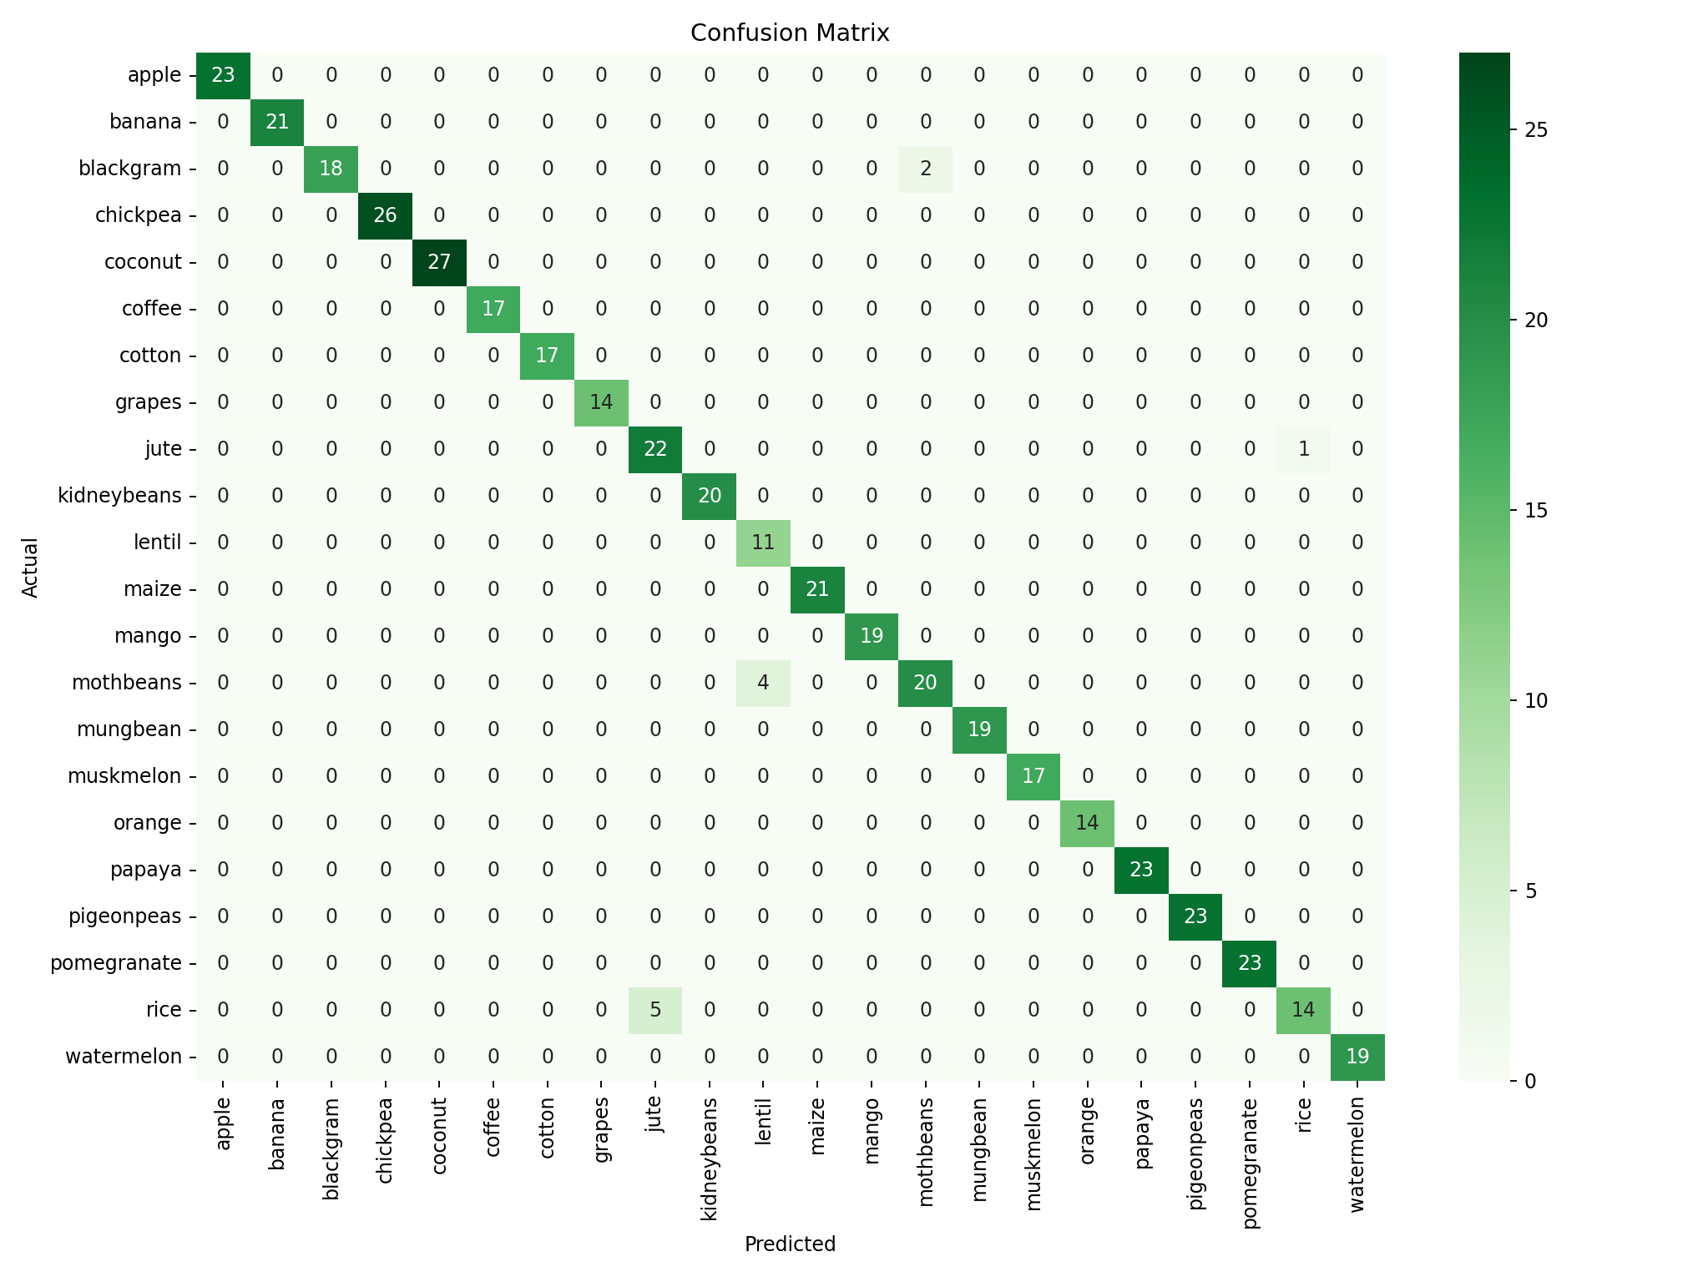
Confusion Matrix Analysis
Rows = actual crop, columns = predicted crop.
Diagonal: correct predictions; a dark diagonal means a strong model.
Off-diagonal: mistakes. Only 12 of 440 samples.
Rice → Jute: 5 times
Mothbeans → Lentil: 4 times
Blackgram → Mothbeans: 2 times
Jute → Rice: 1 time
Why: these crops grow in similar conditions.
Confusion matrix on the 440 test samples
Notes:
Confusion matrix batata hai ki model kahan sahi aur kahan galat hua. Rows asli fasal hain aur columns model ki prediction. Diagonal ke numbers sahi predictions hain, isliye diagonal jitna dark, utna achha. Diagonal ke bahar wale numbers galtiyan hain. Hamare model me sirf 12 galtiyan hui: rice ko 5 baar jute samjha, mothbeans ko 4 baar lentil, blackgram ko 2 baar mothbeans aur jute ko 1 baar rice. Ye fasalein ek jaisi conditions me ugti hain.

Slide 11
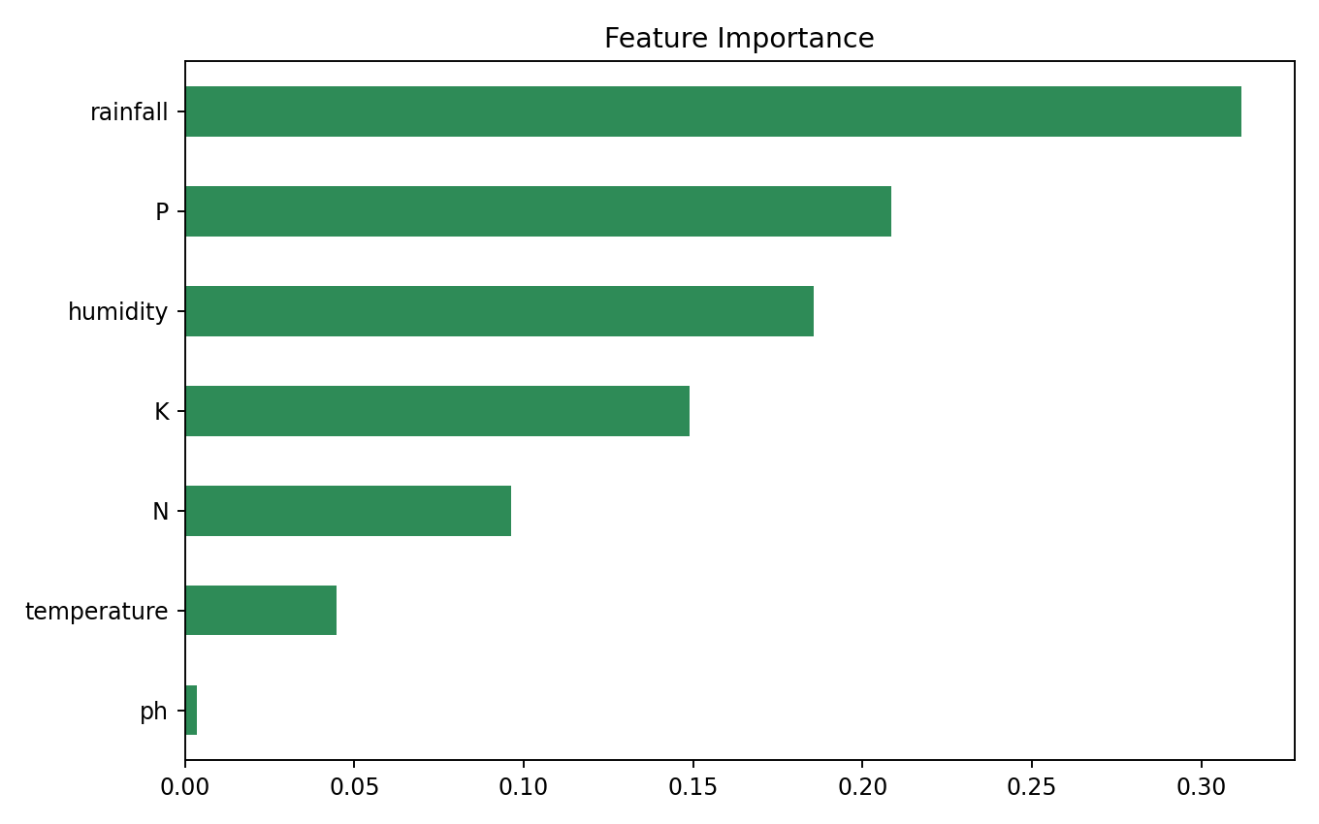
Feature Importance
Feature | Importance
rainfall | 31.2%
P (Phosphorus) | 20.9%
humidity | 18.6%
K (Potassium) | 14.9%
N (Nitrogen) | 9.6%
temperature | 4.5%
ph | 0.4%
Most important: rainfall, then phosphorus and humidity.
Least important: soil pH (about 0.4%).
Meaning: water availability and soil nutrients decide the crop most.
Output of model.feature_importances_
Notes:
Feature importance batati hai ki model ne decision lene me kis input ko kitna weight diya. Rainfall sabse important hai, lagbhag 31 percent, kyunki chawal jaisi fasal ko bahut paani chahiye aur chickpea jaisi ko kam. Uske baad phosphorus 21 percent aur humidity 19 percent. Temperature aur pH ka role kam hai. Real life me bhi baarish aur nutrients fasal chunne ke sabse bade factors hain.

Slide 12
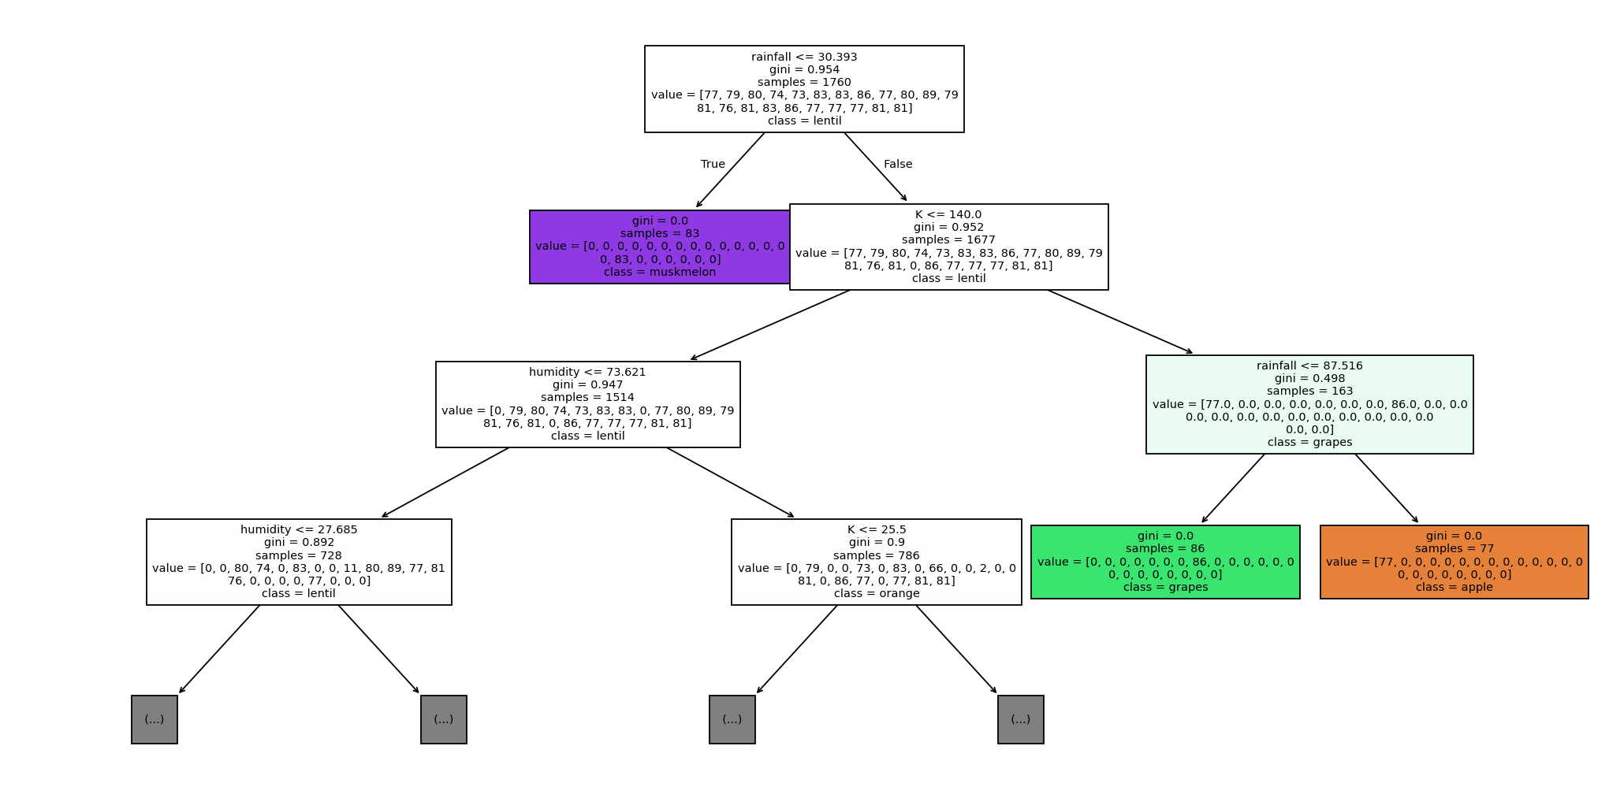
Decision Tree Visualization
Each box: a question on one feature, e.g. rainfall ≤ value.
Yes → left, No → right.
Gini: falls towards 0 as we go down; groups become purer.
Colour: shows the majority crop in that box.
Leaf: the final predicted crop.
Shown: only the top 3 levels for readability (full tree has depth 8).
Top 3 levels of the trained tree (plot_tree)
Notes:
Ye hamare trained tree ke upar ke 3 levels hain, poora tree bahut bada hai. Har box me ek sawal hai, jaise rainfall kisi value se kam hai ya nahi. Agar haan to left, nahi to right. Gini value batati hai ki box kitna pure hai, aur box ka rang us class ko dikhata hai jo us node pe majority me hai. Jaise jaise neeche jaate hain, Gini kam hota jaata hai, matlab group pure hota jaata hai. Last me leaf pe final fasal milti hai.

Slide 13

Live Demo: Final Output
Input given to the model
Model output
Feature | Value
N | 90
P | 42
K | 43
temperature | 21 °C
humidity | 82 %
ph | 6.5
rainfall | 200 mm
How it predicts: the 7 values travel from the root to a leaf, answering one question at every node.
Result: high rainfall and high humidity lead to rice.
Enter 7 values
→
Tree asks questions
→
Reaches a leaf
→
Crop recommended
Notes:
Ab demo dekhte hain. Maine ek naya input diya: N 90, P 42, K 43, temperature 21 degree, humidity 82 percent, pH 6.5 aur rainfall 200 mm. Model ne ye 7 values tree me daali. Tree upar se shuru karke har node pe sawal ka jawab deta gaya, jaise rainfall zyada hai, humidity zyada hai, aur last me leaf pe pahunch kar bola: rice. Ye sahi hai kyunki rice ko zyada paani aur humidity chahiye.

Slide 14
Conclusion & Future Scope
Conclusion
Future Scope
Decision Tree achieved 97.27% accuracy on unseen test data.
Rainfall, phosphorus and humidity are the most influential features.
The model is easy to interpret and explain, with no feature scaling needed.
A balanced dataset gave reliable results across all 22 crops.
Convert into a web app (Streamlit / Flask) for farmers.
Try Random Forest or XGBoost for better stability and accuracy.
Add real-time weather API, season and location inputs.
Provide fertilizer advice and a Hindi-language mobile app.
Notes:
Conclusion: Decision Tree ne 97.27 percent test accuracy di. Rainfall, phosphorus aur humidity sabse important features nikle. Model interpretable hai, yaani hum tree dekhkar samajh sakte hain ki decision kyun liya. Future me isse Streamlit ya Flask web app bana sakte hain jisme farmer values daale aur turant fasal dekhe. Random Forest ya XGBoost se accuracy aur stability badh sakti hai, aur real-time weather API aur Hindi language support bhi jod sakte hain.

Slide 15
Thank You
GITHUB
https://github.com/sneha3498/crop-recommendation-decision-tree.git
DATASET
Kaggle: Crop Recommendation Dataset
SUBMITTED BY
Sneha Kumari (23006501100115)
SUBMITTED TO
Miss Ashna Kushwaha
Questions are welcome
Notes:
Is tarah maine Decision Tree se ek Crop Recommendation model banaya aur evaluate kiya. Mere GitHub repository ka link slide pe hai. Thank you Ma'am. Koi sawal ho to zaroor poochhiye.

