Slide 1
IBM University Engagement Project Submission
“Exploring the Power of Agentic AI with IBM Granite and IBM Bob”

Slide 2
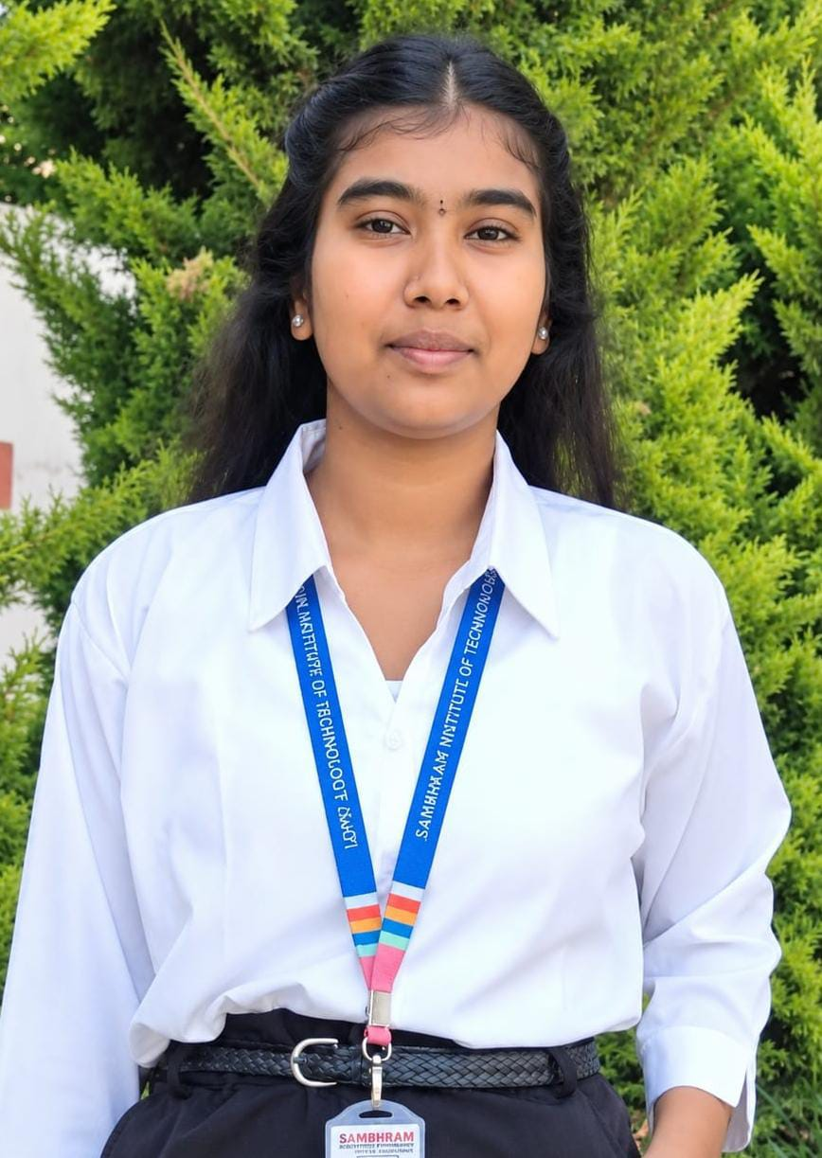
Project Tile – [Problem Statement No.14: AI Agent for Smart Farming Advice]
Domain of Project –[Agriculture]
Student Name | Recent Passport Photo | Email ID | Mobile number [WhatsApp]
Sneha S R |  | sneha969136@gmail.com | 6364866894

Slide 3
Problem Statement -
Problem Statement : Smart water Guardian AI
The Challenge
Farmers face water scarcity and unpredictable rainfall, making it difficult to provide crops with the right amount of water at the right time. This results in water wastage, crop damage, and reduced agricultural productivity.
The Objective
- Personalized Irrigation: Recommend the right amount of water based on crop type, soil moisture, and growth stage.
- Weather Monitoring: Use weather forecasts to plan irrigation and avoid unnecessary watering before rainfall.
- Water Management: Track available water in tanks or reservoirs and estimate crop water requirements.
- Water Conservation: Reduce water wastage through smart irrigation recommendations.
- Multi-Agent AI System: Use specialized AI agents to analyze agricultural data and generate recommendations.
- Scenario Simulation: Compare irrigation strategies and estimate potential water savings.
- Visualization Dashboard: Display water availability, irrigation schedules, weather alerts, and water usage.

Slide 4
Proposed Solution -
Smart Water Guardian AI is an AI-powered irrigation and water management system designed to help farmers overcome water scarcity, unpredictable rainfall, and inefficient irrigation practices. The system analyzes important factors such as crop type, growth stage, soil moisture, weather forecasts, and available water in tanks or reservoirs to provide personalized irrigation recommendations. It uses the Agricultural Knowledge Agent to provide crop-specific irrigation guidance and water conservation tips, the Weather and Risk Agent to analyze weather forecasts and identify rainfall or extreme heat risks, the Personalized Irrigation Planner Agent to recommend the appropriate time and estimated amount of water required for irrigation, and the Water Budget Agent to monitor water availability, calculate estimated water requirements, and track remaining water. An Agent Orchestrator coordinates these agents and combines their findings to generate practical recommendations for farmers. The system also includes a water management dashboard, weather alerts, water usage history, and a scenario simulator that allows farmers to compare different irrigation strategies and estimate potential water savings. By using Python, Flask, the Groq API, Open-Meteo API, SQLite, HTML, CSS, and JavaScript, the platform provides an accessible and user-friendly solution for smart irrigation management. The main benefit is that farmers can save water, reduce irrigation expenses, make timely and informed decisions, avoid unnecessary watering before rainfall, and reduce the risk of crop damage caused by insufficient or excessive irrigation. Ultimately, the project aims to promote sustainable agriculture, improve water-use efficiency, and support better crop management, especially in areas facing water shortages.
.

Slide 5
Technology Used
IBM Bob Platform – For designing and orchestrating multi-agent workflows for the Smart Water Guardian AI system.
IBM Granite Model – For natural language understanding, reasoning, and generating personalized irrigation recommendations for farmers.
IBM Cloud – For providing a reliable, secure, and scalable environment to deploy the Smart Water Guardian AI application.
RAG (Retrieval-Augmented Generation) – For retrieving relevant crop irrigation guidelines and water management information before generating AI-powered recommendations.
IBM watsonx.ai – For AI model integration, deployment, and supporting AI development and governance.
Vector Database (FAISS/Chroma) – For storing and retrieving crop-specific irrigation guidelines, soil information, and water conservation knowledge to support RAG-based responses.
Open-Meteo API – For fetching weather forecasts and rainfall predictions to help farmers make better irrigation decisions.

Slide 6
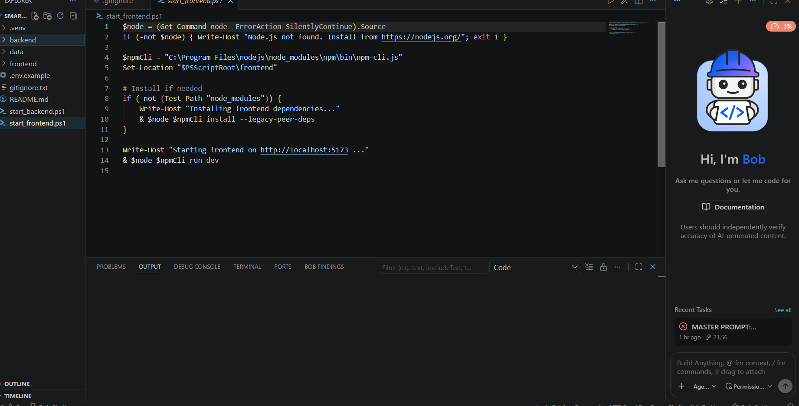
Required Files created using IBM bob -
App.py
Requirements.txt
Style.css
.env
Index.html
Style.js
8. water_guardian.js

Slide 7
IBM Bob Screenshots:

Slide 8
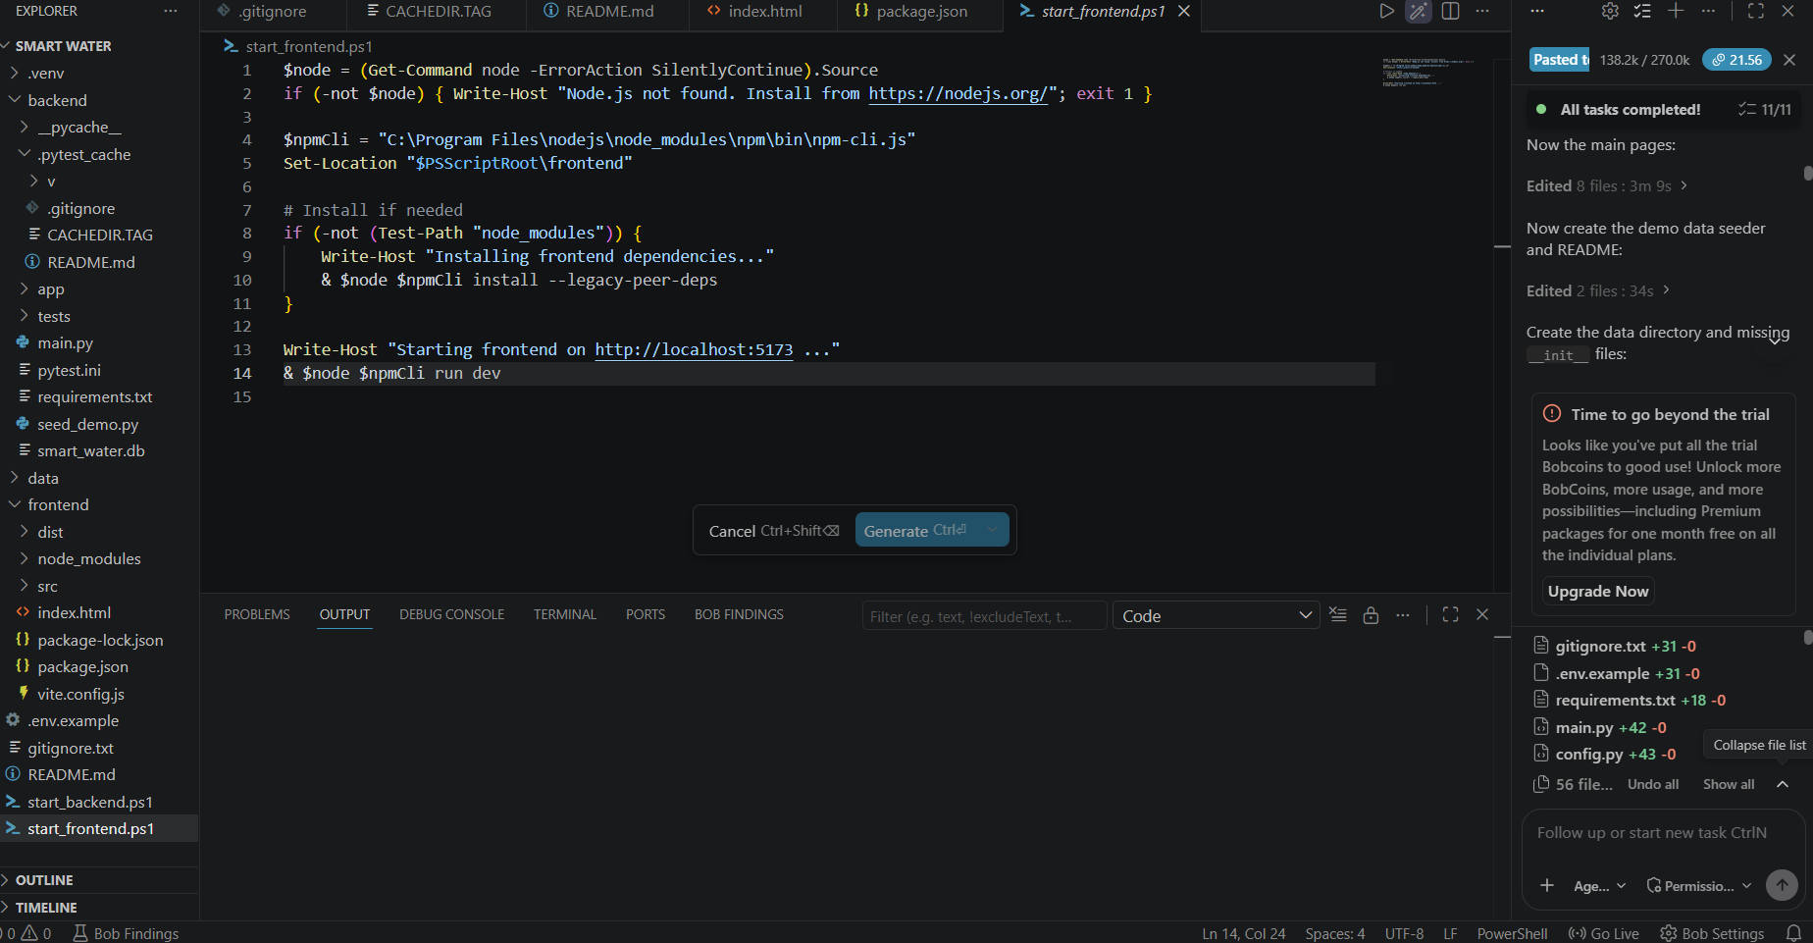

Slide 9
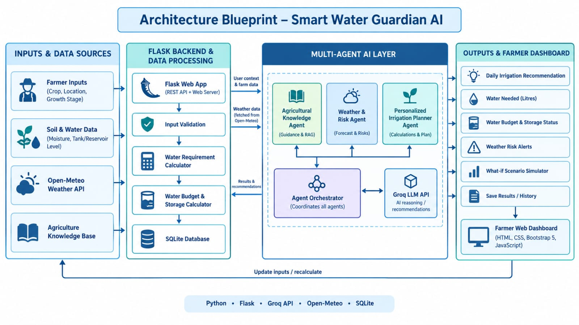
Architecture blueprint for IBM bob:

Slide 10
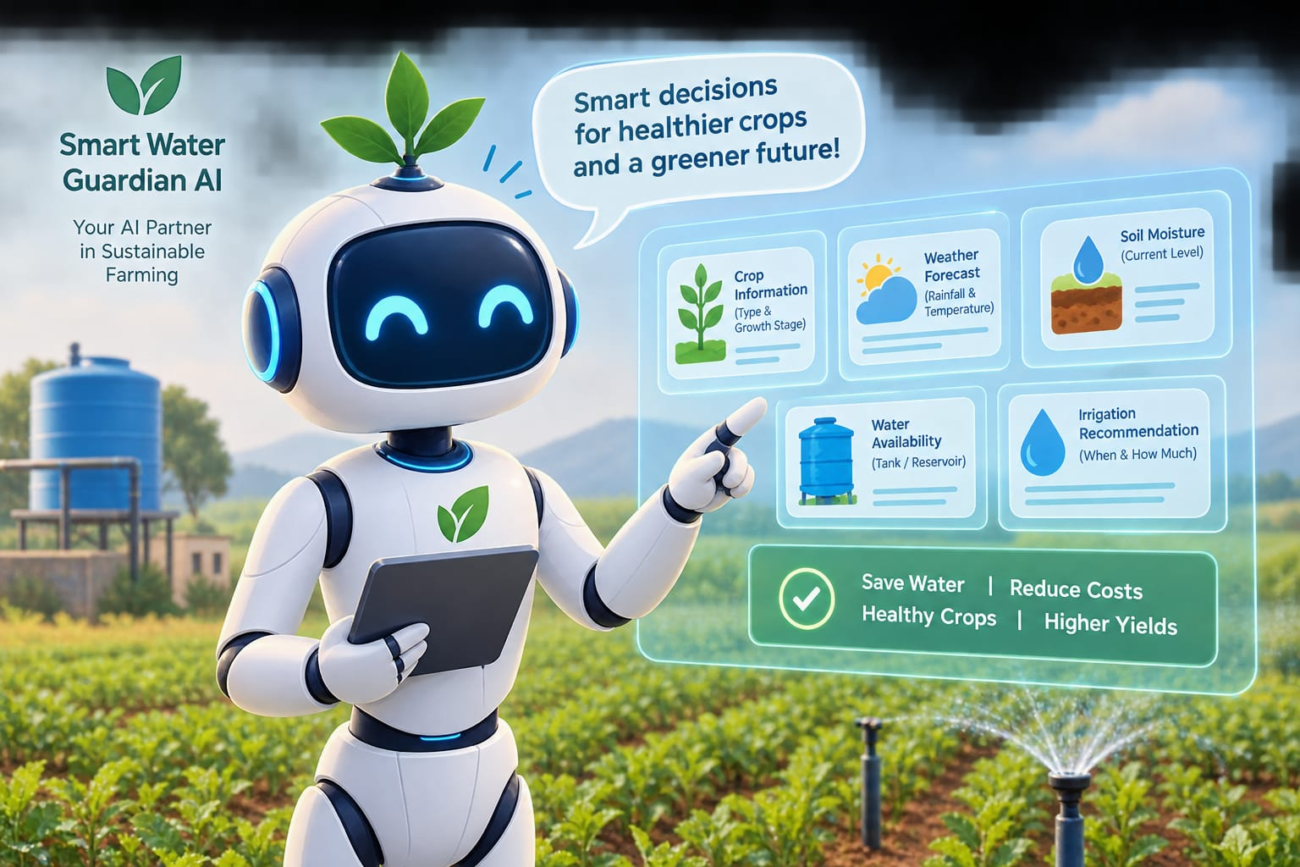
Role of Agentic AI in the solution
- Agricultural Knowledge Agent – Analyzes crop type, growth stage, and irrigation requirements to provide crop-specific guidance.
- Weather and Risk Agent – Checks weather forecasts, rainfall, and temperature to identify risks and avoid unnecessary irrigation before expected rainfall.
- Personalized Irrigation Planner Agent – Combines crop requirements, soil moisture, weather conditions, and water availability to recommend when and how much to irrigate.
- Water Budget Agent – Tracks available water in tanks or reservoirs, estimates irrigation demand, and calculates the remaining water.
- Scenario Simulation Agent – Compares different irrigation strategies and estimates potential water savings.
- Agent Orchestrator – Coordinates all agents, combines their findings, and generates a single, practical recommendation for the farmer.
Overall Role
Agentic AI transforms crop, soil, weather, and water data into personalized irrigation recommendations. It helps farmers conserve water, reduce unnecessary irrigation costs, manage limited water resources, and make better irrigation decisions.

Slide 11
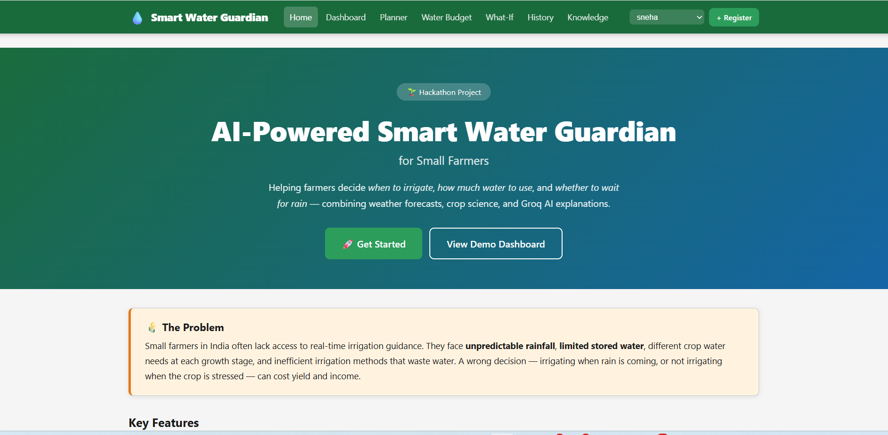
Project Output Screenshot
Please put IBM Bob output screenshots with 2-3 prompts.
You can take 2-3 more slides for each screenshot
·
·
·

Slide 12
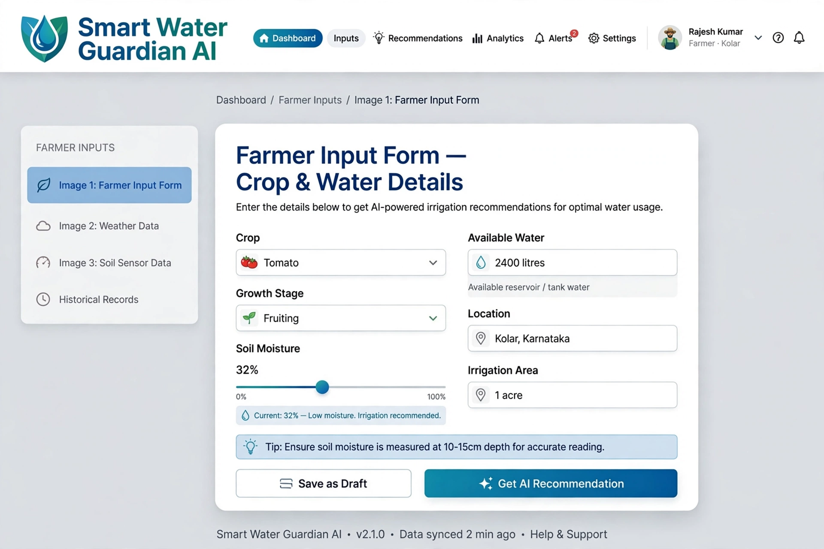
Project Output Screenshot
Please put IBM Bob output screenshots with 2-3 prompts.
You can take 2-3 more slides for each screenshot
·
·
·

Slide 13
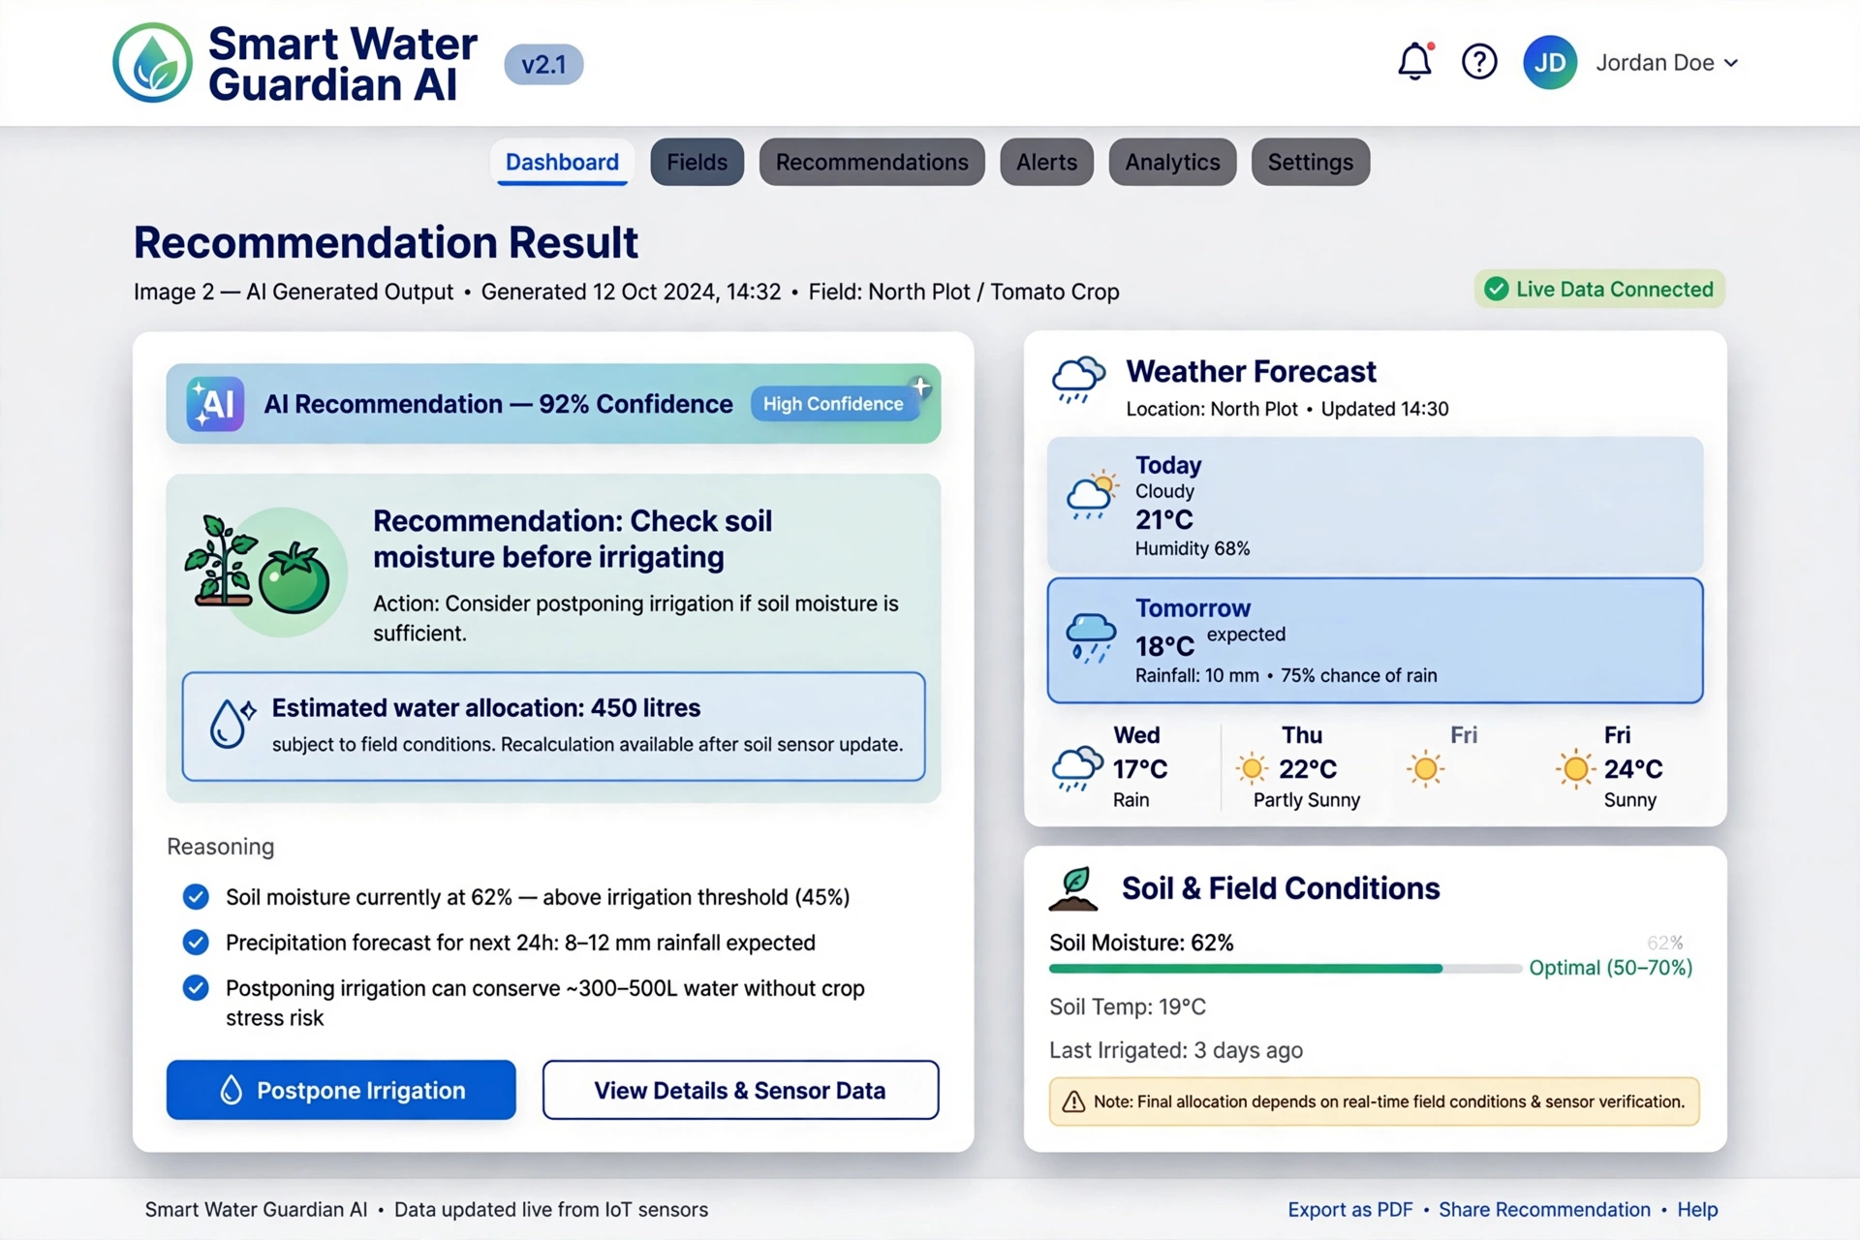
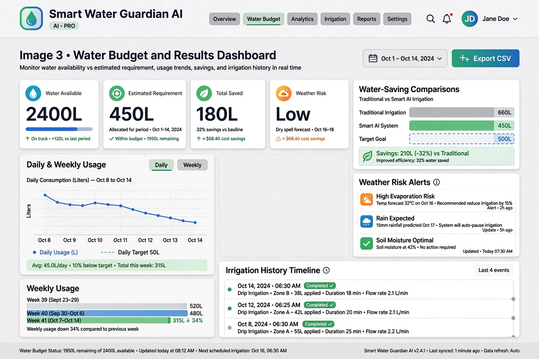
Project Output Screenshot
Please put IBM Bob output screenshots with 2-3 prompts.
You can take 2-3 more slides for each screenshot
·
·
·

Slide 14
Novelty and Uniqueness
The novelty of Smart Water Guardian AI – Personalized Irrigation and Water Management Assistant lies in integrating crop-specific irrigation planning, weather-based risk assessment, soil moisture analysis, and water budget management through a coordinated multi-agent AI architecture. Unlike conventional fixed-schedule irrigation approaches, the proposed system considers the farmer’s current field conditions and available water resources to generate personalized, explainable irrigation recommendations. It aims to reduce unnecessary watering, support better water allocation, and improve irrigation decision-making, particularly in water-scarce agricultural environments.
The main uniqueness of Smart Water Guardian AI is that it acts as a personalized irrigation decision-making assistant rather than simply displaying weather information or soil moisture readings.
* Personalized AI decisions: Considers crop type, growth stage, soil moisture, field area, and available water to suggest irrigation actions.
* Weather + soil intelligence: Combines current field conditions with forecast information to help avoid unnecessary watering before expected rainfall.
* Water availability-based planning: Adjusts recommendations according to the farmer’s available water budget.
* Multi-agent collaboration: Uses specialized AI agents for crop knowledge, weather analysis, irrigation planning, and water budgeting.
* Explainable recommendations: Tells farmers why they should irrigate, delay irrigation, or check field conditions.
* Practical farmer dashboard: Converts technical data into clear recommendations, water estimates, and alerts.
What makes it stand out: It connects what the crop needs, what the weather predicts, and how much water the farmer has to support a single irrigation decision.

Slide 15
Git Hub Link
Github URL –https://github.com/sneha6364/smart-water-guardian-ai.git
(https://github.com/sneha6364/smart-water-guardian-ai)
·
·
·

Slide 16
Future Scope
The future scope of Smart Water Guardian AI – Personalized Irrigation and Water Management Assistant is to develop the system into a more intelligent and automated smart farming solution. In the future, IoT sensors can be integrated to collect real-time soil moisture, temperature, humidity, and water-level data, enabling more accurate irrigation recommendations. Automatic irrigation control can be implemented using smart pumps and valves to reduce unnecessary water usage. Advanced AI models can be developed to predict water requirements, identify crop stress through images, and forecast potential water shortages. The system can also include satellite imagery, multilingual voice assistance, mobile notifications, and offline functionality to support farmers in rural areas. Furthermore, a digital farm simulation module could help farmers compare different irrigation strategies before applying them in the field. These enhancements can make Smart Water Guardian AI more accurate, accessible, and efficient while supporting water conservation, improved crop management, and sustainable agriculture.
·
·
·

Slide 17
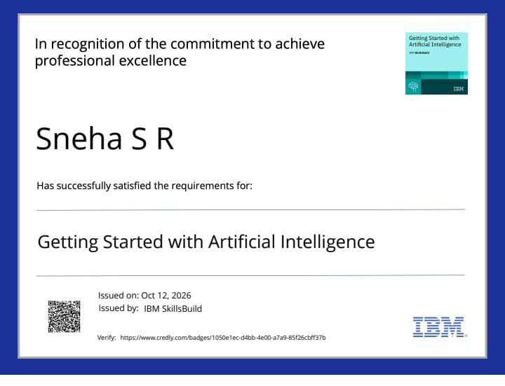
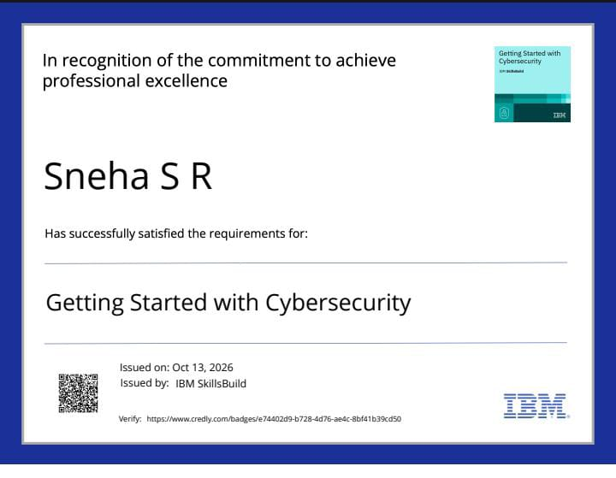
Certificates Earned:
Please add your credly certificate

Slide 18
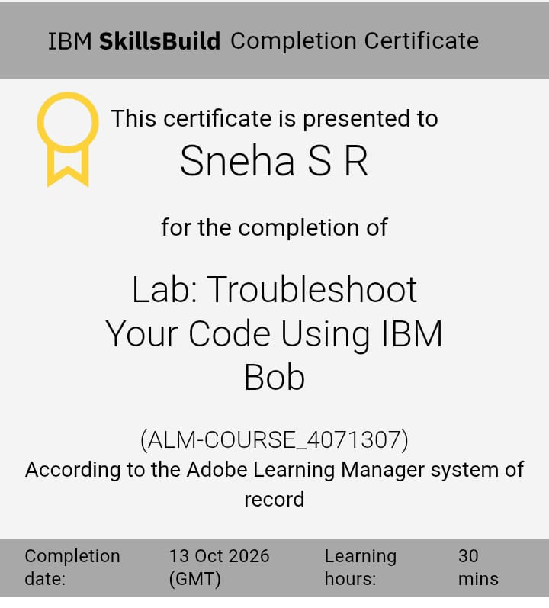
Certificates Earned:​
Add your IBM BOB Certificate

Slide 19


