Slide 1

Problem Statement/ Project name:
SafeQuake Alert System
Team members:
INTERDISCIPLINARY PROJECT WORK (1BPRJ25
Sl. No | Name | USN
1 | ADITYA GUPTA | 1AZ25CS005
2 | AADRITI | 1AZ25CS002
3 | SNEHA KUMARI | 1AY25CS166
4 | VAIBHAV MESTA | 1AY25CS195
5 | YASH KUMAR | 1AZ25CS192
6 | ANAGHA RAJ | 1AZ25CS013

Slide 2
Contents
Introduction and Background of problem statement
Objectives of the problem statement
Strategy to execute
Work carried out so far
Expected outcome

Slide 3
Introduction and Background of problem statement
•Earthquake is a natural disaster that occurs without warning.
•It causes serious damage to life and property.
•If we receive a warning 5–10 minutes earlier, we can move to a safe place
•To solve this problem we are developing a sensor system that can be installed in homes to provide early alerts

Slide 4
Objectives of the problem statement
•To detect the initial vibrations of an earthquake
•To provide an alert at least 10 minutes before the earthquake (if possible)
•To design a device that can be easily installed in houses
•To develop an alarm and mobile notification system

Slide 5
Strategy to execute
•A vibration sensor will be used to detect seismic activity
•A microcontroller (such as Arduino) will process the data
•If unusual vibrations are detected, the alarm system will activate.
•The system will be installed on the floor or wall of the house.

Slide 6
Work carried out so far
Identified the main problem related to lack of early earthquake warning at home level.
Studied the working principle of seismic sensors and accelerometers.
Selected appropriate components such as vibration sensor, microcontroller, and alarm module.
Uninterrupted Power Supply to the device(including a battery backup).

Slide 7
Expected outcome
Early signs of earthquakes will be detected.
People will receive alerts in advance.
Loss of life and property can be reduced.
An affordable safety device can be installed in homes.

Slide 8
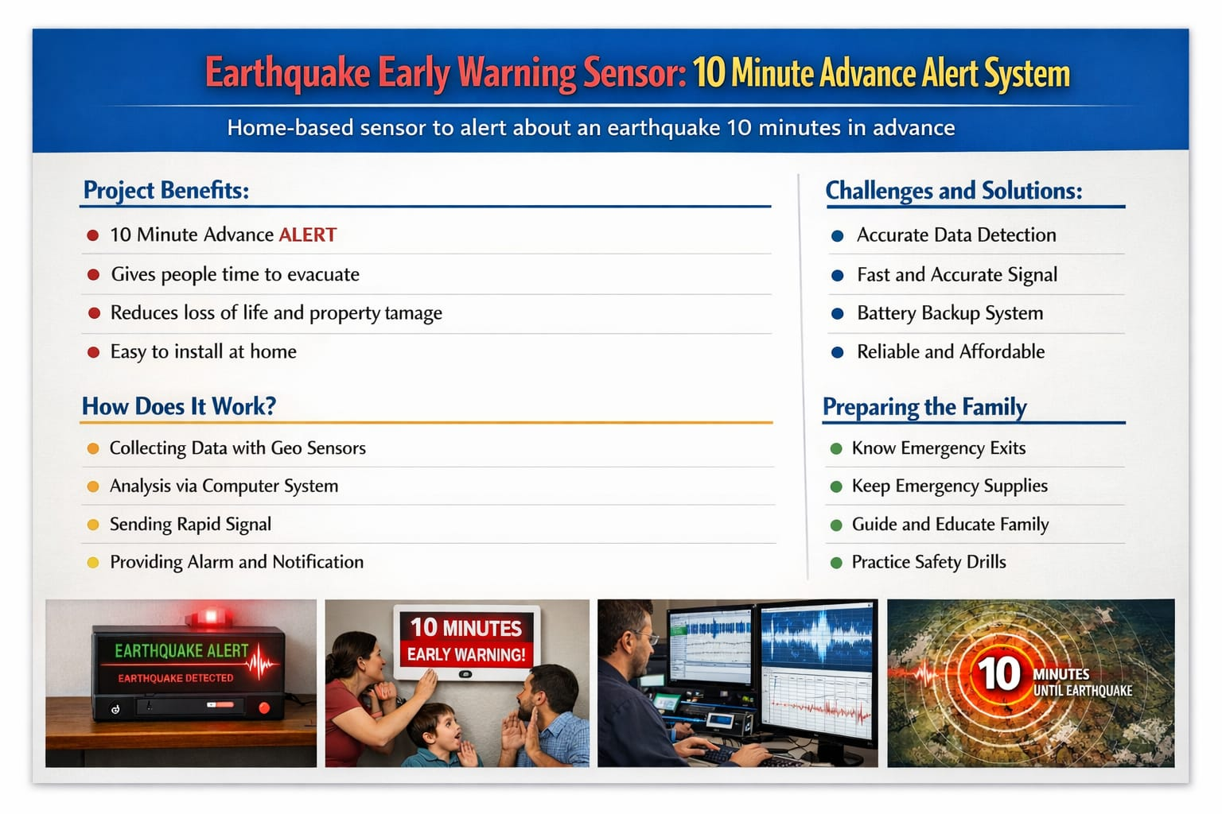
Conclusion:

Slide 9
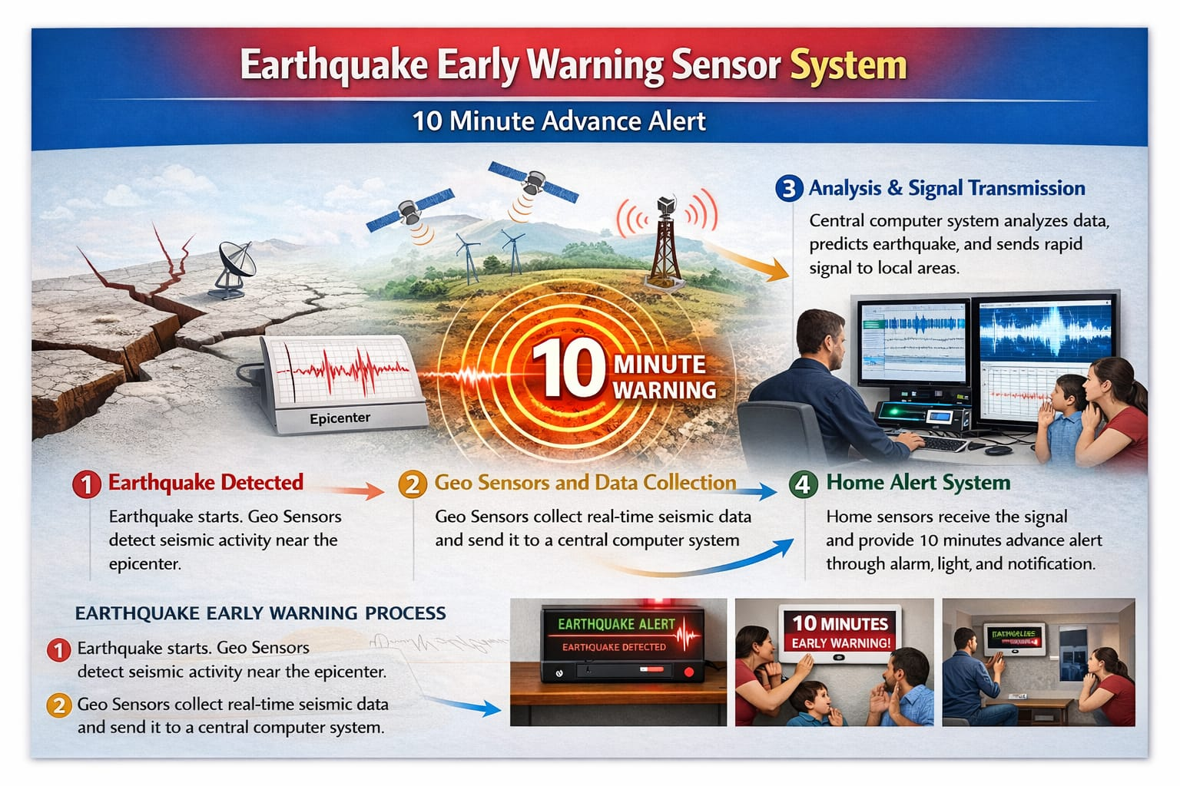

Slide 10
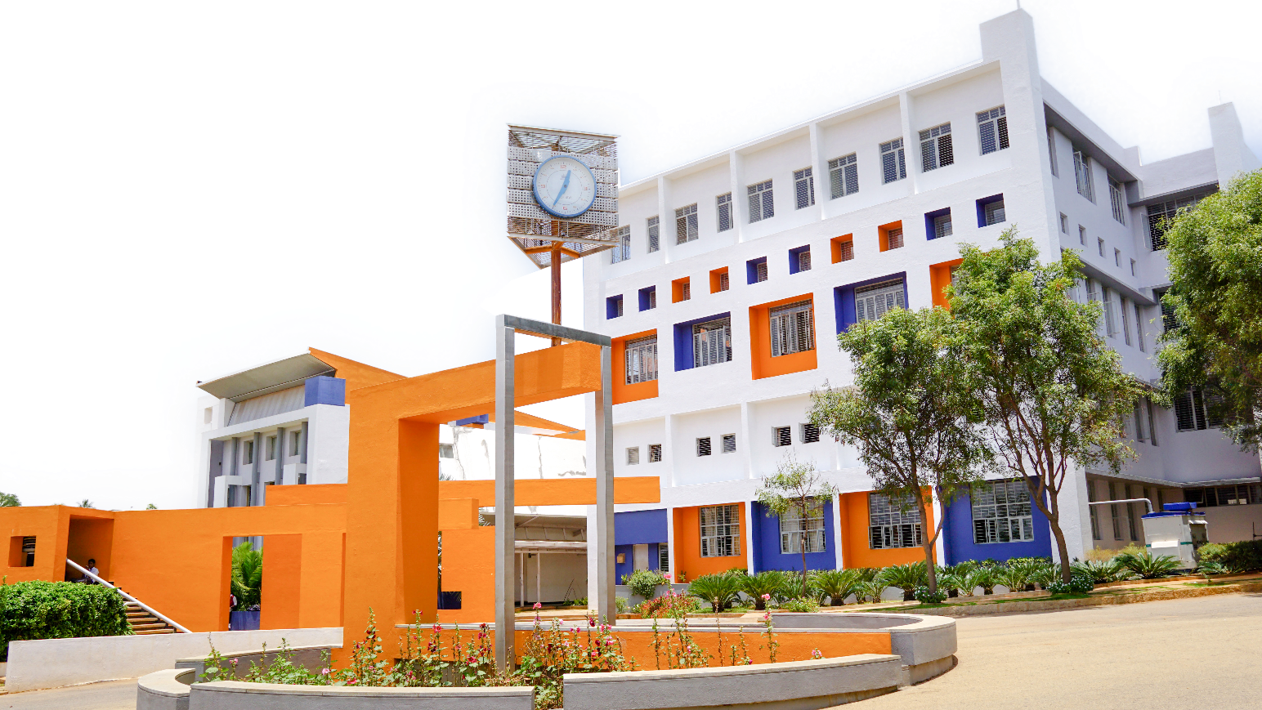
Thank you

