Slide 1
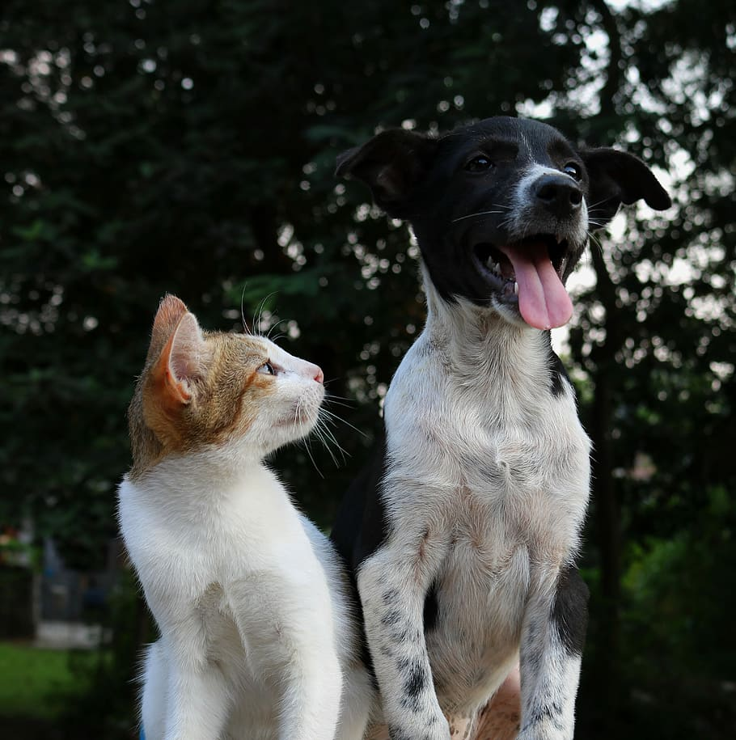
Petify
Connecting Homes and Pets…

Slide 2

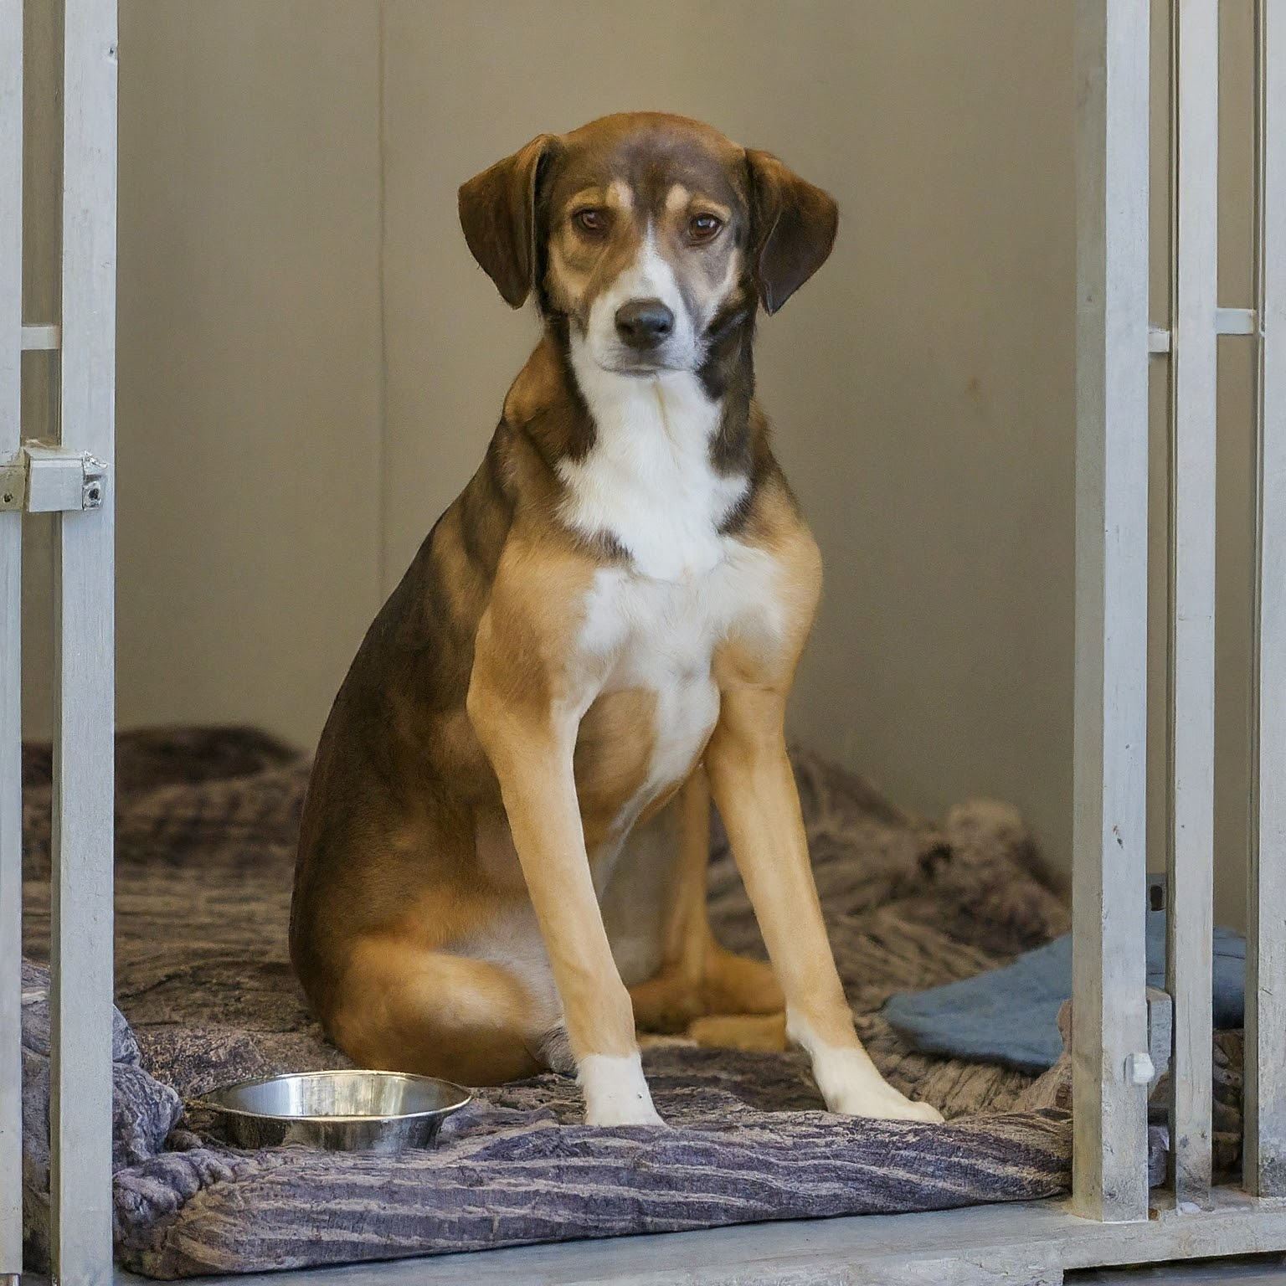
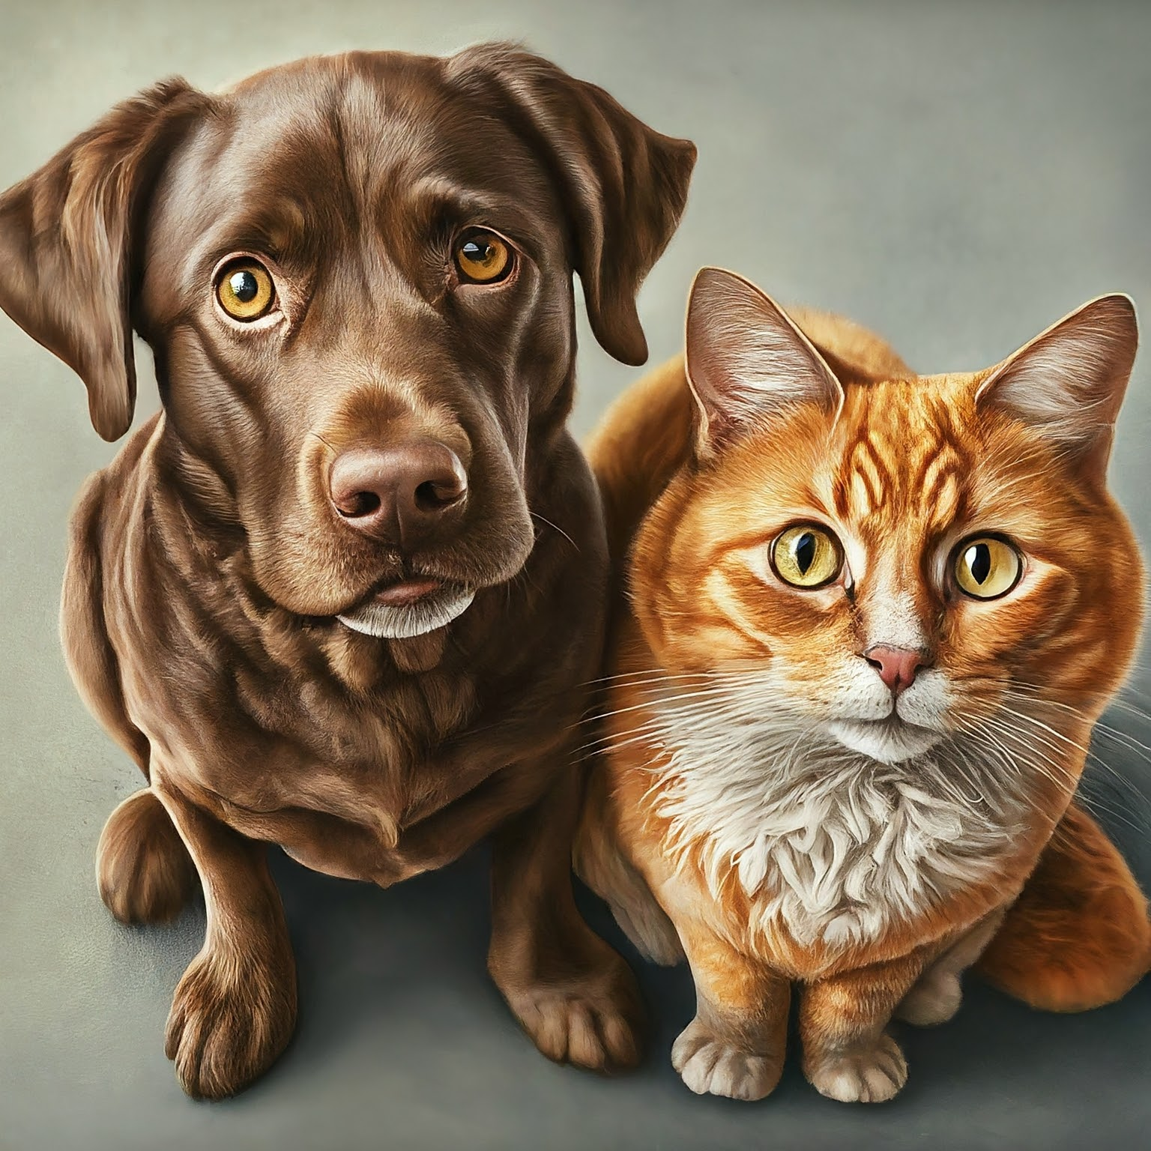
INTROUCTION
We aim to solve the Problem: Unwanted Pets and Lonely Homes.
Petify is a platform dedicated to connecting deserving animals with loving families.
We believe every pet deserves a forever home, and Petify makes this dream a reality by providing a user-friendly platform for adoption.
Petify also empowers individuals with resources and knowledge for responsible pet ownership
Let's create a world where every pet finds its forever home, one adoption at a time. 💗

Slide 3
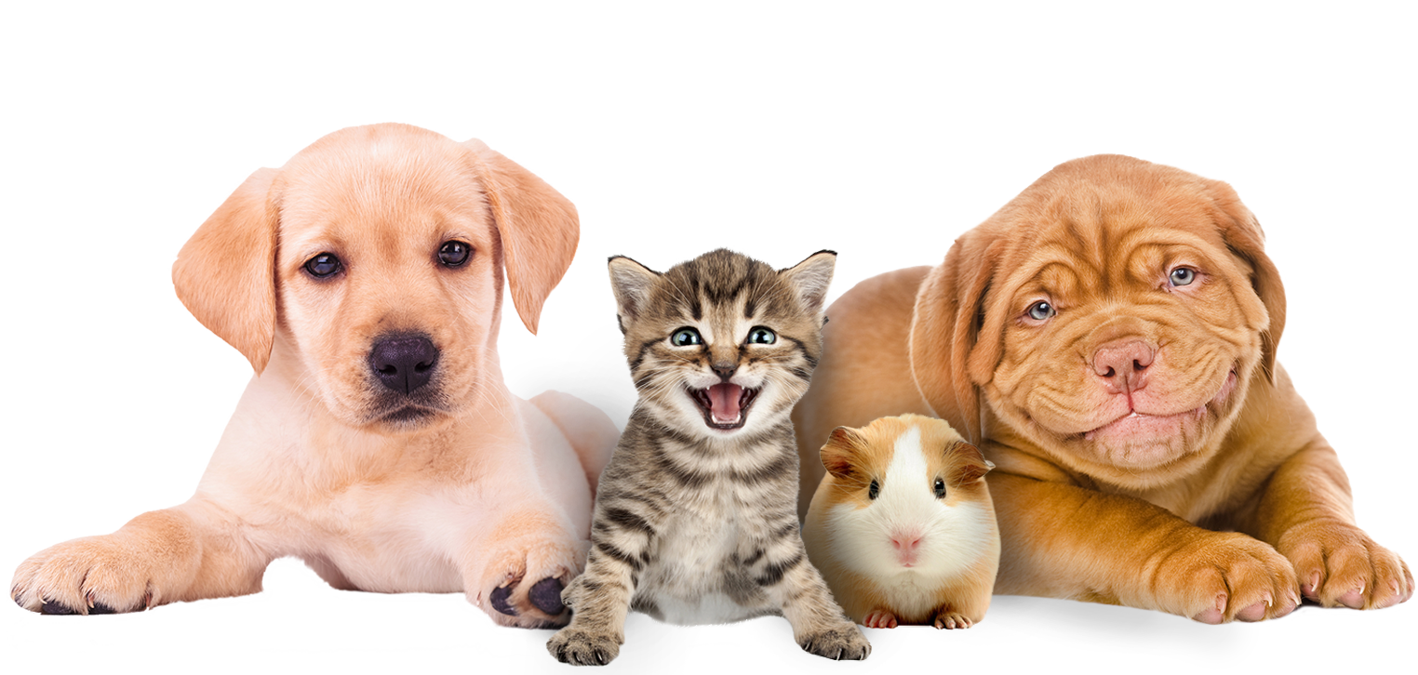
OBJECTIVES
Facilitate pet adoptions
Provide a user-friendly platform
Offer comprehensive adoption information
Promote animal welfare
Integrate a pet products shop
Educate on responsible pet care
Support pet welfare initiatives

Slide 4
Data Tables
Pets
Pet Id | Int (5)
Name | Varchar (30)
Age | Int (3)
Gender | Varchar (7)
Color | Varchar (10)
Breed | Varchar (20)
Photos
Description | Varchar (100)
Shelter
Shelter Id | Int (5)
Name | Varchar (30)
Location | Varchar (30)
Phone | Int(10)
Rescued | Varchar (3)
Photos | Varchar (20)
Cart
Cart id | Int (5)
Product id | Int (5)
User id | Int (5)
Quantity | Int (5)
Billing
User Id | Int (5)
Price | Int (5)
Payment Code | Varchar(50)

Slide 5
Data Tables
Application
App Id | Int (5)
Address | Varchar (30)
Pet id | Int (3)
User id | Int(5)
Status | Varchar (10)
User
User Id | Int (5)
Name | Varchar (30)
Email | Varchar (30)
Phone | Int(10)
Password | Varchar (50)
Address | Varchar (20)
Location | Varchar (30)
Product
Prod Id | Int (5)
Name | Varchar (30)
Description | Varchar(50)
Price | Int(5)
Photo | Varchar (10)
Admin
Admin Id | Int (5)
Password | Varchar (30)

Slide 6
ER Diagram
photo
P_id
addr
S_id
breed
1
has
S_name
Pets
1
Shelters
F_amt
name
1
M
has
M
sees
1
sees
addr
M
1
1
M
appli_id
M
sees
1
Admin
sees
Request
Pet_id
1
1
M
User_id
sees
Adds
has
U_id
P_id
name
psword
P_id
1
1
C_id
sees
U_id
Products
P_name
Users
Cart
prize
quantity
M
1
1
1
adds
pic
proceds
details
User details
1
1
1
sent
entity
Invoice
relation
attribute

Slide 7
Context level DFD
response
0.0
PET ADOPTION
SYSTEM
ADMIN
Request to login
Request to login
USERS
response

Slide 8
Frist Level DFD
1.0
Register/Login
Details
User information
users
User_details
Response
Conformation
2.0
Browse
pets
users
Adds preferences
Gets pet information
pet_details
Suggestions
Gets adopted
3.0
Adopt a pet
User information
pets
User_details
User information
Pet information
pet_details
Adopts
Pet information
users

Slide 9
4.0
Buys product
Product information
Browse products
product_details
users
Product information
Adds to cart
cart
Product information
5.0
Invoice
User Details
Product information
users
invoice_details
confirmation
Product information
User information
User information
User_details
6.0
Orders/ Adoptions
Pet information
pet_details
Gets info
Pet information
admin
Updaqtes info
Product information
product_details
Product information
Product information
cart
Product information

Slide 10
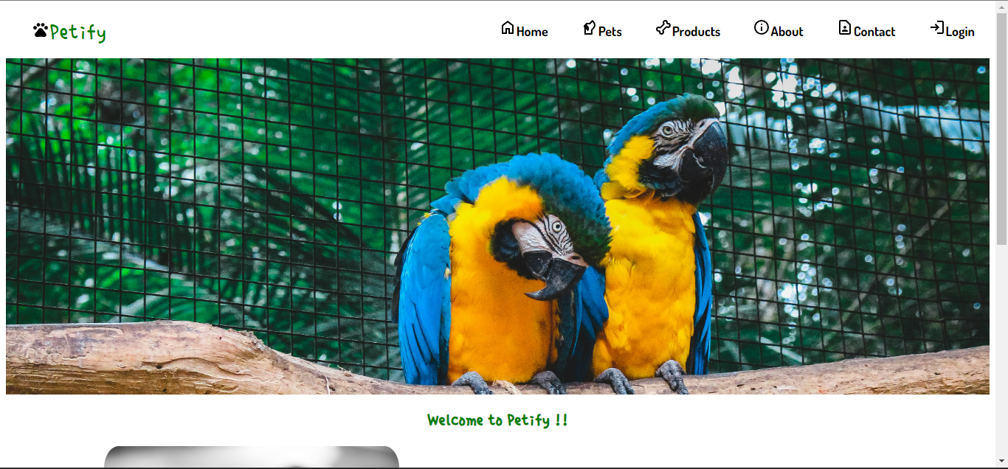
Our Home Page

Slide 11
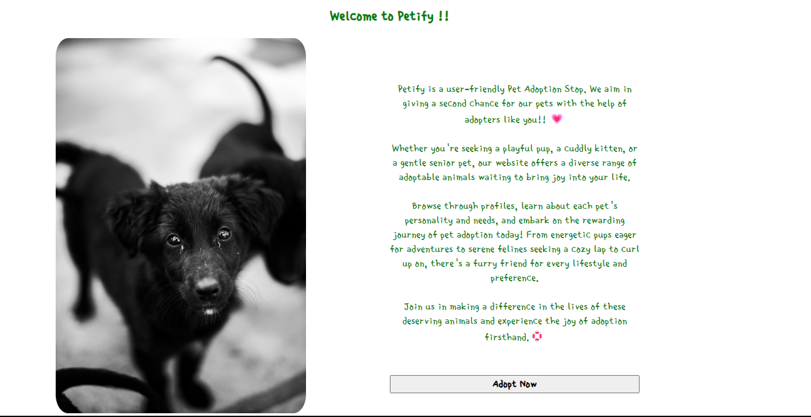
Our Home Page

Slide 12
Our Home Page

Slide 13
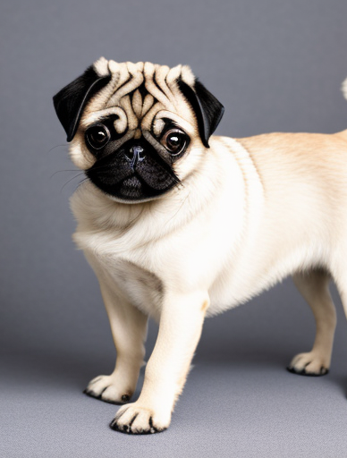
THANK YOU…
A presentation by-
Amartya Nair
Sneha Gaikwad

