Slide 1
OPERATING SYSTEMS
18XD44

Slide 2
READER WRITER PROBLEM

Slide 3
The readers-writers problem relates to an object such as a file that is shared between multiple processes.
It is a synchronization problem.
There are two types of processes in this context.
i) Reader : Any number of readers can read from the shared resource simultaneously.
ii) Writer : Only one writer can write to the shared resource. When a writer is writing data to the resource, no other process can access the resource. A writer cannot write to the resource if there are non zero number of readers accessing the resource at that time.

Slide 4
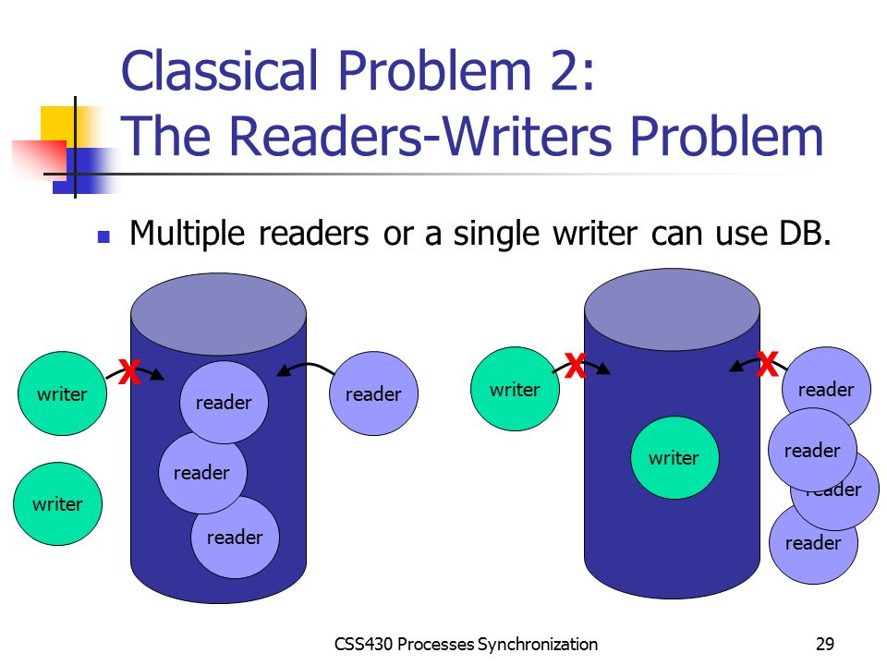

Slide 5
The readers have a higher priority than the writer.
If a writer wants to write to the resource, it must wait until there are no readers currently accessing that resource.
Here, one mutex m and a semaphore w is used. An integer variable read_count is used to maintain the number of readers currently accessing the resource.
The variable read_count is initialized to 0. A value of 1 is given initially to m and w.

Slide 6
WRITER

Slide 7
Semaphore wrt = 1;
// A binary semaphore that will be used both for mutual exclusion and signalling
wait (wrt);
// Perform write operation
signal (wrt);

Slide 8
READER

Slide 9
Mutex mutex1 ; // provides mutual exclusion when readcount is being modified
int readcount = 0; // to keep count of total readers
wait (mutex1);
readcount++ ;
if (readcount == 1)
wait (wrt);
signal (mutex1);
// perform read operation
wait (mutex1);

Slide 10
readcount-- ;
if (readcount == 0)
signal (wrt);
signal (mutex1);

Slide 11
ASSIGNMENT PROBLEM

Slide 12
INTRODUCTION :
The main objective of the assignment is to provide a practical view of the synchronization mechanisms available in the POSIX threads library.
PROBLEM STATEMENT :
Design and implement a concurrent access library operating on the top of a warehouse database, in order to guarantee the consistence of all operations even if the operations are performed in a concurrent manner.

Slide 13
DESIGN

Slide 14
Database Interface (db_warehouse)
int db_warehouse_init()
int db_warehouse_destroy()
int db_warehouse_create_product (char *product_name)
int db_warehouse_get_num_products (int *num_products)
int db_warehouse_delete_product (char *product_name)
int db_warehouse_set_internal_data (char *product_name, void *ptr, int size)
int db_warehouse_get_internal_data (char *product_name, void **ptr, int *size)
int db_warehouse_exists_product (char *product_name)
int db_warehouse_update_stock (char *product_name, int stock)
int db_warehouse_get_stock (char *product_name, int *stock)

Slide 15
Sequential Library
int sequential_init ()
int sequential_destroy ()
int sequential_create_product (char *product_name)
int sequential_get_num_products (int *num_products)
int sequential_delete_product (char *product_name)
int sequential_increment_stock (char *product_name, int stock, int *updated_stock)
int sequential_decrement_stock (char *product_name, int stock, int *updated_stock)
int sequential_get_stock (char *product_name, int *stock)

Slide 16
Concurrent Library
int concurrent_init ()
int concurrent_destroy ()
int concurrent_create_product (char *product_name)
int concurrent_get_num_products (int *num_products)
int concurrent_delete_product (char *product_name)
int concurrent_increment_stock (char *product_name, int stock, int *updated_stock)
int concurrent_decrement_stock (char *product_name, int stock, int *updated_stock)
int concurrent_get_stock (char *product_name, int *stock)

Slide 17
THE IMPLEMENTATION OF THE GIVEN PROBLEM

Slide 18
DB_WAREHOUSE

Slide 19
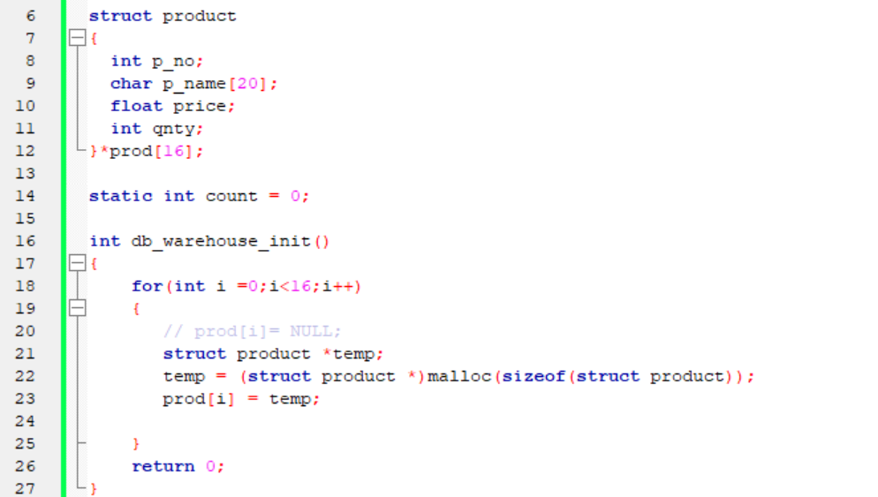

Slide 20
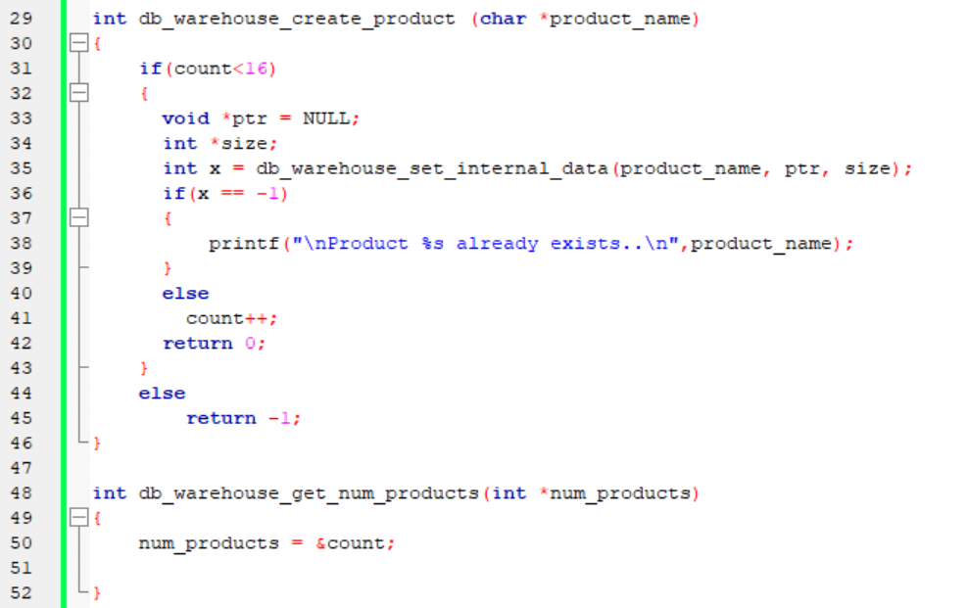

Slide 21
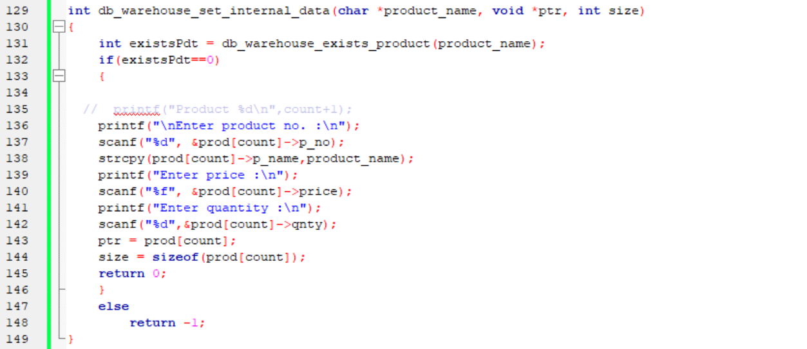

Slide 22
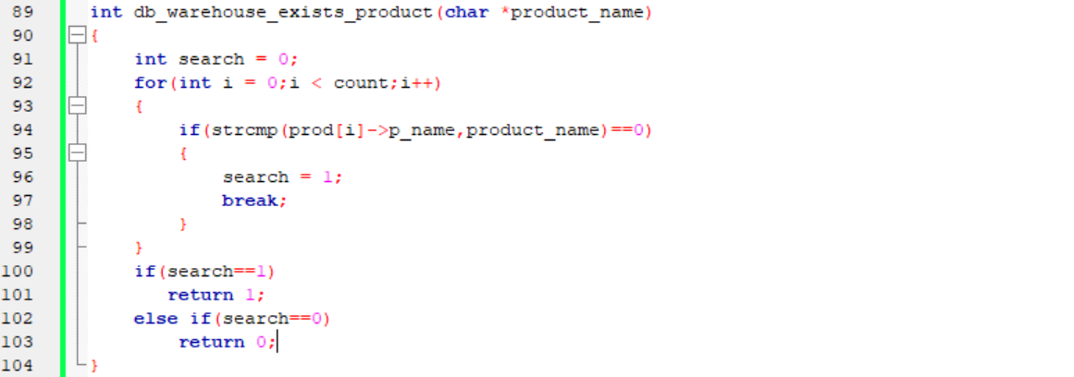

Slide 23
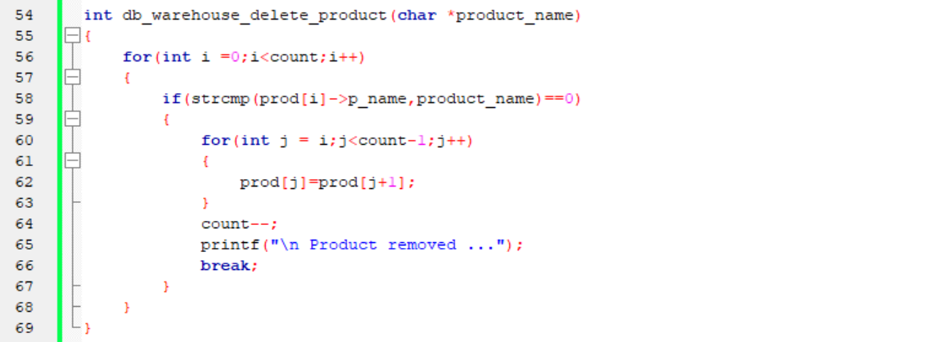

Slide 24
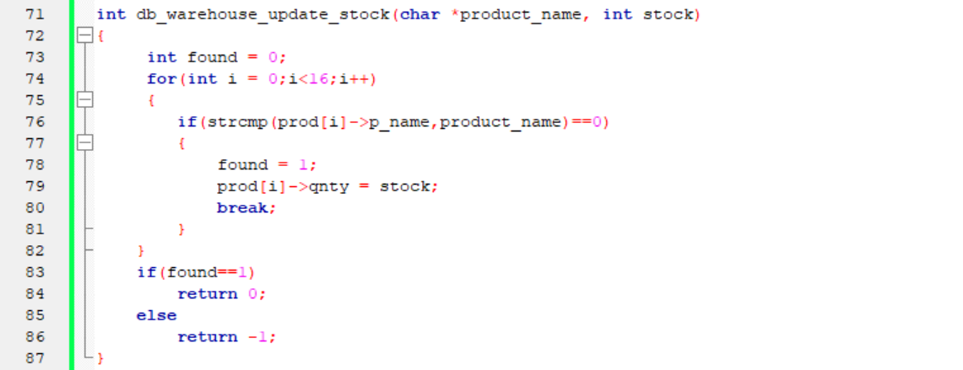

Slide 25
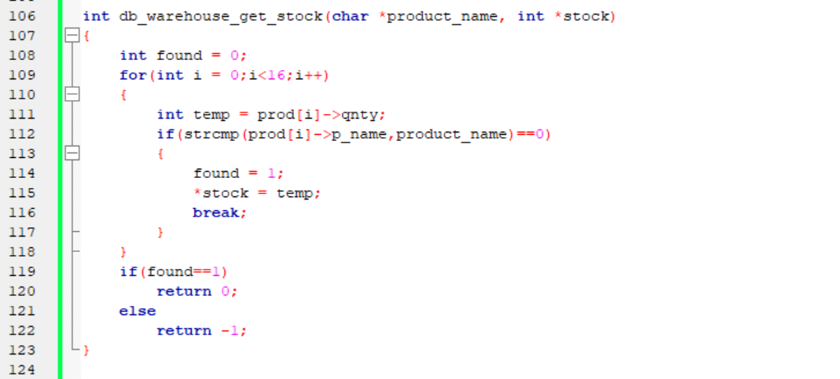

Slide 26
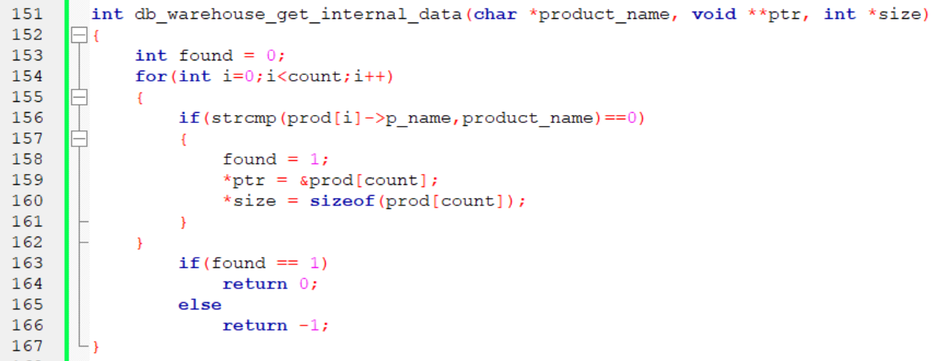

Slide 27
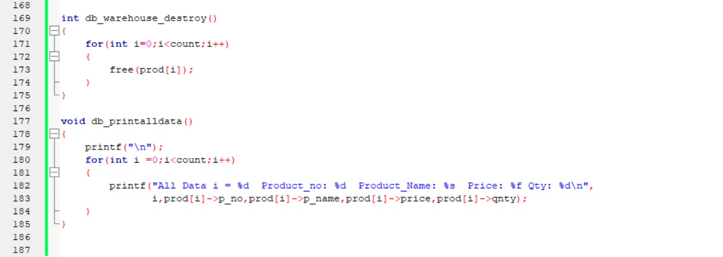

Slide 28
SEQUENTIAL

Slide 29
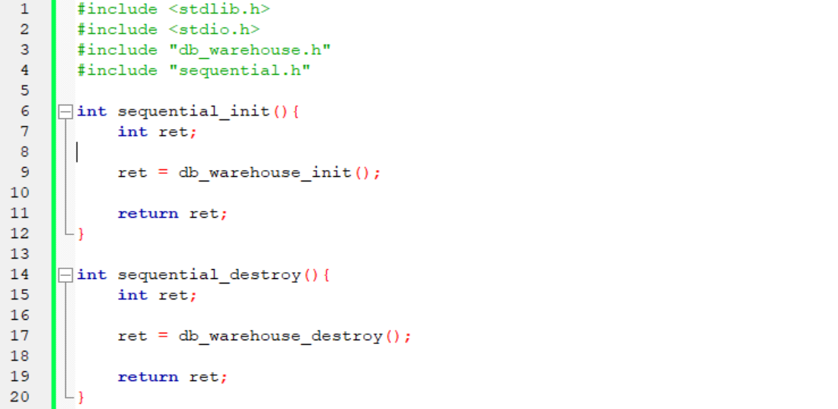

Slide 30
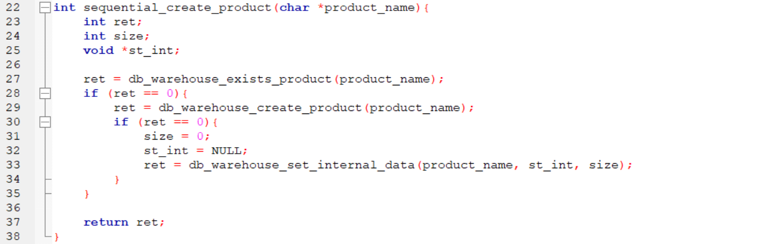

Slide 31
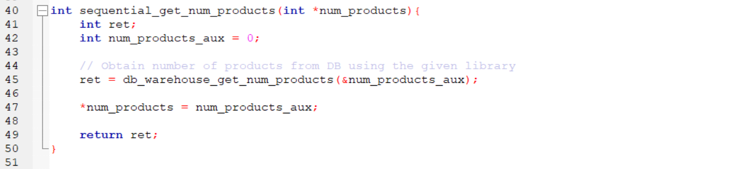

Slide 32
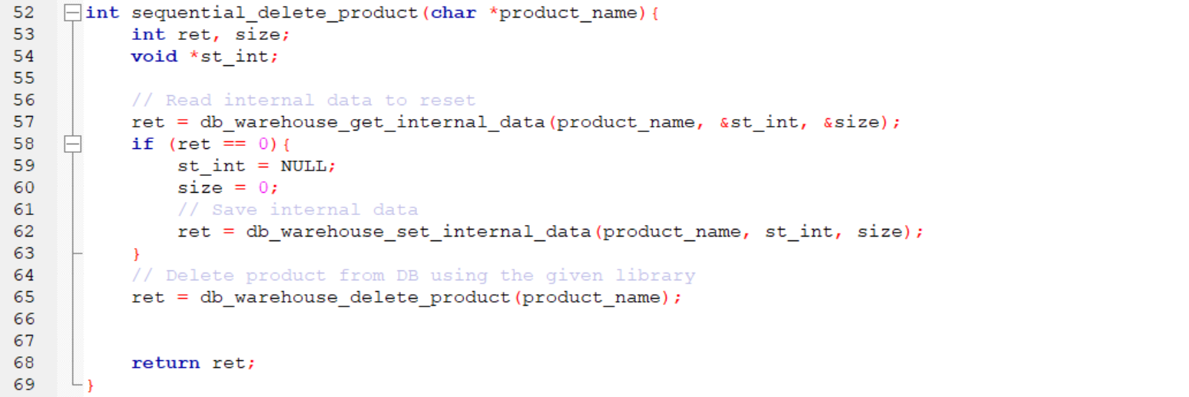

Slide 33
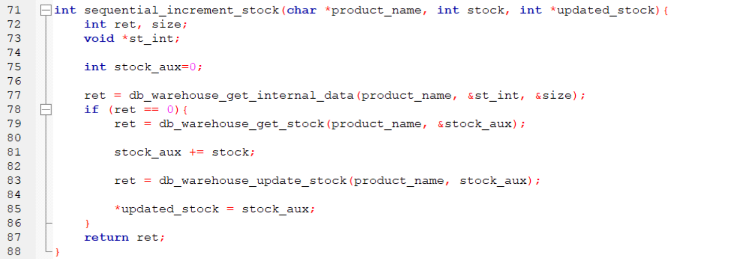

Slide 34
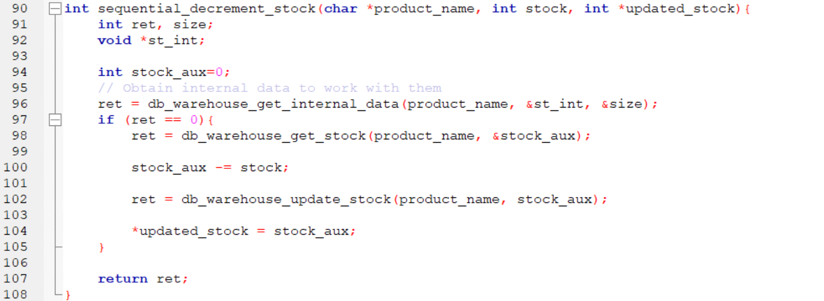

Slide 35
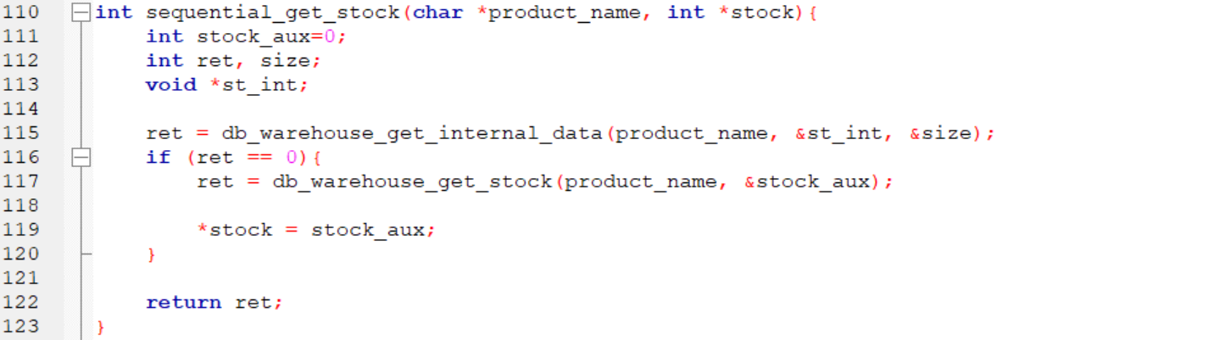

Slide 36
CONCURRENT

Slide 37
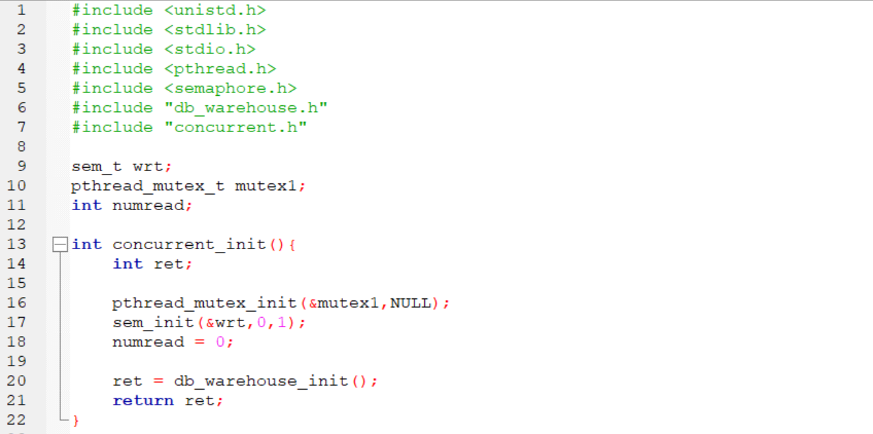

Slide 38
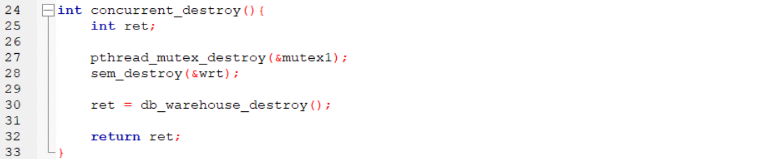

Slide 39
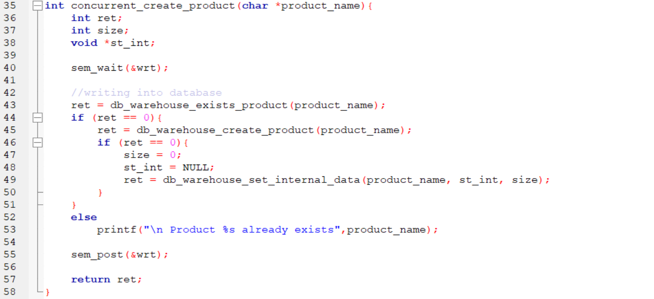

Slide 40
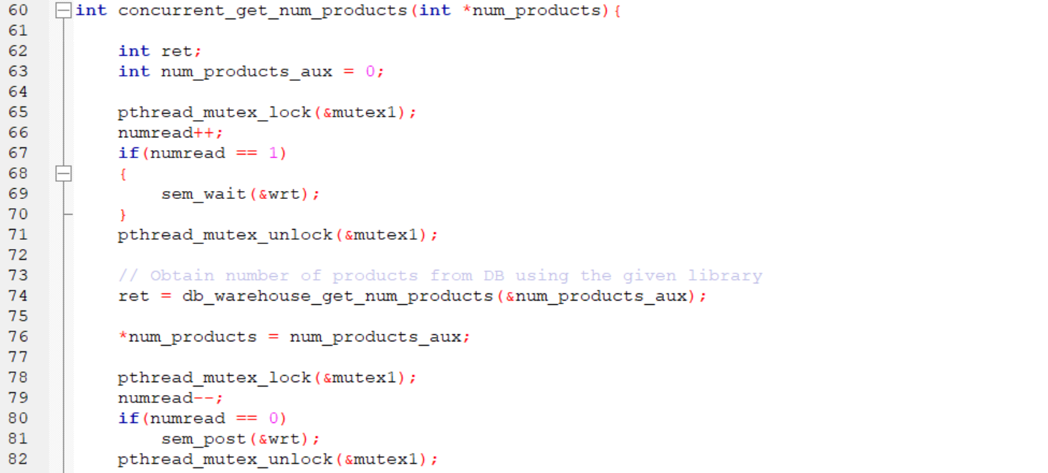
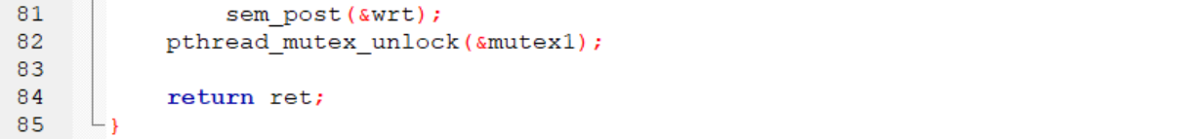

Slide 41
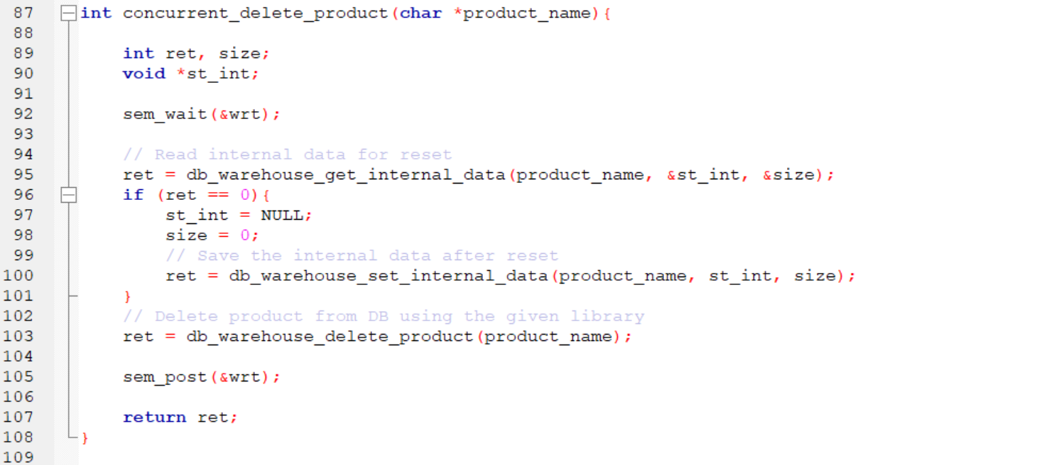

Slide 42
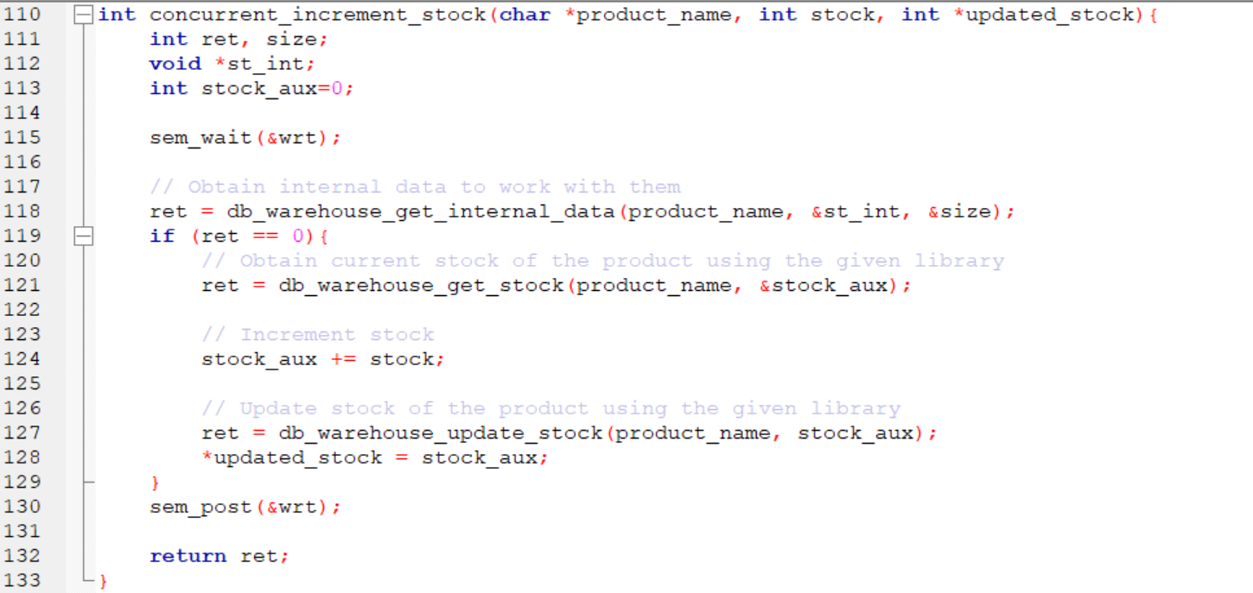

Slide 43
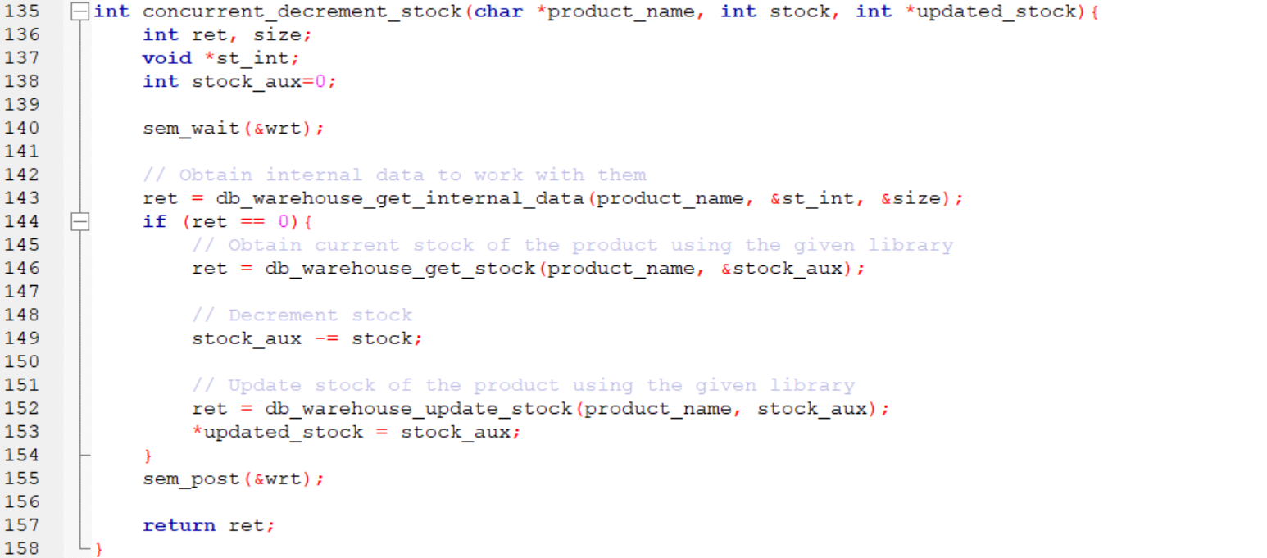

Slide 44
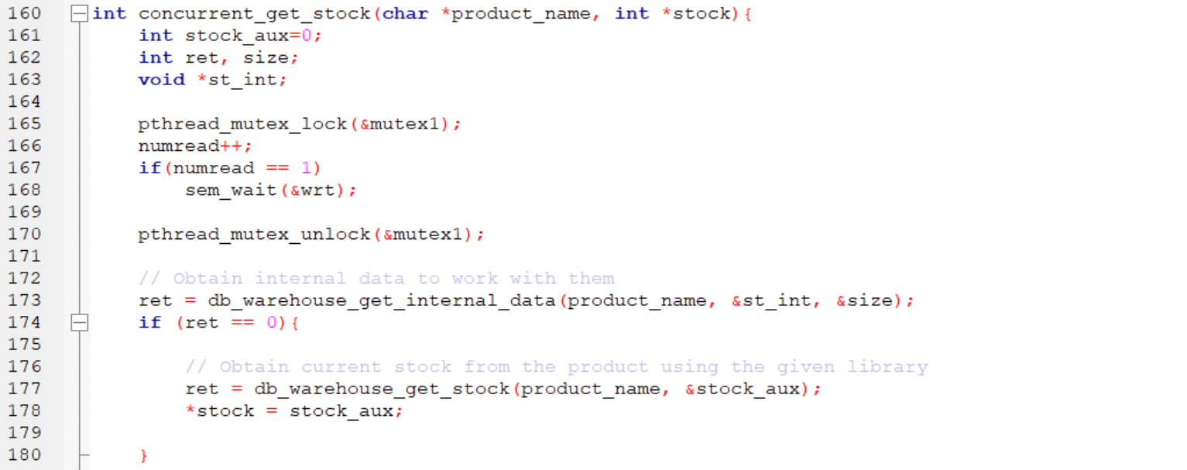

Slide 45
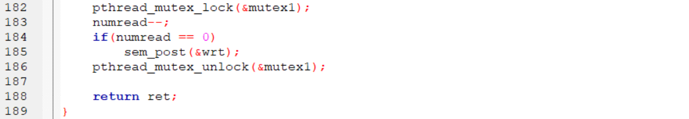

Slide 46
RESULT

Slide 47
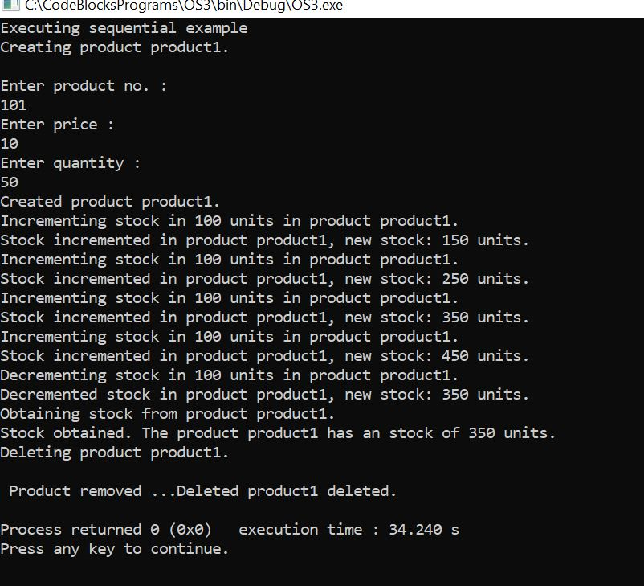
SEQUENTIAL OUTPUT :
Notes:
int stock = 100, updated_stock = 0;
char *product_name= "product1";
sequential_init();
sequential_destroy();

Slide 48
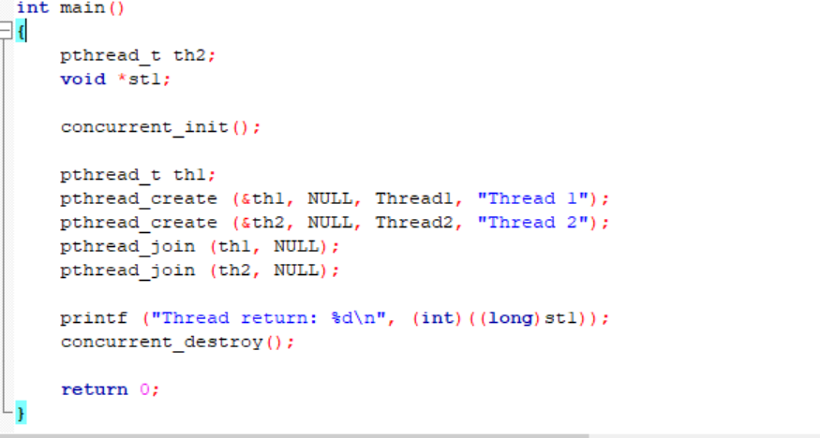
CONCURRENT OUTPUT :

Slide 49
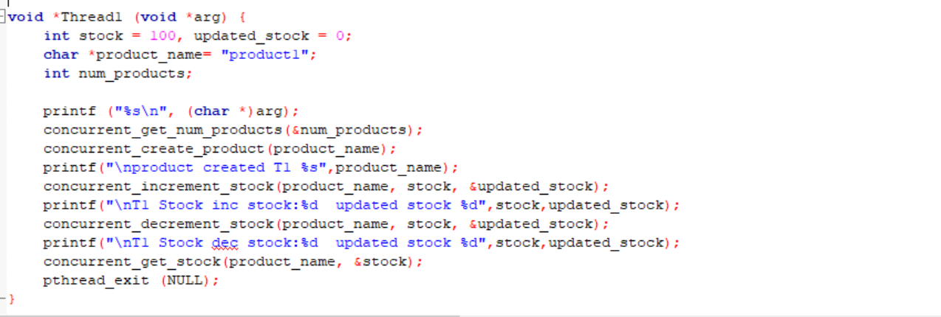

Slide 50
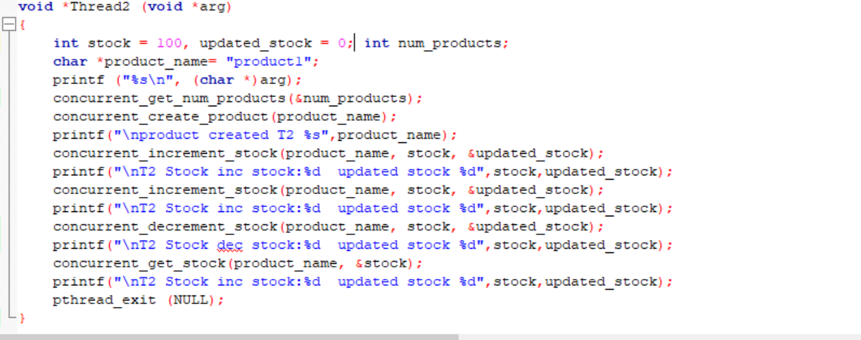

Slide 51
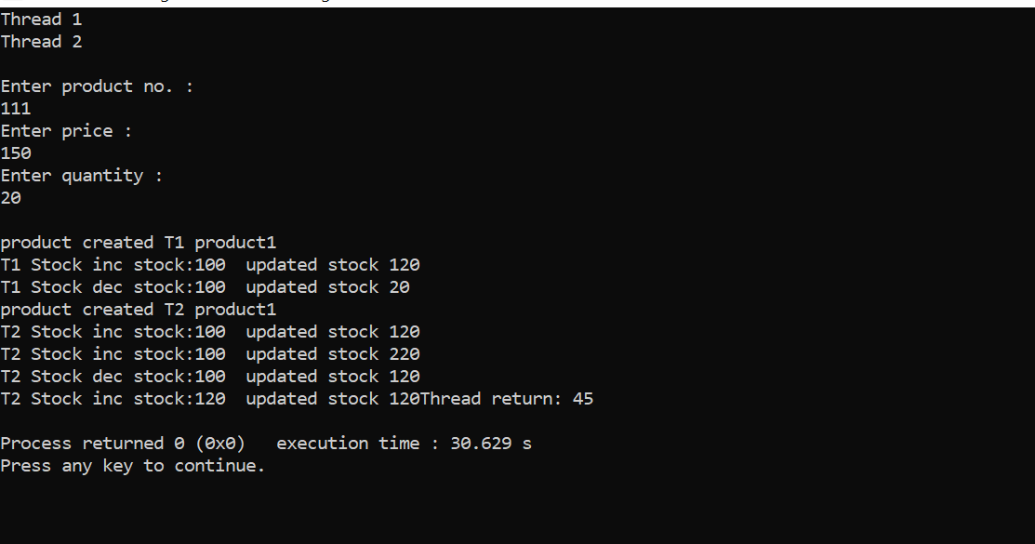
CONCURRENT OUTPUT :
Notes:
int stock = 100, updated_stock = 0;
char *product_name= "product1";
Using create,join and exit
destroy .. pthreads

Slide 52
THANK YOU

