Slide 1
Research Questions – Data Scientist JOBS
Snehaa Potdar
Data Analytics – fall 2018

Slide 2
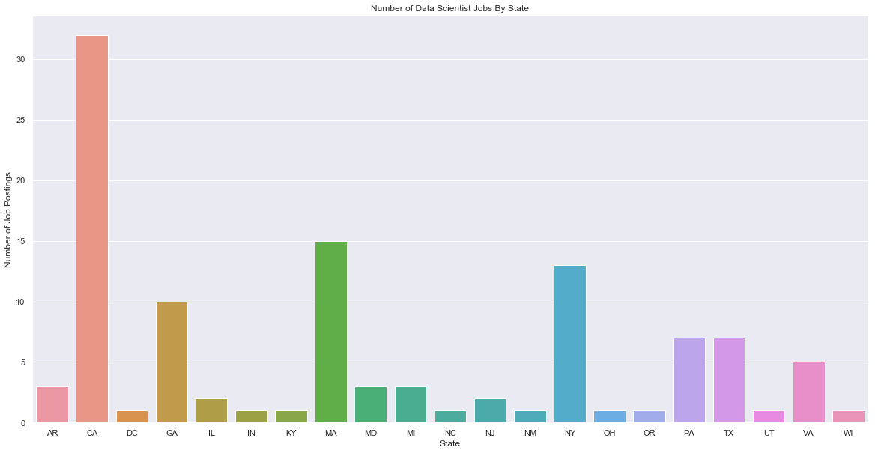
Research Question: Variation in the number of Data Scientist Job Postings by State
Allows us to see which state has the highest chances to secure a job
CA has the highest number of Data Scientist job postings
MA, NY, GA are the next best candidates
We have seen the highest pay packages and highest number of job postings but which is the best place to settle in? ☺
Python Notebook Code For Visualization:

Slide 3
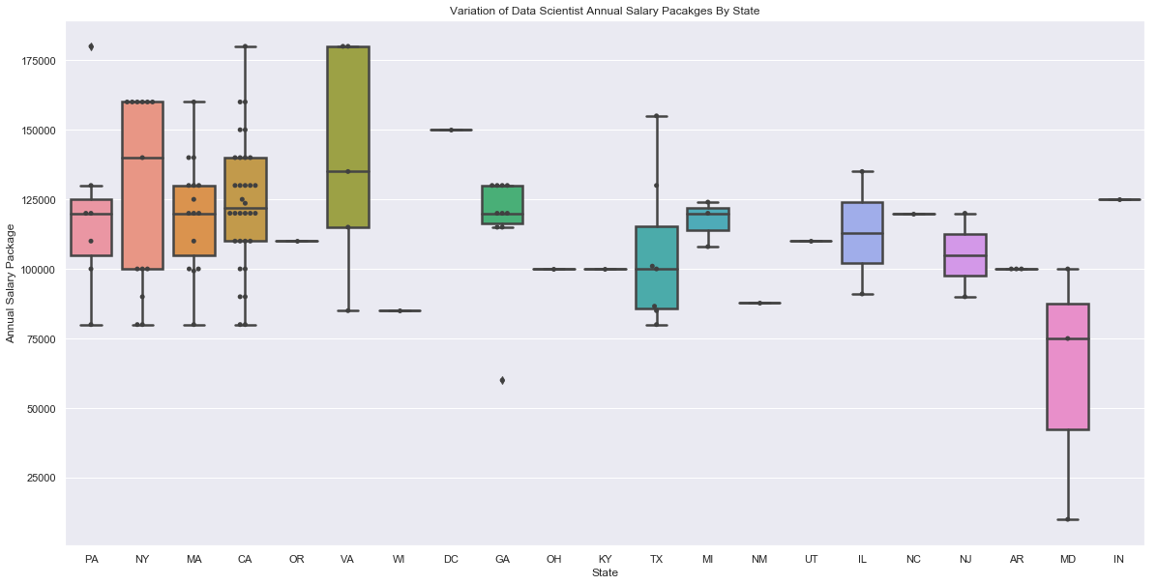
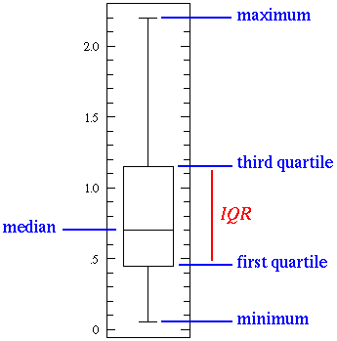
Research Question: Variation of Data Scientist Salaries By State
Allows us to see which is the best state to get a good compensation package
NY has the highest median compensation package
Maryland has the least median average compensation package
Python Notebook Code For Visualization:
*Box Plot shows distribution; Swarm Plot shows actual datapoints

Slide 4
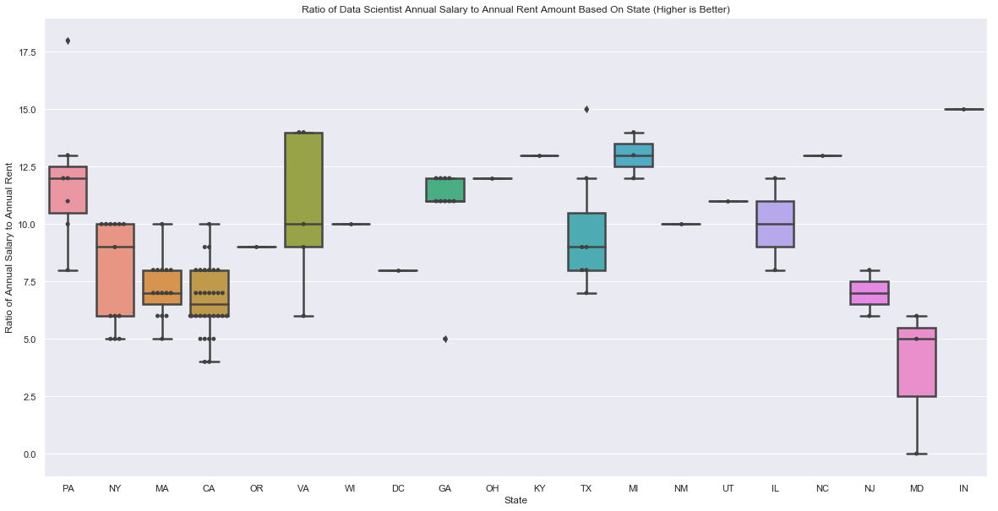
Research Question: Ratio of Data Scientist Annual Salary to Yearly Rent Amount (1BHK) By State
Higher the ratio, better affordability
MI has the highest affordability ratio
MD has the lowest affordability ratio
Rent prices are really high in CA, DC and NY affecting the affordability in these states
CA is not among the best states for affordability ☹
Affordability Ratio = $\frac{Annual Salary}{Annual Rent (1BHK) in each state}$
Rental Data: Source
Python Notebook Code For Visualization:
*Box Plot shows distribution; Swarm Plot shows actual datapoints

Slide 5
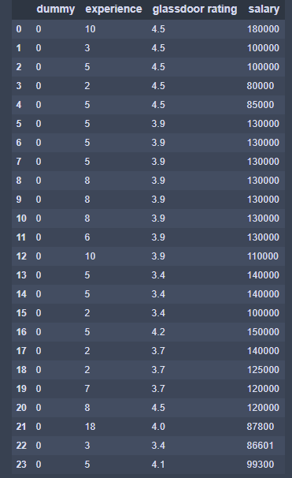
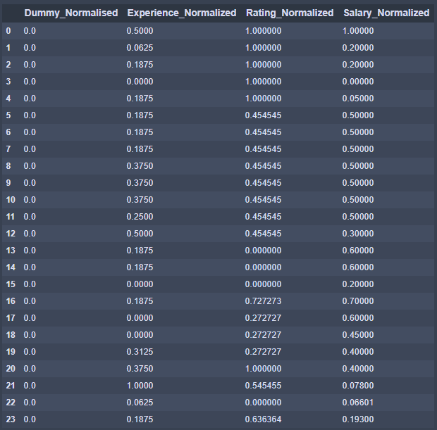
Research Question: MLR to study effect of Experience and Company Rating on Annual Pay Package for Data Scientists
Steps:
Clean dataframe to consider data scientist jobs with experience
Obtain Glassdoor Ratings for all companies in dataframe
Merge both dataframes and keep only dummy, experience, rating & Salary Columns
Normalize all columns
Perform Gradient Descent Algorithm and obtain regression co-efficient
Original DF
Normalized DF
200
Iterations
Regression Co-Efficient:
[0.0, 0.55, 0.31]
Bad correlation
Not good correlation

Slide 6
Conclusion:
Project has been useful to provide insights into the US Data Science job market
The data science market is highly focused in states with high-tech job markets
Job seekers need to compromise between probability of getting a job and affordability
Improvement Ideas:
Current dataset had only 110 data scientist jobs. Need at least 3000 jobs to have a good sample size for regression analysis
Ran into a lot of issues while scraping data from webpages. Had to use time.sleep(60) to limit scraping requests to 1 request per minute. A better approach could be researched and used
Could make affordability ratio more accurate by including other factors such cost of food, transport and entertainment

Slide 7
BACKUP Slides
(Additional Visualizations to help support the data covered previously)

Slide 8
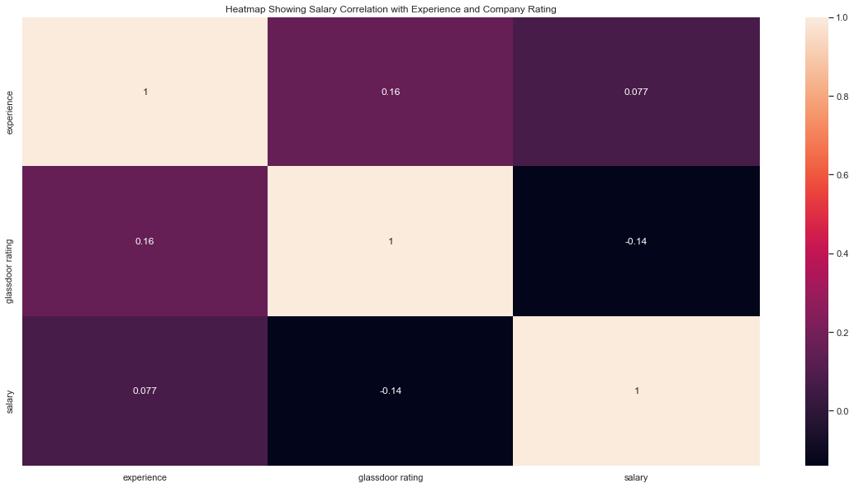
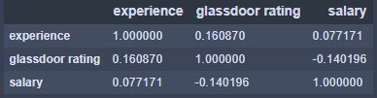
Research Question: Study effect of Experience and Company Rating on Annual Pay Package for Data Scientists (Correlation Approach and Visualization using Heat map)
“Correlation" refers to a mutual relationship or association between quantities
Pandas .corr() method uses Pearson’s method to quantify the degree to which a relationship between two variables can be described by a line
Pearson’s Co-efficient close to 1 indicates good correlation
Experience does not have a good correlation with salary
Rating has even worse correlation with salary
Python Notebook Code For Visualization:
*Pearson’s Co-efficient Calculation:
*Pearson correlation measures the linear association between continuous variables.

