Slide 1
Edu Sahay – AI Agent for Personalized Learning Support
Capstone Project – Kaggle
By: Sneha Bahot

Slide 2
Introduction
AI-powered assistant for personalized learning.
Identifies weak topics using quiz analytics.
Generates micro-learning study plans.
Improves learning efficiency and reduces stress.

Slide 3
Problem Summary
Lack of personalized guidance.
Difficulty identifying weak topics.
One-size-fits-all teaching approach.
Limited access to tutors.

Slide 4
Proposed Solution
Analyzes student quiz performance.
Detects weak chapters/topics.
Generates personalized study plans.
Provides focused Q&A support.

Slide 5
Objectives & MVP Scope
Detect weak topics from quizzes.
Daily/weekly personalized study plans.
Q&A assistance using NLP.
MVP: Quiz input → Weak-topic detection → Study planner → Dashboard.

Slide 6
Dataset Overview
Dataset: Quiz responses + topic labels (synthetic for demo).
Features: question_id, correctness, topic, marks.
Preprocessing: Topic normalization, accuracy scoring.

Slide 7
EDA Summary
Weak-topic distribution analysis.
Student performance histogram.
Topic frequency insights.
Helps tune difficulty-based study planning.

Slide 8
System Architecture
User Interface (Web/Chat).
Quiz Ingestion & Preprocessing.
Weakness Detector (Rule-based + ML).
Planner & Recommendation Engine.
QA Engine using Embeddings.
Database + Dashboard.

Slide 9
Models & Techniques
Topic Classification: rule-based + ML heuristics.
QA Engine: Sentence-transformer-based retrieval.
Planner: priority ranking + spaced repetition logic.

Slide 10
Results & Evaluation
Weak-topic detection accuracy: ~82% (synthetic evaluation).
QA relevance score: ~78% (manual evaluation).
Study plan time reduction: ~40%.

Slide 11
API Contract (Brief)
POST /users/register
POST /reports/submit_quiz
POST /qa/ask
POST /planner/feedback

Slide 12
Conclusion & Future Work
Edu Sahay delivers personalized AI-driven learning support.
Improves student confidence and academic performance.
Future: Multilingual support, voice input, teacher analytics, mobile app.

Slide 13
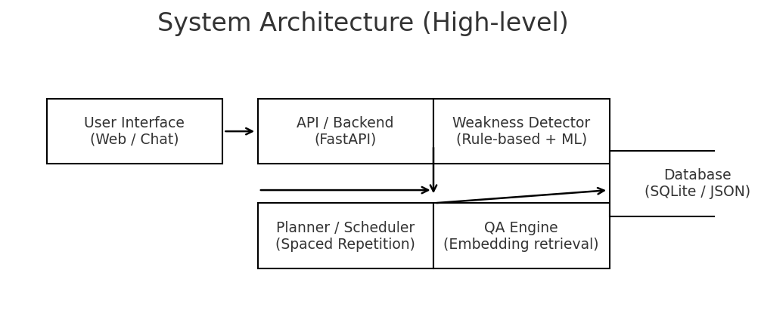

Slide 14
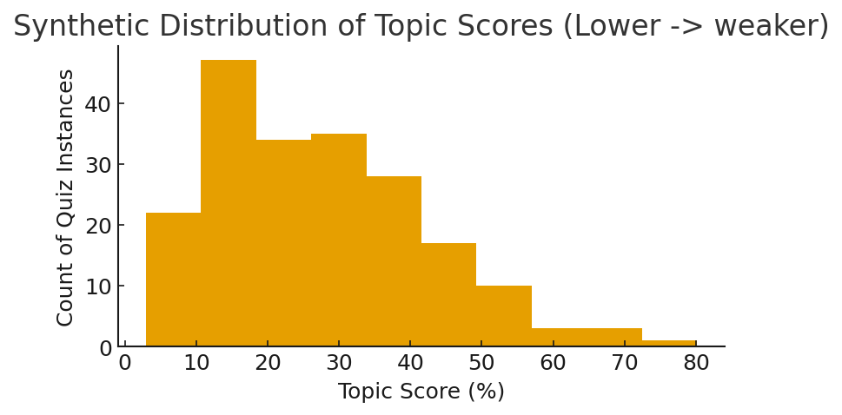

Slide 15
Code Samples (Key Functions)
# Weak-topic detection (pseudo-code)
def detect _ weak _ topics(answers):
# answers: list of {question _ id, correct(bool), topic, marks}
topic _ scores = {}
for a in answers:
topic _ scores. Set default(a['topic'], []).append(a['marks'])
avg = {t: sum(v)/len(v) for t, v in topic _ scores. items()}
weak = sorted(avg. items(), key=lambda x: x[1])[:5]
return weak
# Planner: create daily micro-plan
def generate _ plan(user _ id, weak _ topics, duration _days=7):
plan = []
for d in range(duration _ days):
day _ topics = select_ topics _ for _ day(weak _ topics, d, duration _ days)
plan. append({'day': d+1, 'topics': day _ topics})
return plan

Slide 16
QA Retrieval Code Snippet
# Simple QA retrieval (embedding-based)
from sentence _ transformers import Sentence Transformer, util
model = Sentence Transformer('all-MiniLM-L6-v2')
def answer _ question(question, docs):
q_ emb = model. encode(question, convert _to _ tensor=True)
doc _ embs = model. encode(docs, conver t_ to_ tensor=True)
hits = util. semantic _ search(q_ emb, doc _ embs, top _ k=3)
return hits

Slide 17
Sample API Request / Response
POST /reports/submit_quiz
Request:
{
"user_id":"u_12345",
"quiz_id":"q_001",
"subject":"Math",
"answers":[
{"question_id":"q1","correct":false,"topic":"Algebra","marks":0},
{"question_id":"q2","correct":true,"topic":"Geometry","marks":1}
],
"total_marks":10
}
Response (200 OK):
{
"report_id":"r_67890",
"weak_topics":[{"topic":"Algebra","score":22}],
"suggested_plan_id":"plan_111"
}

