Slide 1
Introduction to the idea behind my Master’s thesis
Sneha Banerjee

Slide 2
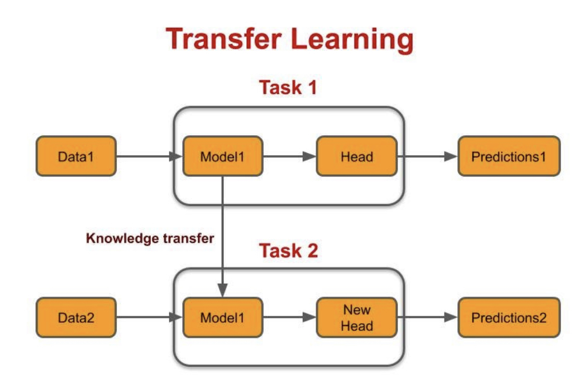
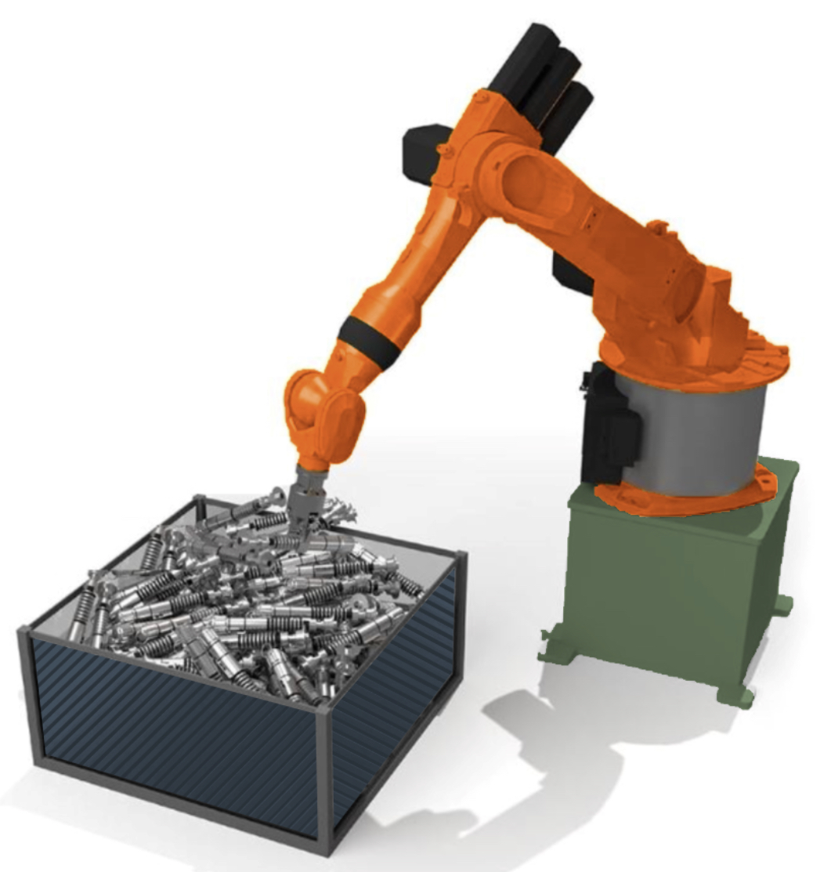
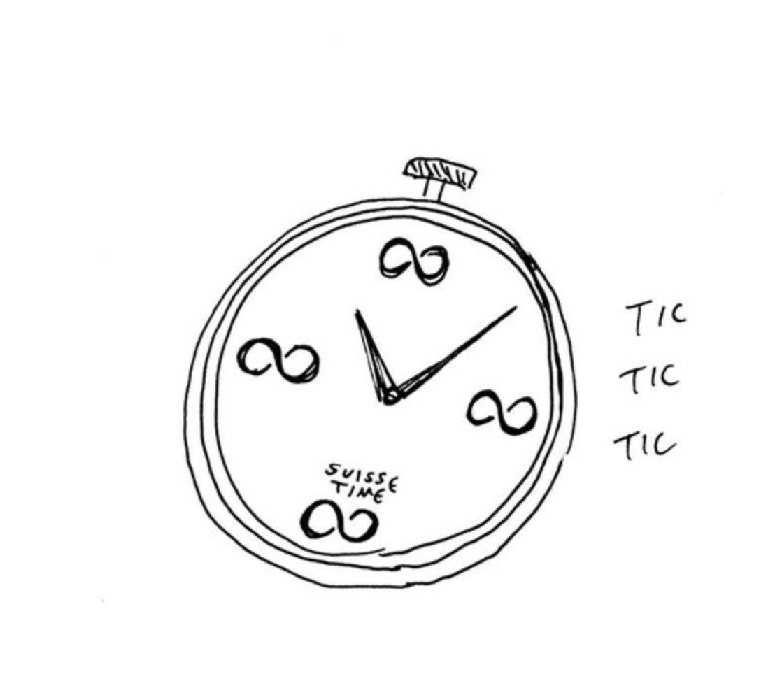
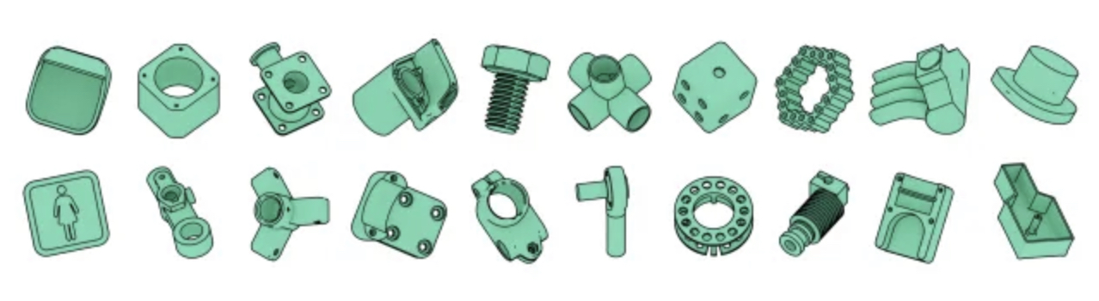
Bin Picking

Slide 3

What is good data?

Slide 4
What is good data?

Slide 5
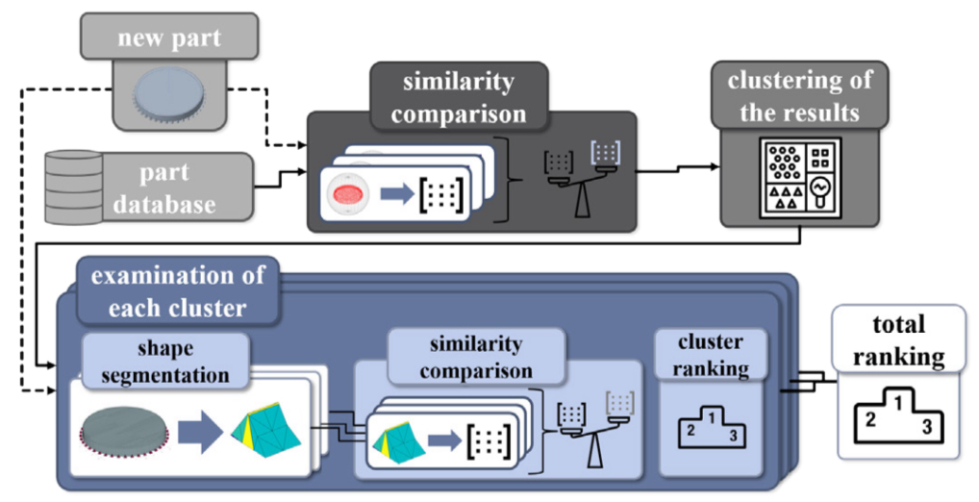
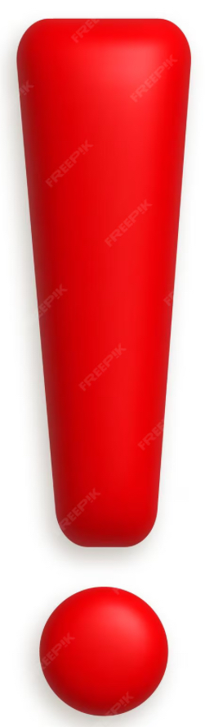
Comparing CAD part models for geometric similarity : A concept using machine learning algorithms
S. Bickel et al.
User defined local geometric similarity

Slide 6
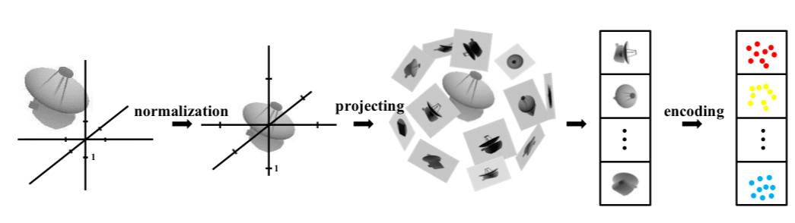
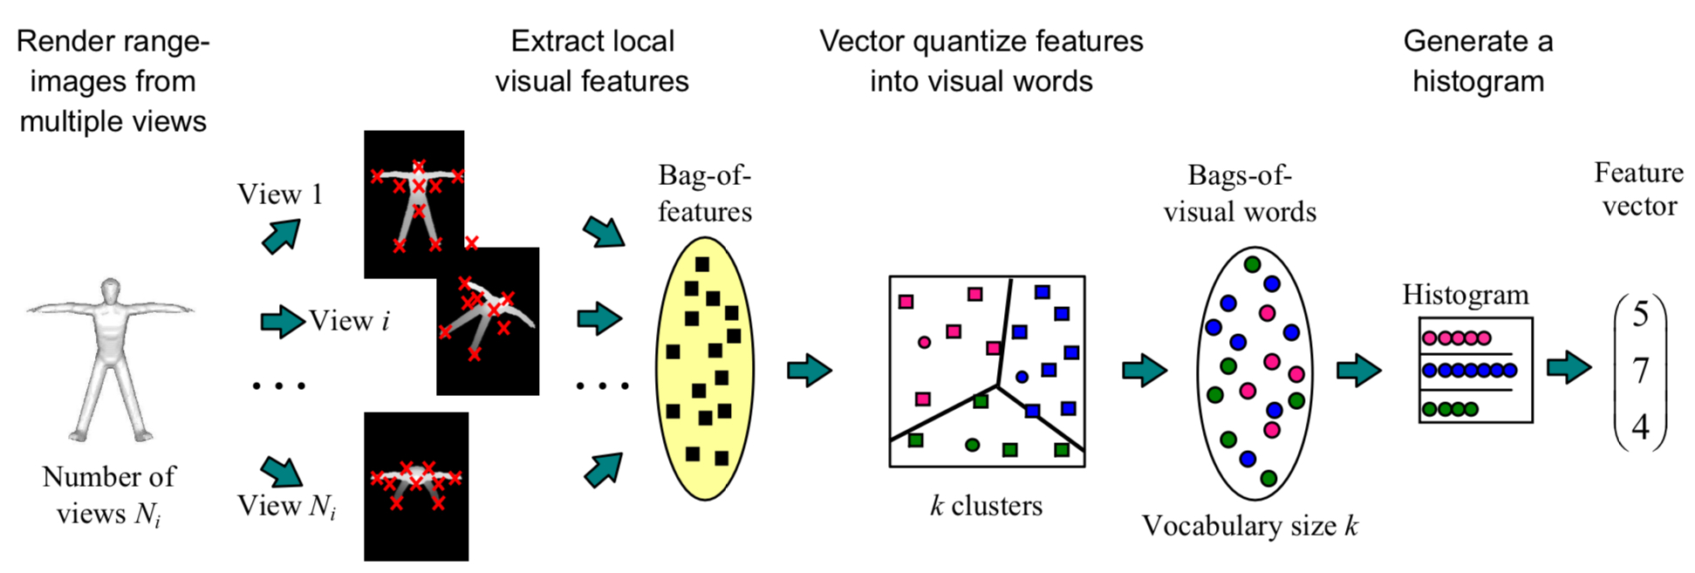
Deep Learning Representation using Autoencoder for 3D Shape Retrieval
Zhuotun Zhu et al.
GLOBAL
LOCAL

Slide 7
Proposed Idea
Autoencoder
+
BoF-SIFT
Ranking list

Slide 8
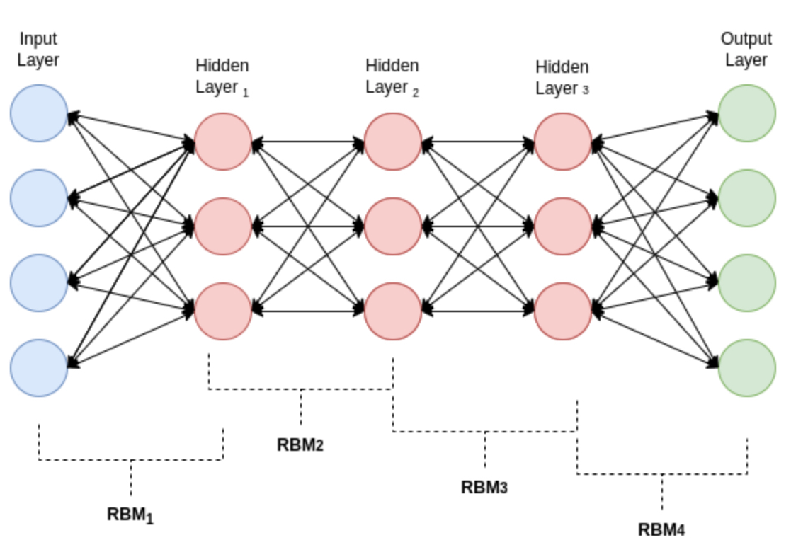
Problems😞
Spatial correlation is lost!!!

Slide 9
Change in Plans !!!!

Slide 10
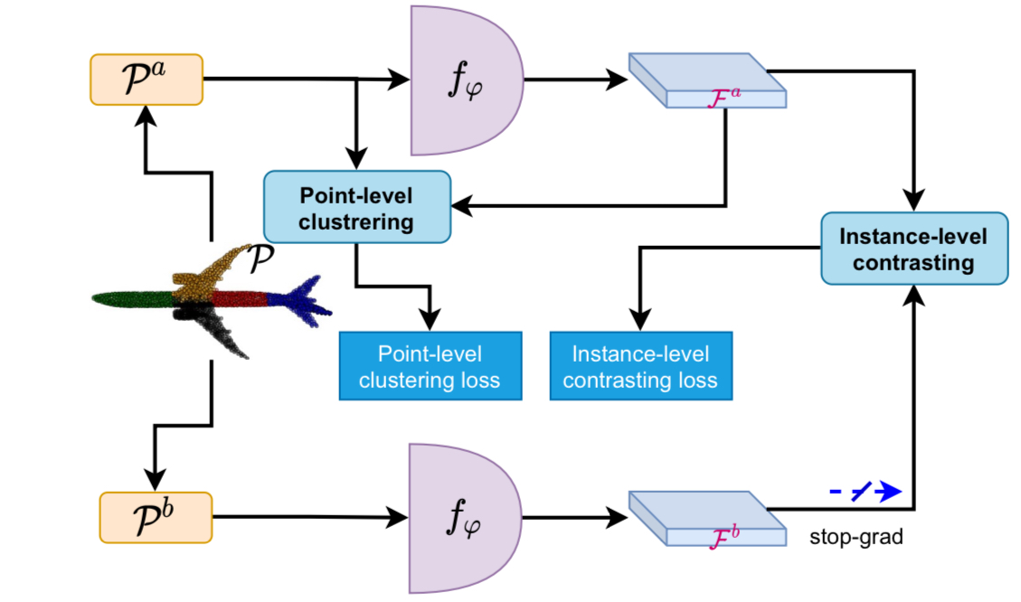
Unsupervised Learning on 3D Point Clouds by Clustering and Contrasting
Guofeng Mei et al.
Spatial correlation preserved
Considers global and local features
No pre-defined set of features
Automatic feature descriptors

Slide 11
New idea
Clustering Algorithm -
DBSCAN
HDSCAN
K-Medoids
KMeans
Evaluation metrics -
Silhouette Score
Davis Bouldin Score

Slide 12
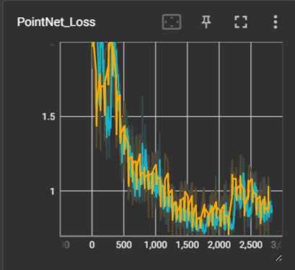
Current state of the work
Caution!
Result currently based on only 10k objects of the ABC dataset
Training loss
Validation loss

Slide 13
Quick Recap
Clustering Algorithm -
DBSCAN
HDSCAN
K-Medoids
KMeans
PointNet
DGCNN
Evaluation metrics -
DBCV: Density based Clustering Evaluation
Silhouette Score
Davis Bouldin Score
DGCNN:Dynamic Graph Convolutional Neural Network

Slide 14
Previous state of the work
Caution!
Result currently based on only 10k objects of the ABC dataset
Training loss
Validation loss

Slide 15
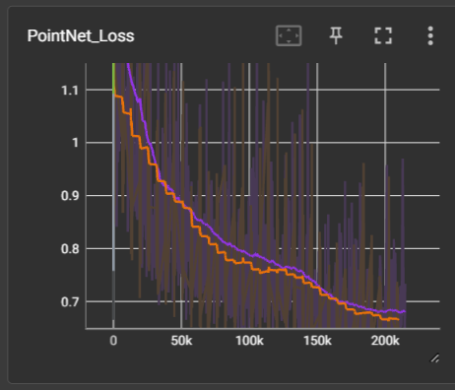
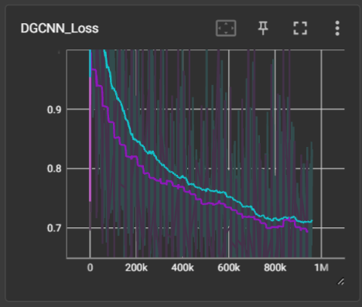
Current state of the work
Entire ABC Dataset 😊
Training loss
Validation loss
Training loss
Validation loss

Slide 16
Quick stats
Factors | PointNet | DGCNN
Epochs | 33 | 37
Time taken | 38 hrs | 168 hrs
GPU used | NVIDIA GeForce RTX 3090 | Tesla V100-PCIE-32GB
Batch size | 128 | 32
Val Loss | 0.6660 | 0.6979

Slide 17
DBCV
Clustering Algo
1024 dim latent space representation
DBCV
❌
Clusters
PointNet/
DGCNN
Dim Red
Clustering Algo
1024 dim latent space representation
Red. dim latent space representation
DBCV
✔
Clusters
PointNet/
DGCNN

Slide 18
Evaluation
Model X
Model Y
Test Set
Representative objects
Test Set
Representative objects
Avg Hausdorff distance(test,repr. Objs) (Model X)< Avg Hausdorff distance(test,repr. Objs) (Model Y)
Model X🎉🎊

Slide 19
Quick Recap
PointNet
DGCNN
Clustering Algorithm -
Agglomerative
HDBSCAN
Spectral
Mini-Batch KMeans
Clustering Algorithm -
DBSCAN
HDSCAN
K-Medoids
KMeans
Multi-level HDBSCAN
Evaluation metrics -
DBCV: Density based Clustering Evaluation
DGCNN:Dynamic Graph Convolutional Neural Network

Slide 20
Multi-level HDBSCAN
No new outliers from second level!

Slide 21
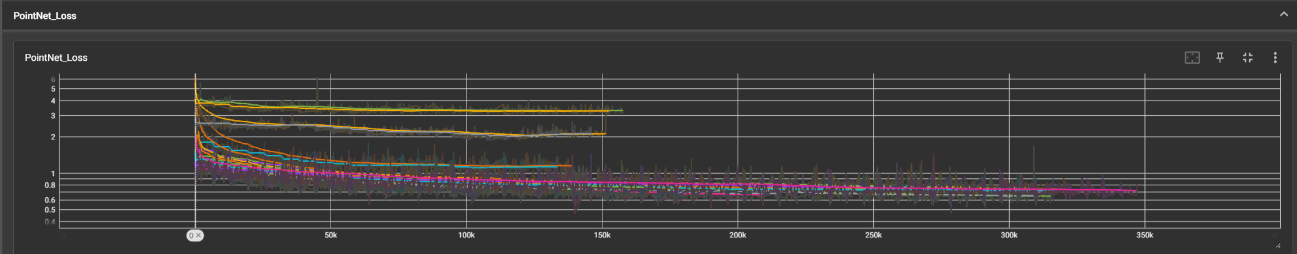
Experiments
Hyperparameter: Dimension size
Dimension 512 gives the best results

Slide 22
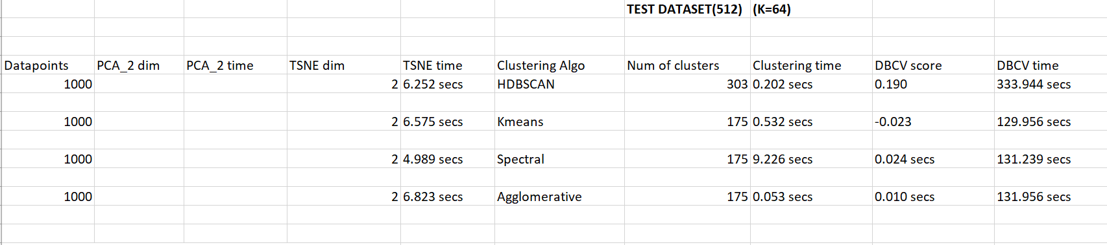
Experiments
Hyperparameter: Dimension size
Dimension 512 gives the best results

Slide 23
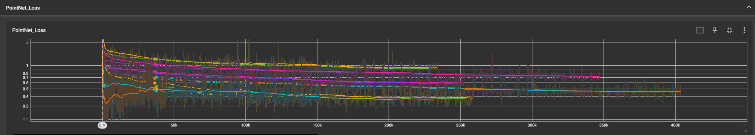
Experiments
Hyperparameter: Partition size
For dimension 512: 32 already gives the decent results

Slide 24
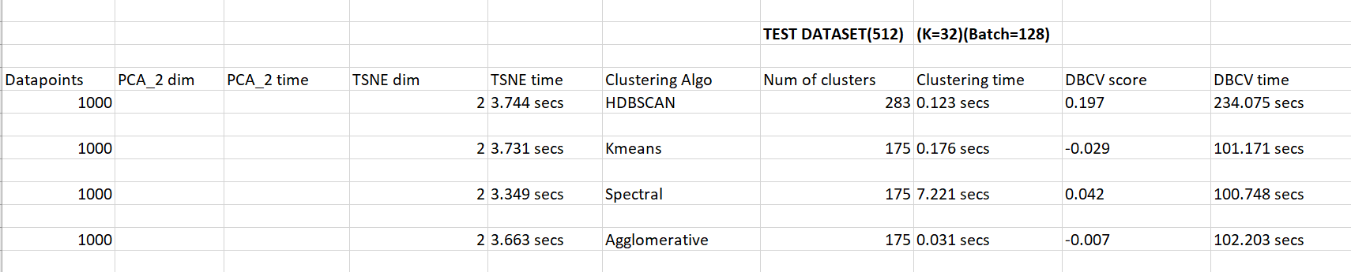
Experiments
Hyperparameter: Partition size
For dimension 512: 32 already gives the decent results

Slide 25
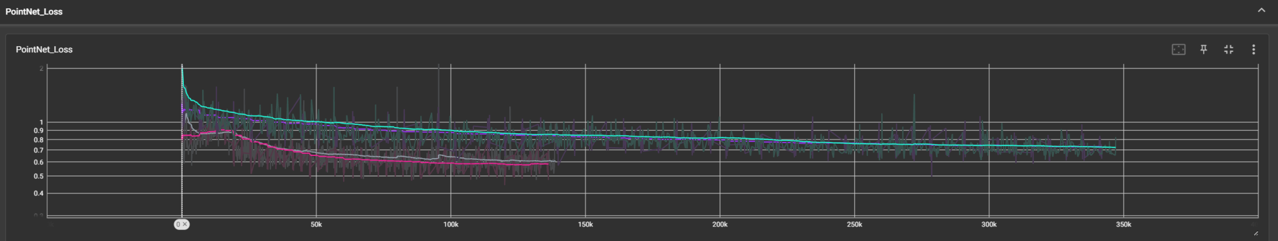
Experiments
Hyperparameter: Batch size
256 is the maximum batch size possible

Slide 26
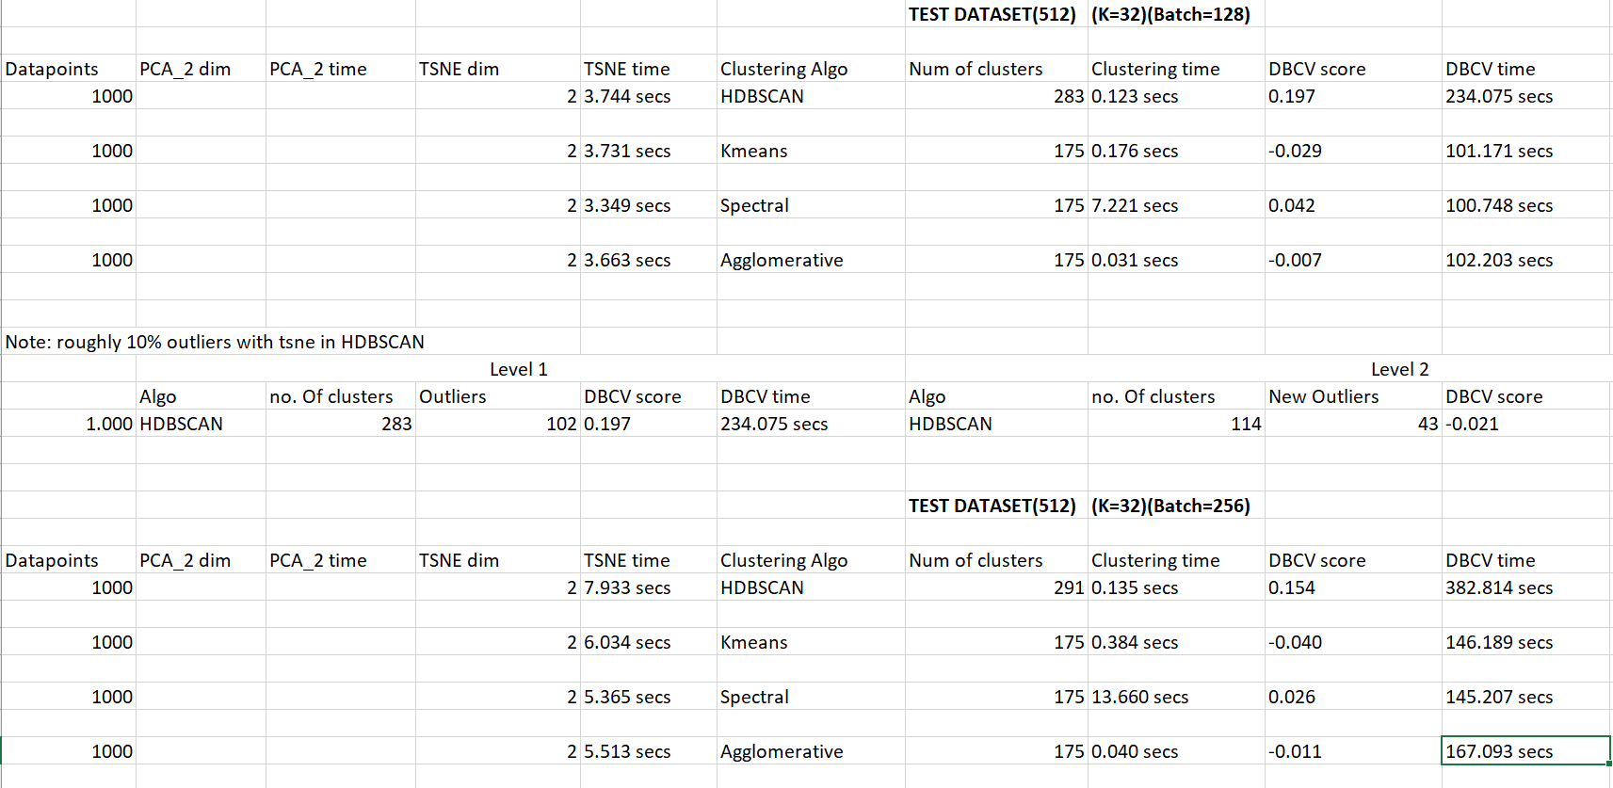
Experiments
Hyperparameter: Batch size
256 is the maximum batch size possible

Slide 27
Experiments
In Progress
Finding the representative objects
Experiments on DGCNN
Experiments on PointNet: Lower batch size

Slide 28
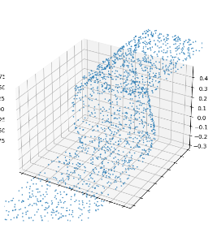
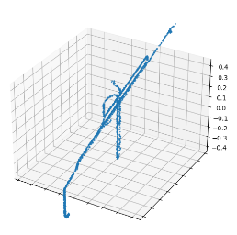
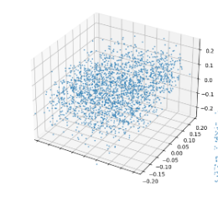
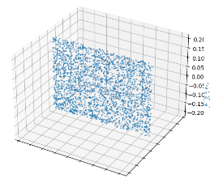
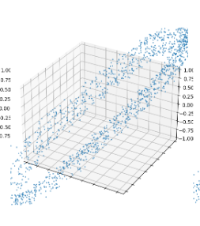
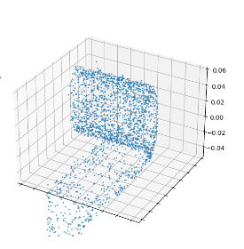
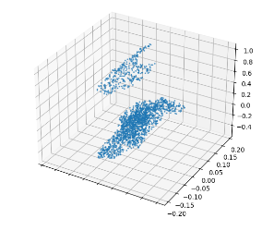
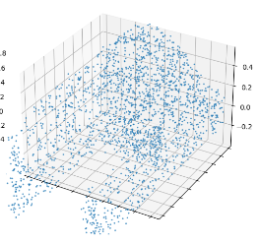
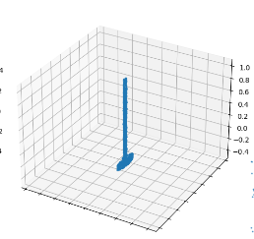
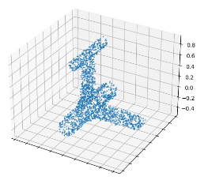
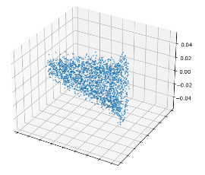
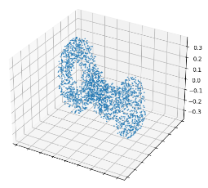

Slide 29
References
Zhu, Zhuotun and Wang, Xinggang and Bai, Song and Yao, Cong and Bai, Xiang : Deep learning representation using autoencoder for 3D shape retrieval
Bickel, Sebastian and Sauer, Christopher and Schleich, Benjamin and Wartzack, Sandro: Comparing CAD part models for geometrical similarity: A concept using machine learning algorithms
Ohbuchi, Ryutarou and Osada, Kunio and Furuya, Takahiko and Banno, Tomohisa: Salient local visual features for shape-based 3D model retrieval
Koch, Sebastian and Matveev, Albert and Jiang, Zhongshi and Williams, Francis and Artemov, Alexey and Burnaev, Evgeny and Alexa, Marc and Zorin, Denis and Panozzo, Daniele:ABC: A Big CAD Model Dataset For Geometric Deep Learning
https://www.baeldung.com/cs/deep-belief-network
Mei, Guofeng, et al. "Unsupervised learning on 3d point clouds by clustering and contrasting." arXiv preprint arXiv:2202.02543 (2022)

