Slide 1


Title: Web Scraping and Exploratory Data Analysis of Flipkart(Mobiles) Company Data

Slide 2
About Me:
I am SNEHA BIJJARAGI, MCA graduated with a strong passion for Data Analytics and Visualization.
Skilled in exploring real-world datasets to uncover meaningful insights.
Experienced in web data extraction and cleaning using Python tools.
Passionate about solving real-world problems using data.
LINKEDIN - www.linkedin.com/in/sneha-bijjaragi-15594825a

Slide 3
Preface:
INTRODUCTION
PROBLEM STATEMENT
OBJECTIVES
TOOLS USED
WEB SCRAPPING
DATA CLEANING STEPS
DATA VISUALIZATION
CONCLUSION

Slide 4
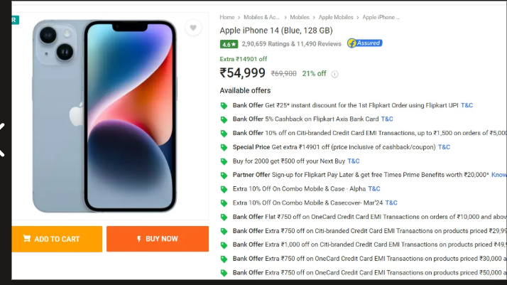
Introduction:
E-commerce platforms like Flipkart generate large amounts of mobile product data.
This data is mostly unstructured and not directly usable for analysis.
Web scraping is used to extract key details like price, ratings, and specifications.
The extracted data is cleaned and converted into a structured format.
The project aims to analyze this data to identify market trends and insights.

Slide 5

Problem Statement:
Mobile product data on platforms like Flipkart is highly dynamic and not readily available in a structured format for analysis.
Consumers and analysts face difficulty in comparing mobile phones across brands due to scattered information on pricing, features, and ratings.
There is limited access to consolidated data for understanding key factors influencing mobile purchasing decisions.
A data-driven approach is required to extract, organize, and analyze this information to identify market trends and customer preferences.

Slide 6
Objectives:
Transforming raw mobile listings from Flipkart into a structured, analysis-ready dataset.
Designing a workflow that reflects real-world data pipelines, from extraction to insight generation.
Identifying hidden patterns in pricing, ratings, and product features across brands.
Simplifying complex product data into clear and meaningful visual insights.
Enabling effective comparison between mobile devices using data-driven methods.
Bridging the gap between raw web data and actionable market insights.

Slide 7
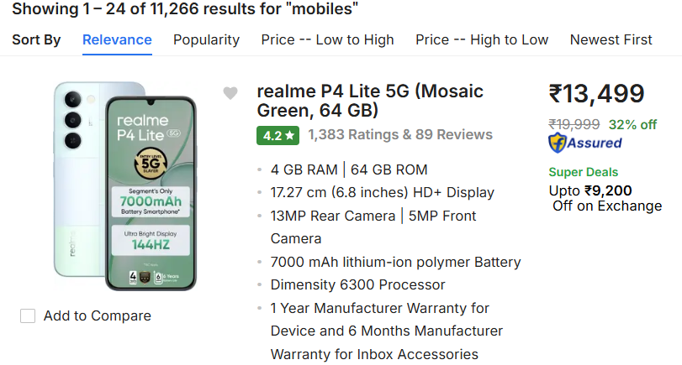
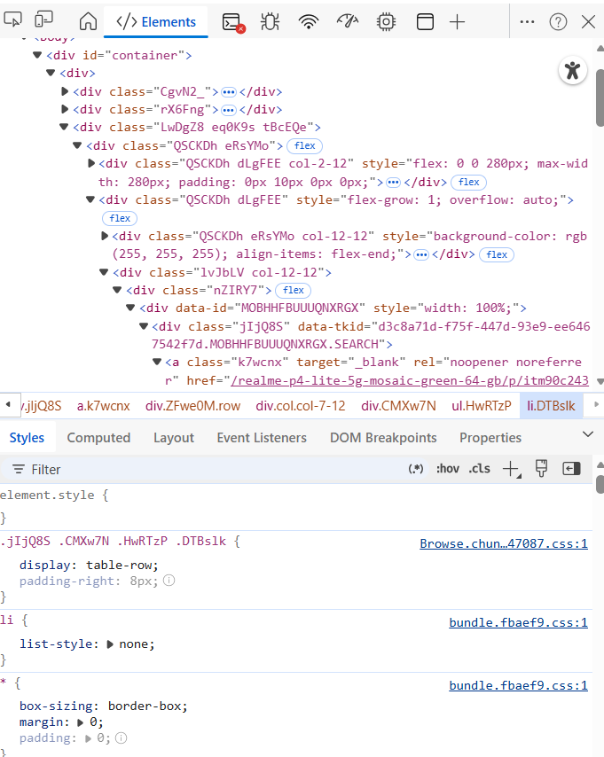
Web Scraping:
Flipkart was selected as the data source.
Used browser developer tools (Inspect Element) to locate relevant HTML tags Data.
Used BeautifulSoup and Requests to extract data from Flipkart.
Sent HTTP requests to fetch web pages.
Performed Exploratory Data Analysis (EDA) to identify trends.

Slide 8
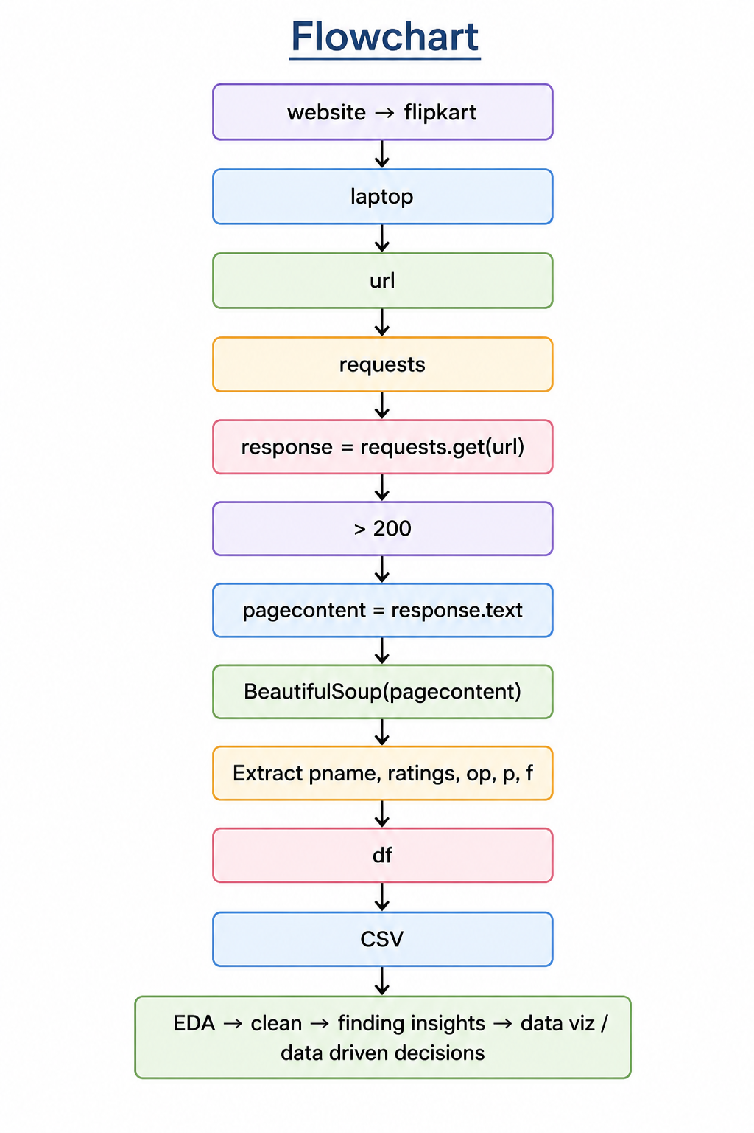
Flowchart:

Slide 9
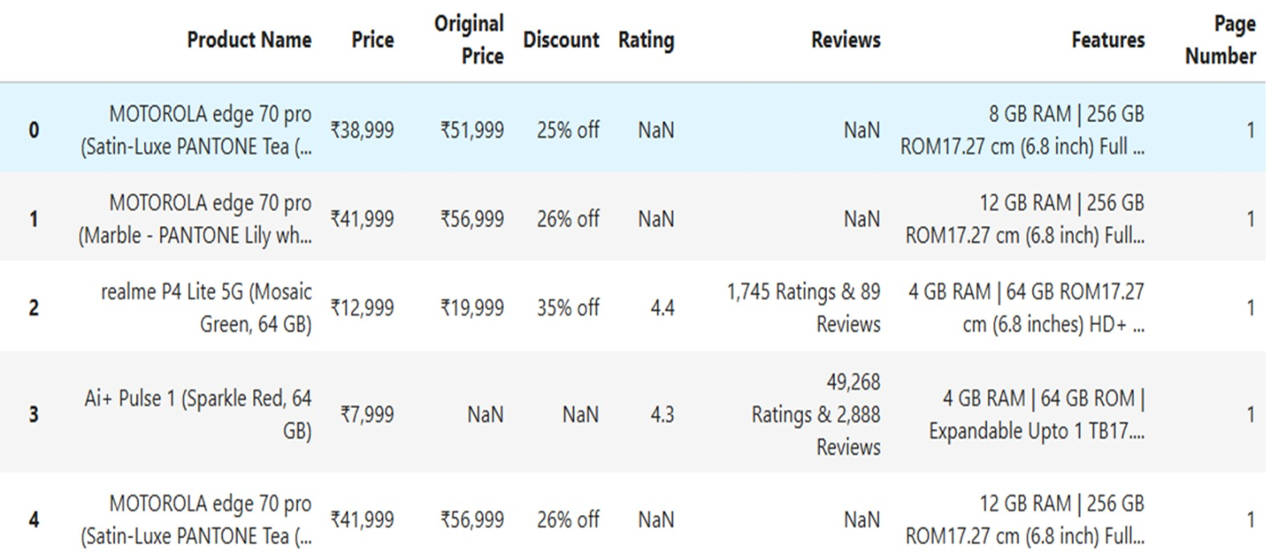
Dataset:

Slide 10






Tools Used:

Slide 11
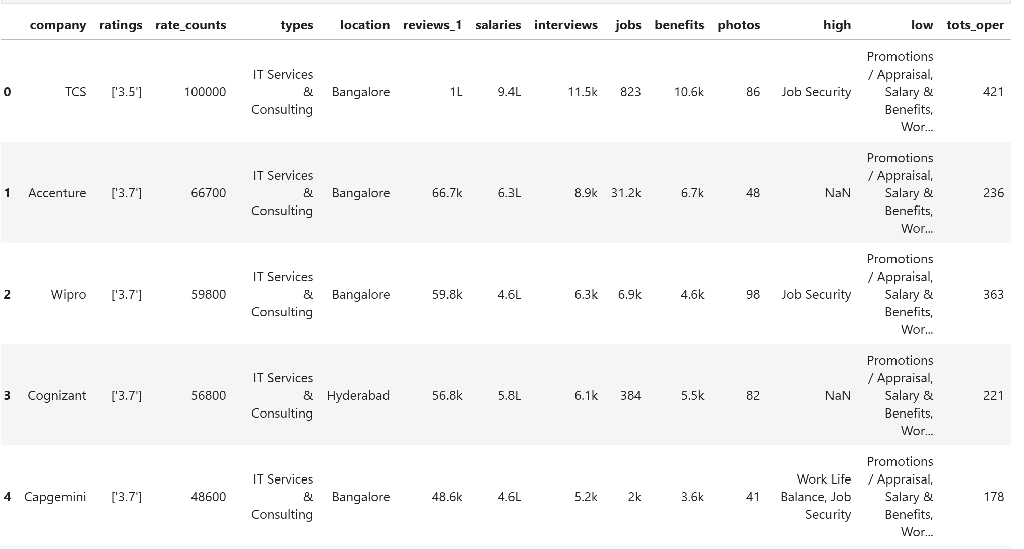
Data Cleaning Steps:
Missing and null values were identified and handled to maintain data completeness.
Duplicate records were removed to avoid redundancy and improve accuracy.
Data types were corrected, especially for price and rating columns, to enable proper analysis.
Column names and formats were standardized for consistency across the dataset.
Irrelevant or incorrect entries were filtered out to improve data quality.
Outliers in price and ratings were identified and managed for better insights.
Unnecessary symbols like ₹, commas, and extra spaces were cleaned from text fields.

Slide 12
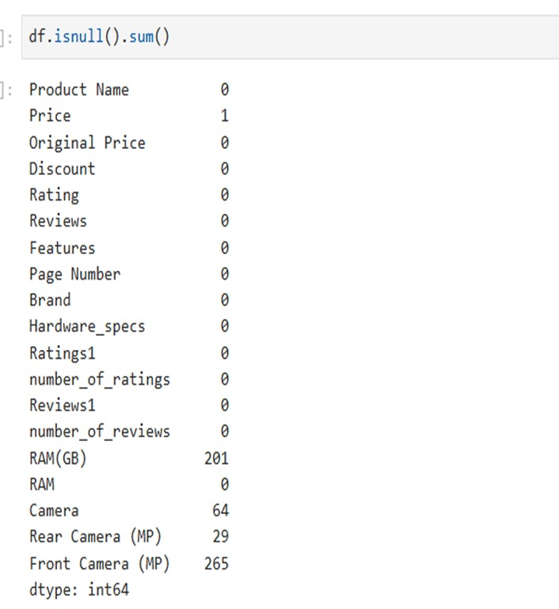
Before Removing Null Values:

Slide 13
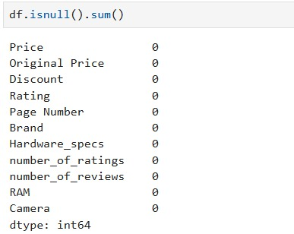
After Removing Null Values:

Slide 14
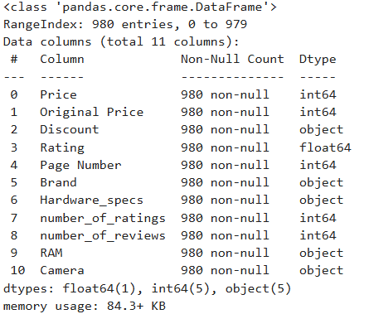
Refined Dataset after Removing Redundant Features:

Slide 15
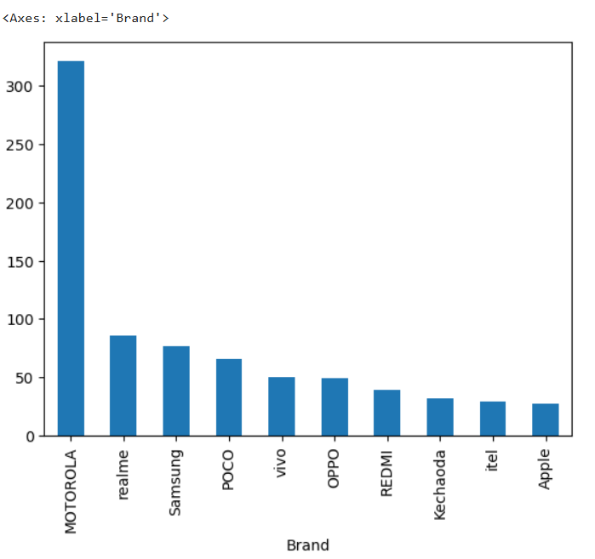
Data Visualization:
Motorola has the highest number of mobile listings in the dataset.
Realme, Samsung, and POCO show strong market presence.
Mid-range brands dominate the dataset compared to premium brands.
Apple has fewer listings than other smartphone brands.
The graph highlights brand-wise distribution and market competition on Flipkart.

Slide 16
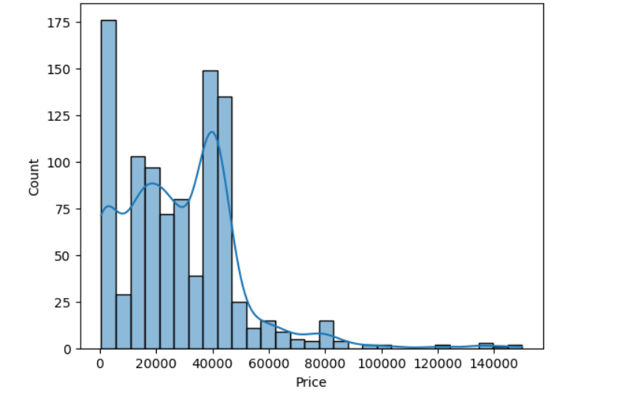
Data Visualization:
DISTRIBUTION OF MOBILE PHONE PRICES
The majority of mobile phones are concentrated in the low to mid-price range (10,000 – 40,000).
The distribution shows a gradual decrease in the number of phones as the price increases.
A small number of high-priced phones extend the distribution towards the right side.
The graph indicates a right-skewed distribution with a long tail of premium devices.
Mid-range smartphones appear to dominate the dataset compared to budget and flagship models.

Slide 17
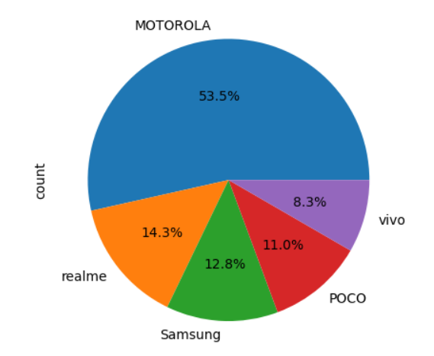
Data Visualization:
This chart represents the brand-wise distribution of mobile listings.
Motorola dominates the dataset with the highest percentage share.
Realme and Samsung maintain a strong presence among top brands.
POCO and vivo contribute comparatively smaller shares.
The distribution highlights the competitive presence of smartphone brands on Flipkart.

Slide 18
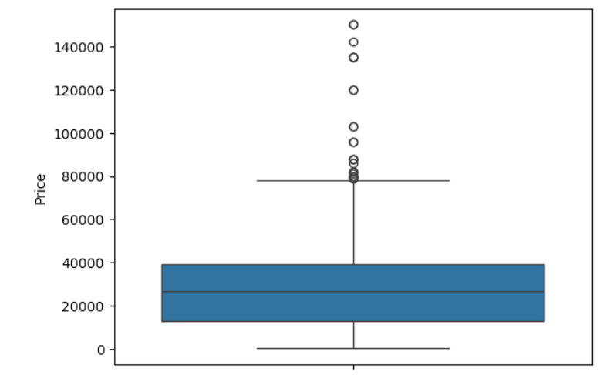
Data Visualization:
Most mobile prices are concentrated in the mid-range (around 10k–40k).
The median price lies in the middle of this range.
A few high-priced outliers are clearly visible.
The distribution is right-skewed due to premium devices.

Slide 19
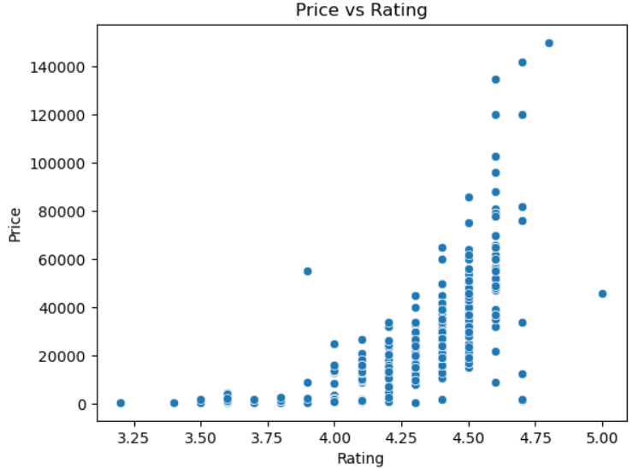
Data Visualization:
Price vs Rating
Higher-rated mobiles generally tend to have higher prices.
Most products are concentrated between ratings of 4.2 to 4.7.
Premium-priced mobiles usually receive better customer ratings.
A few outliers are visible with very high prices and ratings.
The graph indicates a positive relationship between price and rating.

Slide 20
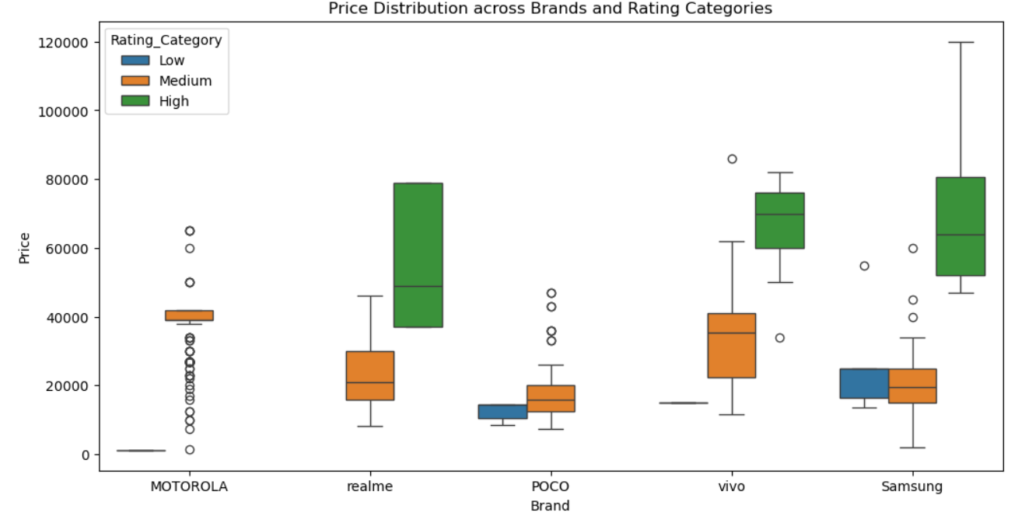
Data Visualization:
Price Distribution across Brands and Rating Categories
Higher-rated mobiles generally fall in the higher price range across most brands.
Samsung and vivo show wider price variations compared to other brands.
Realme and POCO mainly concentrate in the mid-range price segment.
MOTOROLA contains more lower-priced devices with fewer high-price models.
Several outliers indicate the presence of premium mobile models within certain brands.

Slide 21
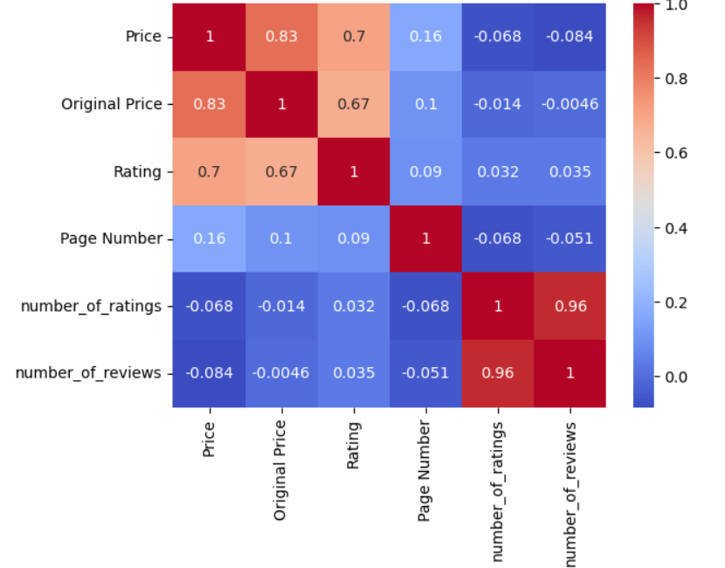
Data Visualization:
Price and Original Price are highly correlated (0.83).
Higher-priced mobiles tend to have better ratings.
Number of ratings and reviews show a very strong correlation (0.96).
Page number has minimal impact on other variables.
Most negative correlations are weak and insignificant.

Slide 22
Conclusion:
Successful Data Extraction :
Mobile product data was successfully scraped and converted into a structured dataset.
Positive Price–Rating Relationship :
Higher-priced mobiles generally showed better customer ratings.
Brand-wise Market Trends :
Different brands displayed noticeable variations in pricing and product distribution.
High Customer Engagement :
Products with more ratings also received a higher number of reviews.
Meaningful Insights through EDA :
Exploratory analysis and visualization revealed useful market and customer trends.

Slide 23
Experiences & Challenges:
Handling dynamic and unstructured data from Flipkart webpages.
Managing missing values, duplicate records, and inconsistent formats during data cleaning.
Extracting relevant product features from complex HTML structures using BeautifulSoup.
Handling large volumes of product data efficiently across multiple pages.
Converting raw scraped data into meaningful insights through visualization and analysis.

Slide 24


Slide 25

THANK YOU

