Slide 1
SCHEDULING

Slide 2
Scheduling
The job of allocating CPU time to different tasks within an operating system.
While scheduling is normally thought of as the running and interrupting of processes, in Linux, scheduling also includes the running of the various kernel tasks.
Running kernel tasks encompasses both tasks that are requested by a running process and tasks that execute internally on behalf of a device driver.

Slide 3
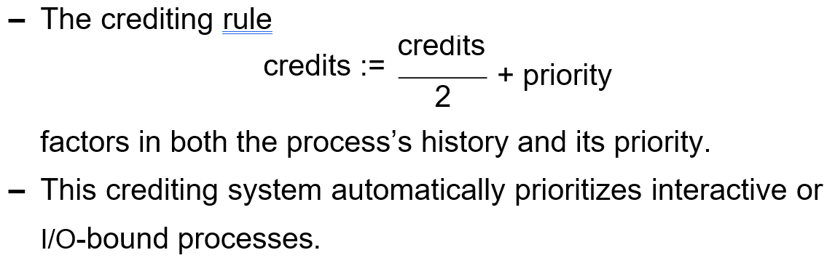
Process Scheduling
Linux uses two process-scheduling algorithms:
A time-sharing algorithm for fair preemptive scheduling between multiple processes
A real-time algorithm for tasks where absolute priorities are more important than fairness
A process’s scheduling class defines which algorithm to apply.
For time-sharing processes, Linux uses a prioritized, credit based algorithm.

Slide 4
Process Scheduling
Linux implements the FIFO and round-robin real-time scheduling classes; in both cases, each process has a priority in addition to its scheduling class.
The scheduler runs the process with the highest priority; for equal-priority processes, it runs the longest-waiting one
FIFO processes continue to run until they either exit or block
A round-robin process will be preempted after a while and moved to the end of the scheduling queue, so that round-robin processes of equal priority automatically time-share between themselves.

Slide 5
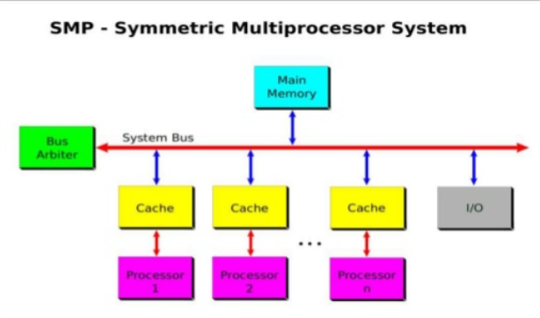
Symmetric Multiprocessor

Slide 6
Symmetric Multiprocessor
Linux 2.0 was the first Linux kernel to support SMP hardware separate processes or threads can execute in parallel on separate processors.
In version 2.2 ,a single kernel spinlock was created to allow multiple process to be active in kernel concurrently.
Later releases implement more scalability by splitting 1 spinlock into multiple locks ensuring protection

Slide 7
Kernel Synchronization
A request for kernel-mode execution can occur in two ways:
A running program may request an operating system service, either explicitly , or implicitly, for example, when a page fault occurs.
A device driver may deliver a hardware interrupt that causes the CPU to start executing a kernel-defined handler for that interrupt.
Kernel synchronization requires a framework that will allow the kernel’s critical sections to run without interruption by another critical section.

Slide 8
Kernel Synchronization
To avoid performance penalties, Linux’s kernel uses a synchronization architecture that allows long critical sections to run without having interrupts disabled for the critical section’s entire duration
Interrupt service routines are separated into a top half and a bottom half
- The top half is a normal interrupt service routine, and runs with recursive interrupts disabled.
- The bottom half is run, with all interrupts enabled, by a miniature scheduler that ensures that bottom halves never interrupt themselves.

Slide 9


Interrupt Protection Levels
top-half interrupt handlers
bottom-half interrupt handlers
kernel-system service routines (not preemptible)
user-mode programs (preemptible)
Each level may be interrupted by code running at a higher level, but will never be interrupted by code running at the same or a lower level.
User processes can always be preempted by another process when a time-sharing scheduling interrupt occurs.

Slide 10
Thank You

