Slide 1
P5 presentation
Anuja Jadhav
Jiajun Xu
Sneha Dalvi
Osman Ali

Slide 2
Project Overview

Slide 3
BookMyTicket
User Authentication
For existing users authenticate with username and password
If new user then create his account
Browsing
Viewing the available shows and theatres for booking
Book
Select the theatre, show time, number of tickets
Payment
Email Confirmation
Checkout with payment via debit/credit card
Send the user email receipt of his payment and reservation
Our project is a web application for booking movie tickets online. The website will have a user registration system for customers, and a user interface that allows customers to view a list of currently airing movies and their show times at various local theatres.

Slide 4
Website Operations
Registration – New customers can register to be a member.
Update profile – Members can change password, update address.
Reset password – A link will automatically send to member’s registered Email. Members can reset password via the link.
Search shows – Output the current shows in theaters
Search movies – Output the movie information
Book Ticket – Purchase a ticket for a movie showing

Slide 5
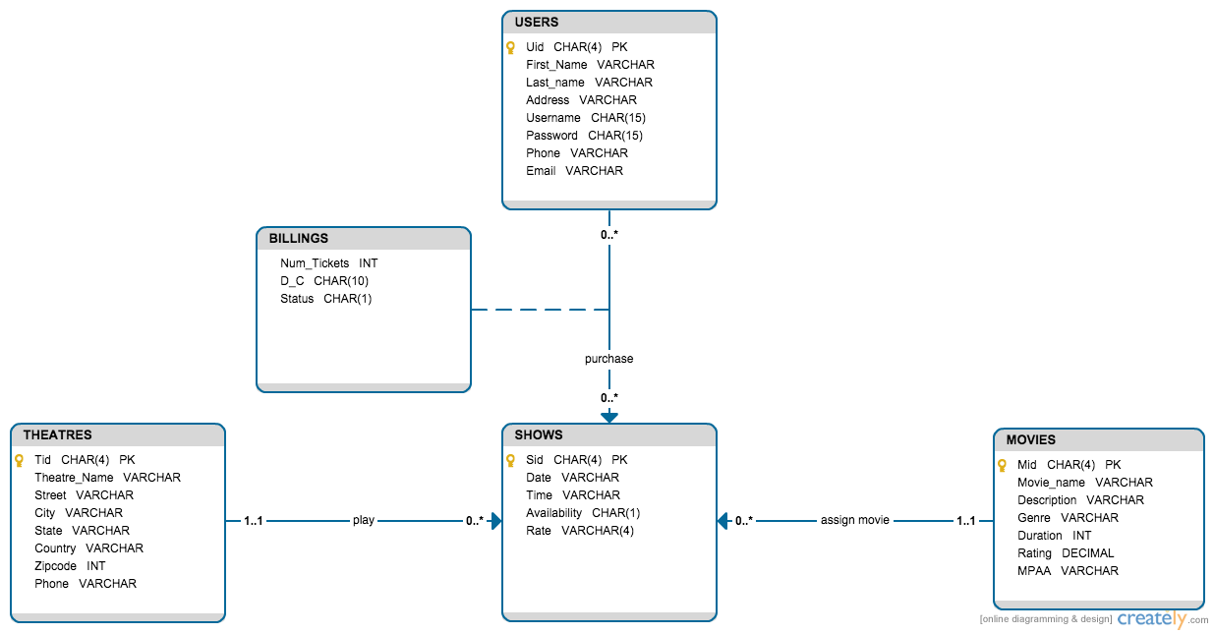
UML

Slide 6
UML to Relational Model
USERS (Uid, First_name, Last_name, Address, Username, Password, Phone, Email)
MOVIES (Mid, Movie_name, Description, Genre, Duration, Rating, MPAA)
THEATRES (Tid, Theatre_name, Street, City, State, Country, Zipcode, Phone)
SHOWS (Sid, Mid, Tid, Date, Time, Availability, Rate)
BILLINGS (Uid, Sid, Num_Tickets, D_C, Status)

Slide 7
BCNF Decomposition
Uid First_name, Last_name, Address, Username, Password, Phone, Email
Mid Movie_name, Description, Genre, Duration, Rating, MPAA Tid Theatre_name, Street, City, State, Country, Zipcode, Phone Sid Mid, Tid, Date, Time, Availability Num_Tickets, D_C, Status

Slide 8
BCNF Decomposition
USERS: (Uid First_name, Last_name, Address, Username, Password, Phone, Email)
Uid -> First_name, Last_name, Address, Username, Password, Phone, Email
(Uid is a superkey. Cannot decompose.)
MOVIES: (Mid Movie_name, Description, Genre, Duration, Rating, MPAA )
Mid-> Movie_name, Description, Genre, Duration, Rating, MPAA)
(Mid is a superkey.)
THEATRES: (Tid, Theatre_name, Street, City, State, Country, Zipcode, Phone)
Tid-> Theatre_name, Street, City, State, Country, Zipcode, Phone
(Tid is a superkey.)

Slide 9
BCNF Decomposition (cont.)
SHOWS (Sid-> Mid, Tid, Date, Time, Availability, Rate)
(Sid is a superkey.)
BILLINGS (Uid, Sid-> Num_Tickets, D_C, Status)
(Uid, Sid is a superkey.)

Slide 10
3NF synthesis
Uid->First_name
Uid->Last_name
Uid->Address
Uid->Username
Uid->password
Uid->phone
Uid->Email
Mid->Movie_name
Mid->Description
Mid->Genre
Mid->Rating
Mid->MPAA
Tid->Theatre_name
Tid->Street
Tid->City
Tid->State
Tid->Country
Tid->Zipcode
Tid->phone
Sid->Mid
Sid->Tid
Sid->Date
Sid->Time
Sid->Availability
Sid->Rate
Uid,Sid->Num_Tickets
Uid,Sid->D_C
Uid,Sid->Status
Any extraneous attributes?
Any redundant FD?
Minimal cover

Slide 11
3NF synthesis (cont.)
Merge FD with common left hand side:
Uid->First_name, Last_name, Address, Username, Password, Phone, Email)
Mid->Movie_name, Description, Genre, Duration, Rating, MPAA)
Tid->Theatre_name, Street, City, State, Country, Zipcode, Phone)
Sid->Mid, Tid, Date, Time, Availability, Rate)
Uid, Sid->Num_Tickets, D_C, Status)
For each FD, make a table relation (and we will get exactly 5 same tables as BCNF decomposition)

Slide 12
Comparison
Changes in database design with normalization

Slide 13
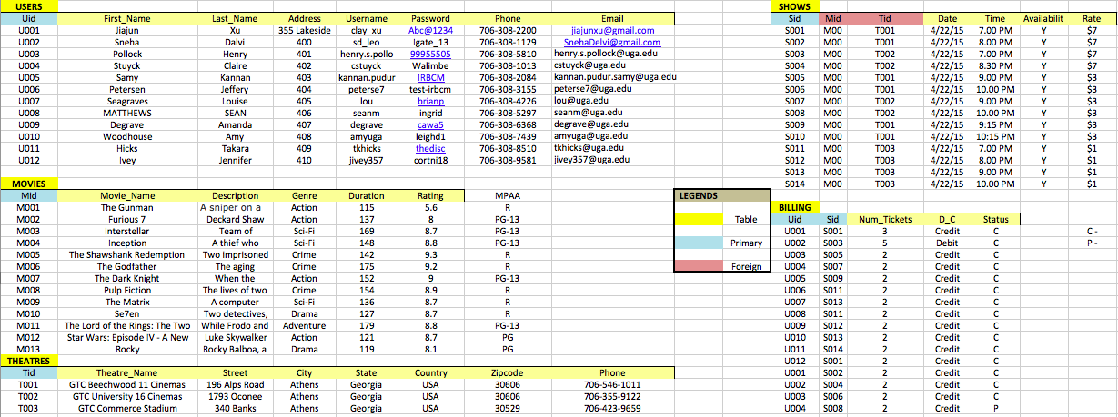
Normalized DB Design

Slide 14
Schema.sql
Database creation file

Slide 15
Technology
Struts 2.0
Apache Tomcat
PostgreSQL
JDBC
jQuery/Javascript
JSP, HTML
Notes:
Struts 2.0 - a web application framework which follows Model-View-Controller (MVC) architectural pattern

Slide 16
System Architecture and Components
Browser
Results
Request
Apache Tomcat Server
Controller – FilterDispatcher, Struts.xml
View –
JSP, HTML
execute()
Model – Action Classes
ValueStack/OGNL
Database Access Logic
JDBC Connection
PostgreSQL DB
Reference: http://www.tutorialspoint.com/struts_2/struts_architecture.htm
Notes:
First, a user sends a request to the server for requesting some resource (i.e. pages).
Then, the FilterDispatcher of Controller looks at the request and determines the appropriate Action.
Then, selected action is executed to perform the requested operation.
If required, it accesses database to retrieve information.
Finally the result is prepared by the view and returns the result to the user.

Slide 17
Demo
BookMyTicket Web Application

