Slide 1
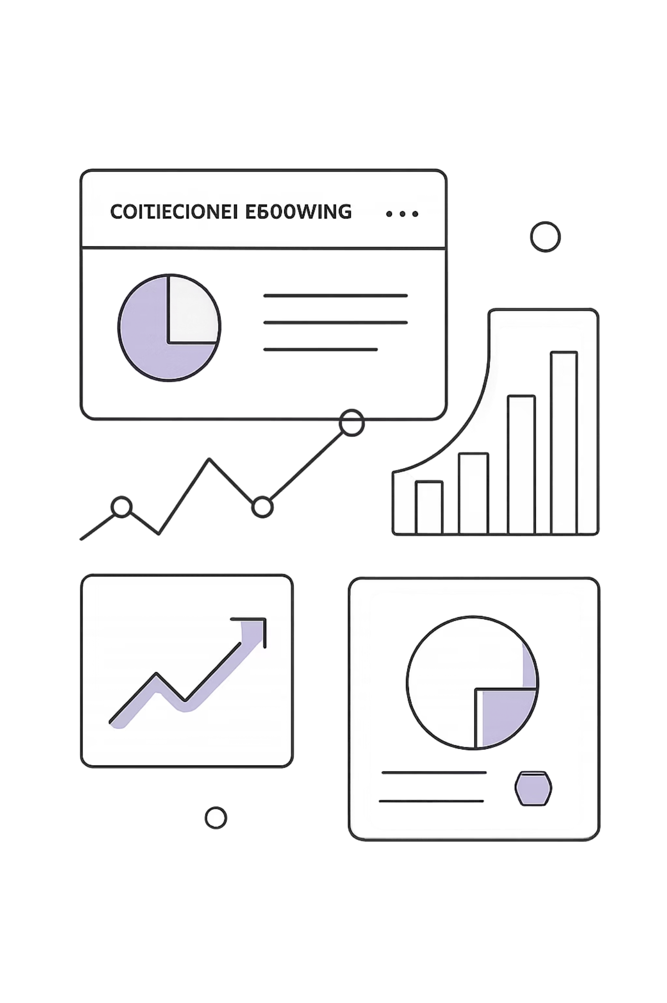
Customer Shopping Behavior Analysis
Uncovering spending patterns, customer segments, and product preferences from 3,900 transactions to guide strategic business decisions.

Slide 2
Dataset at a Glance
3,900
18
Transactions
Columns
37
$59.76
Missing Values
Avg Purchase
Review Rating only
Features span demographics, purchase details, and shopping behavior.

Slide 3


Python: Data Preparation
Clean & Standardize
Imputed missing Review Ratings by category median; renamed columns to snake_case.
Feature Engineering
Created age_group bins and purchase_frequency_days; dropped redundant promo_code_used.
Database Integration
Loaded cleaned DataFrame into PostgreSQL for SQL analysis.

Slide 4
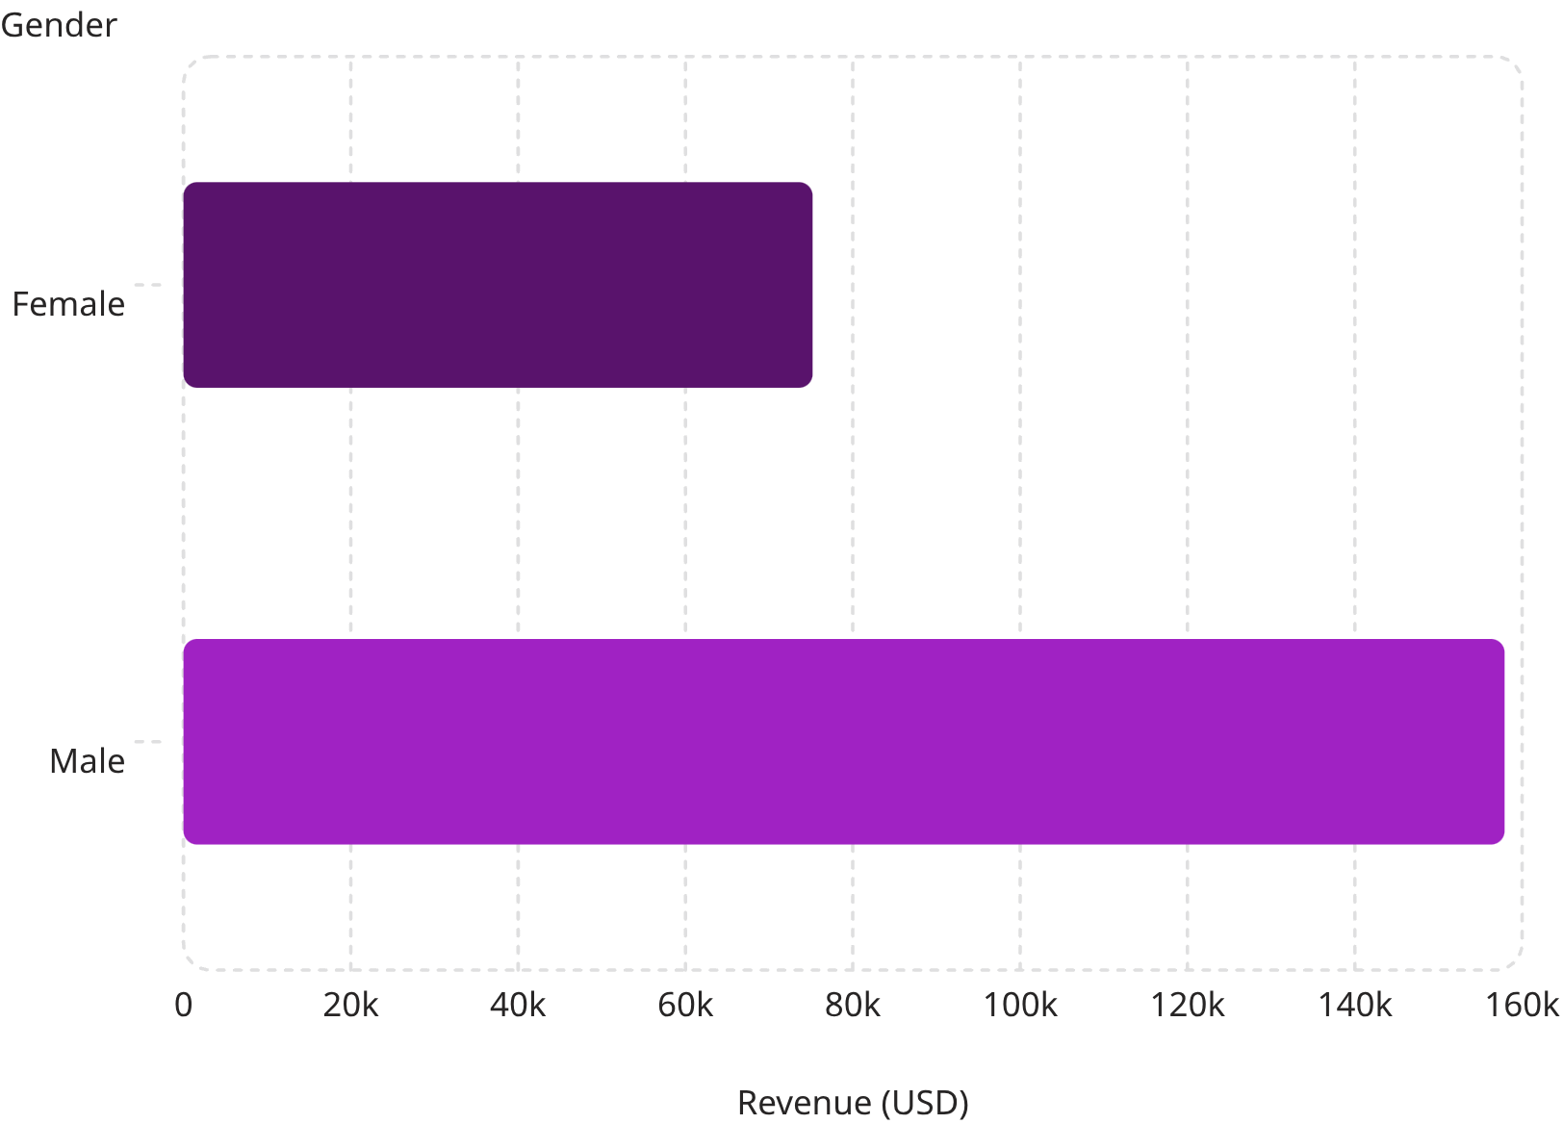

Revenue by Gender
Key Insight
Male customers generated more than double the revenue of female customers.
Male: $157,890 · Female: $75,191

Slide 5
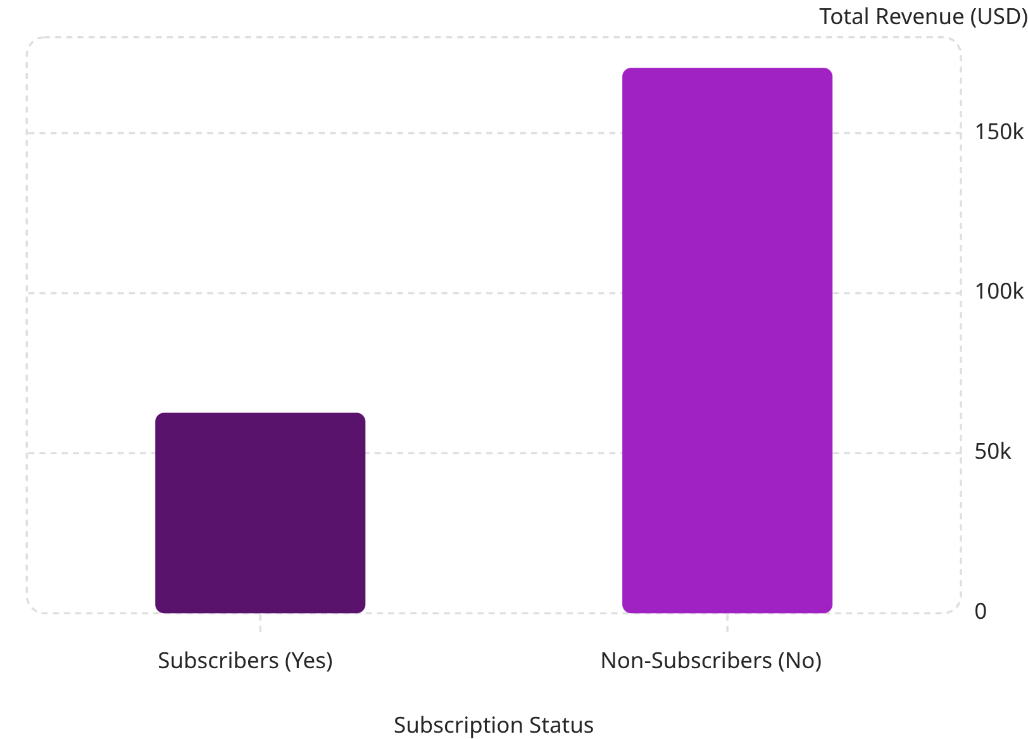
Subscribers vs. Non-Subscribers
Revenue Gap
Non-subscribers drive 73% of total revenue despite similar average spend (~$59).
27%
73%
Subscribers
Non-Subscribers

Slide 6
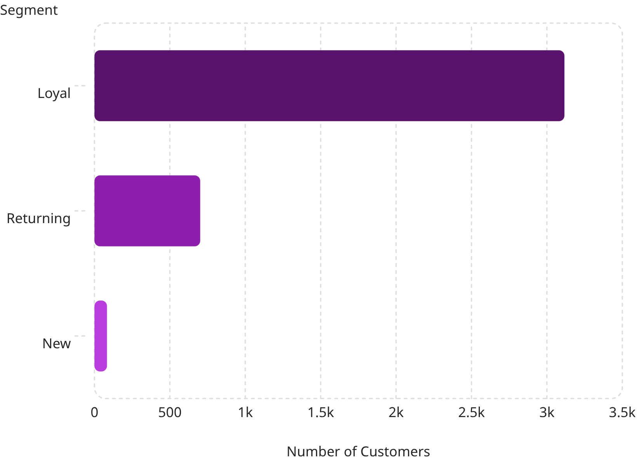
Customer Segmentation
Segment Breakdown
Loyal — 3,116
80% of base
Returning — 701
18% of base
New — 83
2% of base
Of 958 repeat buyers (>5 purchases), only 27% subscribe.

Slide 7
Top Products & Categories
Top 5 by Review Rating
Top 3 per Category
Item
Rating
Category
Top Items
Gloves
3.86
Accessories
Jewelry, Sunglasses, Belt
Sandals
3.84
Clothing
Blouse, Pants, Shirt
Boots
3.82
Footwear
Sandals, Shoes, Sneakers
Hat
3.80
Outerwear
Jacket, Coat
Skirt
3.78

Slide 8
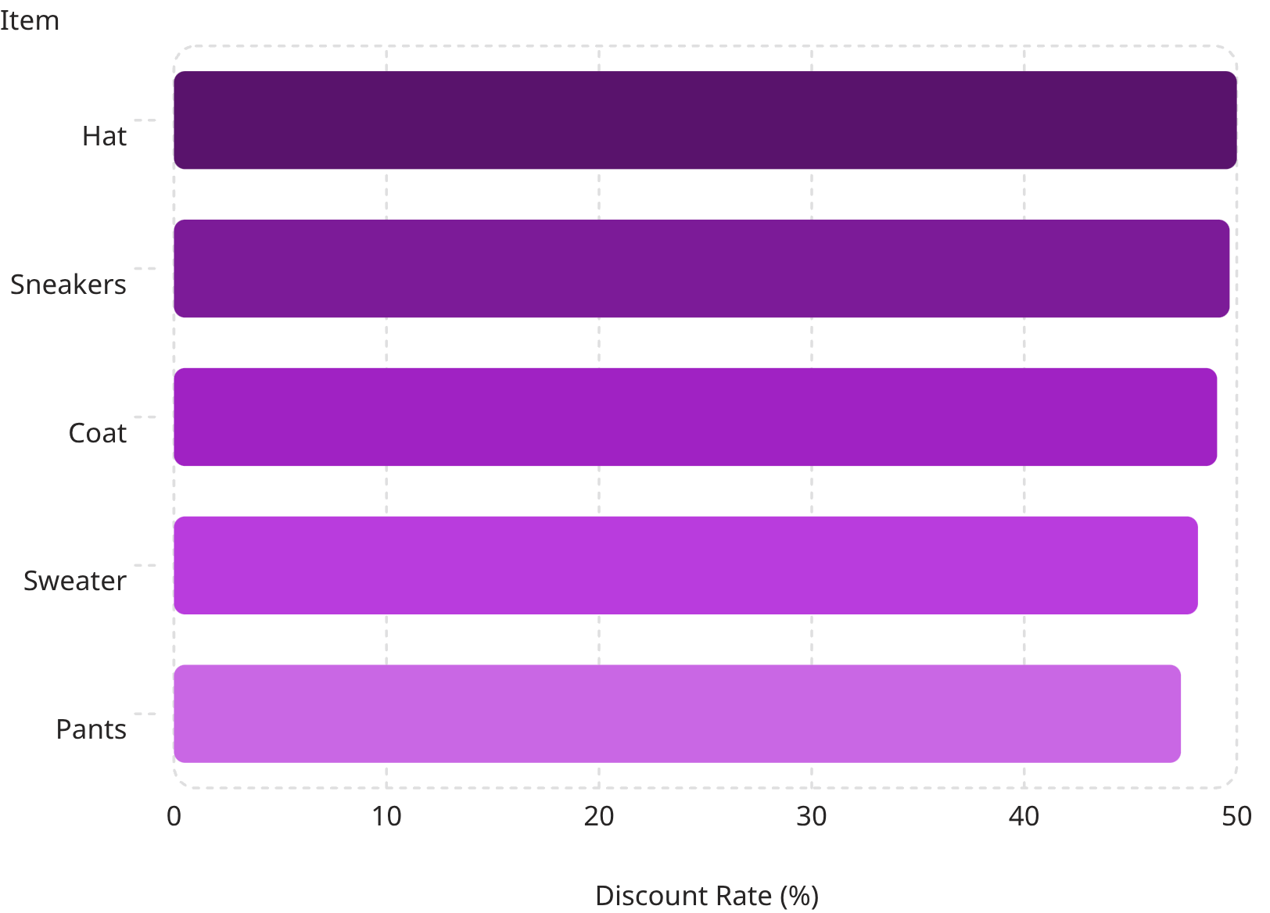
Discount & Shipping Insights
Most Discount-Dependent Products
Shipping Type — Avg Spend
Express
Standard
$60.48 avg
$58.46 avg
839 customers used discounts yet spent above average.

Slide 9
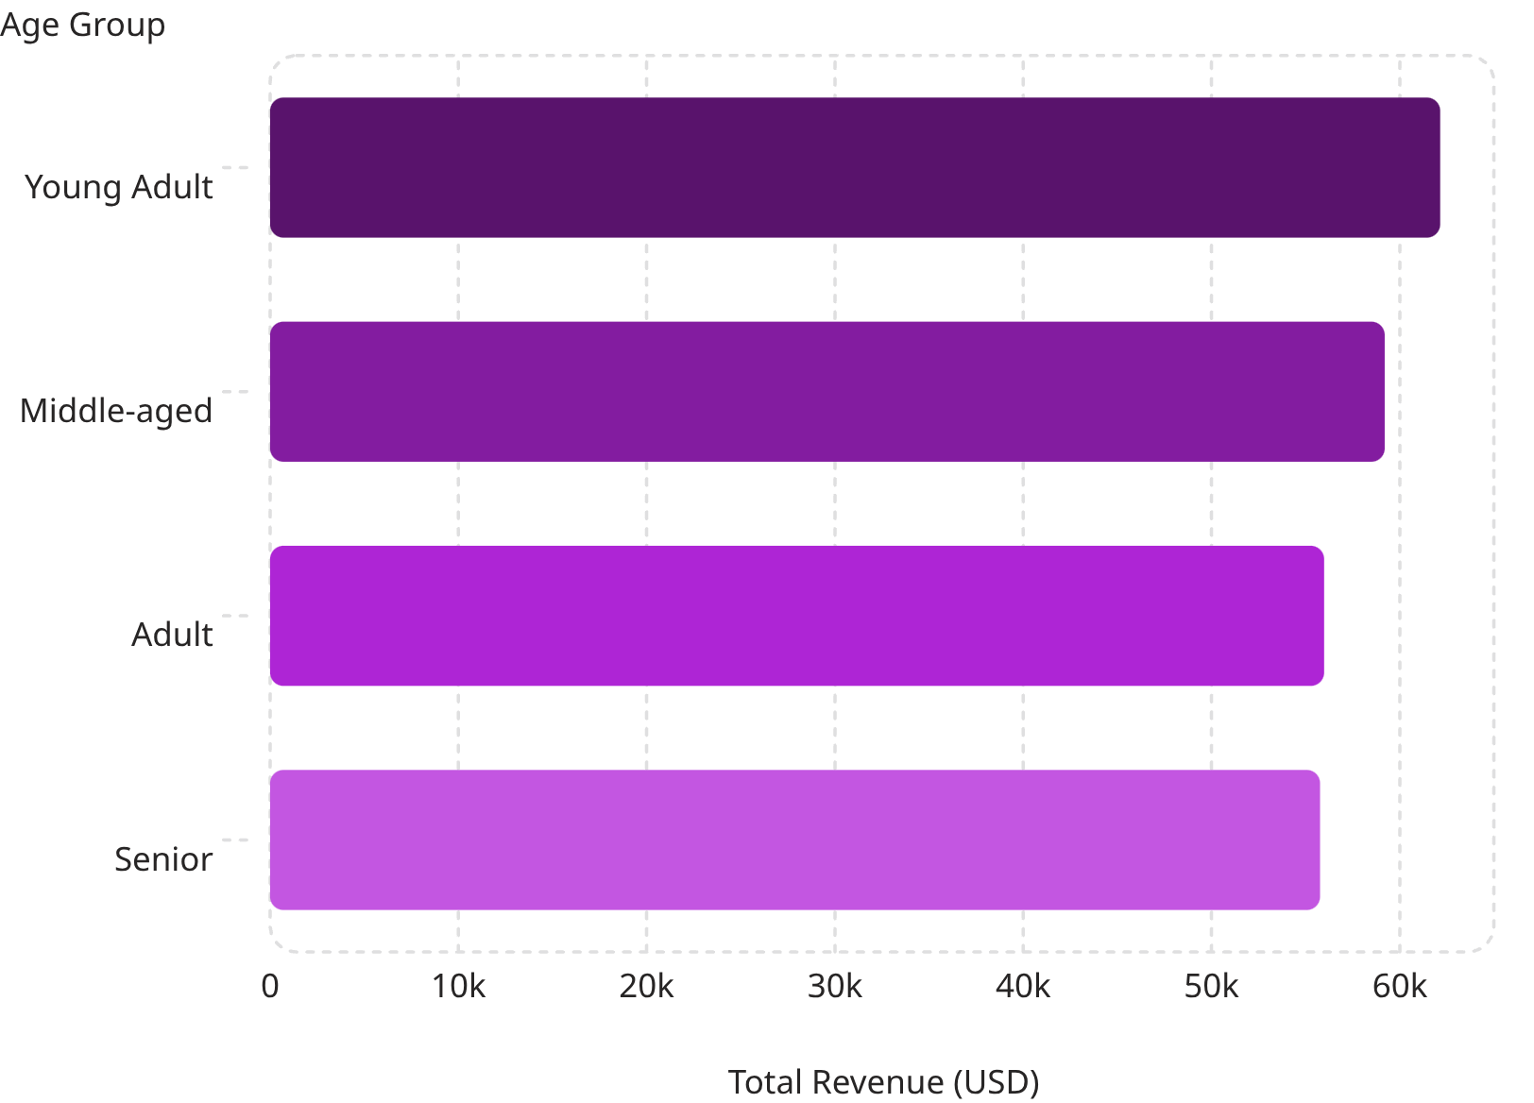
Revenue by Age Group
Age Group Insights
Young Adults lead in revenue, but all groups are relatively close — broad targeting is viable.
Average customer age: 44 years (range 18–70)

Slide 10
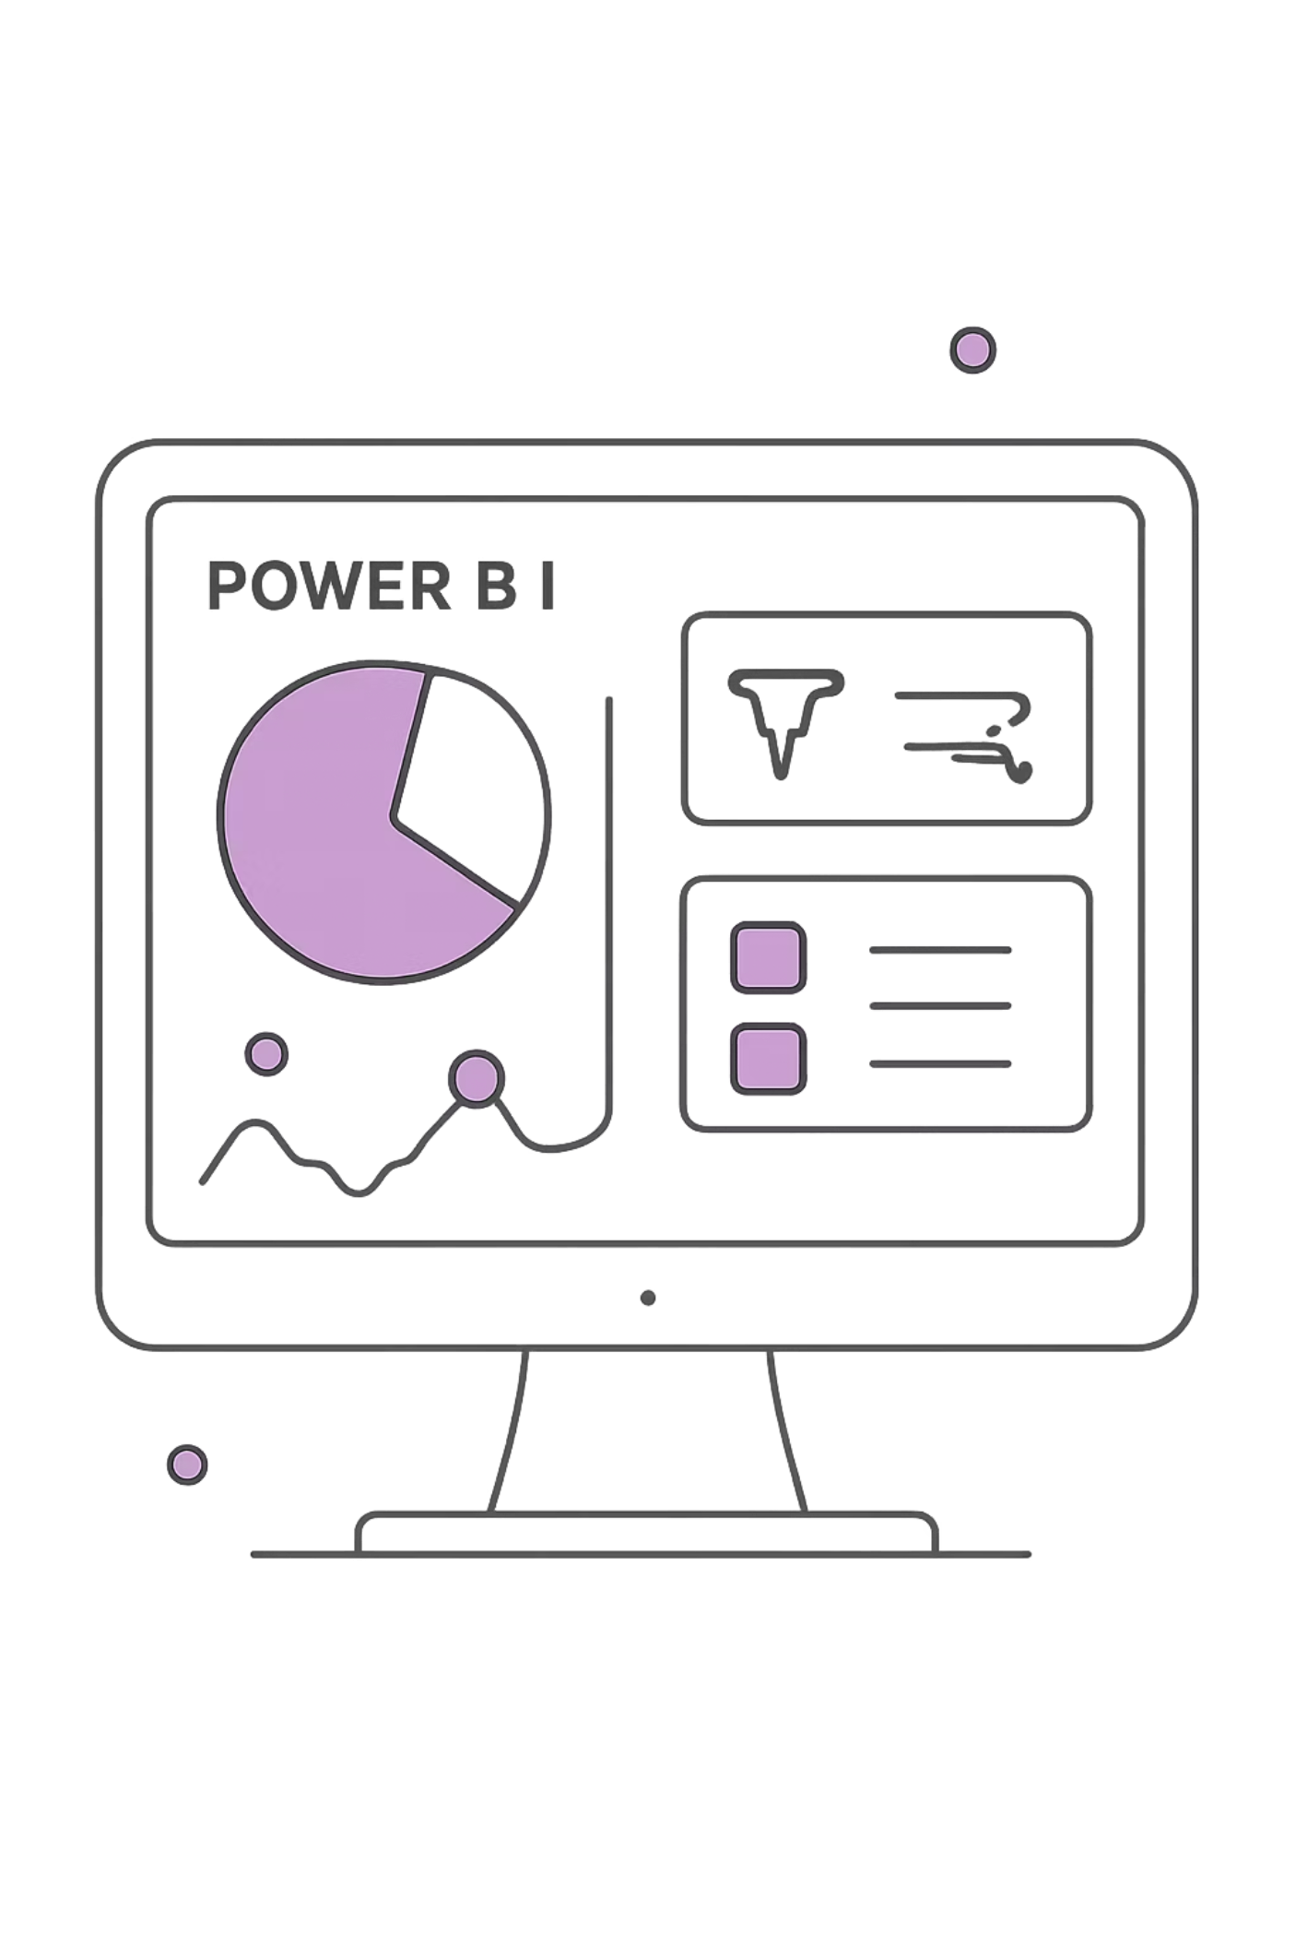
Power BI Dashboard & Recommendations
Boost Subscriptions
Promote exclusive subscriber benefits.
Loyalty Programs
Reward repeat buyers to grow the Loyal segment.
Review Discount Policy
Balance sales boosts with margin control.
Targeted Marketing
Focus on high-revenue age groups and express-shipping users.

