Slide 1
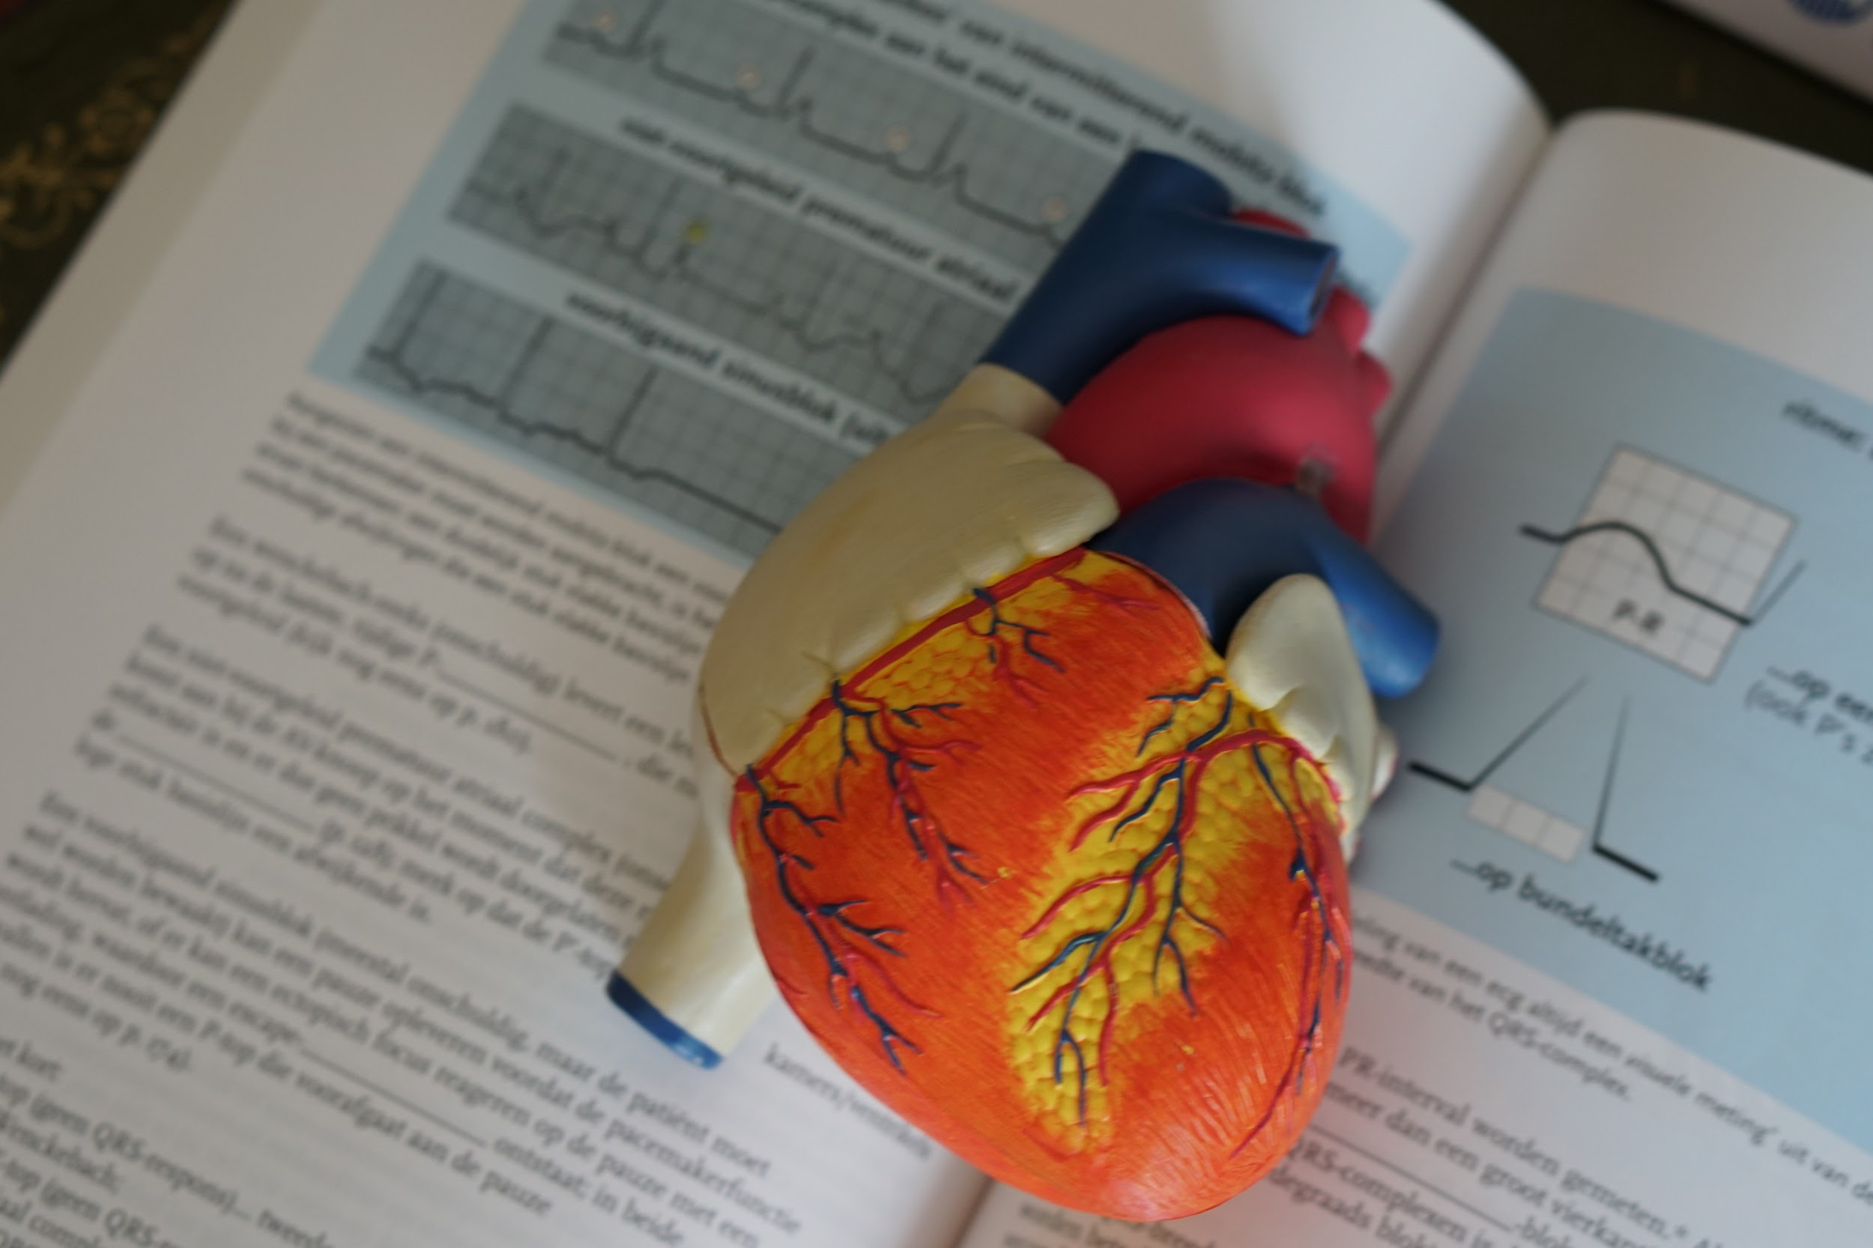
Project- 2
Heart disease classification
Presented by-
Team 24
Sneha Dey
(Seacom Engineering College)

Slide 2
ABOUT THE PROJECT
Machine Learning is used across many spheres around the world. The healthcare industry is no exception. Machine Learning can play an essential role in predicting presence/absence of Locomotor disorders, Heart diseases and more. Such information, if predicted well in advance, can provide important insights to doctors who can then adapt their diagnosis and treatment per patient basis.
In this project, I’ll discuss where I worked on predicting potential Heart Diseases in people using Machine Learning algorithms. The algorithms included K Neighbors Classifier and Support Vector Classifier and applying PCA on these 2 models.
Objective
Improve cardiovascular health and quality of life through prevention, detection, and treatment.
Early identification and treatment of heart attacks and strokes.
Prevention of repeat cardiovascular events and reduction in deaths from cardiovascular disease.

Slide 3
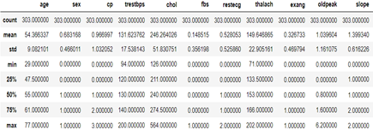
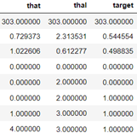
IMPORTING LIBRARIES AND DATASET
I imported several libraries for the project and all the necessary Machine Learning algorithms.
In the dataset,there are a total of 13 features and 1 target variable. Also, there are no missing values so we don’t need to take care of any null values. Next, I used describe() method.
dataset.describe()
The method revealed that the range of each variable is different. The maximum value of age is 77 but for chol it is 564. Thus, feature scaling must be performed on the dataset.

Slide 4
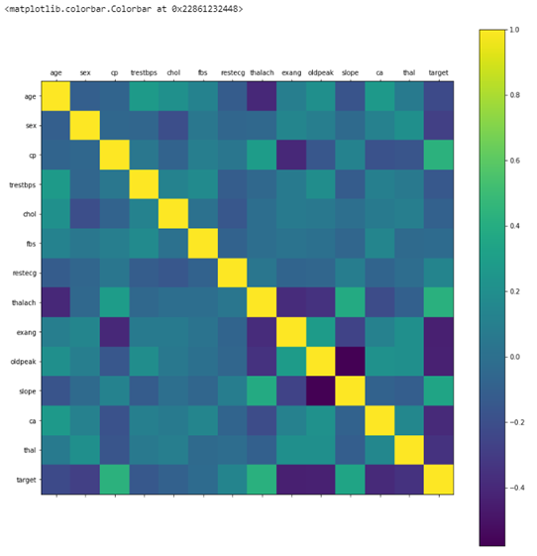
Confusion Matrix
To begin with, let’s see the correlation matrix of features and try to analyse it. The figure size is defined to 12 x 8 by using rcParams. Then, I used pyplot to show the correlation matrix. Using xticks and yticks, I’ve added names to the correlation matrix. colorbar() shows the colorbar for the matrix.
It’s easy to see that there is no single feature that has a very high correlation with our target value. Also, some of the features have a negative correlation with the target value and some have positive.

Slide 5
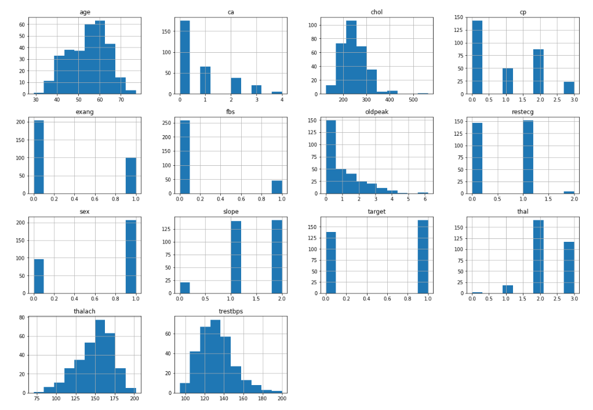
Histogram
The best part about this type of plot is that it just takes a single command to draw the plots and it provides so much information in return. Just use dataset.hist().
Let’s take a look at the plots. It shows how each feature and label is distributed along different ranges, which further confirms the need for scaling. Next, wherever you see discrete bars, it basically means that each of these is actually a categorical variable. We will need to handle these categorical variables before applying Machine Learning. Our target labels have two classes, 0 for no disease and 1 for disease.

Slide 6
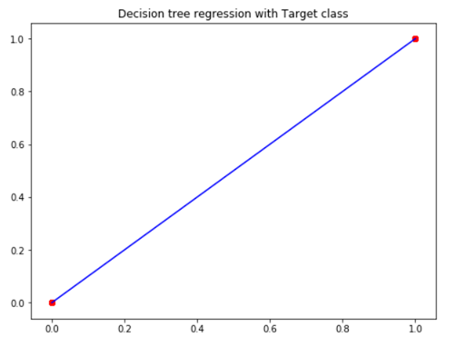
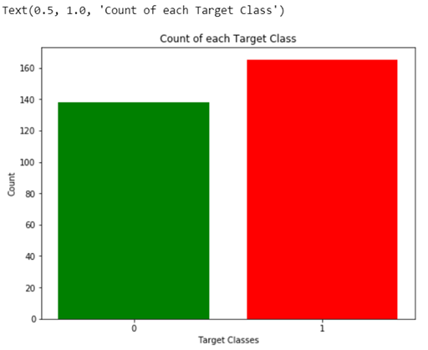
Predict the Target class
It’s really essential that the dataset we are working on should be approximately balanced. An extremely imbalanced dataset can render the whole model training useless and thus, will be of no use.
From the plot, we can see that the classes are almost balanced and we are good to proceed with data processing.
For x-axis I used the unique() values from the target column and then set their name using xticks. For y-axis, I used value_count() to get the values for each class. I colored the bars as green and red.
Bar Plot for Target Class

Slide 7
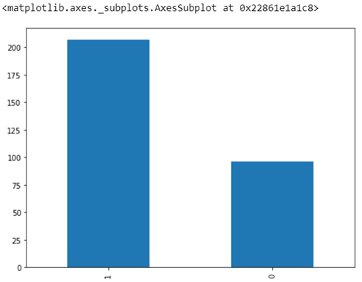
Bar plot for Count of male and female
As per dataset,
0 – female and 1 – male
The plot shows the number of male is mostly 2X greater than female patients in the active study.

Slide 8
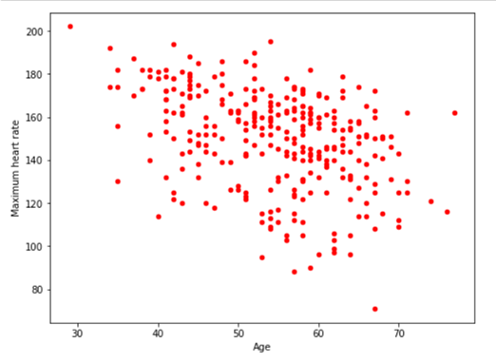
Scatter plot between Age and Maximum heart rate
A scatter plot is a type of plot or mathematical diagram using Cartesian coordinates to display values for typically two variables- Age and Maximum Heart Rate.
The plot shows the ages between 40 to 70 is more effective patients due to Maximum Heart Rate.

Slide 9
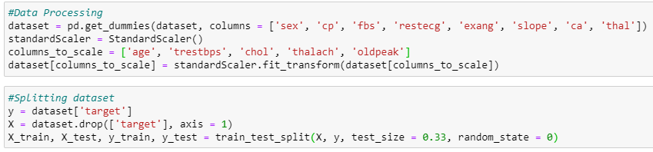
Data Processing and Splitting
To work with categorical variables, we should break each categorical column into dummy columns with 1s and 0s.
In this project, I took 4 algorithms and varied their various parameters and compared the final models. I split the dataset into 67% training data and 33% testing data.

Slide 10
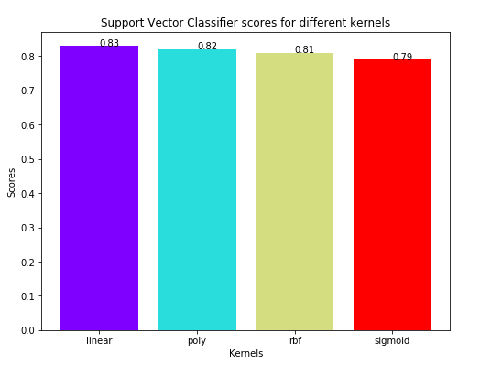
Support Vector Machine
I will run the model on the train and test set using SVC( Support Vector Classifier) and then use the test set to see what kind of prediction results we get using the test data set.This classifier aims at forming a hyperplane that can separate the classes as much as possible by adjusting the distance between the data points and the hyperplane. There are several kernels based on which the hyperplane is decided. I tried four kernels namely, linear, poly, rbf, and sigmoid.
Once I had the scores for each, I used the rainbow method to select different colors for each bar and plot a bar graph of the scores achieved by each.
As can be seen from the plot above, the linear kernel performed the best for this dataset and achieved a score of 83%

Slide 11
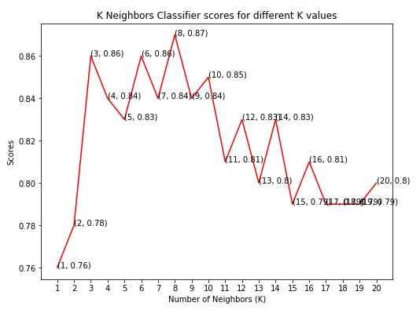
K – nearest neighbor classifier
This classifier looks for the classes of K nearest neighbors of a given data point and based on the majority class, it assigns a class to this data point. However, the number of neighbors can be varied. I varied them from 1 to 20 neighbors and calculated the test score in each case.Then, I plot a line graph of the number of neighbors and the test score achieved in each case.
As you can see, we achieved the maximum score of 87% when the number of neighbors was chosen to be 8.

Slide 12
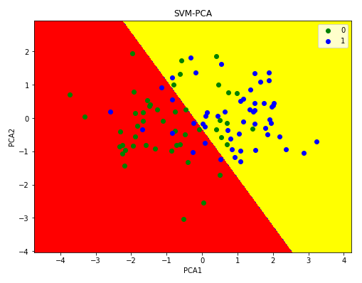
SVM with PCA
The PCA/SVM-based method involves PCA-based data selection and image feature extraction for SVM classification; this method can be used to solve the detection problems inherent in imprecise, uncertain, and incoherent data from multiple sensors.
As you can see, we achieved the maximum score of 80% the best for this dataset as per accuracy check.

Slide 13
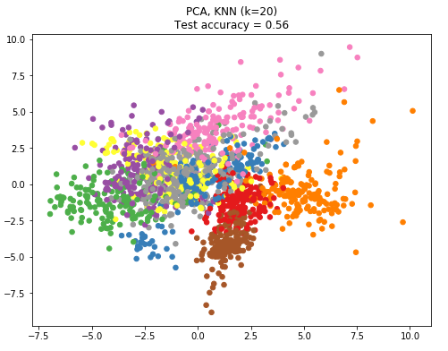
KNN with PCA
I am using KNN to classify and I also now have implemented PCA to reduce the dimensionality.As one closest neighbor is red circle. Basically, with lower K value, - KNN model is trying to fit the model to data very closely and trying to find.
As you can see, we achieved the maximum score of 56% when the number of neighbors was chosen to be 20.

Slide 14
ACCURACY
1. Support Vector Classifier: 83%
2. K Neighbours Classifier: 87%
3. SVM with PCA: 80%
4. KNN with PCA: 56%
K Neighbours Classifier scored the best score of 87%

Slide 15
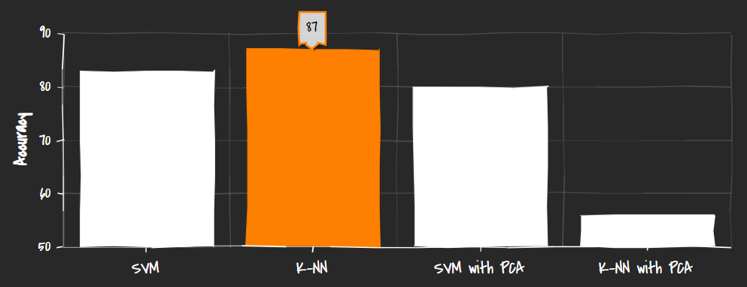
inference
K-Neighbours Classifier is amongst the most popular learning method grouped by similarities to build machine learning models particularly for Heart disease prediction and document classification.

Slide 16
THANK YOU

