Slide 1
MEDHELP
Online Doctor Appointments App

Slide 2
Content
Introduction
Problem Statement
Data Flow Diagram
Module Of project
Project Screenshot
References

Slide 3
Introduction
It is an Front Office Management of Medical Android App named “MedHelp” .Doctor appointment mobile apps allow patients to connect with medical professionals on the online platform. In other words, patients get a consultation from doctors in the virtual world, from the comfort of their home and at their preferred timings. For healthcare providers, the mobile app of their clinic is the solution to various problems.

Slide 4
PROBLEM STATEMENT
Our main motto to take up this problem is to cater to each and every need of the patient as well as monitor his/her health from the time he/she first visits the hospital till he/she totally recovers.Additional attention and adequate support to ensure faster recovery is not possible as there is no proper communication channel/link between the doctor and the patient after the check-up.Due to insufficient data obtained in the form of feedback the government is unable to do the necessary improvements required in this field

Slide 5
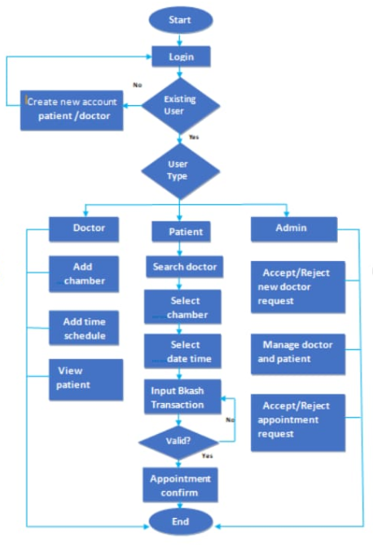
DATA FLOW DIAGRAM

Slide 6
MODULE OF PROJECT

Slide 7
Splash Screen: The first screen with which the user interacts will be this screen containing the logo and the app name. This will disappear within 5 seconds after the app is displayed. Login Page: This page is for those users who have already registered themselves on the app and have a username and a password. There is also a way on this page for the new users to register themselves which will take them to the registration page. Registration Page: This is page is solely designed for the new users of the app who are willing to register themselves. This page takes input of the various details of the user and stores it in the database, later helping the user to login into the account with credentials they have provided. Google Sign Up: This page comes into picture when one of the users wants to sign up for the app and he/she might want to sign up then there is an option for them that he/ she will login through their registered google account and once they sign up their data is automatically saved in the history.

Slide 8
Search: This is the most important part of the application that provides interactivity within the app as it connects the various activities together like it is a side bar on which the profile, the dashboard section, the FAQ section, the About page of the page are linked and on clicking on each you can visit the pages. Dashboard Page: This is the page displayed for every user after entering the app successfully. It contains the search bar where the user can search the doctor according to the wish as well as some of the disease lists are suggested so that user can easily search for their doctor as per their need. Appointment Description Page: After searching there are a number of doctors that appear, when the user selects the appointment page the page will be displayed that will contain all the details of the doctors i.e., the doctor’s name, their specification and a short summary of the doctors and the link to book the appointment. Medical Folder: It contains the information of all the medicines and saves data. In this we can search for any medicines.

Slide 9
Profile: This page will contain all the user details that the user entered while creating the account on the app. The user can update and make changes to all this information as desired. FAQ Pages: This page contains some of the questions that might arise in the mind of the users while using the app and to answer those, these answers are pre-written. Logout page: Then is this last panel for the users to sign out from the account. As soon as the users sign out, they are brought back to the login page.

Slide 10
PROJECT SCREENSHOTS

Slide 11
USER LOGIN

Slide 13
Quarterly performance

Slide 14
Areas of growth
 | B2B | Supply chain | ROI | E-commerce
Q1 | 4.5 | 2.3 | 1.7 | 5.0
Q2 | 3.2 | 5.1 | 4.4 | 3.0
Q3 | 2.1 | 1.7 | 2.5 | 2.8
Q4 | 4.5 | 2.2 | 1.7 | 7.0

Slide 15
Business opportunities are like buses. There's always another one coming.
“
”
Richard Branson

Slide 16
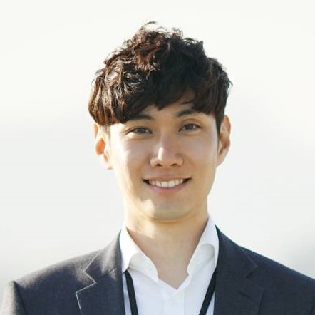



Meet our team
Takuma Hayashi
Mirjam Nilsson
President
Chief Executive Officer
Flora Berggren
Rajesh Santoshi
Chief Operation Officer
VP Marketing

Slide 17
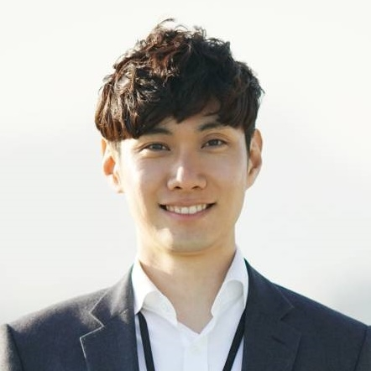



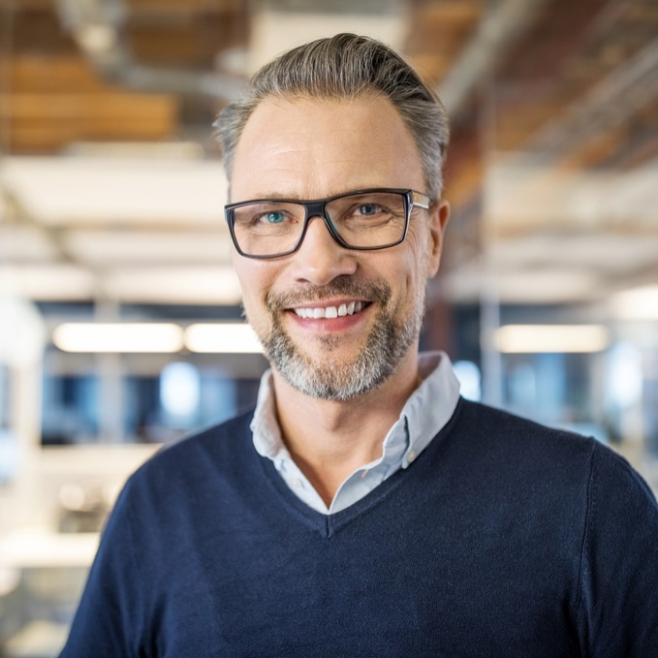



The full team
Takuma Hayashi
Mirjam Nilsson
Flora Berggren
Rajesh Santoshi
President
Chief Executive Officer
Chief Operations Manager
VP Marketing
Graham Barnes
Rowan Murphy
Elizabeth Moore
Robin Kline
VP Product
SEO Strategist
Product Designer
Content Developer

Slide 18
Plan for product launch
Deploy strategic networks with compelling e-business needs
Planning
Synergize scalable e-commerce
Marketing
Disseminate standardized metrics
Design
Coordinate
Foster holistically superior methodologies
Launch
Strategy
e-business applications
1
2
3
4
5

Slide 19
Timeline
Deploy strategic networks with compelling e-business needs
Sep 20XX
Synergize scalable e-commerce
Nov 20XX
Disseminate standardized metrics
Jan 20XX
Coordinate e-business applications
March 20XX
Foster holistically superior methodologies
May 20XX

Slide 20
Areas of focus
B2B market scenarios
Cloud-based opportunities
Develop winning strategies to keep ahead of the competition
Capitalize on low-hanging fruit to identify a ballpark value
Visualize customer directed convergence
Iterative approaches to corporate strategy
Establish a management framework from the inside

Slide 21
How we get there
ROI
Niche Markets
Supply chains
Envision multimedia-based expertise and cross-media growth strategies
Visualize quality intellectual capital
Engage worldwide methodologies with web-enabled technologies
Pursue scalable customer service through sustainable strategies
Engage top-line web services with cutting-edge deliverables
Cultivate one-to-one customer service with robust ideas
Maximize timely deliverables for real-time schemas

Slide 22
Summary
At Contoso, we believe in giving 110%. By using our next-generation data architecture, we help organizations virtually manage agile workflows. We thrive because of our market knowledge and great team behind our product. As our CEO says, "Efficiencies will come from proactively transforming how we do business."

Slide 23
Thank you
Mirjam Nilsson​
mirjam@contoso.com
www.contoso.com

