Slide 1
SALES ANALYTICS REPORT

Slide 2
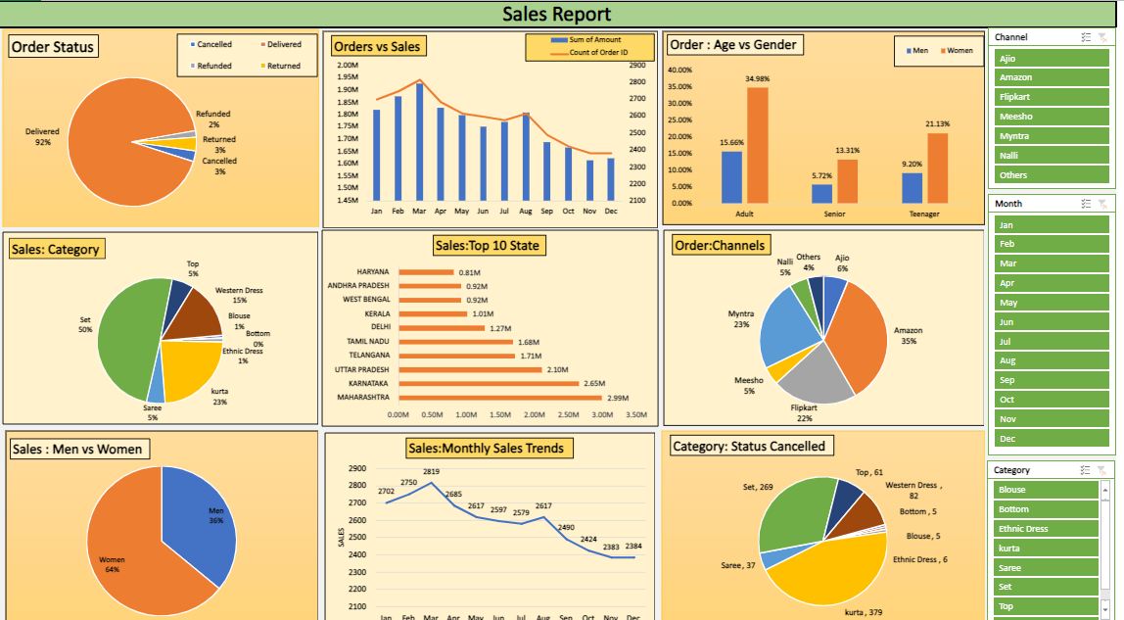

Slide 3
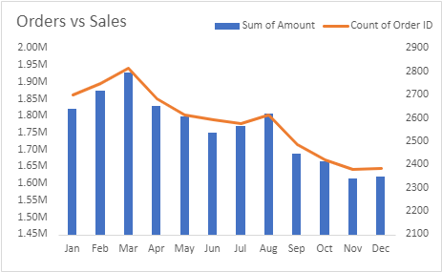
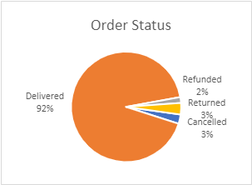
Sales Overview
Orders vs Sales:
Total sales reached a peak of 2.00M in April and declined steadily to 1.45M in December.
Analyze the reasons behind the fluctuations (e.g., seasonality, promotions, new product launches).
Order Status:
Delivered orders consistently account for the majority (92%), followed by cancellations and refunds at lower percentages.
Investigate the causes of cancellations and refunds to identify potential improvements.

Slide 4
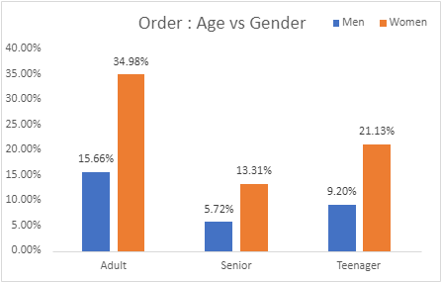
Age vs Gender:
The largest customer segment is Adults (40%), followed by Seniors (35%) and Teenagers (30%).
Women slightly outnumber men in terms of order volume.
Tailor marketing strategies to address the preferences of different age groups and genders.

Slide 5
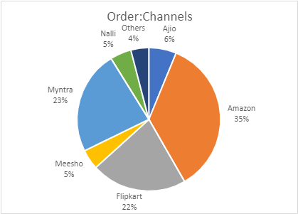
Order Channels
Amazon leads as the most popular channel, followed by Flipkart and Meesho.
Evaluate the performance of each channel to identify growth opportunities.
Consider optimizing product listings and promotions on high-performing channels.

Slide 6
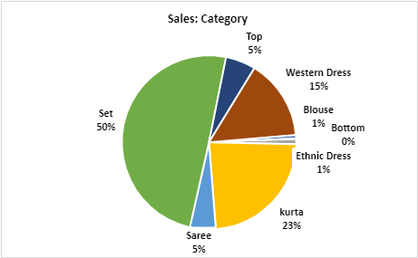
Sales: Category
Western Dress emerges as the top-selling category, followed by Ethnic Dress and Bottomwear.
Assess the profitability of each category and identify potential cross-selling opportunities.

Slide 7
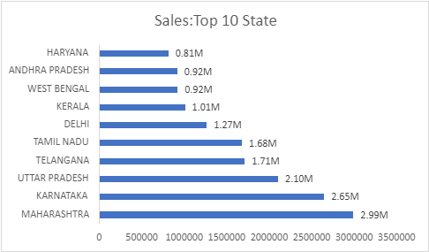
Sales: Top 10 States
Haryana leads in sales, followed by Andhra Pradesh and West Bengal.
Analyze regional sales trends to identify untapped markets and optimize distribution channels.

Slide 8
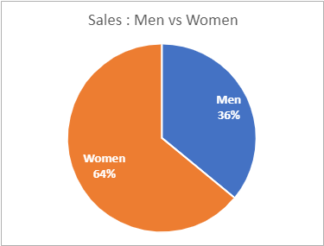
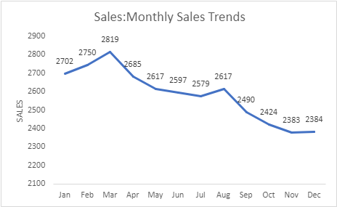
Customer Behavior
Sales: Men vs Women:
Women consistently spend more than men across all categories.
Develop targeted marketing campaigns to cater to the preferences of both genders.
Sales: Monthly Sales Trends:
Sales peak in April and May, with a gradual decline towards the end of the year.
Analyze seasonal trends to optimize inventory management and promotional activities.

Slide 9
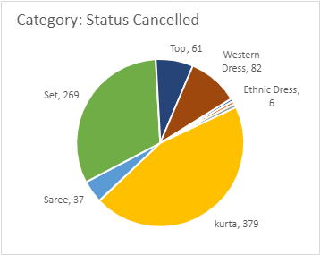
Operational Insights
Category: Status Cancelled:
Identify the top categories with high cancellation rates (e.g., Western Dress, Bottomwear).
Investigate the reasons behind cancellations and implement measures to reduce them.

