Slide 1

Presented By:
Sneha (211042)
Yatendra Singh (211202)
Rajendra Kumar (210816)
Chitresh Meena (210291)
Ayush Raj (210249)
ECO342A: Econometrics-II Term Paper

Slide 2
Structural Gravity Model Estimation Using India-ASEAN Trade Data & Counterfactual Analysis
Introduction & Objective
Literature Review
Data Sources
Model Description
Methodology
Results
Codes
References

Slide 3

Introduction & Objective
India's Free Trade Agreement (FTA) with ASEAN, known as AIFTA, was signed in 2009 and enacted in 2010, fostering a free trade area among member nations.
This study aims to explain the trade pattern between ASEAN countries and India, considering the factors for trade flows between countries.
This is modified version of the original gravity equation.
We have 27 countries in total - 10 ASEAN member countries, one India and 16 other countries.
Counterfactual analysis to explain the welfare effects if India joins the ASEAN agreement.
There would be 729 observations as a result of 27*27.

Slide 4
Literature Review
Tinbergen(1962) initially applied the model to evaluate international trade patterns.
Chan(2005) examined trade flows in Korea, Bhattacharya(2006) explained trade patterns in India, and studied when the gravity model can explain African exporting activities.
Endoh (1999), revealed that the ASEAN had a favorable and substantial impact on trade flows, whereas factors were negative and insignificant in two estimations.
Models that include population are often referred to as augmented gravity models (Cheng and Wall, 2004).
A recent paper by Subhash Jagdambe and Elumalai Kannan (2020), analyzing the impact of ASEAN-India FTA on agricultural trade have found positive results for India. Using the more reliable PPML method, they have shown a higher magnitude of the Trade Creation effect as compared to the Trade Diversion effect.
Richa Khurana & D. K. Nauriyal (2017) evaluated trade creation and trade diversion effects for India-ASEAN free trade agreement.
Bharti, S.K., & Nisa, S. (2021) studied India’s trade flows with ASEAN using the augmented gravity model.

Slide 5

Data Sources
The amount of exports for each country to several other countries was taken from World Integrated Trade Solutions (WITS) database.
We obtained the distance between countries using the CEPII (Center for Prospective Studies & International Information) database.
We used the World Bank database to download the GDP (Gross Domestic Product) of each country.
Common language, common colony, colony and common border dummies were obtained from the same CEPII database.
Bilateral Trade flows as reported by the origin (1000 current USD) were obtained from UN Comtrade.

Slide 6
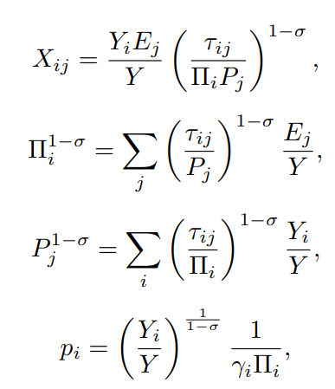

Model Description
The one_sector_ge model in the gegravity package replicates the structural model of Yotov .
That model is based on the earlier demand-side - constant elasticity of substitution (CES)-Armington structural gravity model of Anderson and van Wincoop (2003).
The model system takes the form given alongside.
Equation (1) is a typical gravity equation, which relates bilateral trade (Xij) between exporter i and importer j to exporter output (Yi), importer expenditures (Ej ), global output (Y), bilateral trade costs (τ_{ij}), the elasticity of substitution (σ) and outward and inward multilateral resistances (Π_{i} and P^{j} respectively).
Multilateral Resistance (MR) terms are defined by equations (2) and (3). These terms can be thought of as aggregate trade cost or price indices for the exporter and importer.
Equation (4) defines factory gate prices (pi), which are determined by output, OMRs, and the CES preference parameter (γi).
Finally, equation (5) determines expenditures and provides a market clearing condition. Expenditures are determined as a fixed ratio (φi) of the value of domestic production. Domestic production is defined by the product of output quantity (Qi) and factory gate prices. In this version of the model, output quantity is fixed/exogenous and all changes in the value of output are captured though the price term. Throughout, the notation above is used to denote baseline variable values. Counterfactual versions of each variable are denoted with an ∗. For example, counterfactual trade costs are written as τ∗ij.

Slide 7
Methodology
We used the Poisson Pseudo-Maximum Likelihood Estimator for estimation of the gravity model.
It is the same as applying a specific kind of nonlinear least squares to the initial equation.
Poisson Probability Mass Function given by : (𝛬𝑘*𝑒^{−ᴧ}) / (𝑘!).
For applied policy researchers utilizing gravity models, the Poisson estimator provides a number of extra useful characteristics.
Fixed effects can be inserted as dummy variables just like in a OLS model.
Observations for which the observed trade values 0 are naturally included in the Poisson estimator.
Interpretations of the Poisson model's coefficients is simple and adheres to the same pattern as OLS.
We used the "gegravity" python package to estimate General Equilibrium (GE) structural gravity models and simulate counterfactual experiments.
Using the gme package, we structured the gravity data – defined an econometric gravity model - estimated the model using Poisson Pseudo Maximum Likelihood (PPML) - store all relevant inputs and outputs in a single convenient Python object that is used by gegravity.
In next step we built the baseline model. Using parameters from the input data, the outward and inward multilateral resistance terms were calculated.
After solving the baseline model we conducted counterfactual experiment of India being a part of ASEAN nations.

Slide 8
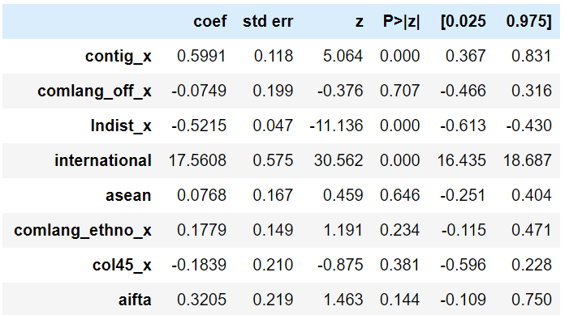
Results

Slide 9
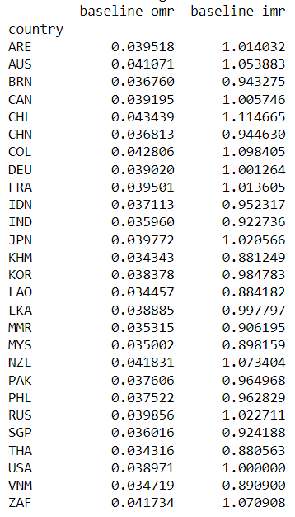
Baseline Multilateral
Resistance Estimates

Slide 10
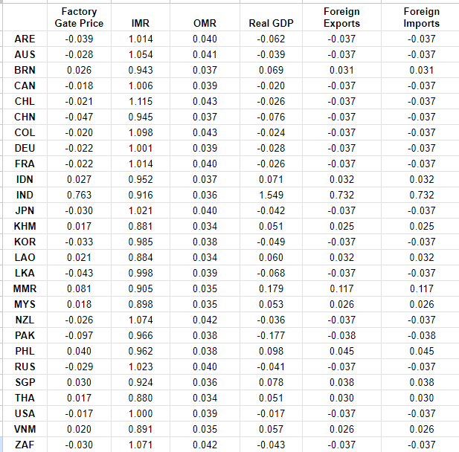
gegravity Modeled Effects Of India Joining ASEAN

Slide 11
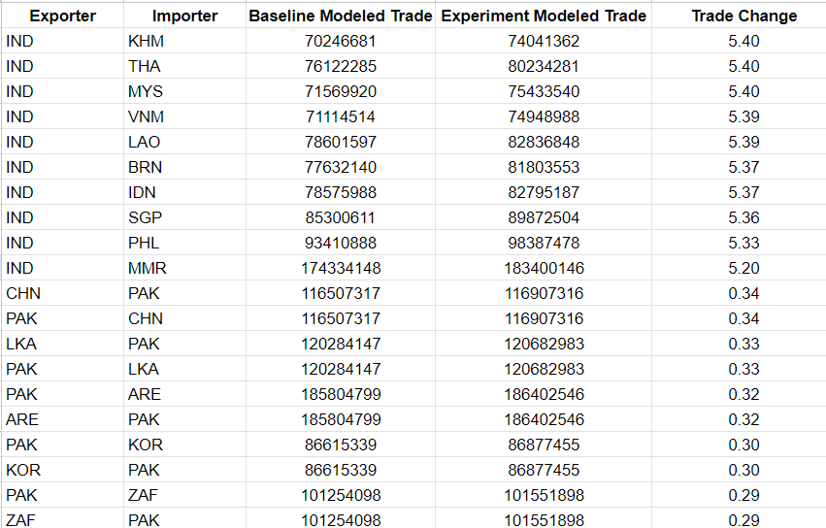
gegravity Modeled Effects Of India Joining ASEAN

Slide 12

Codes
import pandas as pd
import gme as gme
import gegravity as ge
gravity_data_location = r"C:\Users\singh\OneDrive\Desktop\IIT Kanpur\IITK 6th Semester\ECS\Herman-Trade\Real_Final_Data.csv"
grav_data = pd.read_csv(gravity_data_location)
grav_data
gme_data = gme.EstimationData (grav_data,
imp_var_name = "iso3_d_x",
exp_var_name = "iso3_o_x",
year_var_name = "year_x",
trade_var_name = "exports")
gme_model = gme.EstimationModel (gme_data,
lhs_var ="Exports",
rhs_var =["contig_x", "comlang_off_x", "lndist_x","international","asean","comlang_ethno_x","col45_x","aifta"],
fixed_effects =[["iso3_o_x"], ["iso3_d_x"]])
gme_model.estimate()
gme_model.results_dict["all"].summary()

Slide 13
Codes
ge_model = ge.OneSectorGE
( gme_model , year = "2020",
expend_var_name = "gdp_o_x",
output_var_name = "gdp_d_x",
reference_importer = "USA", sigma = 5)
ge_model.build_baseline (omr_rescale =10)
print(ge_model.baseline_mr)
exp_data = ge_model.baseline_data.copy()
#BRN
exp_data.loc [( exp_data["iso3_d_x"]=="IND") &
( exp_data["iso3_o_x"]=="BRN") , "asean"] = 1
exp_data.loc [( exp_data["iso3_d_x"]=="BRN") &
( exp_data["iso3_o_x"]=="IND") , "asean"] = 1
#KHM
exp_data.loc [( exp_data["iso3_d_x"]=="IND") &
( exp_data["iso3_o_x"]=="KHM") , "asean"] = 1
exp_data.loc [( exp_data["iso3_d_x"]=="KHM") &
( exp_data["iso3_o_x"]=="IND") , "asean"] = 1

Slide 14
Codes
#IDN
exp_data.loc [( exp_data["iso3_d_x"]=="IND") &
( exp_data["iso3_o_x"]=="IDN") , "asean"] = 1
exp_data.loc [( exp_data["iso3_d_x"]=="IDN") &
( exp_data["iso3_o_x"]=="IND") , "asean"] = 1
#LAO
exp_data.loc [( exp_data["iso3_d_x"]=="IND") &
( exp_data["iso3_o_x"]=="LAO") , "asean"] = 1
exp_data.loc [( exp_data["iso3_d_x"]=="LAO") &
( exp_data["iso3_o_x"]=="IND") , "asean"] = 1
#MYS
exp_data.loc [( exp_data["iso3_d_x"]=="IND") &
( exp_data["iso3_o_x"]=="MYS") , "asean"] = 1
exp_data.loc [( exp_data["iso3_d_x"]=="MYS") &
( exp_data["iso3_o_x"]=="IND") , "asean"] = 1
#MMR
exp_data.loc [( exp_data["iso3_d_x"]=="IND") &
( exp_data["iso3_o_x"]=="MMR") , "asean"] = 1
exp_data.loc [( exp_data["iso3_d_x"]=="MMR") &
( exp_data["iso3_o_x"]=="IND") , "asean"] = 1
#PHL
exp_data.loc [( exp_data["iso3_d_x"]=="IND") &
( exp_data["iso3_o_x"]=="PHL") , "asean"] = 1
exp_data.loc [( exp_data["iso3_d_x"]=="PHL") &
( exp_data["iso3_o_x"]=="IND") , "asean"] = 1

Slide 15
Codes
#SGP
exp_data.loc [( exp_data["iso3_d_x"]=="IND") &
( exp_data["iso3_o_x"]=="SGP") , "asean"] = 1
exp_data.loc [( exp_data["iso3_d_x"]=="SGP") &
( exp_data["iso3_o_x"]=="IND") , "asean"] = 1
#THA
exp_data.loc [( exp_data["iso3_d_x"]=="IND") &
( exp_data["iso3_o_x"]=="THA") , "asean"] = 1
exp_data.loc [( exp_data["iso3_d_x"]=="THA") &
( exp_data["iso3_o_x"]=="IND") , "asean"] = 1
#VNM
exp_data.loc [( exp_data["iso3_d_x"]=="IND") &
( exp_data["iso3_o_x"]=="VNM") , "asean"] = 1
exp_data.loc [( exp_data["iso3_d_x"]=="VNM") &
( exp_data["iso3_o_x"]=="IND") , "asean"] = 1
#Supply the updated data.
ge_model.define_experiment(exp_data)
ge_model.simulate()
country_results = ge_model.country_results
bilateral_results = ge_model.bilateral_trade_results
ge_model . export_results (directory =r"C:\Users\singh\OneDrive\Desktop\IIT Kanpur\IITK 6th Semester\ECS\Another",
name ="INDIA_IDN")

Slide 16

References
Anderson, J. E., M. Larch, and Y. V. Yotov (2018). GEPPML: General equilibrium analysis with ppml. The World Economy 41 (10), 2750–2782.
Anderson, J. E. and E. van Wincoop (2003). Gravity with gravitas: A solution to the border problem. American Economic Review 93, 170–192.
gegravity: General Equilibrium Gravity Modeling in Python by Peter R. Herman
https://www.researchgate.net/publication/370625410
An Advanced Guide to Trade Policy Analysis: The Structural Gravity Model by Yoto V. Yotov, Roberta Piermartini, José-Antonio Monteiro, and Mario Larch •
Richa Khurana & D. K. Nauriyal (2017): ASEAN-India Free Trade Agreement: Evaluating Trade Creation and Trade Diversion Effects, Journal of East-West Business •
Bharti, S.K., & Nisa, S. (2021). A Study of India’s Trade Flows with the ASEAN: Gravity Model Analysis, Orissa Journal of Commerce 42(3), 15-26

