Slide 1

Thinking Models vs Instruct Models
Submitted By:
Jidigam Venkata Sai Pavan Kalyan
Rajasekhar Reddy Palavali
Dnyaneshwari Jayawant Shinde
Pavithra Pn
Mentor:
Varun Vennelaganti

Slide 2
Comparing Thinking Models vs Instruct Models
AI Model Comparison Project
We have done the project in 5 steps
1. Load API keys
2. Create model clients
3. Define model functions
4. Run evaluation
5. Show results (UI / scorecard)

Slide 3
Introduction
Large Language Models (LLMs) are widely used for tasks such as answering questions, solving problems, and generating code. Different types of models approach problems in different ways. This project compares Thinking Models and Instruct Models to understand how they perform across different tasks.
Thinking models generate step-by-step reasoning before providing the final answer. This helps explain how the solution was reached. In contrast, instruct models focus on direct responses, providing concise answers without showing intermediate reasoning steps.
The goal of this project is to evaluate how these two types of models perform on different tasks and determine when each type can be used.

Slide 4
Model Types
Thinking Models: step-by-step reasoning
Instruct Models: direct answers
Creating Model Functions
Here we are performing
1. Start timer
2. Send request to model
3. Get response
4. Calculate time
Return:
i. Answer
ii. Time Taken

Slide 5
Project Goal
Compare accuracy, reasoning, and response speed.
Methodology
Four AI models were tested:
Two Thinking Models
Two Instruct Models
All models were evaluated using three types of tasks.

Slide 6
Datasets Used
GSM8K (Math)
HumanEval (Coding)
TriviaQA (General Knowledge)

Slide 7
Task 1: Math Word Problems
Dataset used: GSM8K
50 math problems were sent to each model. The results were evaluated based on:
Correct final answer
Quality of reasoning
Response time

Slide 8
Task 2: Coding Problems
Dataset used: HumanEval
25 Python coding problems were given to each model. Code responses were tested in Google Colab to verify whether the code ran successfully.
Evaluation criteria:
Code correctness
Execution success
Code clarity

Slide 9
Task 3: General Knowledge Q&A
Dataset used: TriviaQA
50 general knowledge questions were tested.
Evaluation criteria:
Accuracy of answer
Clarity of explanation
Response speed

Slide 10
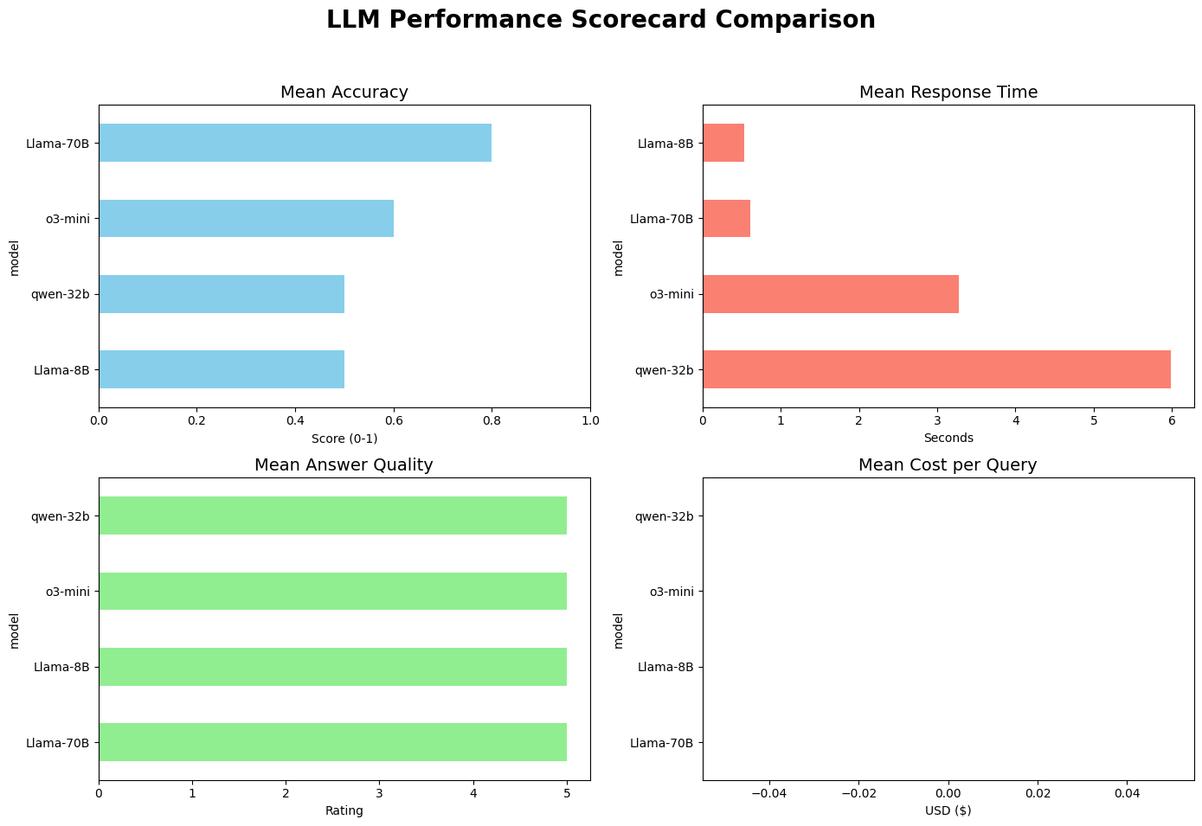
* Note: Since we’re using open source Cost per query chart is not available

Slide 11
Answer Quality vs Accuracy Mismatch
Some models give long, detailed answers. But final answer is wrong
It shows that High answer quality ≠ high accuracy
Reasoning-optimized models outperform general LLMs on structured problem-solving tasks, but at the cost of higher latency and computational overhead.

Slide 12
Observations
Models like o3-mini and qwen-32b perform better in math reasoning
Models like Llama (8B/70B) struggle with multi-step problems
Llama-8B → fastest
o3-mini / qwen are slower but more accurate
o3-mini → highest accuracy
qwen-32b → close second
Llama-70B → moderate
Llama-8B → lowest
o3 mini model recommended for Student chatbot considering the reasoning details required and overall accuracy/response time/reasoning quality

