Slide 1

Group 5:
Pooja
Tran Pham
Amit
Monika
Prajakta
Anvit
Sneha
Mohamad

Slide 2

SJSU Washington Square
CMPE 283 - Virtualization VStack Project
Agenda
Introduction
Design Concept
Implementation & Technologies
Issues, challenges and solutions
Demo
Notes:
Tran

Slide 3
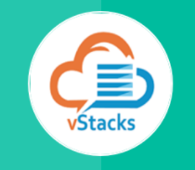
Introduction
Built on top of OpenStack
Setup Web application platform.
1-click install
Extensible service templates
Notes:
Tran
Anytime, we want to set up environment to run web application, the steps is always the same: setup web server, setup db server, connect the two servers, set up security rule for that connection. In a company, developer team want to have development env, QC team want to have qc env, QA team want to have QA env. Those step is repeated. => the 1st problem
Application now expand and require more hardware, sys operator have to migrate the environment to a more powerful physical server manually => 2nd problem
VStack goal is to solve that 2 problems: remove repetition and provide a scalable environment for services.
VStack application solve these 2 problems and provide a convenient way to set up infrastructure for web services.
Built on top of OpenStack, VStack provide several service templates to choose from and an integrated view to monitor all resources backing that service. This make the administrative job simple.
Powered by OpenStack, the service provided by VStack is highly scalable which can adapt well to business need for a scalable web application platform but private, on-premises.

Slide 4
SJSU Washington Square
VStack - What does it do?
Service provisioning
Service health check
Service metering and billing
SSO
Notes:
Anvit
Service Provisioning: In our project, we have given service of launching an instance. Vstack talks with openstack and launches an instance from our application. We have also given option of resuming, deleting and stopping the instance we create.
Service Health: Vstack focuses on providing health check of our application as well as instances we create. Like health check of Apache or MySQL server as well as health check for our instances. (Application - Apache and MySQL, Instances - Running or stopped)
Service Metering: Vstack also focuses on providing metering and billing features as in we charge user based on what flavour, and image he selects before launching an instance. (based on Image, disk and CPU)
SSO: Single Sign on as in we have integrated our login page with the FB button and hence anyone can login to Vstack using their facebook credentials and that fulfills SSO requirement.

Slide 5
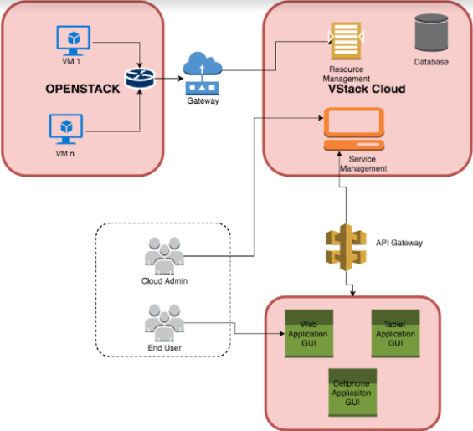
Infrastructure Design
SJSU Washington Square
Notes:
Anvit
This slide explains the infrastructure design of Vstack. We see application

Slide 6
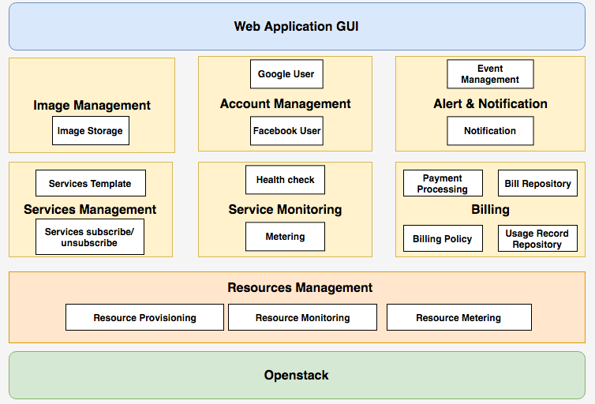
System Component Design
Notes:
Prajakta

Slide 7
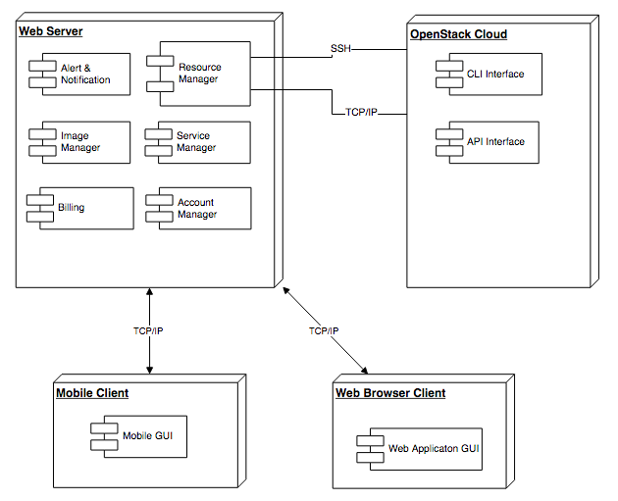
Deployment Design
SJSU Washington Square
Notes:
Sneha
The web server has all are modules deployed in it like - Resource Manager, image manager , Service Manager etc
The web server communicates with openstack using 2 interfaces. 1) REST 2) Command Line Our VStack Application can be accessed by any web browser
similarly since our application is developed on angular it can be accessed by any mobile browser as well

Slide 8
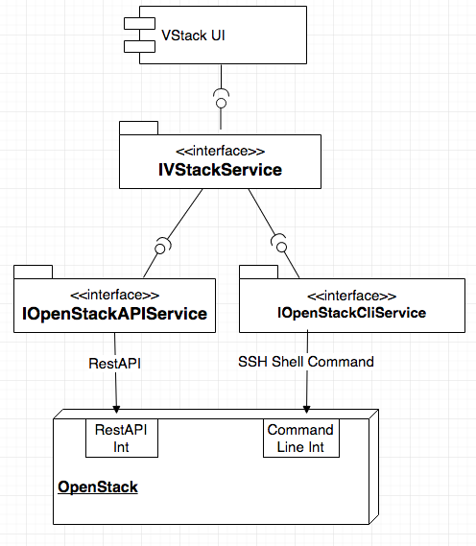
Component Design
SJSU Washington Square
Notes:
Senha
Vstack UI is on the Top - Which talks to our Vstack Servic
we have developed a web Service using Springframework.
Our Service Communicates with Open Stack via 2 interface REST and Command Line. For Certain instances we are using
We have used a combination of Rest API service and Command Line service for communicating to our Open Stack
For any command line executing we need to source the environment file first, in our project we are not downlading the file and sourcing it, We are getting the User details from REST Service and Exporting the envirnment variablles for Authentication to use command line
For Example , to delete an instance using command line we are getting the user details for authentication via REST API , and using those details to executing our command line for deleting the instance
We have used Keystone, Compute and Neutron Rest API to Create Instance, user, Get User Details and Network Details
Command Line we have used JSCh Java library to SSH into our Compute node , then exported the Environment Variables for authentication , we have used command line for deleting and instance, assigning Floating IP, Assigning User Role.
IOpenStackAPIService: a wrapper interface of Openstack RestAPI interface. Provide necessary functions for IVStackService
IOpenStackCliService: a wrapper interface of Openstack Command Line interface. Provide necessary functions for IVStackService

Slide 9
SJSU Washington Square
Implementation
Project requirement analysis
Project Planning
Project Development
Project Testing
Notes:
Monika
Project requirement analysis- Basic need of any system. We discussed about the requirement of our system, gathered info, created mockups, shared with teammates → designed our project
Project Planning - We started our planning by first analyzing the strength of each member and divided the tasks accordingly and followed the sprint model. We planned to work on individual microservice and then integrate it into one.
Project Development: We set our weekly goal, worked independently and used to update the respective work on weekly basis.
Project Testing: For testing we carried out regression testing for each module and focussed on end to end flow ie. from launching of the application to verification of services with installed application server and database.

Slide 10
SJSU Washington Square
Issues, challenges and solutions
Issues & Challenges:
Hardware limitation to run Openstack
Networking issues
Development & Testing Environment issues
Solutions:
Hardware: Use lightweight image: CentOS
Network: Created Network > Subnet > Router > Interface
Dev & test: Create a new ‘Domain’ other than ‘Default’
(Bug link)
Referred Trystack
Notes:
Amit

Slide 11
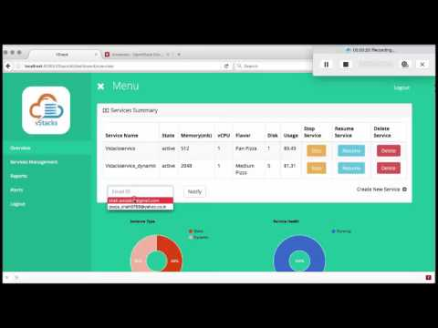
SJSU Washington Square
Demo
URL: https://www.youtube.com/watch?v=1hzipdrkJDs
Notes:
Pooja & Mohamad

Slide 12

THANK YOU

