Slide 1
How to flatten the curve during a pandemic?
Sneha Koneru

Slide 2
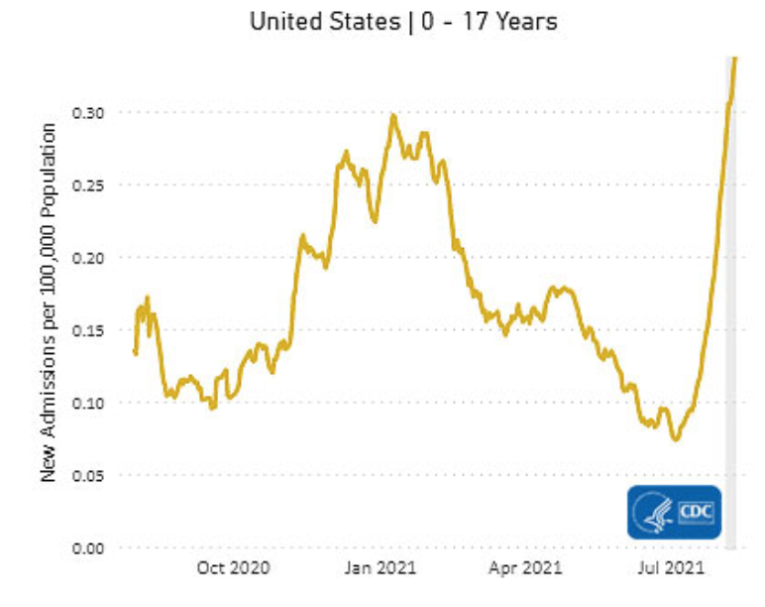
COVID-19 in 2021: A pandemic of unvaccinated population
Children under the age of 12 years: ~34 million susceptible schoolchildren
Vaccine hesitant population
New variants from around the world that can be spread even by vaccinated people
Which public health measures were effective at state and county level in 2020?

Slide 3
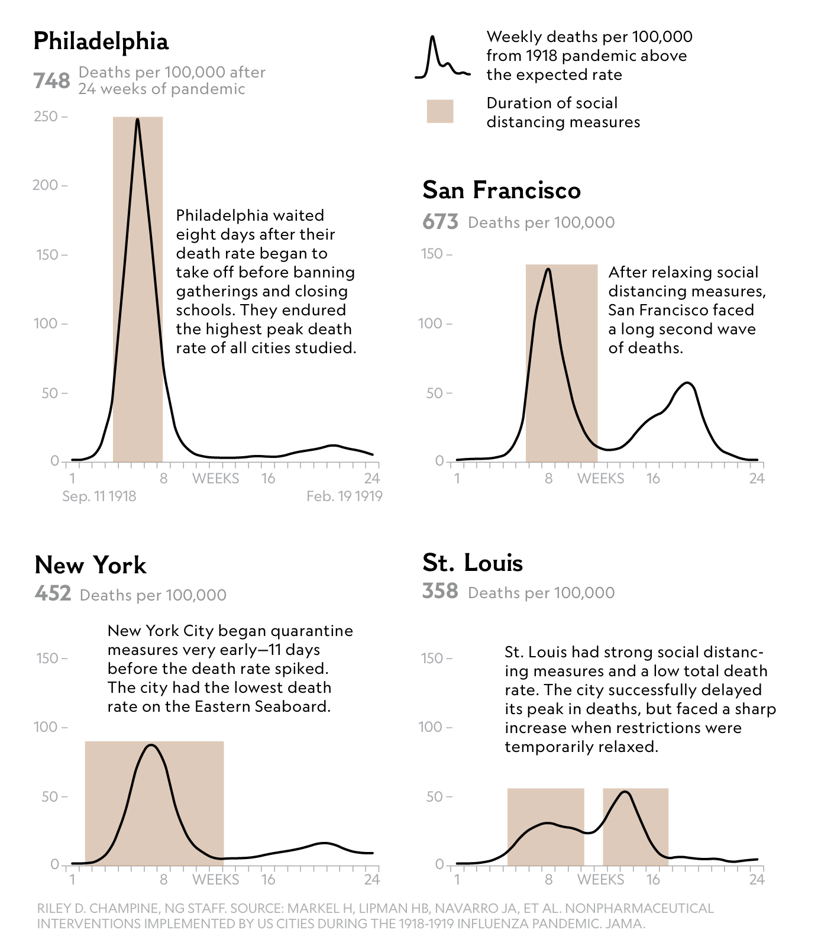
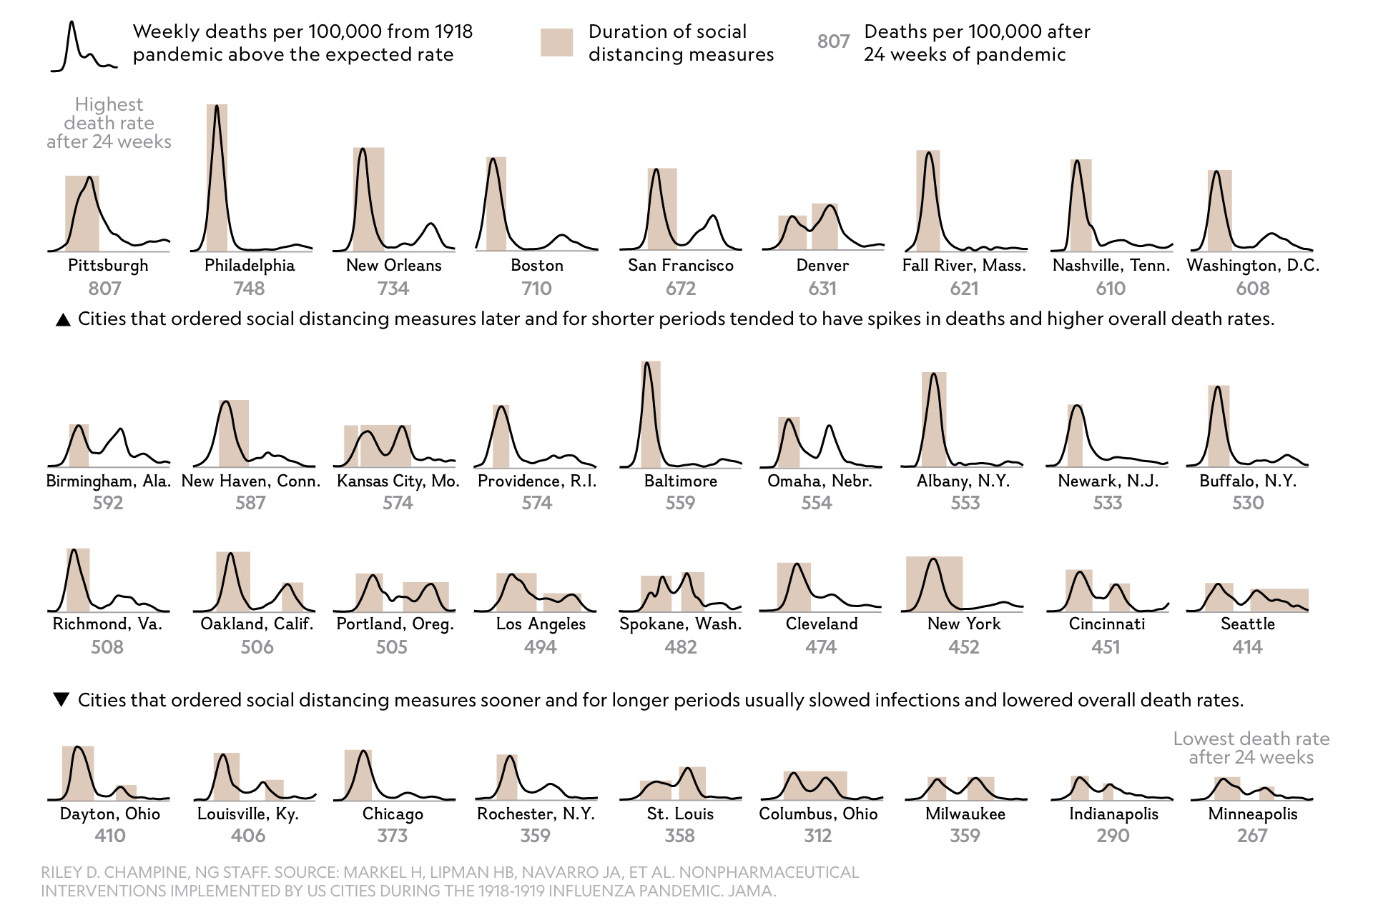
Lessons from 1918 Flu
RILEY D. CHAMPINE, National Geographic magazine. SOURCE: MARKEL H, LIPMAN HB, NAVARRO JA, ET AL. NONPHARMACEUTICAL INTERVENTIONS IMPLEMENTED BY US CITIES DURING THE 1918-1919 INFLUENZA PANDEMIC. JAMA.

Slide 4
Data sources
CDC, Johns Hopkins University, The New York Times, The Atlantic and more..

Slide 5
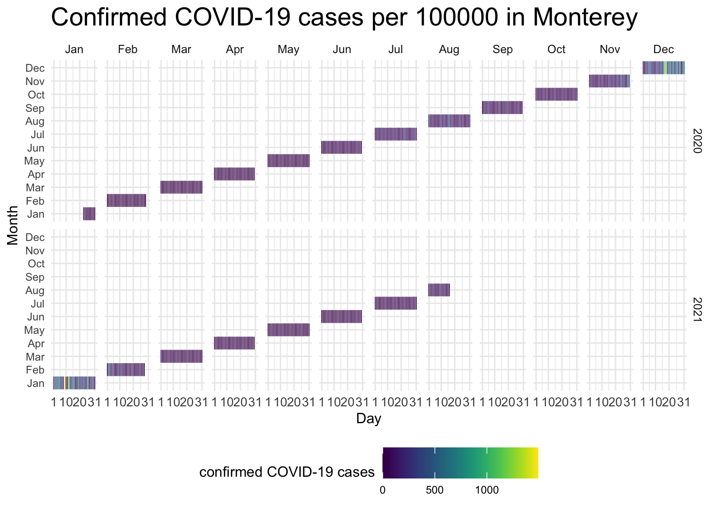

Comparison between two counties with similar population size
Vaccination rate? About the same number of vaccine doses have been delivered in both the counties
Data source: Johns Hopkins University

Slide 6
Correlation between willingness to wear a mask and COVID-19 positivity rates
How often do you wear a mask in public when you expect to be within six feet of another person?
Data source: NYT, CDC

Slide 7
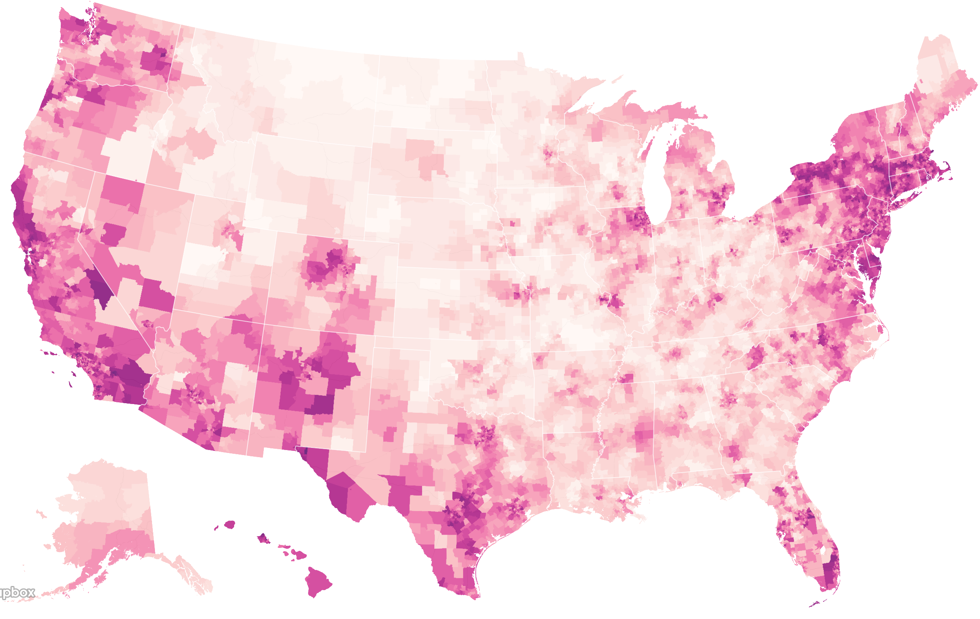
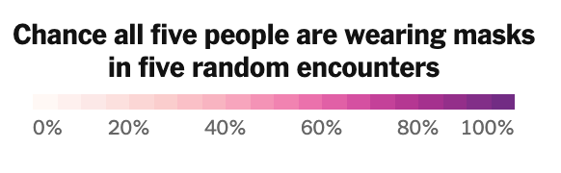
Willingness to wear a mask is not uniform across all states
MT
ID
MO
AK
HI
Data source: NYT

Slide 8
Time-Series Forecasting with Machine Learning
Objective: To forecast COVID-19 cases and mortality rates from different variables such as social distancing, mask mandates and lockdown period
Data: COVID-19 Data Repository by the Center for Systems Science and Engineering (CSSE) at Johns Hopkins University
https://github.com/CSSEGISandData/COVID-19/tree/master/csse_covid_19_data/csse_covid_19_time_series
Methodology: ARIMA model and LSTM
AR: The evolving variable of interest is regressed on its prior values
I: The data values are replaced by the difference between their values and the previous values
MA: Infers the regression error is the linear combination of error terms of values at various stages of the priorly time

