Slide 1
IDENTIFYING A RANKING OF PREFERENCES FOR A POLLINATOR
Undergraduate Research by Sneha Krishna
Advisors: Dr. Rebecca Hutchinson and
Prof. Tom Dietterich
Notes:
Little bit about myself
I just graduated from the computer science program at OSU
I am joining a PhD program in computer science at UIUC
I have been working with Rebecca and Tom for two years
Research Goal: To create a method to identify a ranking of plant preferences for a pollinator given field observations of plant-pollinator interactions and to determine how floral traits affect the preference for a plant

Slide 2
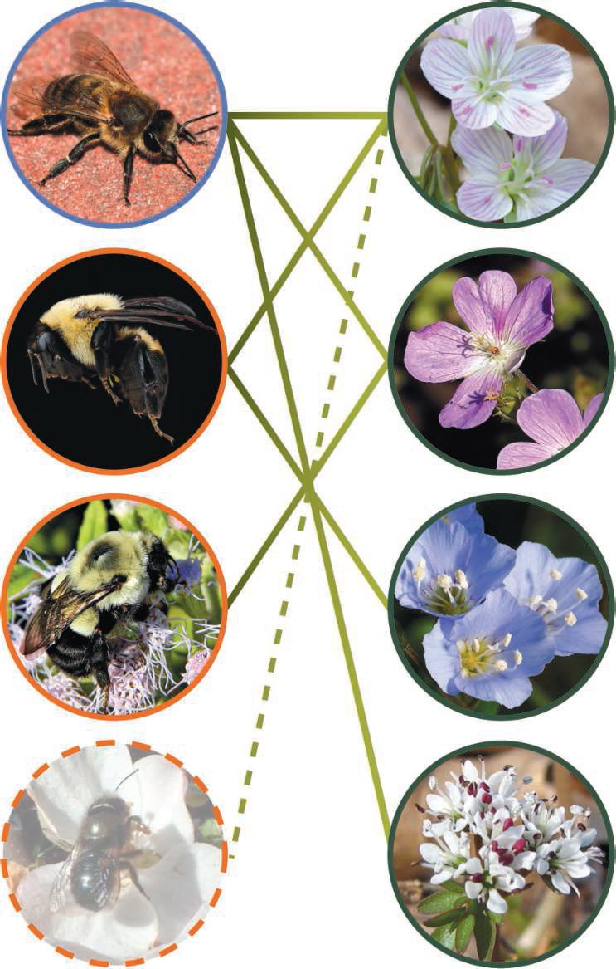
The Pollinators are disappearing
“Three-quarters of global food crops depend at least partly on pollination”
--Tylianakis, 2013
So what happens when a plant becomes extinct?
Notes:
Tylianakis says ¾ of food crops depend at least partly on pollination
But because of changing land use, populations of wild pollinators are decreasing and plant distributions are changing all around the world.
Because of the importance of pollinators, we could have a pollination crisis on our hands.
ecologists predict that the loss of pollinators will affect plant biodiversity (picture)
So what happens when a plant goes extinct?
We would expect this (point) pollinator to go extinct as well right?
But field studies show that pollinators (even ones that interact with only a few plants) can be resilient and adapt to new plant distributions
Understanding how pollinators choose flowers to visit will allow us to understand how plant-pollinator networks will adapt over time

Slide 3
Specialization vs Generalization
Generalist
Generalist
Specialist
Specialist
Notes:
Generalists interact with many species
Specialists interact with only one (or a few) species
Many rarely observed species are labelled specialists without enough evidence.
Although a few such as species in the genus Dufourea are truly specialists
For example if a pollinator is only observed 20 times, and all 20 interactions are with one plant, it will probably be labelled a specialist even if it really isn’t. (sampling error)
To keep things in perspective, Apis mellifera (the honeybee and a generalist) is very populous and can have upwards of 300 interactions during a 15 minute window in the dataset we are using.
For this reason, we will be using insects that have many interactions in our dataset including Apis mellifera, Bombylius major, and Eristalis hirtus

Slide 4
Research Goal
To create a method to identify a ranking of plant preferences for a pollinator given field observations of plant-pollinator interactions and to determine how floral traits affect the preference for a plant
Notes:
We applied these models to analyze plant-pollinator observations observed in the field. These models take steps towards creating systems that will be able to predict plant-pollinator interactions in the case of the extinction of existing plants in a network or the introduction of plants to an area

Slide 5
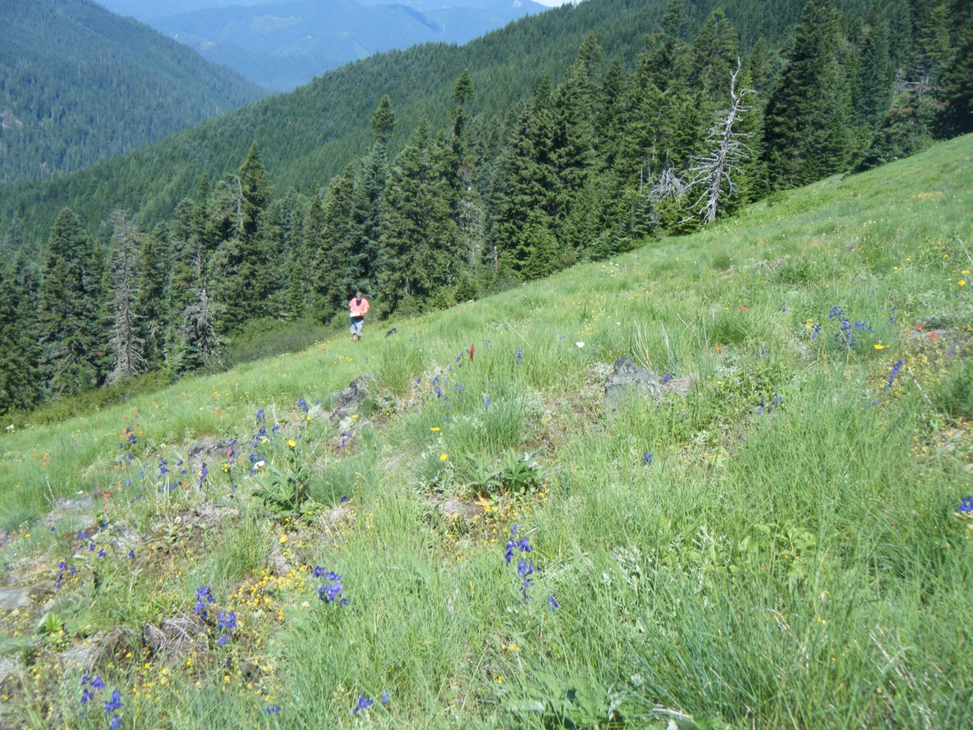
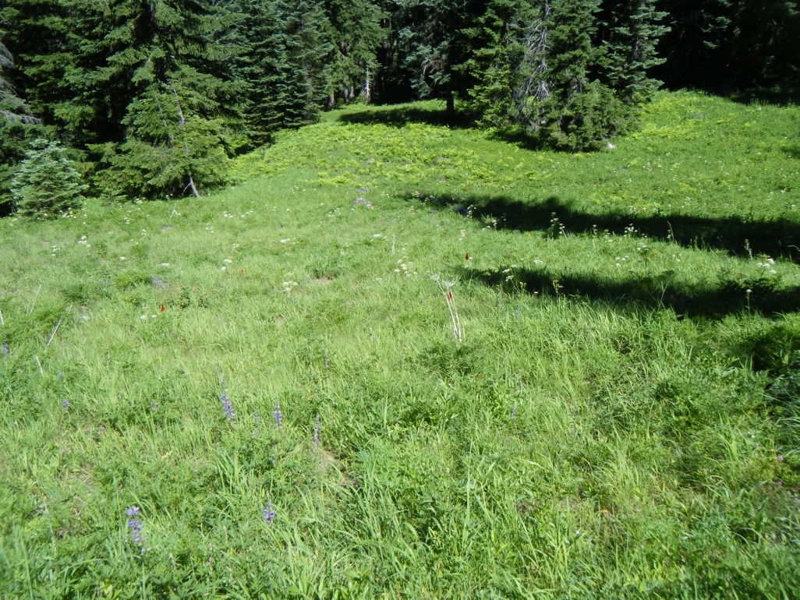
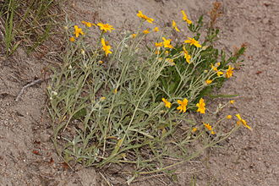
The Field Data
Carpenter Basin
Lookout Mountain
Eriophyllum lanatum
Notes:
The field data was collected over the summers of 2011-2014
At the HJ Andrews Experimental Forest by Vera Pfeiffer and the Eco-Informatics Summer Institute
There were 110 plants and 493 pollinators present in the entire dataset
At each visit, observations were made in 15 non-consecutive minutes

Slide 6
An Example Meadow-watch
Lookout Mountain July,2014
Notes:
Get date from Rebecca if she has it
Add availability of plants
The pollinators are on the x-axis (the columns)
Plants are on the y-axis (the rows)
The darker the cell is shaded, the more interactions took place between the plant and pollinator associated with that cell

Slide 7
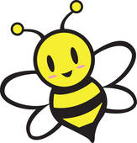
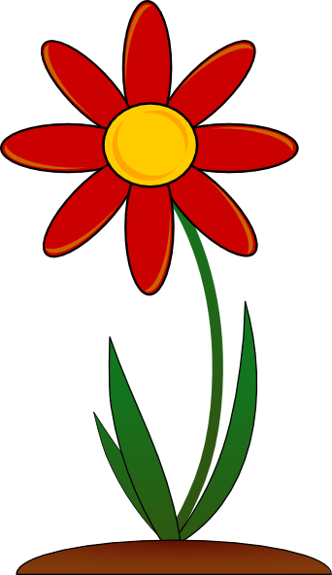
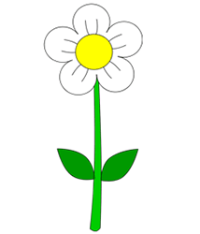
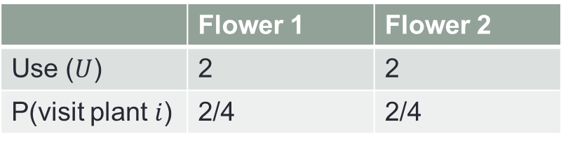
Probability of Use
 | Flower 1 | Flower 2
Use ($U$) | 2 | 2
P(visit plant $i$) | 2/4 | 2/4
Flower 1
Flower 2
Notes:
The idea of the multinomial model is that the insect rolls a weighted die where each side represents a plant species
In this simple example, the weight is the fraction of time the pollinator visits that plant (talk about table and probability)
However, Flower 1 is much more abundant than Flower 2
So we have to add Flower abundance to the data available to us to account for plant density independence

Slide 8
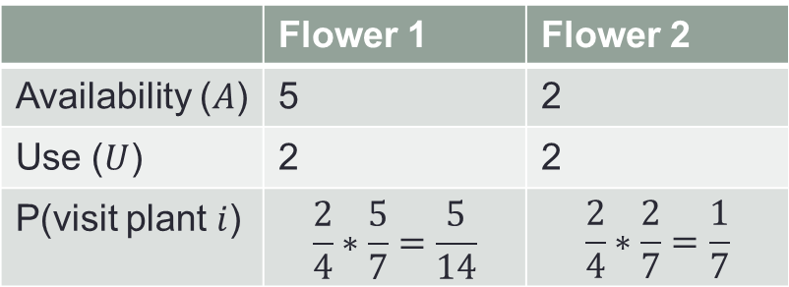
Adding Availability
 | Flower 1 | Flower 2
Availability ($A$) | 5 | 2
Use ($U$) | 2 | 2
P(visit plant $i$) | $$\frac{2}{4}∗\frac{5}{7}=\frac{5}{14}$$ | $$\frac{2}{4}∗\frac{2}{7}=\frac{1}{7}$$
Flower 1
Flower 2
Notes:
Talk about availability in table
Now that we have the availability data, we can calculate the probability of the pollinator visiting flower 1 and flower 2
However, this doesn’t look right either.
Flower 1 is available more often than Flower 2, but flower 1 is not used very many times
It looks like the pollinator prefers flower 2 over flower 1, but the probability does not reflect this.
How can we quantify this?

Slide 9
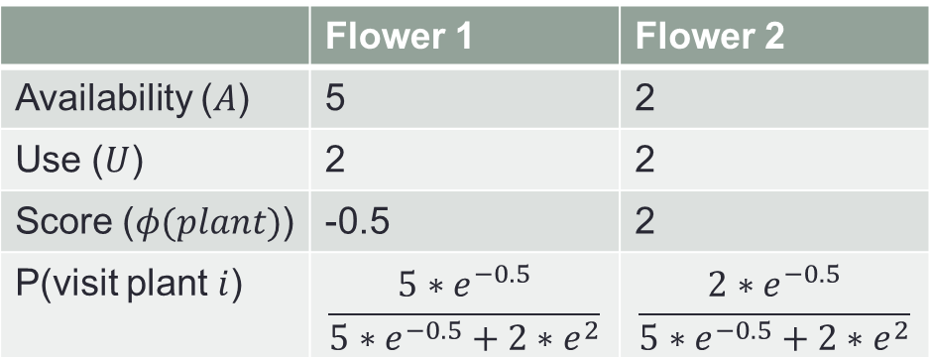
Adding Pollinator Preferences
 | Flower 1 | Flower 2
Availability ($A$) | 5 | 2
Use ($U$) | 2 | 2
Score ($φ(plant)$) | -0.5 | 2
P(visit plant $i$) | $$\frac{5∗e^{−0.5}}{5∗e^{−0.5}+2∗e^{2}}$$ | $$\frac{2∗e^{−0.5}}{5∗e^{−0.5}+2∗e^{2}}$$
Flower 1
Flower 2
Notes:
We add a score for each plant for the pollinator.
A score of zero means the pollinator is ambivalent about the plant
A more positive score indicates the pollinator is more attracted to that plant
In this example, we will assume the scores for flower 1 and 2 are -0.5 and 2 respectively
To calculate the probability, we first multiply the availability of the plant by e^score for the plant
Then we divide by the sum of all the availabilities multiplied by e^score

Slide 10
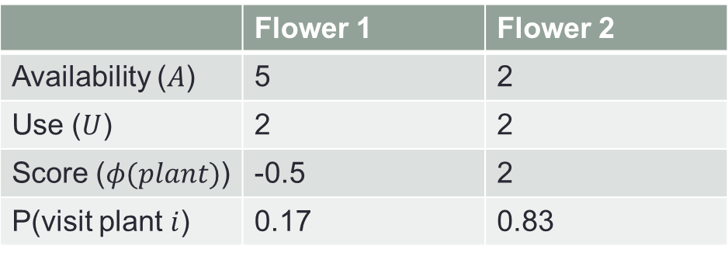
Adding Pollinator Preferences
 | Flower 1 | Flower 2
Availability ($A$) | 5 | 2
Use ($U$) | 2 | 2
Score ($φ(plant)$) | -0.5 | 2
P(visit plant $i$) | 0.17 | 0.83
Flower 1
Flower 2
Notes:
The probability is now
This probability makes more sense
Note from here on, I use Phi vector and score function interchangeably

Slide 11
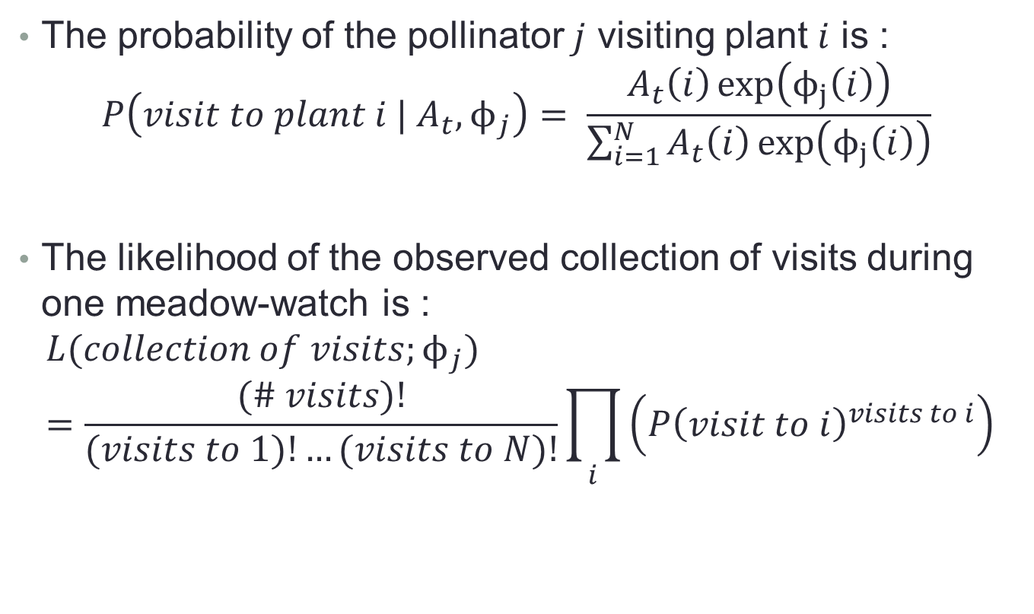
Writing our model mathematically
The probability of the pollinator $j$ visiting plant $i$ is :
$$P\left(visit to plant i | A_{t},ϕ_{j}\right)= \frac{A_{t}\left(i\right)\exp\left(ϕ_{j}\left(i\right)\right)}{\sum_{i=1}^{N}{A_{t}\left(i\right)\exp\left(ϕ_{j}\left(i\right)\right)}}$$
The likelihood of the observed collection of visits during one meadow-watch is :
$$L(collection of visits;ϕ_{j})=\frac{(\# visits)!}{(visits to 1)!…(visits to N)!}\prod_{i}{\left({P\left(visit to i\right)}^{visits to i}\right)}$$
Notes:
We can symbolize the equation we used in the previous example to this equation
Where A(t) is the availability of plants at meadow-watch t
Phi(j) is the scores of the plants given by pollinator j
Our goal is to find the score function (represented by phi)
To do this we will maximize the likelihood of the collection of visits using gradient descent
(Explain the L() equation)

Slide 12
Evaluating the Multinomial Model— Simulated Data
Choose the score function for the pollinator.
Calculate the probability a pollinator would visit each plant in the meadow
Generate random use data for all the meadows using the probability vector.
Use gradient descent to find the fitted scores.
Generalist
Half-Special
True-Special
Notes:
Before we continue with using this model, we need some reassurance that this model is doing a good job
in the ideal situation where the assumptions of the model are being met.
To do this we tested the model on a simulated pollinator for which we know the score function.
First….(continue with steps)

Slide 13
Does the model work as is?
Without Regularization--Generalist
Solution—Introduce Regularization.
Notes:
Does the model work? Kind of.
The plot shows the values of original score function on the x axis and the fitted score function (using the model) on the y axis.
Each point represents one plant
The range of the fitted score function (~-15--5) is much greater than the range of the true score function (-2--2)
The majority of the points follow a line parallel to the x=y line
There is a group of points in the lower left of the graph that are far from their true values.
This is due to the plant being available but not used by the pollinator
To calibrate model, we use regularization
The regularization will penalize fitted scores that are far away from the x=y line

Slide 14


Using Regularization
Without Regularization--Generalist
With Regularization--Generalist
Pearson’s $r$ = 0.531
Pearson’s $r$ = 0.812
Notes:
On the left we have the plot without regularization, on the right we have the plot with regularization.
With Regularization, the range of the fitted score function becomes -4—3, when previously the range was -15—5
We see that the green dots on the lower left of the left hand plot are now much closer to the x=y line

Slide 15
Testing our model
Bootstrapping
Goodness of Fit—Chi-squared tests

Slide 16
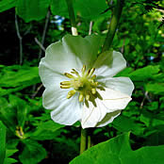
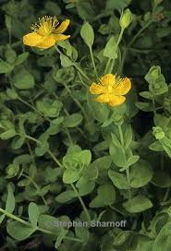
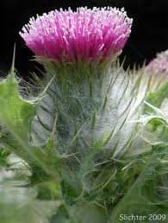
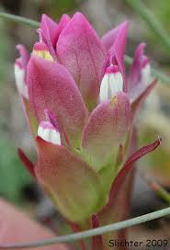
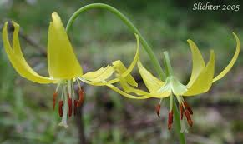
Traits Model
Can we explain the field interactions better if we incorporate the traits of the flowers?
Erythronium grandiflorum
Hypericum anagalloides
Cirsium callilepis
Orthocarpus imbricatus
Notes:
Some flower traits in question include:
Biomass
Feebleness
Suspension
Tube shape
Closed vs open

Slide 17
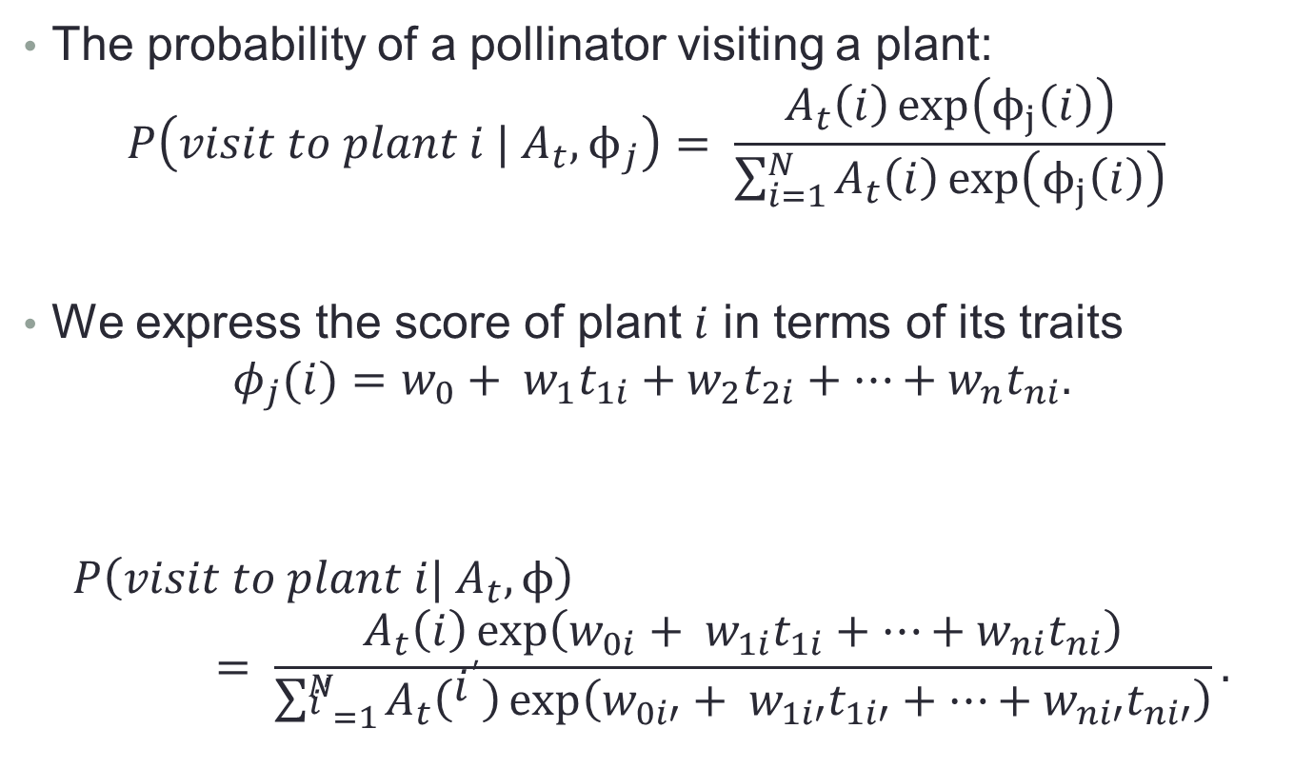
Mathematical Traits Model
The probability of a pollinator visiting a plant:
$$P\left(visit to plant i | A_{t},ϕ_{j}\right)= \frac{A_{t}\left(i\right)\exp\left(ϕ_{j}\left(i\right)\right)}{\sum_{i=1}^{N}{A_{t}\left(i\right)\exp\left(ϕ_{j}\left(i\right)\right)}}$$
We express the score of plant $i$ in terms of its traits
$$φ_{j}(i)=w_{0}+ w_{1}t_{1i}+w_{2}t_{2i}+…+w_{n}t_{ni}.$$
$$P\left(visit to plant i| A_{t},ϕ\right)= \frac{A_{t}\left(i\right)\exp\left(w_{0i}+ w_{1i}t_{1i}+…+w_{ni}t_{ni}\right)}{\sum_{i^{′}=1}^{N}{A_{t}\left(i^{′}\right)\exp\left(w_{0i′}+ w_{1i′}t_{1i′}+…+w_{ni′}t_{ni′}\right)}}.$$
Notes:
Our objective is to find the w’s

Slide 18
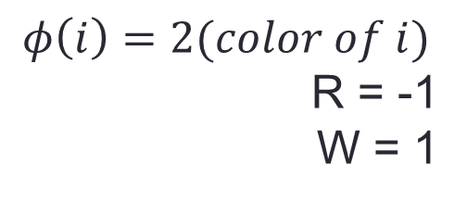
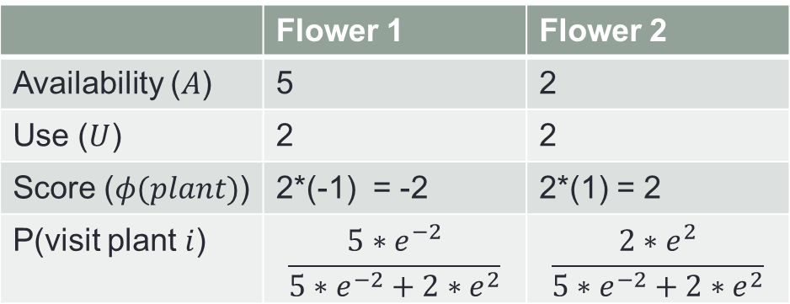
Adding Traits
$$φ\left(i\right)=2(color of i)$$
R = -1
W = 1
 | Flower 1 | Flower 2
Availability ($A$) | 5 | 2
Use ($U$) | 2 | 2
Score ($φ(plant)$) | 2*(-1) = -2 | 2*(1) = 2
P(visit plant $i$) | $$\frac{5∗e^{−2}}{5∗e^{−2}+2∗e^{2}}$$ | $$\frac{2∗e^{2}}{5∗e^{−2}+2∗e^{2}}$$
Flower 1
Flower 2
Notes:
The probability is now
This probability makes more sense
Note from here on, I use Phi vector and score function interchangeably

Slide 19
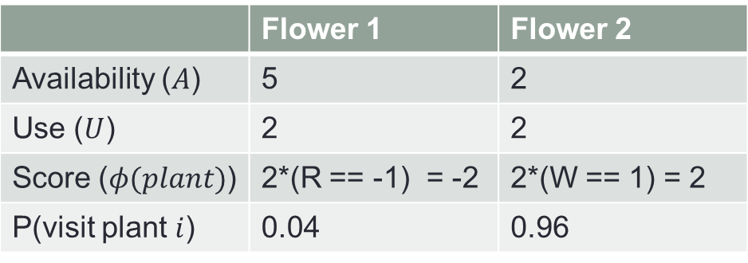
Adding Traits
$$φ\left(i\right)=2(color of i)$$
R = -1
W = 1
 | Flower 1 | Flower 2
Availability ($A$) | 5 | 2
Use ($U$) | 2 | 2
Score ($φ(plant)$) | 2*(R == -1) = -2 | 2*(W == 1) = 2
P(visit plant $i$) | 0.04 | 0.96
Flower 1
Flower 2
Notes:
The probability is now
This probability makes more sense
Note from here on, I use Phi vector and score function interchangeably

Slide 20
Conclusions
We can predict the score function for a pollinator
The multinomial model cannot explain the field observations
The traits model does not return the expected weights for the traits
The likelihood of the multinomial model and traits model are not significantly different
Notes:
We can predict the score function for a particular pollinator with some degree of accuracy
A model based on purely the frequency of interactions between a plant and a pollinator cannot explain the field observations
A linear regression of the traits shows there is some information in the traits
Values for the weights of the traits fitted by the traits model do not have the expected signs, so we cannot be sure this is the right model to use
A comparison between the multinomial model and traits mode using the likelihood ratio test shows the two models are not significantly different.

Slide 21
Next Steps
Model Verification
Markov chain model extension of the multinomial model
Boosted regression trees for the traits model
Expand multinomial and traits model to handle interactions of multiple pollinators at the same time

Slide 22
Any Questions?

