Slide 1


P4 from scratch
Snehal Shyamsukha

Slide 2


WHAT IS P4?
Programming Protocol-Independent Packet Processors
Network systems are currently built on the bottom up approach, which is the fixed function ASIC ,and their datasheet roughly tell us " this is HOW I KNOW to process packets" and that defines bottoms up how your system will be built.
If you want to add new features, or support additional protocols you would have to change the fixed function chip which would take multiple years.
Data plane programming with P4 is trying to turn the philosophy upside down.
What we really want is to be able to define at a high level exactly how the chip should process packets "This is HOW I WANT packets to be processed", which is done by writing a P4 program
That P4 program is then compiled down to the chip.
This way network system designers get to define exactly what features they want to have in their system, without having to rely on third party chip vendors to make the decisions for them.

Slide 3
What do you mean by a Programmable Data Plane?
Programmable Data Planes represent the next step in enabling switches to perform complex operations on packets. Current forwarding chips are designed to operate on packets with standard layer 2 formats and for the IP protocol set.
The development of SDN added flexibility by moving the control plane out of the switch itself and removing the reliance on Layer 2 and 3 switching and routing protocols.
A programmable data plane can forward packets using criteria other than the values in Layer 2 or IP packet fields. The ability to forward packets based on any arbitrary frame format could be useful to support a non-IP protocol, which some IoT devices use. A switch with a programmable data plane could forward these packets and modify them to be sent over an IP network.

Slide 4
Installation of P4
For installation, queries and practise refer: https://github.com/p4lang/tutorials
This git hub repository is the go-to for P4 beginners and will have the answer to most of your questions.
Issues you might face while installation:
The P4 VM image installation for the Ubuntu 20.04 version does not work so you can try installing it for Ubuntu 16.04.
The P4 VM for Ubuntu 16.04 has been updated from Python 2 to Python 3, so you might face issues like- Mininet not being installed for Python 3.
In any case once you have a P4 VM image on your system you can start running your exercises and try a few basic exercises.

Slide 5
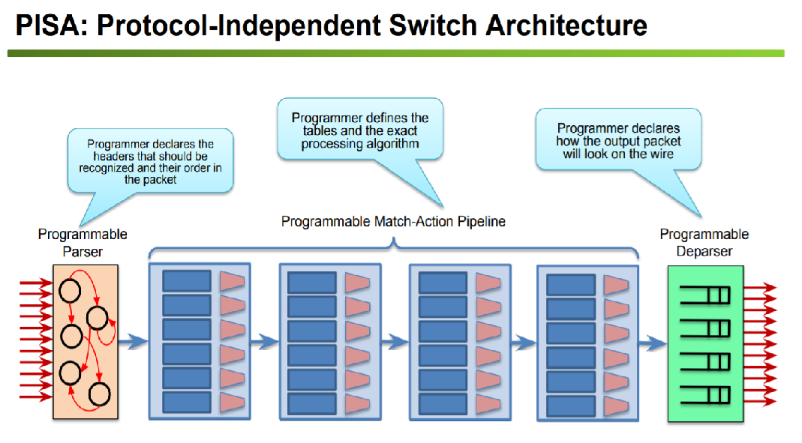
P4 data plane model-PISA
Protocol Independent Switch Architecture

Slide 6
P4 WORKING, SOFTWARE AND ELEMENTS
P4 Working:
Packets are parsed into individual headers. Headers and immediate results can be used for matching and actions.
Headers can be modified or removed.
Packets are then deparsed and emitted out.
Software tools Pre-Installed on the VM:
Bmv2: a P4 software switch
p4c: the reference P4 compiler
Mininet: a lightweight network emulation environment
Scapy: a python software used for sending and receiving packets.
$ make : compiles P4 program, execute on Bmv2 in Mininet, populate tables
*.py: send and receive test packets in Mininet
P4 Language elements:
Parsers – State machine, bitfield extraction.
Controls- Tables, Actions, control flow statements
Expressions- Basic operations and operators
Data Types- Bit strings, headers, structures, arrays

Slide 7
V1 Model Standard Metadata and Basic Types
ingress_port - the port on which the packet arrived
egress_spec - the port to which the packet should be sent to
egress_port - the port on which the packet is departing from (read only in egress pipeline)
There is a P4 cheat sheet available on the git hub repository linked in the previous slides, containing all relevant Data Types and constraints required to program in P4.
Note- We use type casts while equating two variables of different bit widths.

Slide 8
P4 Infrastructure
Step 1: While studying the P4 exercises it is important to look at the topology.json file, this is where you will define how you want your switches and hosts to be connected while performing packet processing.
Step 2: Write your P4 program with the required algorithm for match action as that will decide how your packets are to processed.
Step 3: Modify Sx-runtime.json files to accordingly suit your match action tables that have been used.
Step 4: Use Scapy to send and receive packets, you can modify it to send different types of packets.

Slide 9
P4 Parsers and Controls
PARSERS
Parsers are functions that map packets into headers and metadata, written in a state machine style
Every parser has three predefined states
◦ start ◦ accept ◦ reject
CONTROLS
Can declare variables, create tables, instantiate externs, etc.
Functionality specified by code in apply statement
Represent all kinds of processing that are expressible as DAG:
Match-Action Pipelines
Deparsers
Additional forms of packet processing (updating checksums)

Slide 10
Tables and Match Action Processing
◦ Specifies what data to match on and match kind
◦ Specifies a list of possible actions
◦ Optionally specifies a number of table properties ■ Size ■ Default action ■ Static entries ■ etc.
An entry contains:
◦ A specific key to match on
◦ A single action that is executed when a packet matches the entry
◦ Action data (possibly empty)

Slide 11
Match Action Processing
Data Plane (P4) Program
Defines the format of the table
Key Fields
Actions
Action Data
Performs the lookup
Executes the chosen action
Control Plane (IP stack, Routing protocols)
Populates table entries with specific information
-Based on the configuration
-Based on automatic discovery
-Based on protocol calculations

Slide 12
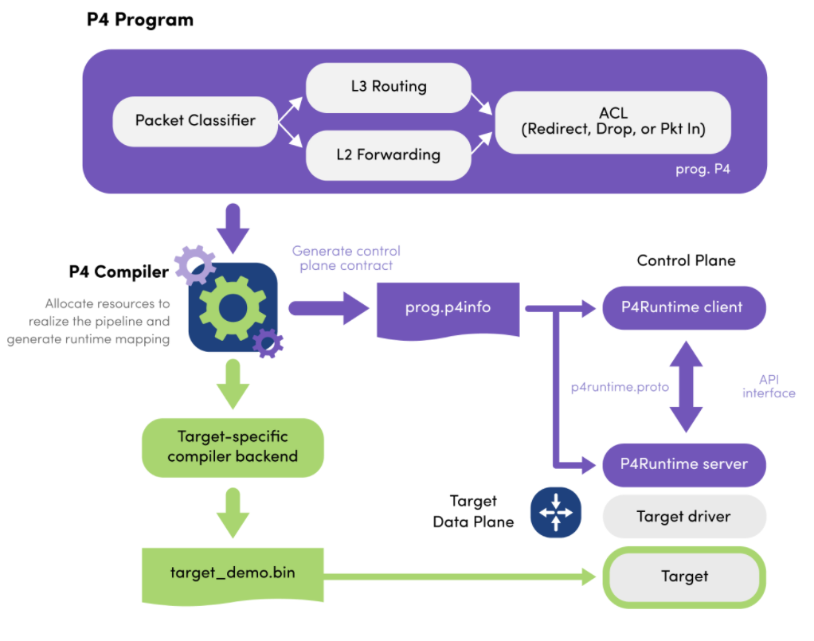
P4 (Backend)

