Slide 1
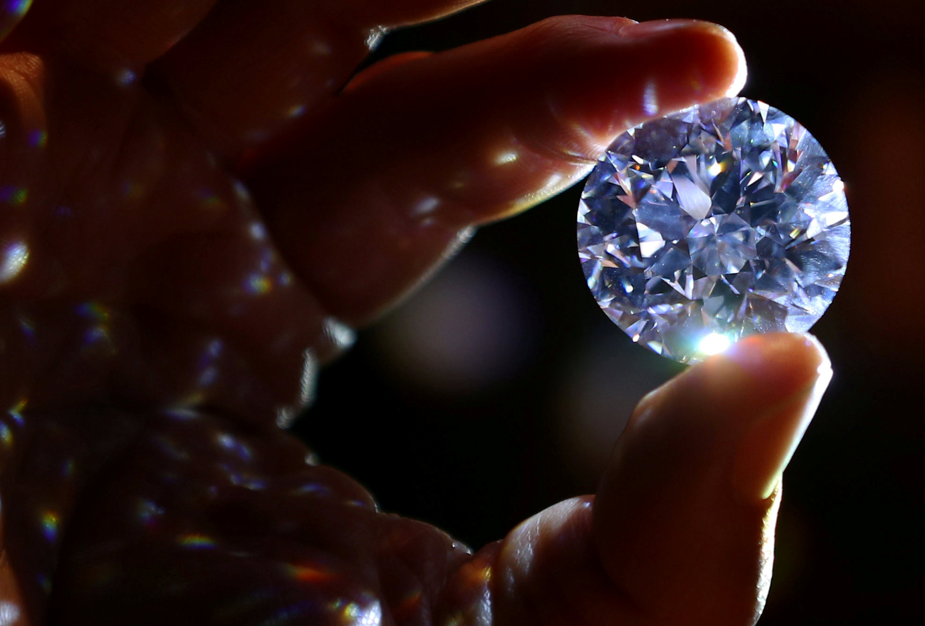
DIAMOND PRICE PREDICTION
Using Linear Regression Machine Learning Model

Slide 2
Contents :
Objective
Dataset description
Visualizations
Feature Encoding
Feature selection
Feature scaling
Modelling Algorithms
Selecting the best model
Conclusion .

Slide 3
Diamond Price Prediction :
Business Scenario:
Gemstones like diamonds are always in demand because of their value in the investment market. This makes it very important for diamond dealers to predict its price.
Objective :
The goal of project is to build a predictive model that can accurately predict the price of diamond given its weight , quality & dimension measurements.

Slide 4
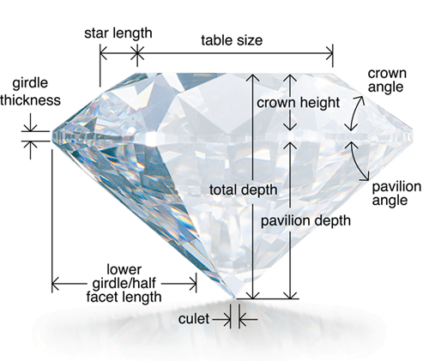
Dataset Description :
For this study, I have taken a dataset from the Kaggle : https://www.kaggle.com/shivam2503/diamonds
This dataset contains almost 53,940 records & 11 features .
No. of qualitative features → 3
No. of quantitative Features → 8
Features :
Price : price in US dollars (\$326--\$18,823)
carat : weight of the diamond (0.2--5.01)
cut : quality of the cut (Fair, Good, Very Good, Premium, Ideal)
color : diamond color, from J (worst) to D (best)
order : J < I < H < G < F < E < D
clarity : a measurement of how clear the diamond is
order : (I1 (worst) < SI2 < SI1 < VS2 < VS1 < VVS2 < VVS1 < IF (best))
x : length in mm (0 to 10.74)
y : width in mm (0 to 58.9)
z : height in mm (0 to 31.8)
Depth : total depth in percentage : Depth = length x width x height / (length x width)
table : width of top of diamond relative to widest point .

Slide 5
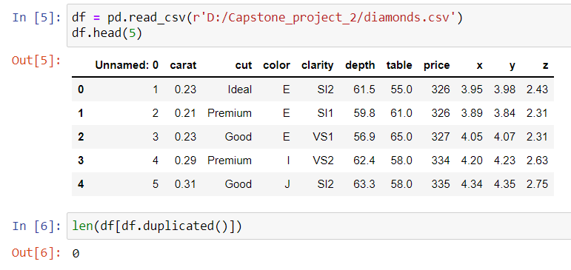
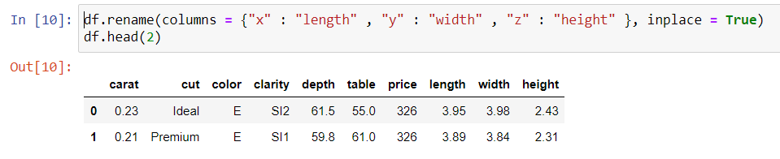
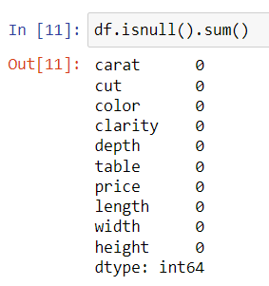
Import Dataset : →
No duplicate entry →
Drop the 'Unnamed: 0' column as we already have Index.
Rename a feature x , y , z as Length, width and height of the diamond respectively.
There is no null values present in the dataset →

Slide 6
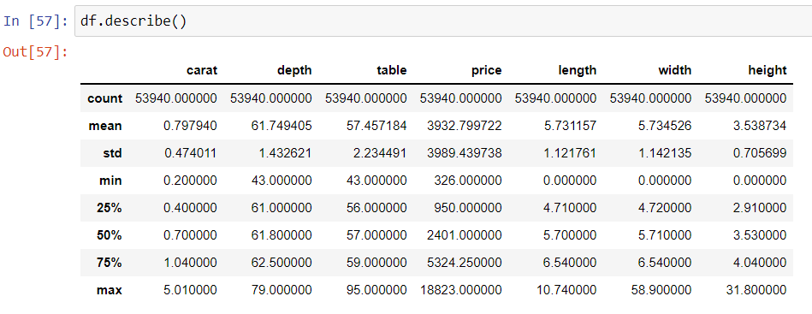
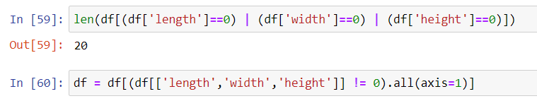




Their is Min. Value of length , width & height is zero. It can't be possible..
Checking how many rows that contain zero value as a length , width & height :
Dropping that rows →

Slide 7
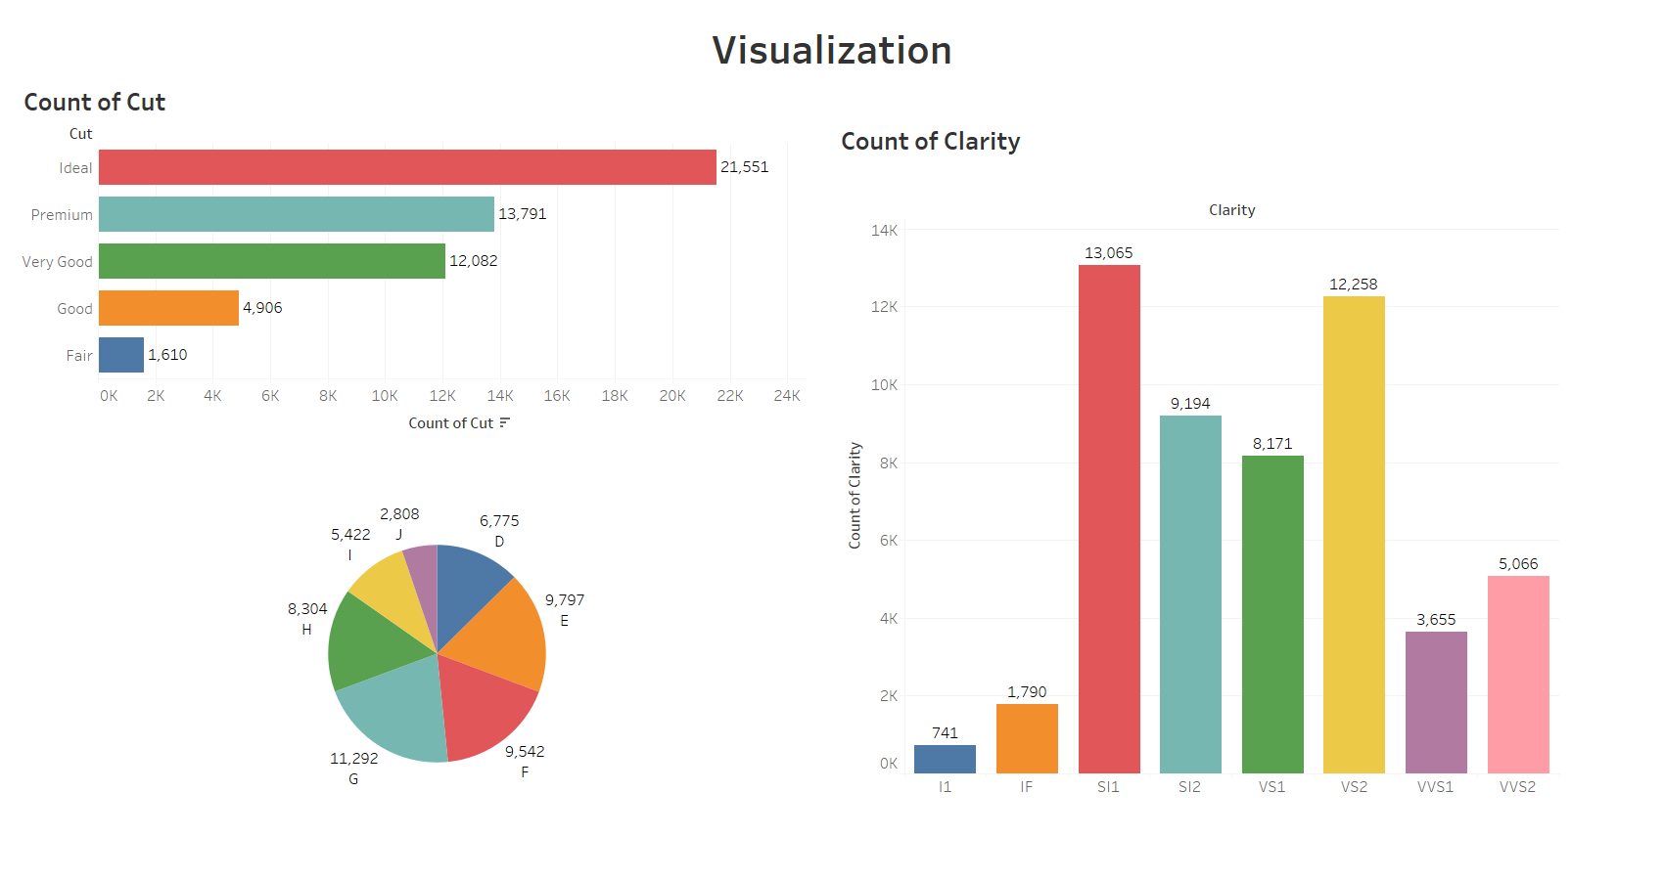
Count of Color
Count of Color

Slide 8
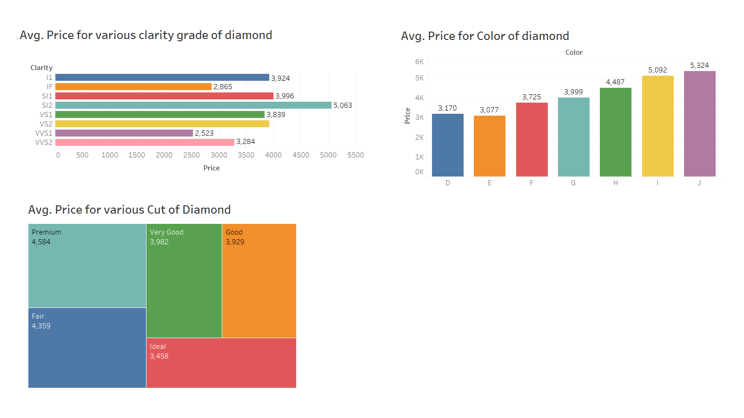
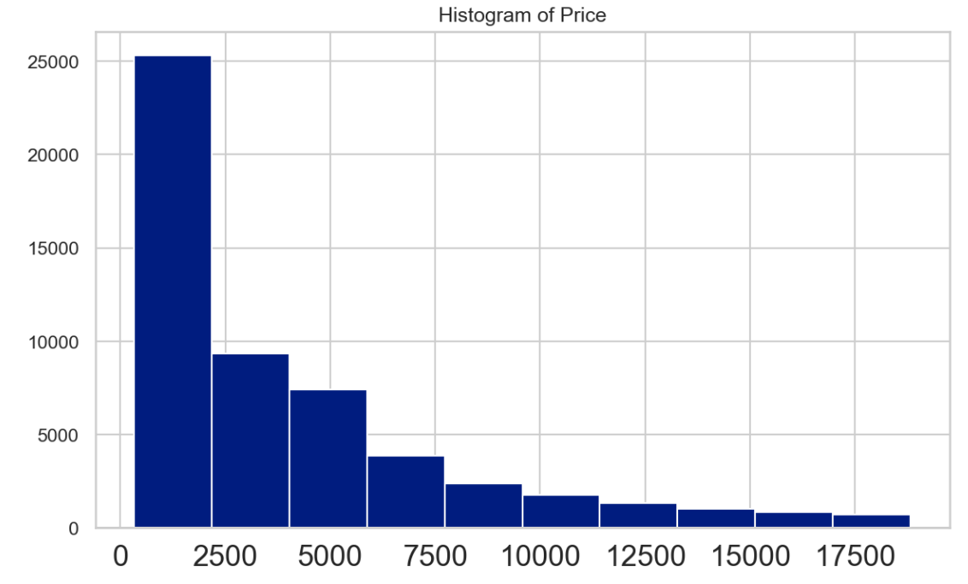

Slide 9
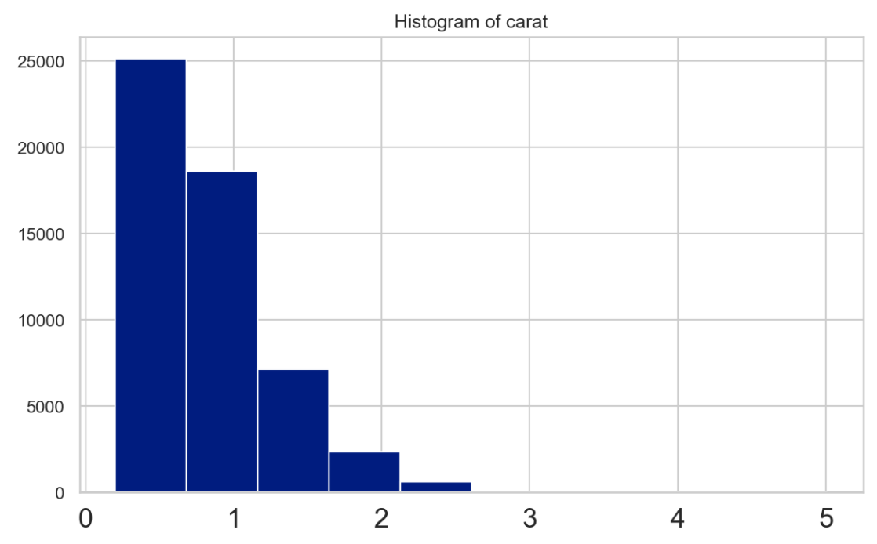
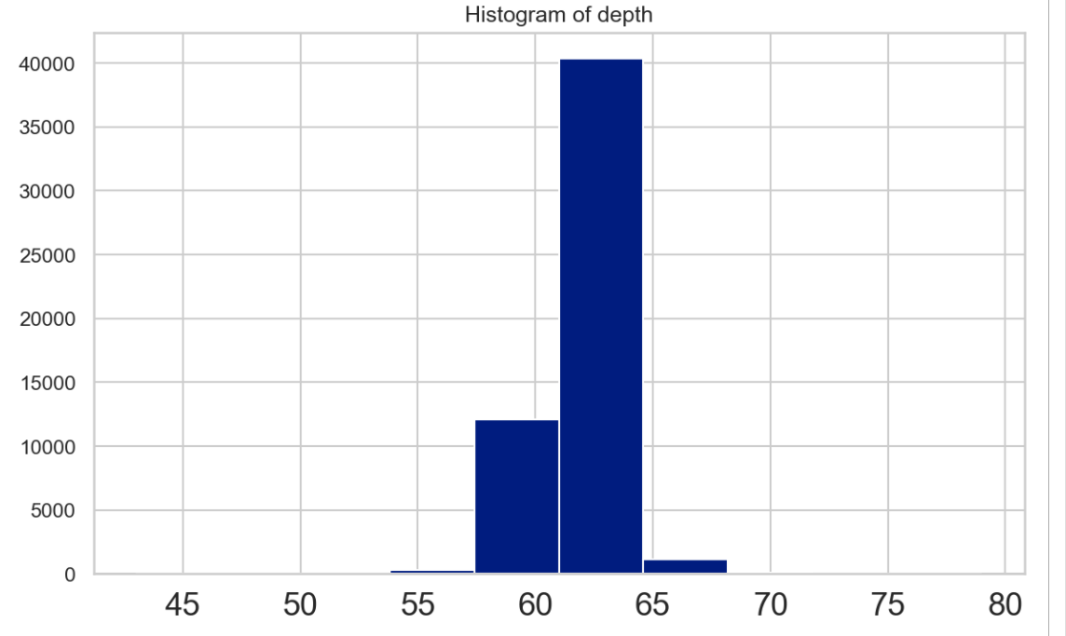
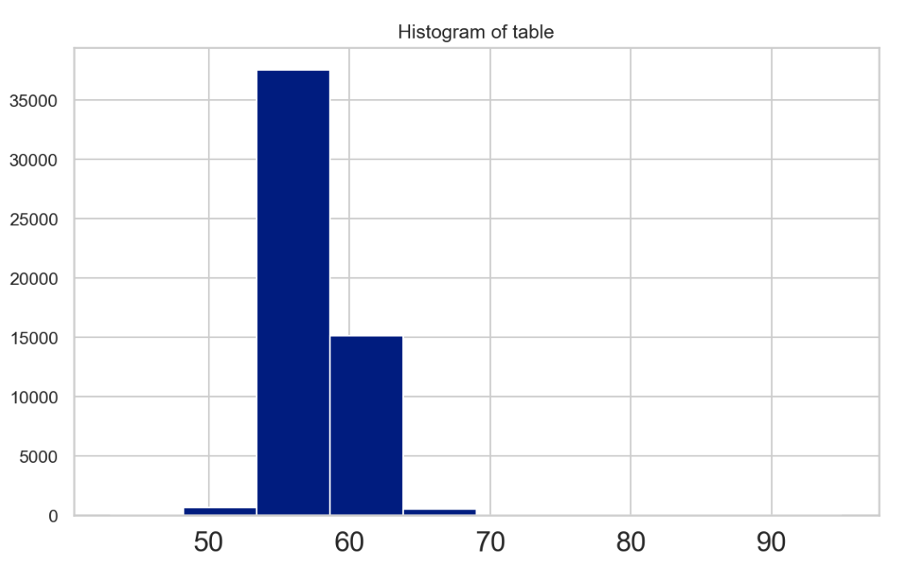
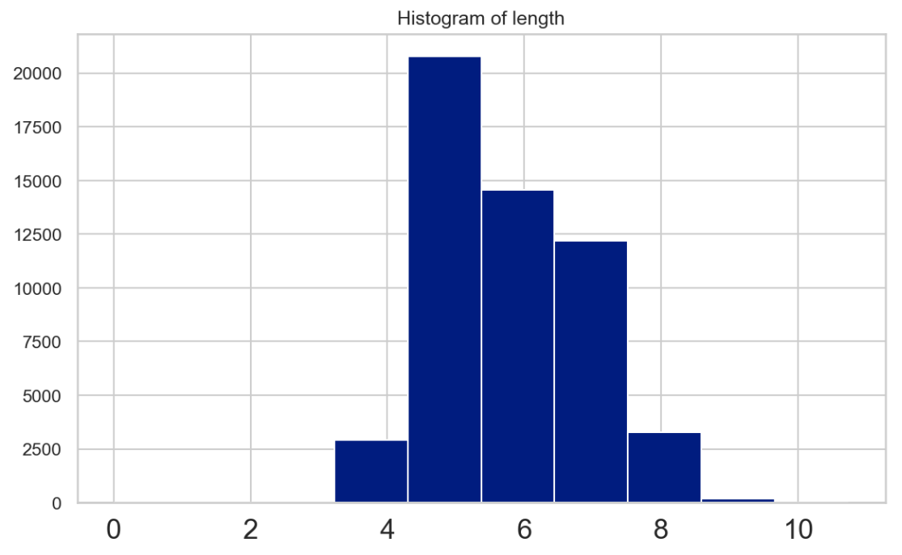
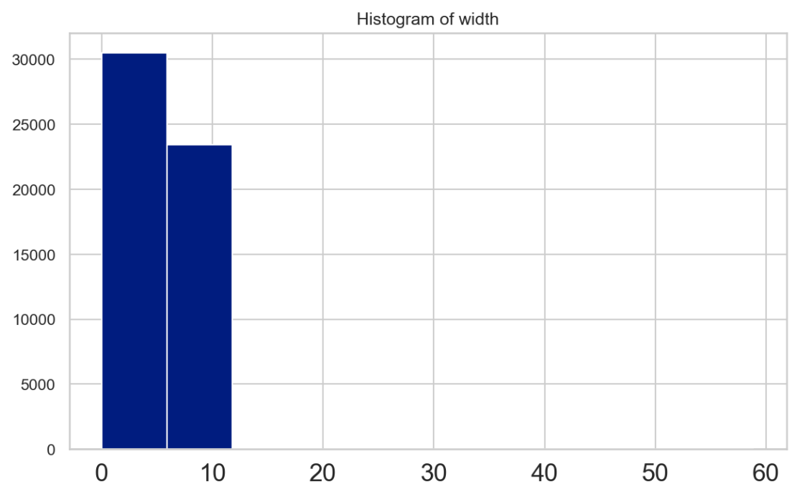
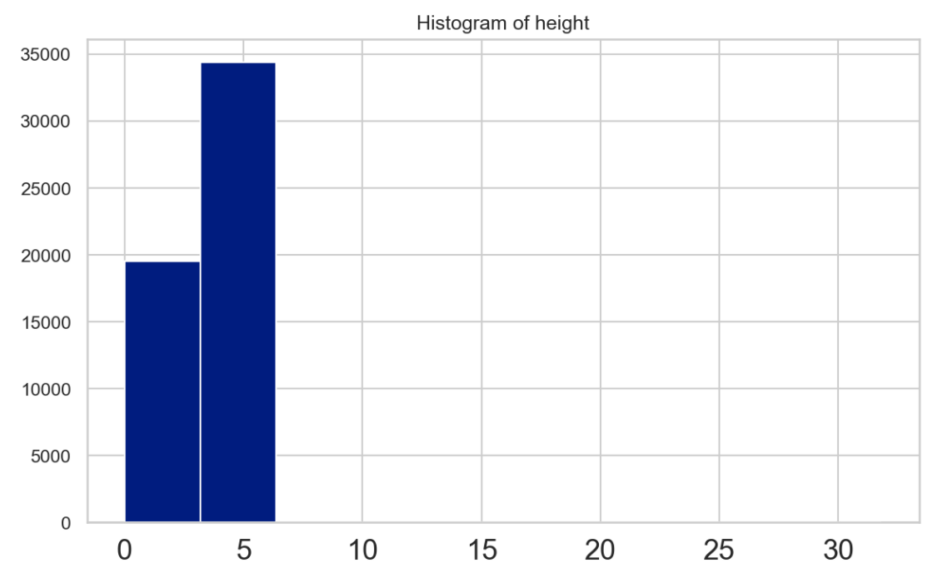

Slide 10
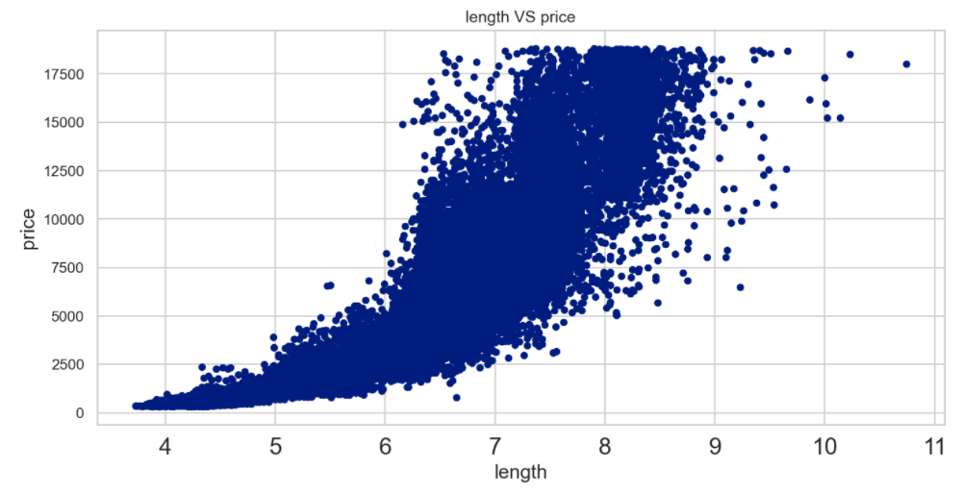
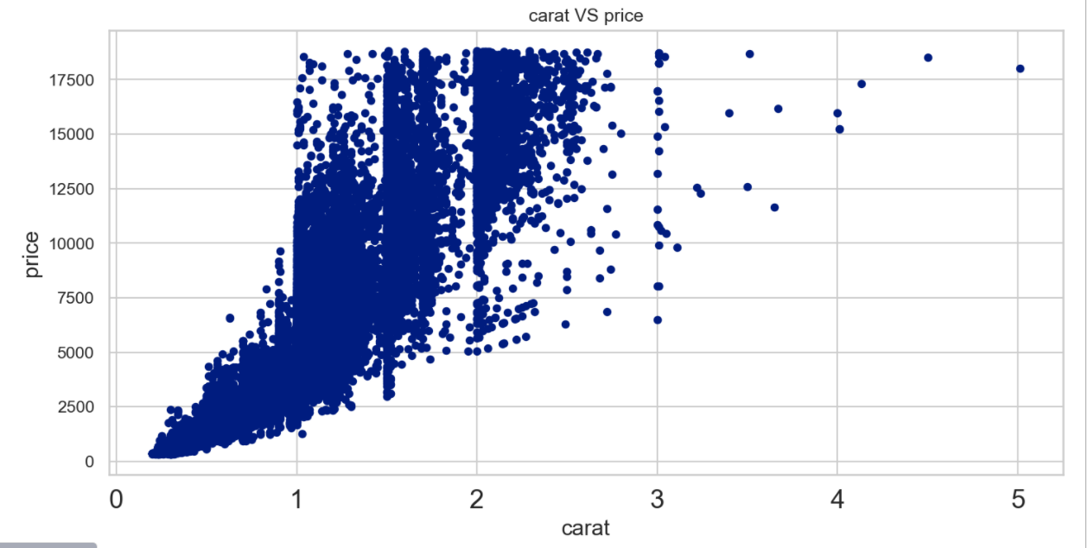
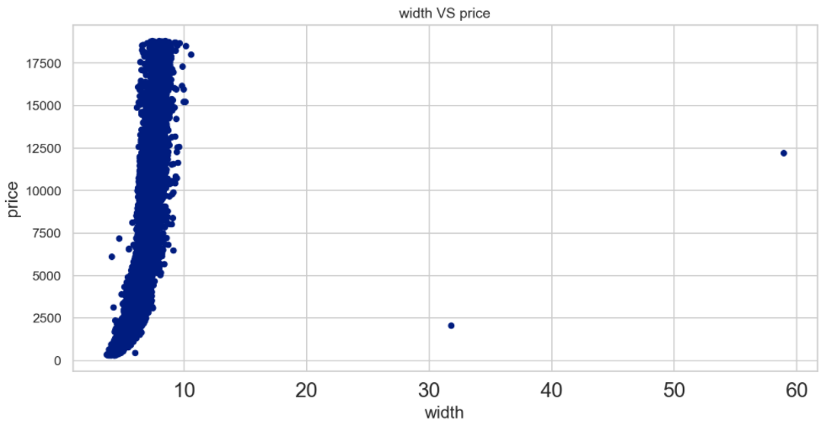
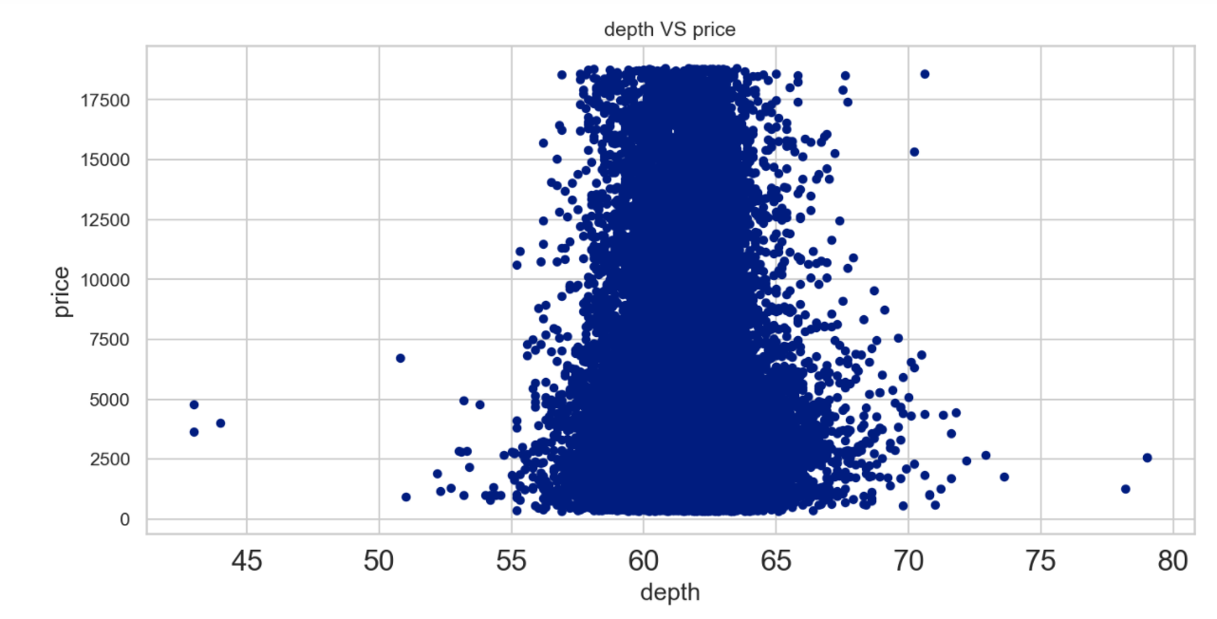
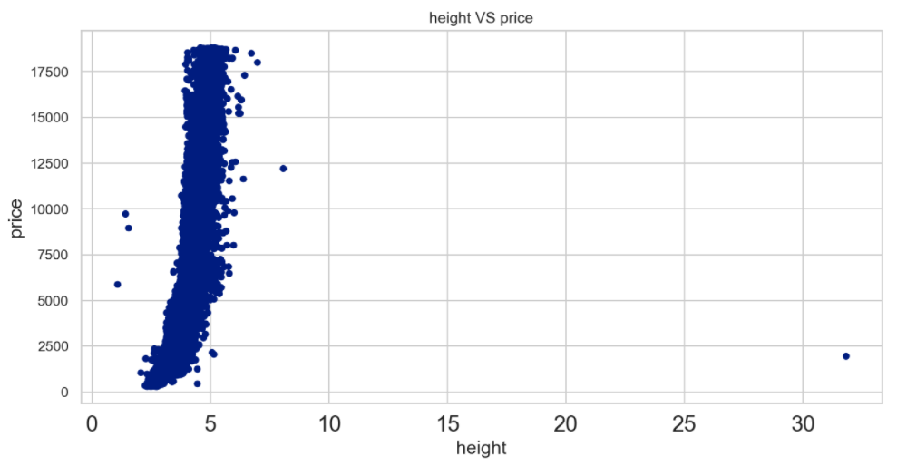

Slide 11
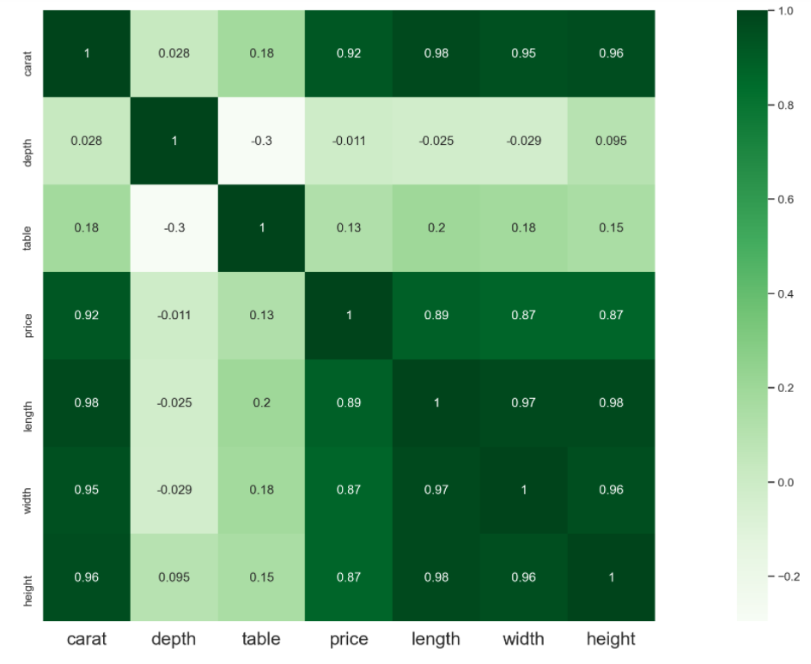
Correlation :
The Price of the Diamond is highly correlated to Carat, and its Dimensions i.e. length , width & height
The Carat of a diamond has the most significant impact on its Price.
The Length(x) , Width(y) and Height(z) seems to be highly related to Price and even each other.
Self Relation i.e. of a feature to itself is 1 as expected.

Slide 12
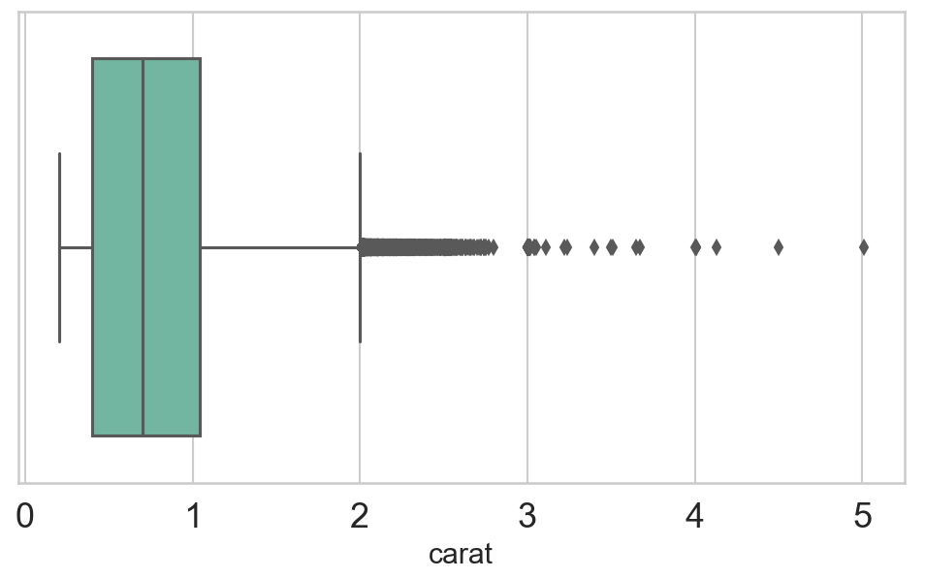
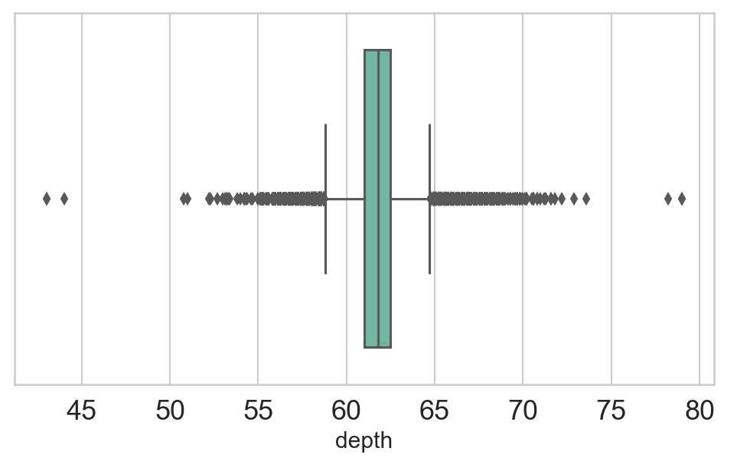
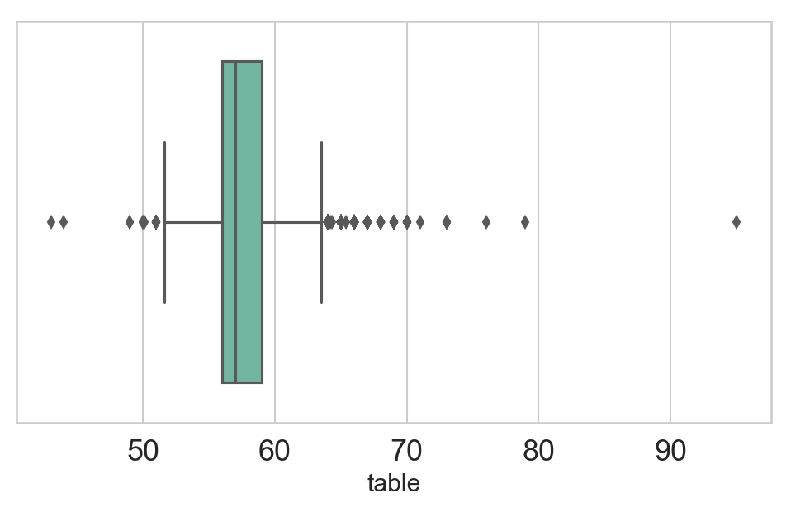
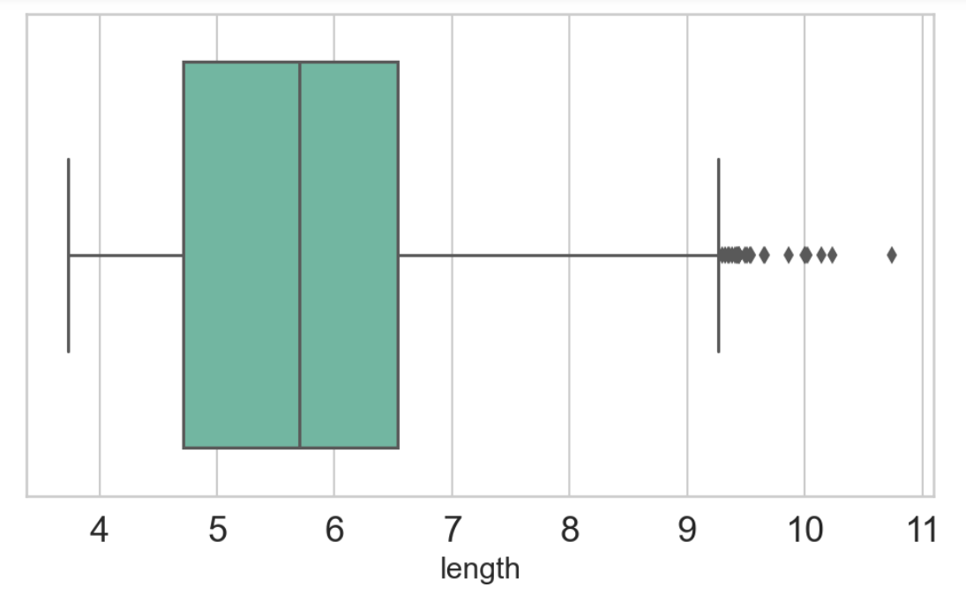
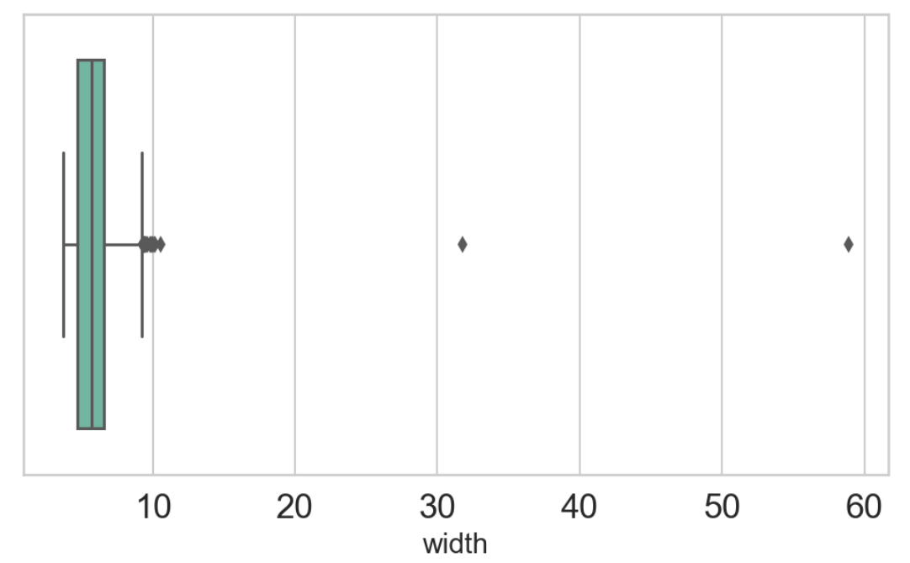
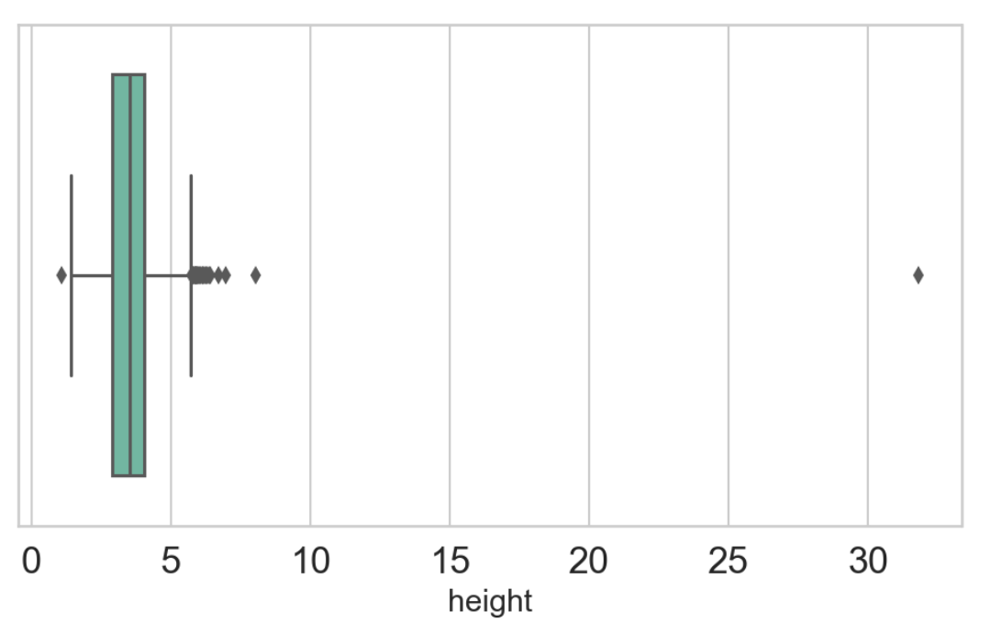
Outliers detection :

Slide 13
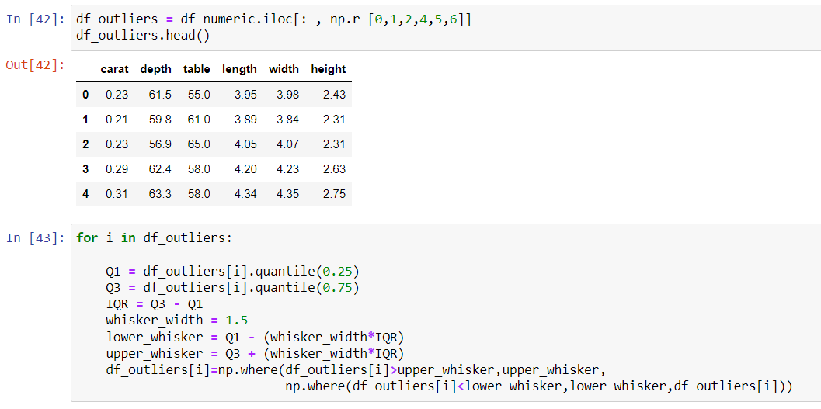
Outliers Treatment :
Capping method :

Slide 14
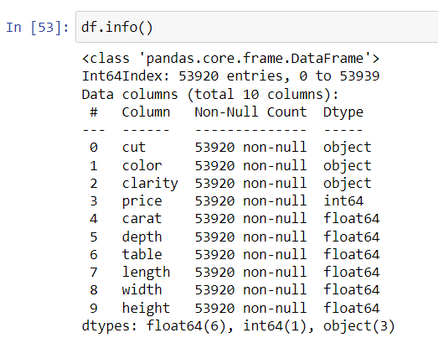
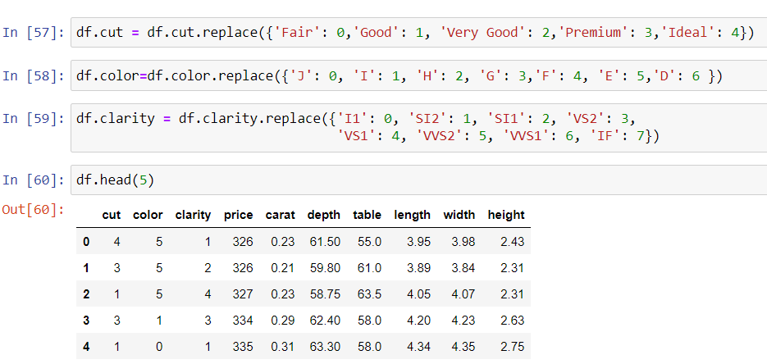
Feature Encoding :
Categorical feature : Color , Cut , Clarity

Slide 15

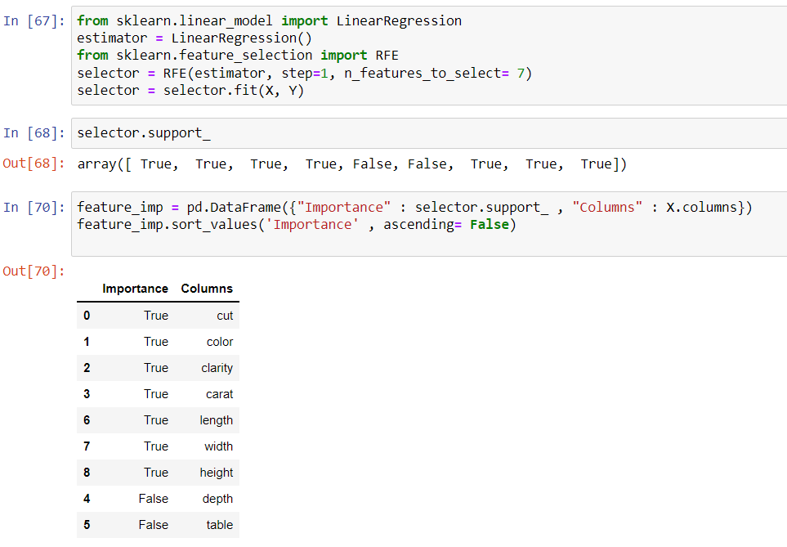
Feature selection :
RFE :

Slide 16
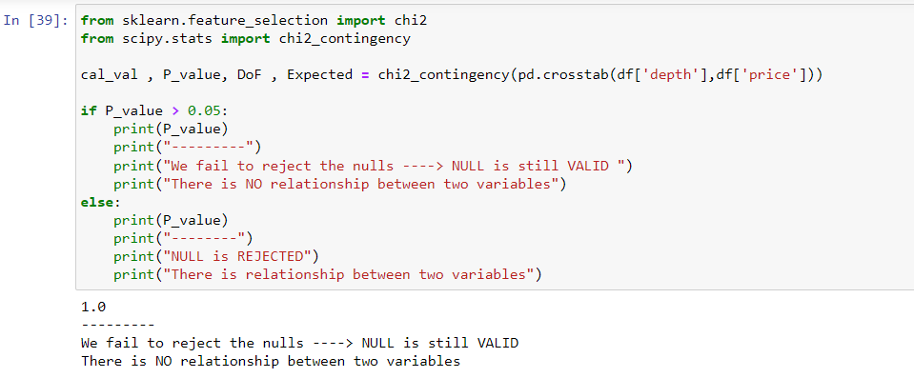
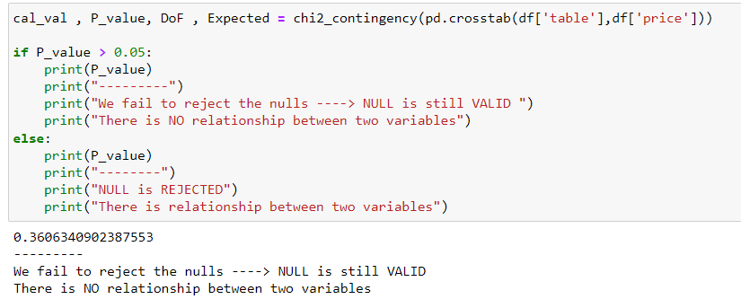
Chi-square test :

Slide 17
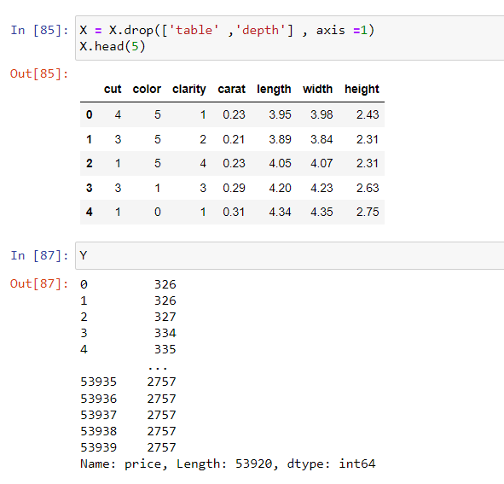
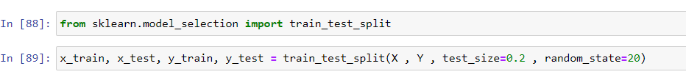
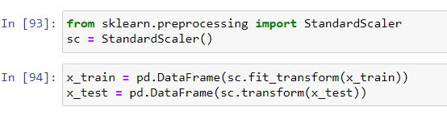
Selecting most significant variable
Train-test split :
Feature Scaling :

Slide 18
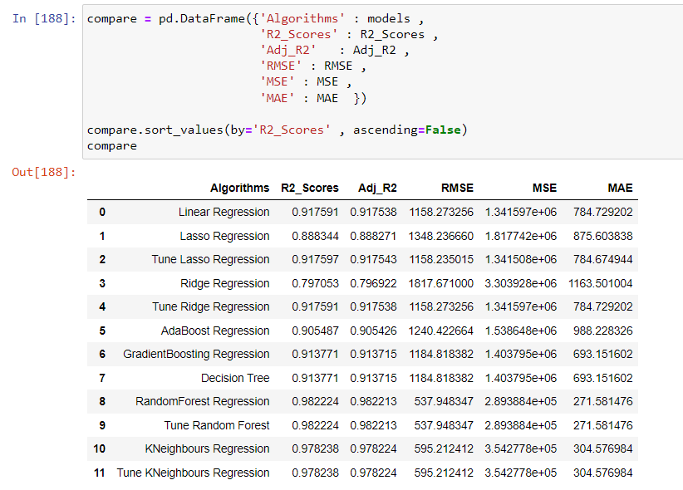






Modelling Algorithms :

Slide 19
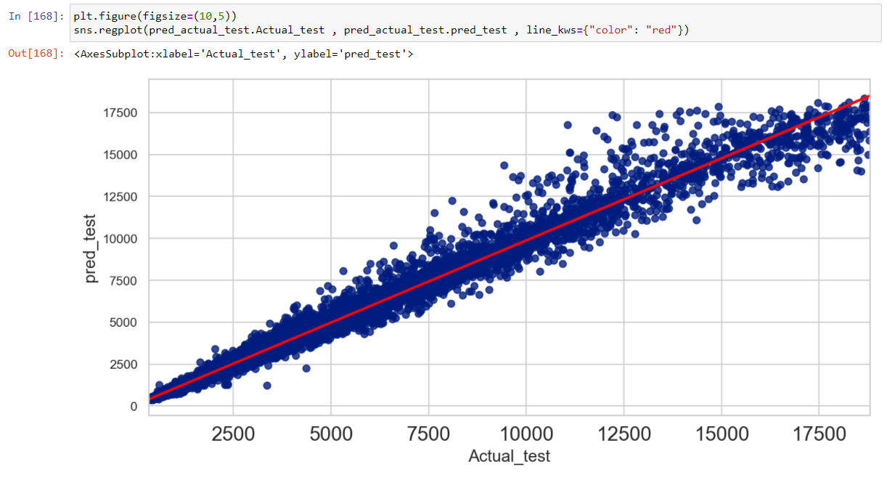
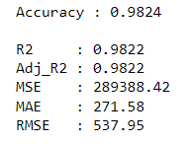
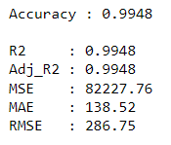
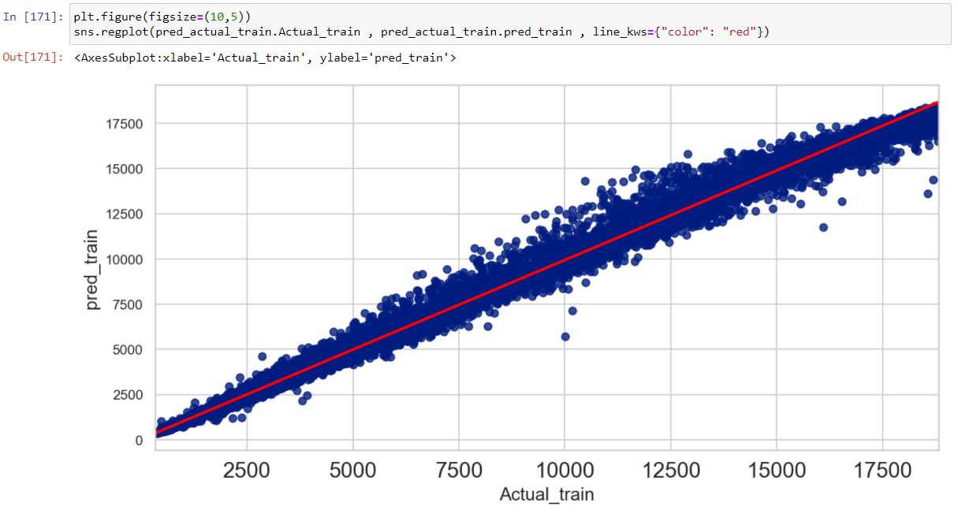
Selecting the best Model:
Random Forest Regressor model is works better than other models.
Test dataset :
Train dataset :

Slide 20
Conclusion & Recommendations :
Random forest regressor outperformed all other types of model.
A random forest regressor model with 7 features is the most robust.
Carat has the largest effect on price , followed by length, width, height , color & clarity & cut .
It is recommended businesses or consumers use the random forest regressor model to determine the price of a diamond.

Slide 21
THANK YOU !

