Slide 1

AI BUSINESS FINANCE ANALYSIS
Project Name: FinAnalyzer
Tagline: Smart financial planning for your business powered by AI
Team Name: Not-Your-Type
Event: DevCraft: Simon’s Command Line (or your event name)
Date: 06-04-26
Domain: FinTech

Slide 2
Problem Statement
Starting a business requires accurate financial planning, but many users find it difficult to estimate total startup costs, compare them with available funds, and choose suitable loan options. Manual calculations of investment, interest, EMI, and repayment plans are time-consuming and prone to errors. Therefore, FinAnalyzer, an AI-powered website, is designed to calculate required capital, identify funding gaps, suggest suitable bank loan options, and provide EMI and repayment analysis to help users make informed business financing decisions.

Slide 3
Target Audience
Aspiring entrepreneurs planning to start a new business
Small business owners needing financial planning support
Students working on startup ideas or business projects
First-time business founders with limited financial knowledge
Individuals looking for bank loans to start a business
Startup teams estimating investment and funding requirements

Slide 4
Existing Solutions
Current solutions available for business financial planning include:
Manual calculation using spreadsheets like Microsoft Excel and Google Sheets
Online EMI calculators provided by banks such as State Bank of India and HDFC Bank
Basic loan comparison websites that only calculate EMI
Financial planning apps that require complex data input
Manual consultation with financial advisors
Limitations of existing solutions
No unified startup cost + loan analysis
No automatic funding gap calculation
No AI-based suggestions

Slide 5
Gaps & Opportunities
Gaps in Existing Solutions
-No single platform to calculate startup cost and loan together
-Lack of automatic funding gap analysis
-EMI calculators work separately from business budgeting
-No beginner-friendly financial planning tools
Opportunities for FinAnalyzer
-Provide all-in-one business finance planning platform
-Help first-time entrepreneurs make better decisions
-Offer instant startup cost estimation
-Suggest suitable loan options automatically
-Visualize budget, funding gap, and EMI using graphs
-Reduce financial planning complexity

Slide 6
Your Solution
Provide a web-based platform for business financial planning
Allow users to enter business expenses and startup costs
Calculate total investment required automatically
Compare required investment with available funds
Identify funding gap for the business
Suggest suitable bank loan options
Calculate interest rate, EMI, and repayment period
Display results using graphs and visualizations
Provide easy-to-use and user-friendly interface
Help users make informed financial decisions before starting a business

Slide 7
Key Features
Startup cost calculation based on business expenses
Available fund vs required investment comparison
Automatic funding gap identification
Loan suggestion from multiple banks
EMI calculation with interest and duration
Repayment plan analysis
Graphical visualization of financial data
Step-by-step interactive UI
Dynamic and responsive dashboard
User-friendly web interface for quick financial planning

Slide 8
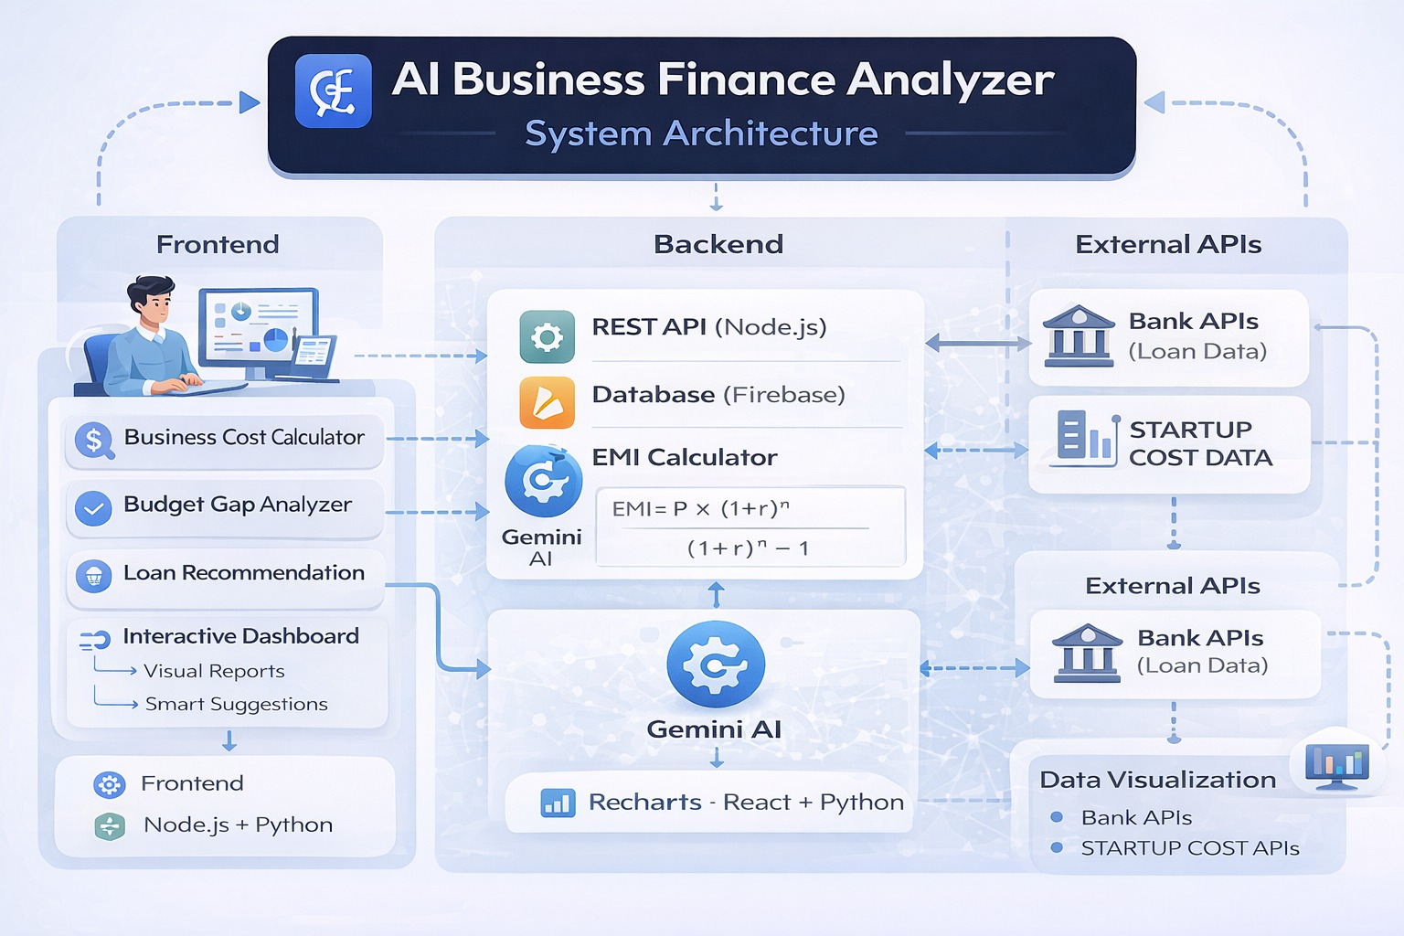
System Architecture
FinAnalyzer takes user inputs such as business expenses and available funds, processes them using cost, funding, and EMI calculation modules, and displays the required investment, loan suggestions, and graphical financial analysis on the dashboard.

Slide 9
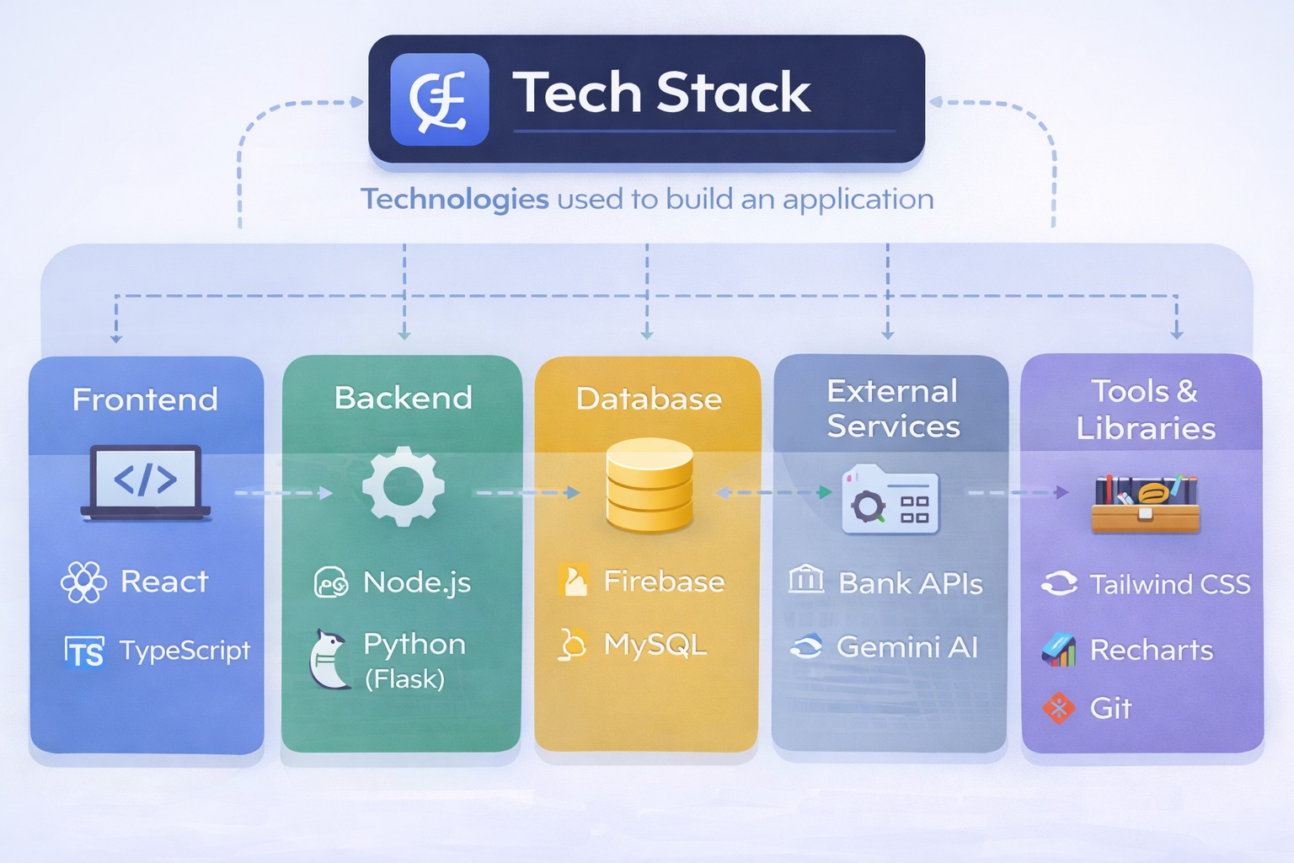
Tech Stack

Slide 10
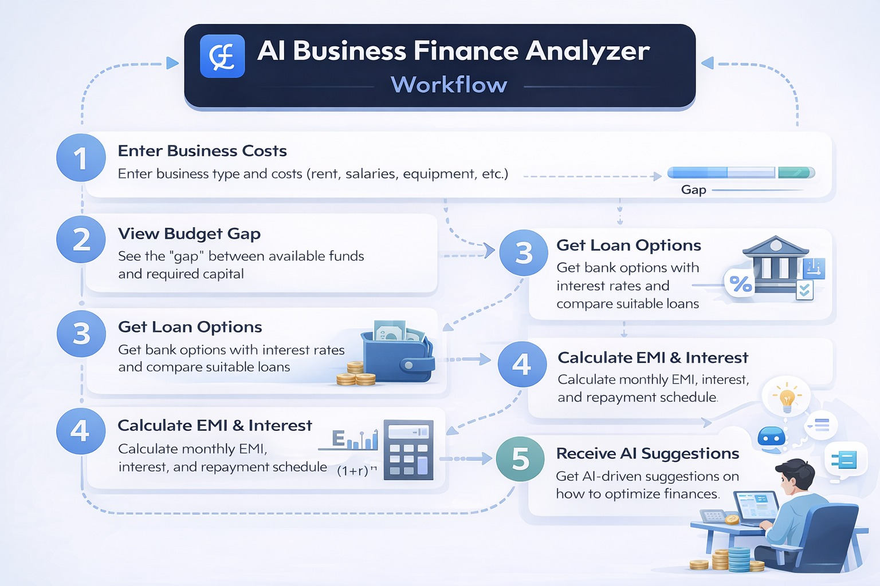
Workflow

Slide 11
Impact
Helps entrepreneurs plan business finances accurately
Reduces risk of underestimating startup costs
Simplifies loan and EMI decision-making
Saves time by automating financial calculations
Improves financial awareness for first-time founders
Provides clear visualization of funding requirements

Slide 12
Future Scope
Integration with real-time bank loan APIs
AI-based business profit prediction
Personalized loan recommendations
Multi-business category support
Expense templates for different industries
User login and save project feature
Integration with government startup schemes
Mobile app version of FinAnalyzer
Advanced analytics with charts and forecasting

Slide 13
Team Information
Member 1: Snehal Ray
Member 2: Agni Das
Member 3: Nilesh Koduri
Member 4: Sameer Bisht

