Slide 1

Store Inventory Optimization Initiative

Slide 2
OBJECTIVE
Retail store inventory management processes often lead to frequent stockouts and high holding costs, affecting the ability to meet customer demands
The Store Inventory Optimization Initiative aims to improve inventory management by introducing a streamlined and predictive inventory system
Optimizing store inventory processes to achieve a reduction in stockouts, a decrease in holding costs, and an overall improvement in store performance indicators

Slide 3
MODEL SELECTION
Linear Regression : To provide better insights by uncovering patterns and relationships by performing an analysis of past sales data to help uncover future sales predictions.
Monte Carlo Simulation : The Monte Carlo simulation provides multiple possible outcomes and the probability of each from a large pool of random data samples. It offers a clearer picture than a deterministic forecast.

Slide 4
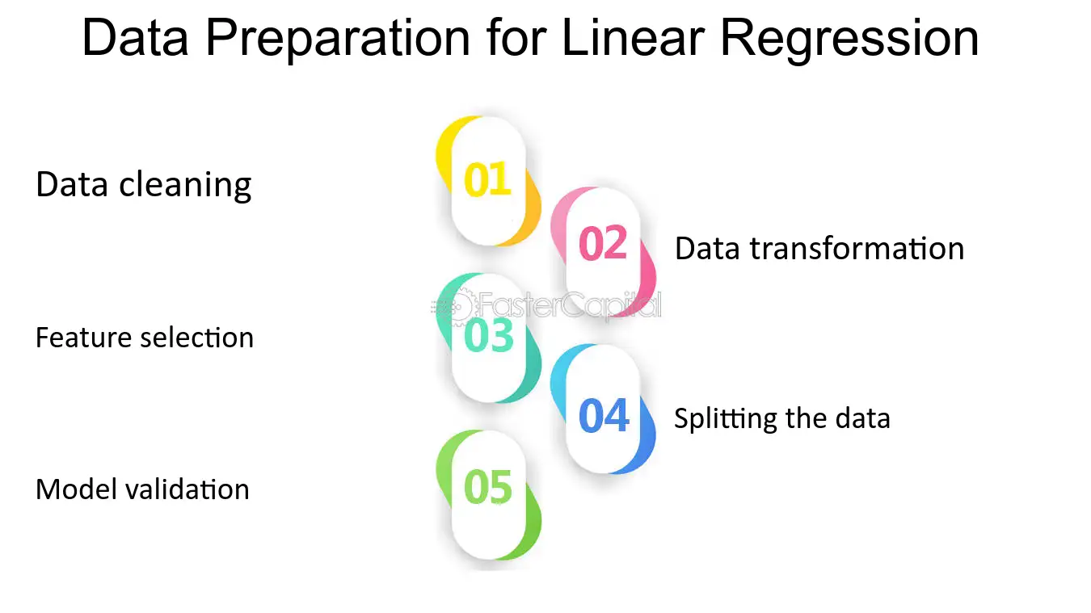

Slide 5
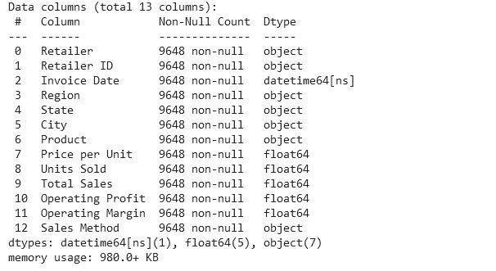
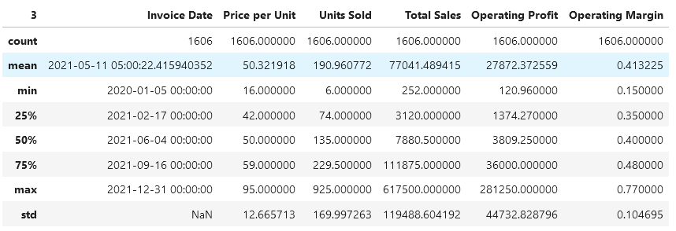
Data Used for Linear Regression
Data Analysis

Slide 6
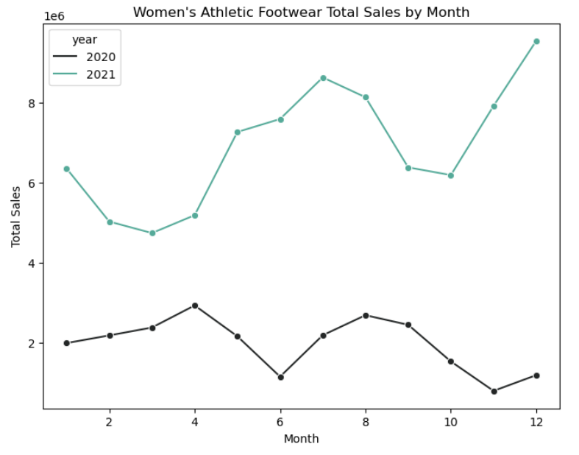
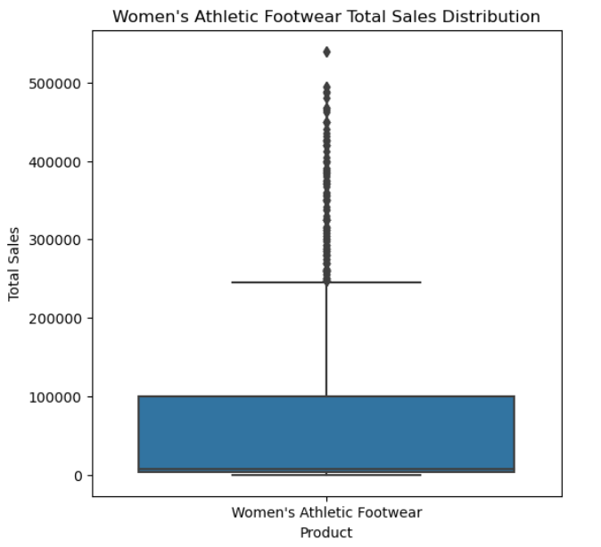

Slide 7
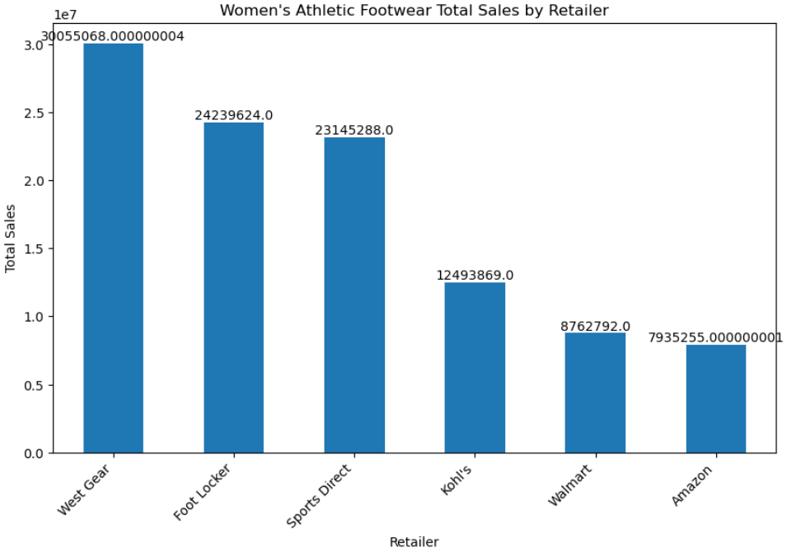
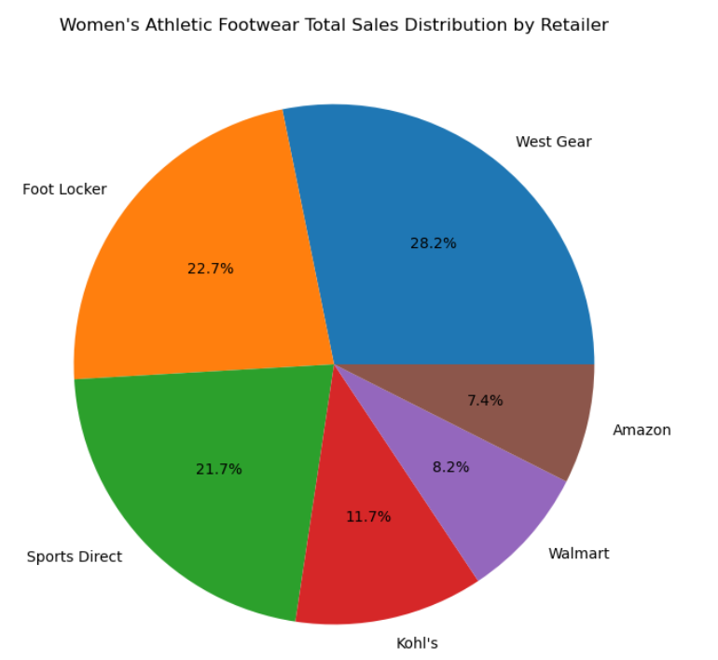

Slide 8
Linear Regression
Linear regression was selected due to its assumption of linearity, observed during data exploration. Its interpretability offers clear insights into variable impacts. Additionally, its simplicity and transparency make it suitable for both technical and non-technical audiences. Serving as a baseline model, linear regression establishes a benchmark for predictive performance comparison with more complex algorithms.
Its computational efficiency is advantageous for large datasets or resource-limited environments. We ensured adherence to statistical assumptions, particularly normality of residuals, to maintain model validity. Stakeholder preferences for a straightforward and interpretable approach further validated the choice.

Slide 9
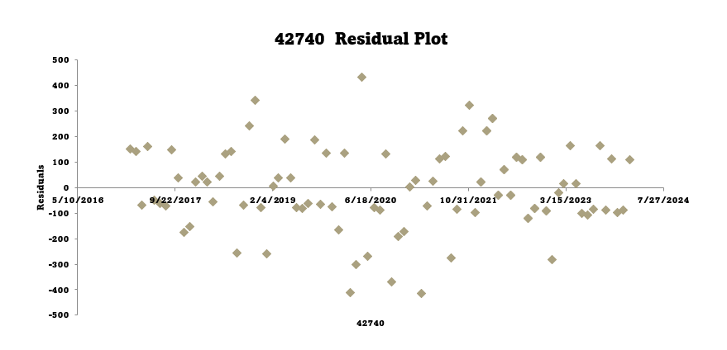

Slide 12
LINEAR REGRESSION RESULTS

Slide 13
MONTE CARLO SIMULATION
Monte Carlo simulation technique
To forecast future sales of Women's Apparel, we employed a Monte Carlo simulation technique. This method involves generating multiple simulated scenarios based on historical sales data and assumed growth rates. We first calculated the historical growth rate from the sales data and then used this rate to simulate future sales values.
By conducting 1000 simulations for the next 12 months, we generated a range of possible outcomes for sales. The mean sales forecast provided us with the average expected sales for each month, while the 95% confidence interval gave us a measure of the uncertainty in the forecast. This technique allowed us to better understand the potential range of sales outcomes and make informed decisions to optimize our sales strategy.

Slide 14
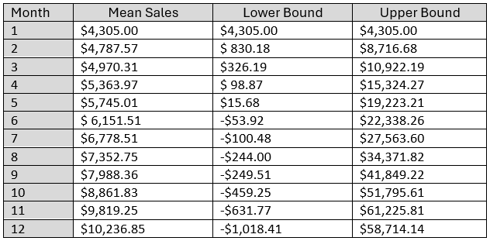
MONTE CARLO SIMULATION
Results:
This table presents the mean sales forecast along with the 95% confidence interval for each month's sales. The mean sales represent the average forecast, while the lower and upper bounds of the confidence interval provide a range within which we are 95% confident the true sales value will fall. These results can help in making informed decisions regarding inventory management, marketing strategies, and financial planning for Women's Apparel sales.

Slide 15
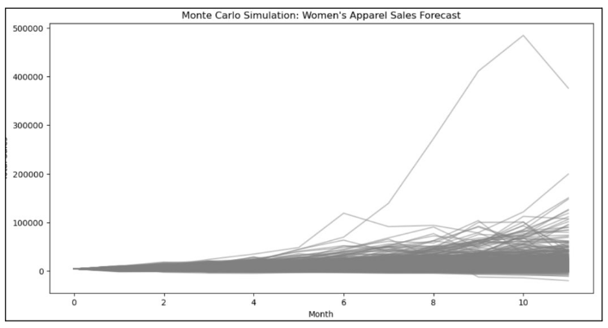
MONTE CARLO SIMULATION

Slide 16
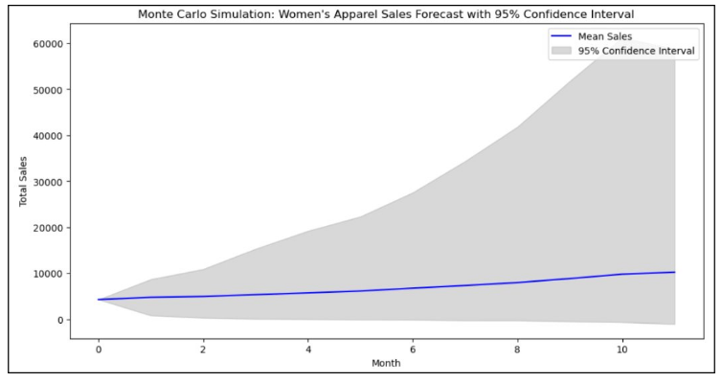
MONTE CARLO SIMULATION

Slide 17
RECOMMENDATION
Linear Regression for Sales Forecasting:
Utilize linear regression to analyze historical sales data of women's athletic footwear and uncover underlying patterns and relationships.
Identify key factors influencing sales trends, such as seasonal variations, promotional activities, product features, and customer demographics.
Develop a robust linear regression model that accurately predicts future sales based on these factors, providing valuable insights into demand forecasting.

Slide 18
Monte Carlo Simulation for Risk Analysis:
Implement Monte Carlo simulation to assess the uncertainty and variability in sales forecasts generated by the linear regression model.
Generate multiple simulated scenarios of future sales based on random variation and probabilistic distributions of key variables (e.g., demand fluctuations, market trends).
Analyze the range of potential outcomes and their probabilities using Monte Carlo simulation to understand the level of risk and uncertainty associated with sales projection
.

Slide 19
Integrated Approach for Strategic Planning
Combine the insights from linear regression (sales patterns, influential factors) with Monte Carlo simulation (risk analysis, variability) to develop a comprehensive sales forecasting and risk management strategy.
Use the results from both techniques to inform strategic planning decisions, such as inventory management, production scheduling, marketing campaigns, and financial forecasting.
Leverage the power of data-driven decision-making by integrating advanced analytics techniques like linear regression and Monte Carlo simulation into your business processes.

Slide 20
CONCLUSION
The analysis of women's athletic footwear sales trends provides valuable insights that can inform business strategies and improve decision-making processes. By understanding historical sales patterns and leveraging predictive modeling techniques, retailers can better anticipate market trends, optimize inventory management, and enhance their overall competitiveness in the fashion industry. This project demonstrates the power of data analysis in uncovering actionable insights that drive business success in the dynamic and ever-evolving fashion market.

