Slide 1


A Presentation on AMAZON PRODUCT REVIEWS SENTIMENT ANALYSIS”
IACSD AKURDI,PUNE
e-DBDA
2021
Student
Ms. Sayali Mahajan (1327)
Ms. Snehal Warade (1358)
Guide
Mr. Tilekar A.
INSTITUTES FOR ADVANCED COMPUTING AND SOFTWARE DEVELOPMENT AKURDI, PUNE

Slide 2
contents
ABSTRACT
INTRODUCTION
OBJECTIVES
METHODOLOGY
REQUIREMENTS
TECHNOLOGY
DIAGRAM
MODELS
ACCURACY GRAPH
MODEL ACCURACY TABLE
TEST SENTIMENT
FUTURE SCOPE
CONCLUSION

Slide 3
Abstract
Every one of us have a different perspective and view towards online marketing. sentimental analysis is another term in reading the data efficiently from the customers point of view. The model can focus over the overall semantic(positive or negative or neutral) depending on the reviews through consumers. The prediction model can further execute and undergo through certain machine learning algorithms, visualized views and methodologies in predicting and analyzing amazon products reviews.

Slide 4
Introduction
What is Sentiment Analysis?
1.Sentiment analysis is a technique through which you can analyze a piece of text to determine the sentiment behind it. It combines machine learning and natural language processing (NLP) to achieve this.
2.Using basic Sentiment analysis, a program can understand whether the sentiment behind a piece of text is positive, negative, or neutral.
3.It is a powerful technique in Artificial intelligence that has important business applications.

Slide 5
Objective of the Project
Scrapping product reviews on various websites featuring various products specifically amazon.com.
Analyze and categorize review data.
Analyze sentiment on dataset from document level (review level).
Categorization or classification of opinion sentiment into-
Positive
Negative
Neutral

Slide 6
Methodology
Data collection
Data overview
Data cleaning
Split data in X,Y
Apply model
Test Sentiment

Slide 7
Data Overview
We’re assuming that sample size of 30K examples are sufficient to represent the entire population of sales/reviews
We’re assuming that the information we find in the text reviews of each product will be rich enough to train a sentiment analysis classifier with accuracy (hopefully) > 70%

Slide 8
Apply Model
Naïve Bayes
Logistic Regression
Support Vector Machine
Decision Tree
Random Forest

Slide 9
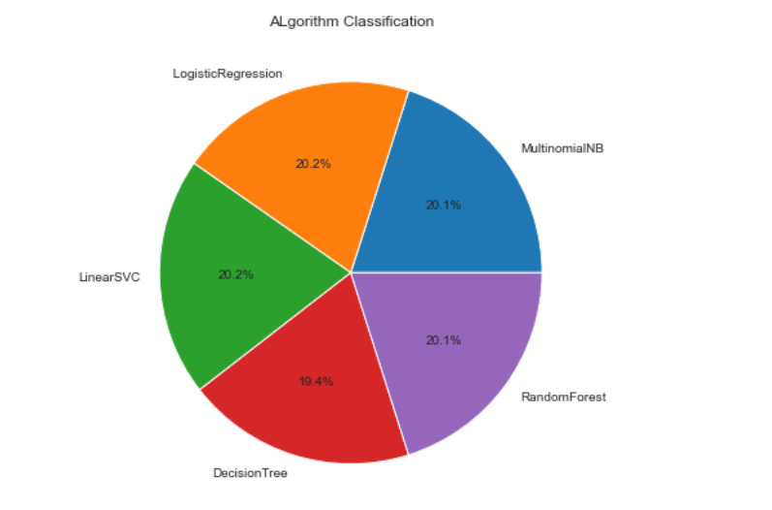
Accuracy Graph

Slide 10
Models | Accuracy
Naïve Bayes | 0.9344498989315623
Logistic Regression | 0.9392145538550389
Support Vector Machine | 0.9393589373375686
Decision Tree | 0.9016748483973434
Random Forest | 0.9350274328616807

Slide 11
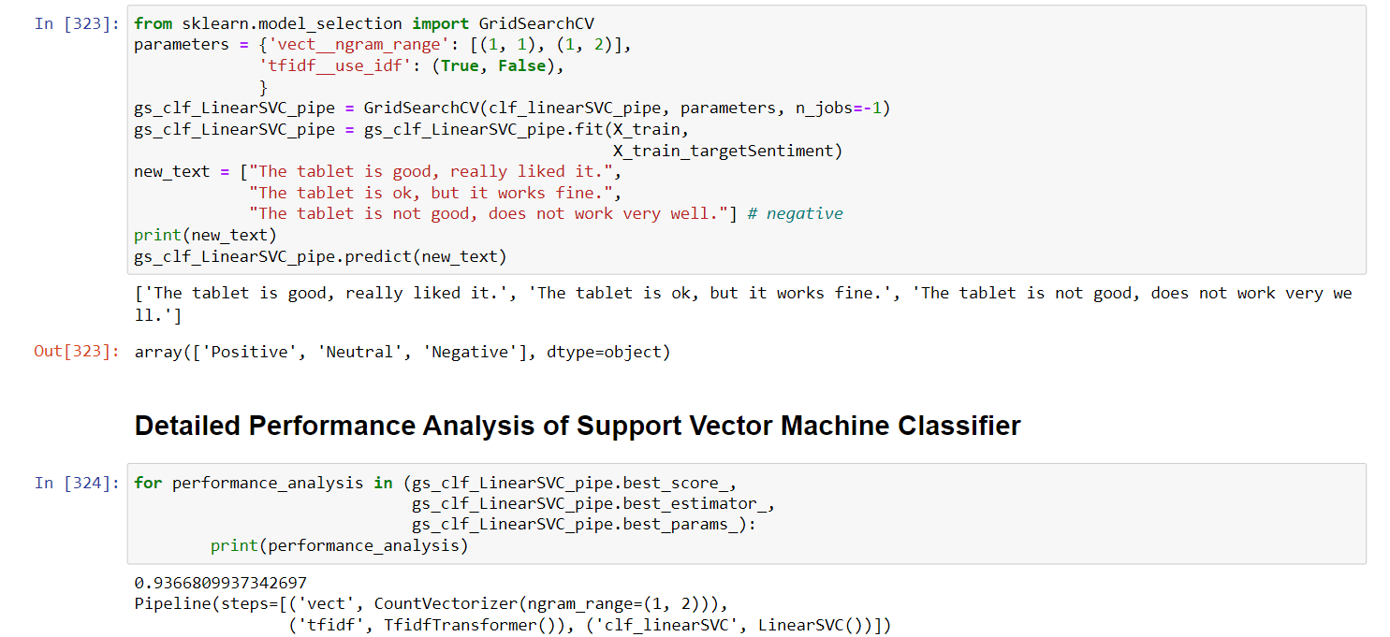
Test Sentiment

Slide 12
FUTURE SCOPE
From the analysis above in the classification report, we can see that products with lower reviews are not significant enough to predict these lower rated products are inferior. On the other hand, products that are highly rated are considered superior products, which also performs well and should continue to sell at a high level.
As a result, we need to input more data in order to consider the significance of lower rated product, in order to determine which products should be dropped from Amazon’s product roster.
The good news is that despite the skewed dataset, we were still able to build a robust Sentiment Analysis machine learning system to determine if the reviews are positive or negative. This is possible as the machine learning system was able to learn from all the positive, neutral and negative reviews, and fine tune the algorithm in order to avoid bias sentiments.

Slide 13
CONCLUSION
In conclusion, although we need more data to balance out the lower rated products to consider their significance, however we were still able to successfully associate positive, neutral and negative sentiments for each product in Amazon’s Catalog.

Slide 14
THANK YOU

