Slide 1

“IOT BASED PATIENT MONITORING SYSTEM ”
Presented by :
1.Prajakta V. Danake
2.Snehal N. Gaikwad
3.Kajal G. Thite
4.Pranali S. Supekar
5.Dnyanada S. Mahajan
Under the guidance :
Dr.P.A.Hagargi
HOD CSE :
Dr.B.C.Melinamath

Slide 2
OUTLINE
INTRODUCTION
EXISTING SYSTEM
DISADVANTAGES OF EXISTING SYSTEM
PROPOSED SYSTEM
ADVANTAGES OF PROPOSED SYSTEM
WORK PLAN
CONCLUSION

Slide 3
INTRODUCTION
In the recent years wireless technology has increasing for the need of upholding various sectors
Health monitoring is the major problem in today’s world. Due to lack of proper health monitoring, patient suffer from serious health issues.
Having a smart system, various parameters are observed that consume power, cost and increase efficiency

Slide 4
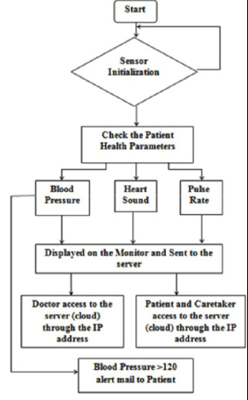
System Architecture:

Slide 5
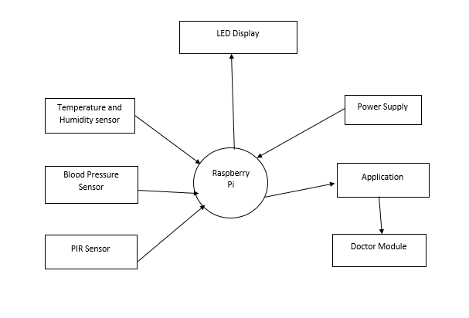
DFD Level 0 Diagram:

Slide 6
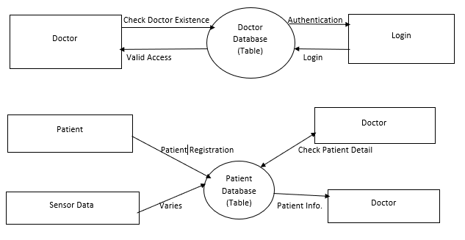
DFD Level 1 Diagram:

Slide 7
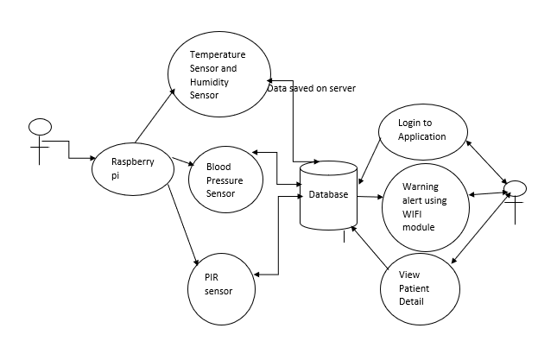
Use Case Diagram:

Slide 8
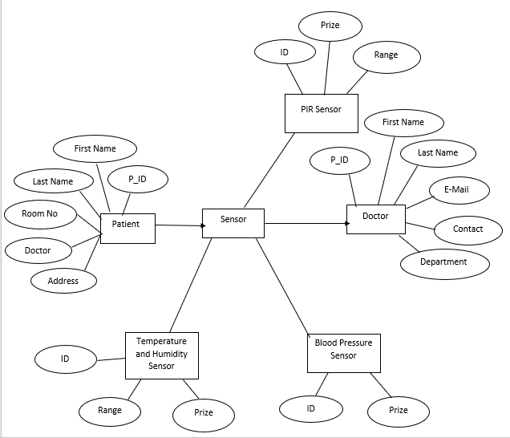
Entity Relationship Diagram:

Slide 9
EXISTING SYSTEM
Blood sugar testing.
Patient’s information is stored on the cloud.

Slide 10
DISADVANTAGES OF EXISTING SYSTEM
Privacy can be potentially undetermined.
Can be used only for detecting blood group and blood sugar testing.

Slide 11
PROPOSED SYSTEM
Measure body temperature.
Blood pressure detection.
Blood Sugar testing.
Measure heart rate.

Slide 12
ADVANTAGES OF PROPOSED SYSTEM
Decreased costs-with iot ,patient monitoring can be done in real time, drastically cutting down the need for doctors going out and making visits.
Reduced errors-iot allows for the accurate collection of data.
Better patient experience-A connected healthcare system creates an environment that meets each patient’s need.
Iot monitoring proves really helpful when we need to monitor and record and keep track of changes in health parameters of the patient over the period of time.
Patient health parameter data is stored over cloud.

Slide 13
Conclusion
The proposed system of patient health monitoring can be highly used in emergency situation.
Due to the importance of observing medical patient, continuous remote monitoring is necessary.
Our project work is giving the opportunity to monitor the patient continuously and record patient health status.
The efficiency of hospital staff is increased by using these applications.

Slide 14
Thank you

