Slide 1
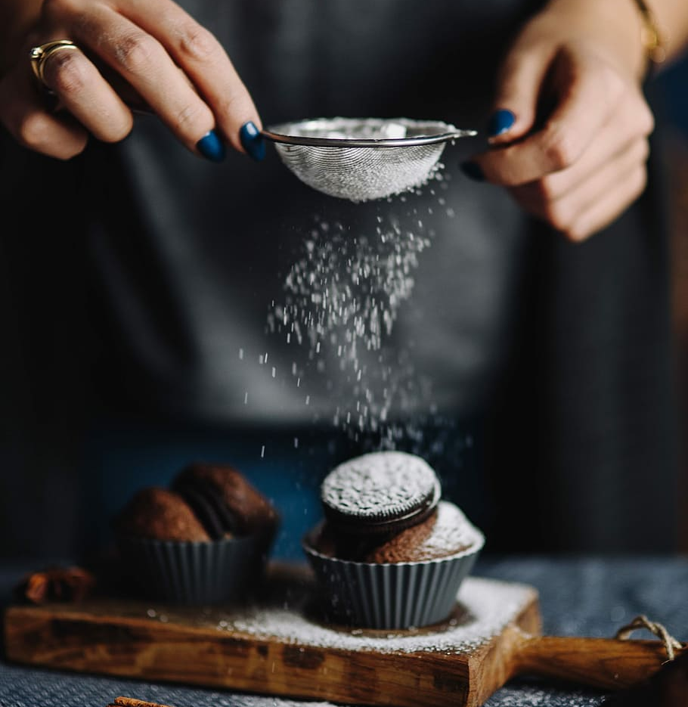
Eats and Treats
Under the guidance of
Prof. Swati Chandana
Prof. Adil Alias Rehmatullah
UI/UX Design and Implementation
Keerthana Kandaswamy(11013023)
Snehal Ghule(11013732)

Slide 2
Agenda
The Background
The Challenge
Solution
Results from the Research
Prototype
Implementation
Future Work

Slide 3

The Background
Many websites are available for ordering cake.
People prefer online shopping to make life easier.
But, do people opt for ordering cake online ?

Slide 4



The Challenge
Inconvenience
Trust
Poor Quality Content

Slide 5



Solution
Understand the user
User-friendly design
Usability Testing

Slide 6




Research
Target audience, Survey
Persona, CJM, POV
Design Thinking Process
Design ideas
Usability testing
Notes:
Target Audience – Anyone from age 18 – 50 who would like to order cake online.

Slide 7
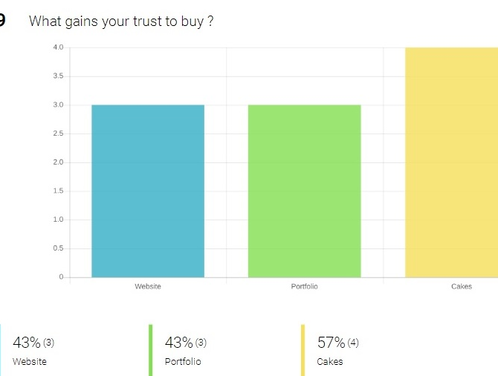
Empathize
Finding the right target audience.
Take surveys

Slide 8
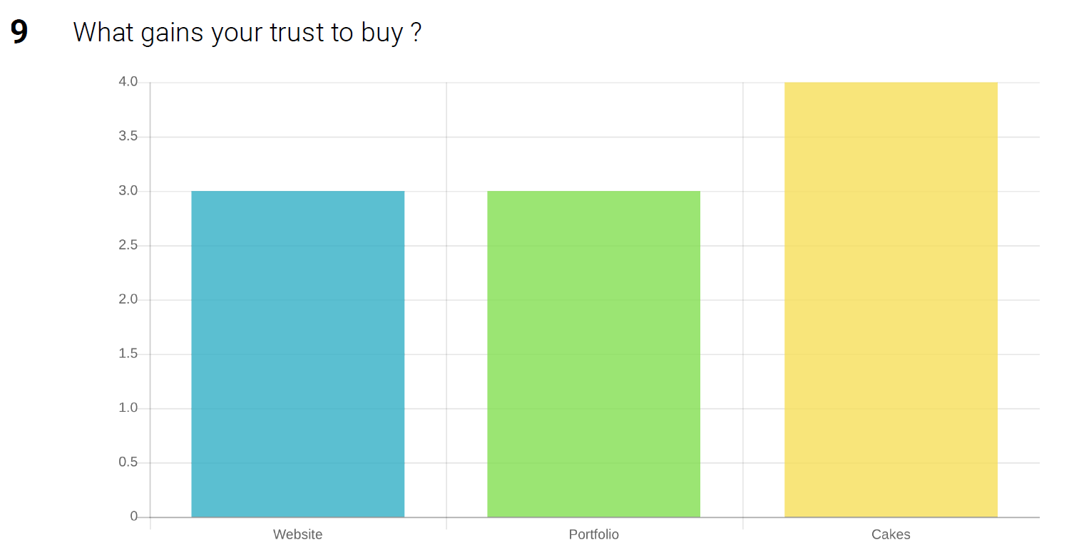
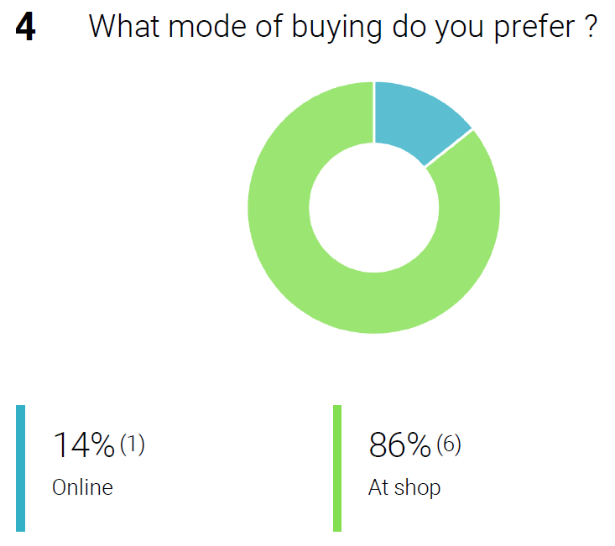
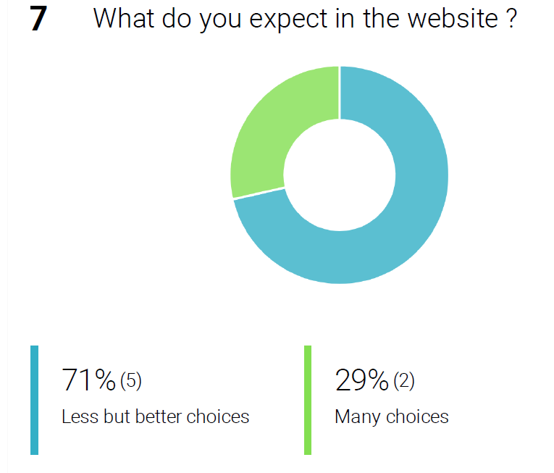
Survey results

Slide 9
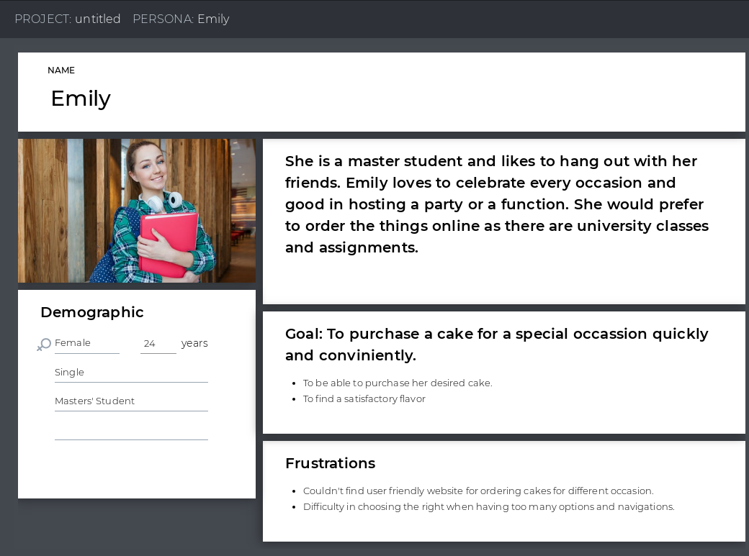
Define
Use the input from ‘Empathize’ step.
Create Personas, CJM(Customer Journey Map)
POV(Point of View)

Slide 10
Persona

Slide 11
POV
User | Need | Insight
A young student who lives in a city | To order cakes and desserts for every occasions | The user would not want to go to shop for ordering a cake every time as it is time-consuming. She would like to have a simple and reliable website

Slide 12
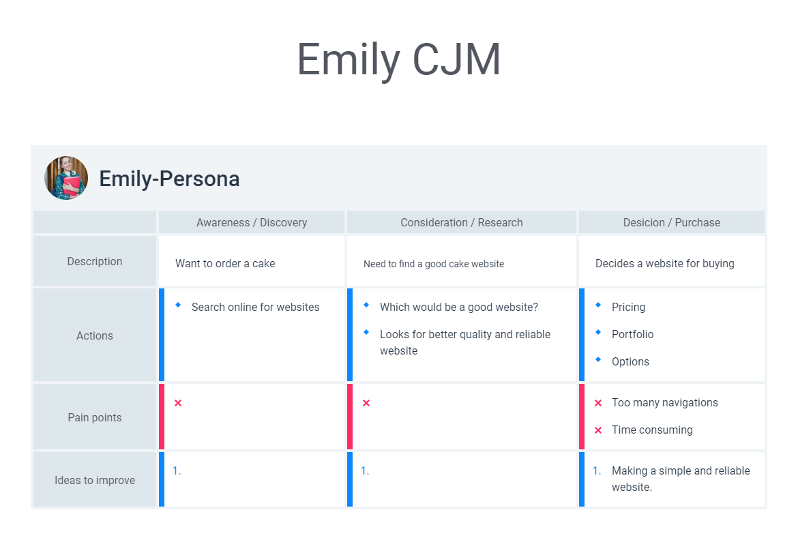
Customer Journey Map

Slide 13

Ideate
Brainstorming
Thinking out of Box for different ideas
More than one solutions

Slide 14
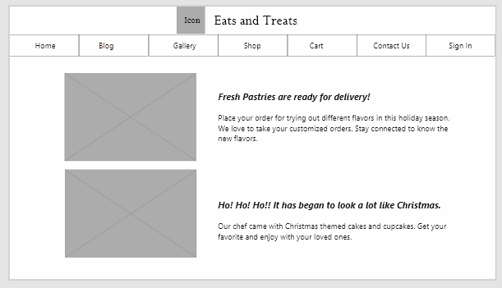
Prototype
Low-fidelity sketches
Wireframes
High-Fidelity Prototyping

Slide 15
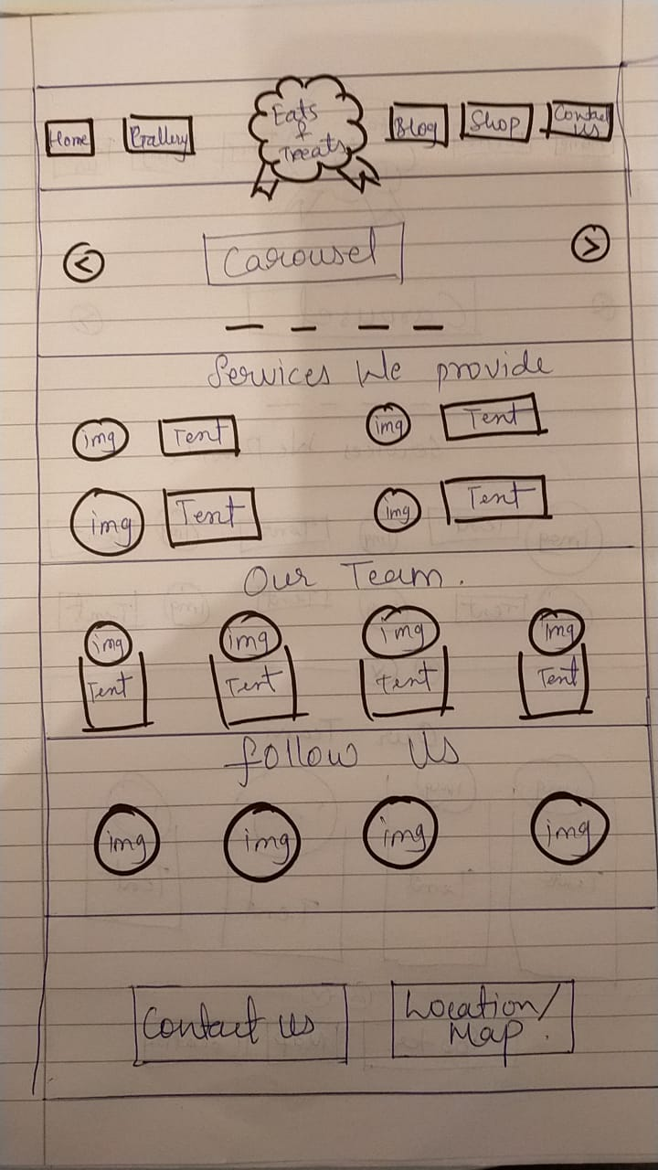
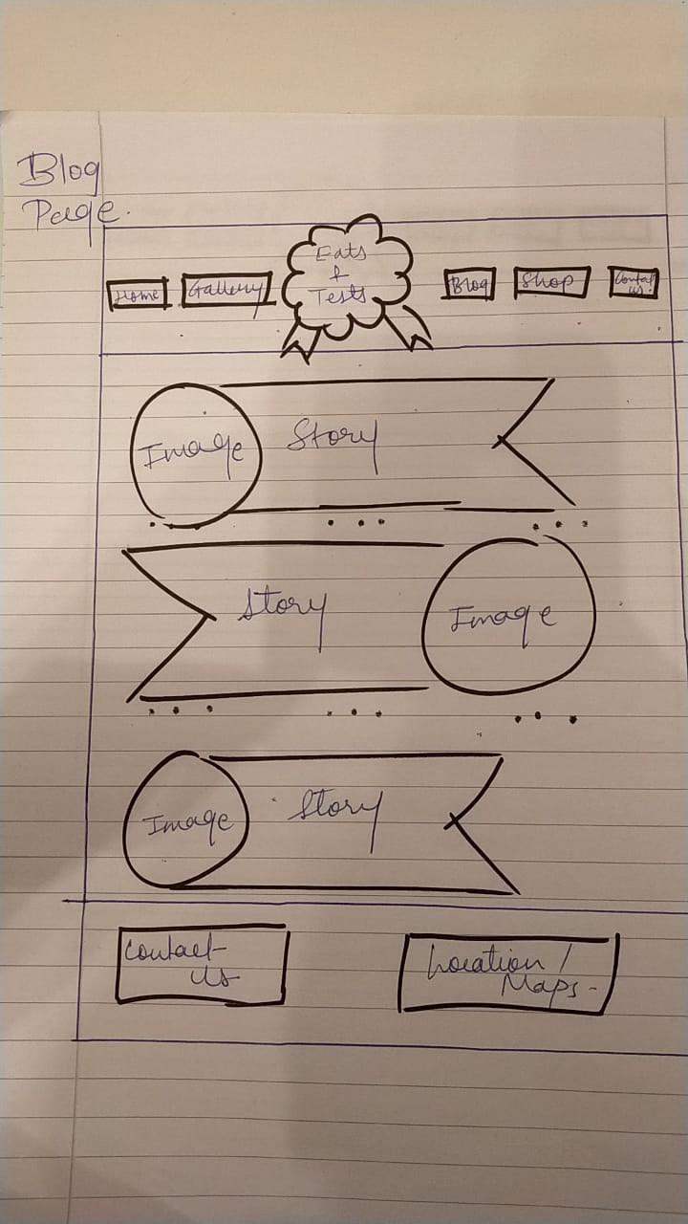
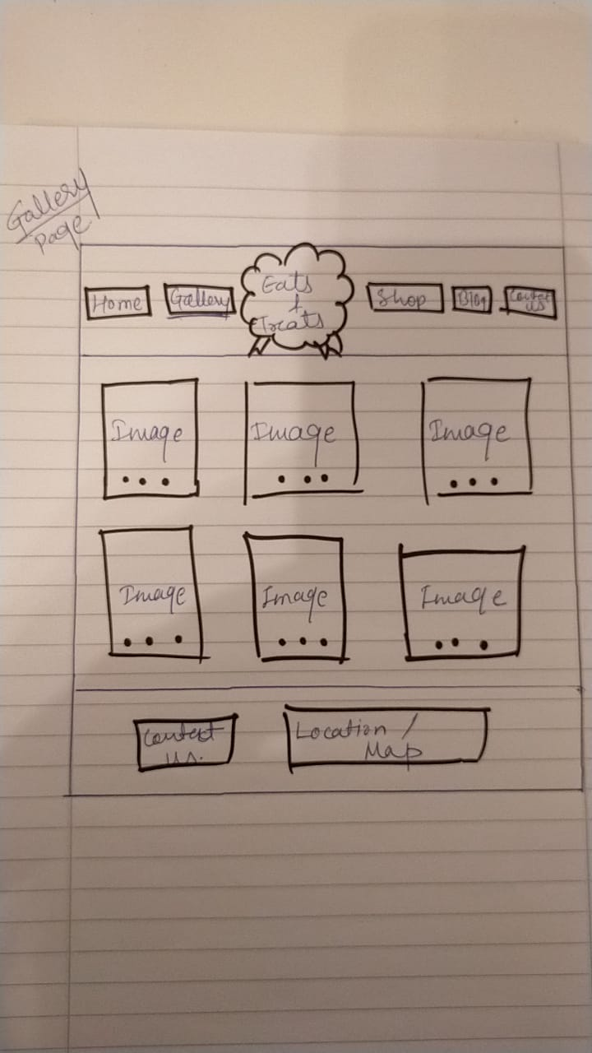
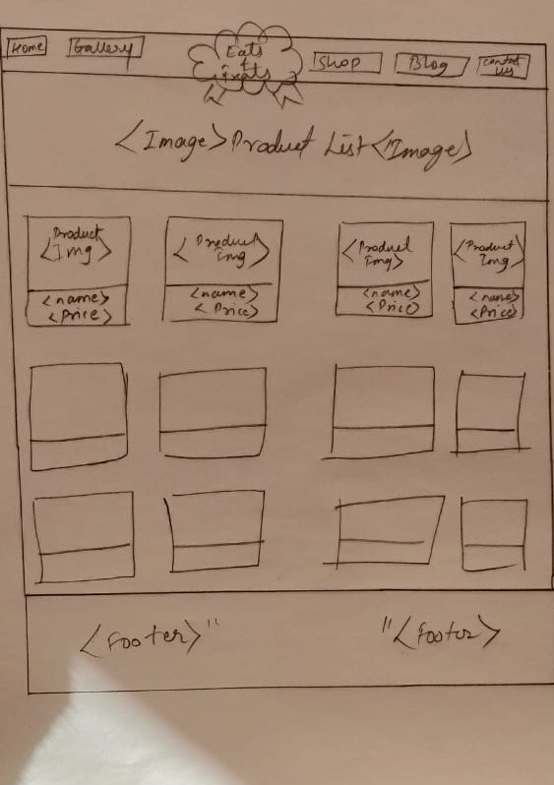
Initial sketch

Slide 16
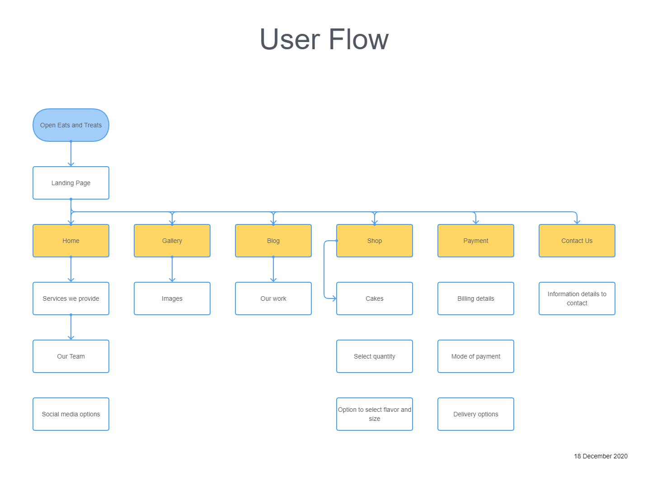
Information Architecture

Slide 17
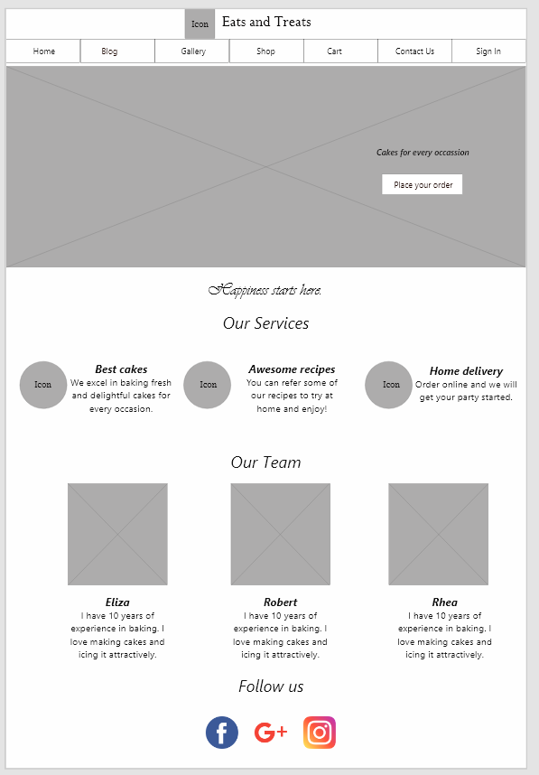
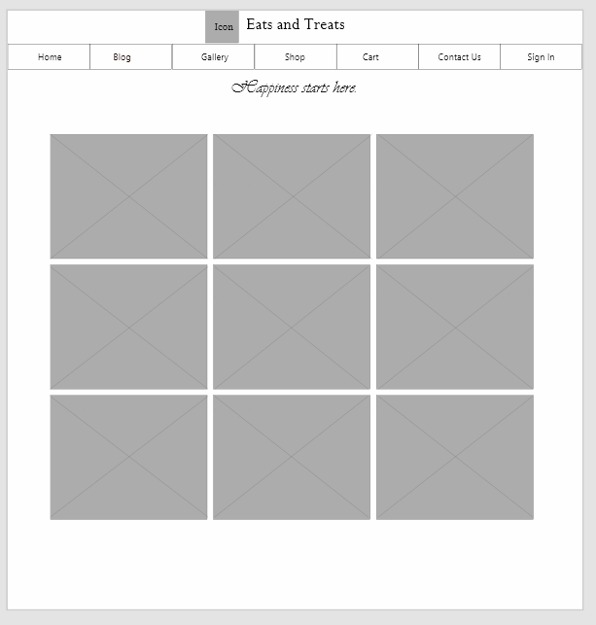
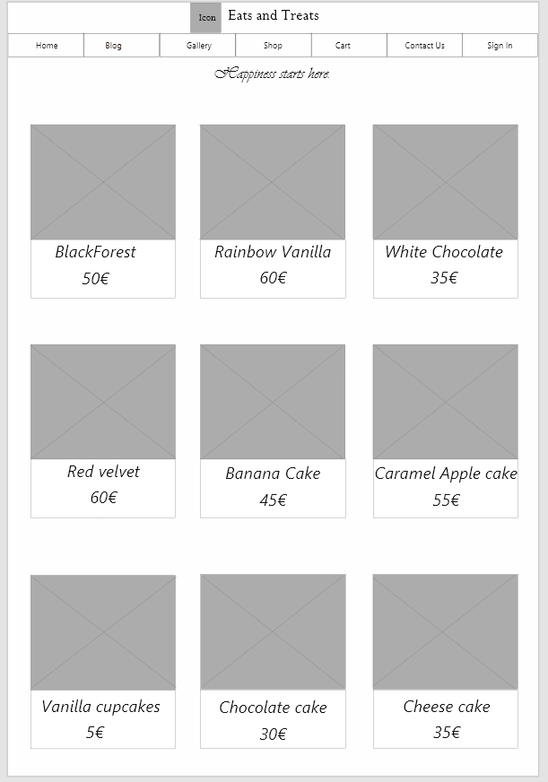
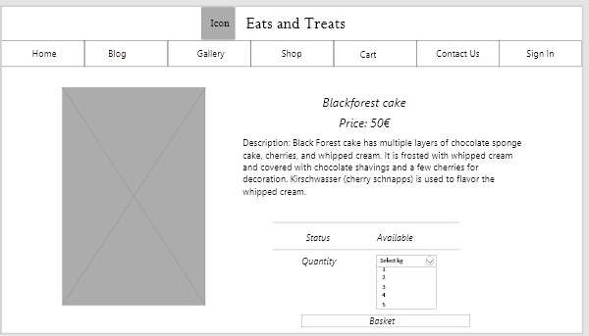
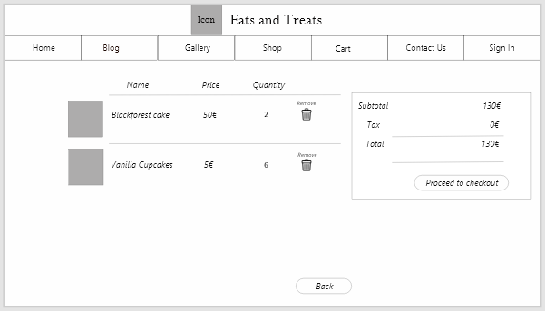
Wireframe

Slide 18

Prototype
Showcase of our prototype

Slide 19

Implementation
Demo of our website implementation

Slide 20
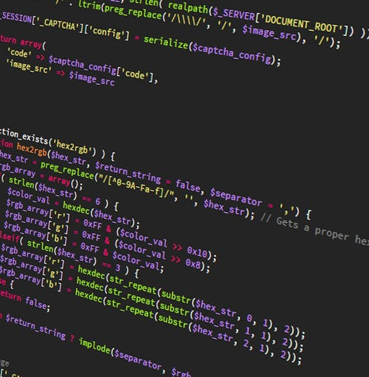
Future Work
Could be implemented for Mobile phones and tablets.
Admin part of the website

Slide 21
Thank You

Slide 22
Customize this Template
Template Editing Instructions and Feedback

