Slide 1
Enabling the Internet of Things
manusha Reddy
Sneha Lagandula
Dheeraj Reddy Bethi

Slide 2
Contents
Introduction/Overview
The Internet Of Things
Technologies Required
Physical Web
Applications of IoT
Challenges and Barriers in IoT
Future of IoT

Slide 3
What is IoT
The INTERNET OF THINGS is a scenario in which objects, animals or people are provided with unique identifiers and the ability to transfer data over a network without requiring human-to-human or human-to-computer interaction.
Enabling an internet presence for any person ,place, or thing on the planet , thereby pushing our notion of the physical web beyond smart devices.

Slide 4
The Internet of Things
The term internet of things was first used by Kevin Ashton in 1999
Refers to uniquely identifiable objects and their virtual representations in an internet-like structure.

Slide 5
Advantage of using IoT
“Today computers -- and, therefore, the Internet -- are almost wholly dependent on human beings for information. Nearly all of the data available on the Internet were first captured and created by human beings by typing, pressing a record button, taking a digital picture or scanning a bar code.
The problem is, people have limited time, attention and accuracy -- all of which means they are not very good at capturing data about things in the real world. If we had computers that knew everything there was to know about things -- using data they gathered without any help from us -- we would be able to track and count everything and greatly reduce waste, loss and cost. We would know when things needed replacing, repairing or recalling and whether they were fresh or past their best.”

Slide 6
IoT
A thing in the Internet of Things, can be a person with a heart monitor implant, a farm animal, an automobile that has built-in sensors to alert the driver when tire pressure is low -- or any other natural or man-made object that can be assigned an IP address.
Must be provided with the ability to transfer data over a network.
The first internet appliance for example, was a Coke machine at Carnegie Melon University in the early 1980s. The programmers could connect to the machine over the Internet, check the status of the machine and determine whether or not there would be a cold drink awaiting them, should they decide to make the trip down to the machine.

Slide 7
Practical Issues
Handling dramatic increases in network scale
Interaction Model
Integration of Devices

Slide 8
IoT Vision
Interaction Model provided by web– It allows users get device related information
Next Generation of conventional web which includes interaction with appliances and electronic devices
Physical Web=Web technology and IoT

Slide 9
How it Works
Identifiers – serve as addresses for a global network of devices
Alternative- URL along with DNS

Slide 10
Methods
Direct
A smartphone can query the state of an IoT device in its proximity
Example : Fitbit fitness monitor
Proxy
Mobile users near an IoT enabled object or device.

Slide 11
IoT
Popular buzzword
Networking companies like Cisco and microprocessor
Home Automation Systems connect to the internet through home’s Wi-Fi
Address space for the internet needs to be increased
IETF(Internet Engineering Task force) working on IPv6 standard

Slide 12
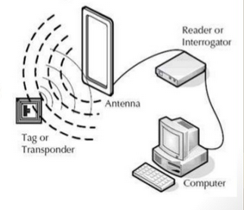
Enabling Technologies for the IoT
RFID consists of
Tags (Transmitters/Responders)
Tag is a microchip connected with an antenna
Readers (Transmitters/Receivers)
RFID reader communicates with RFID tags using radio waves

Slide 13
Enabling Technologies for the IoT
Near Field Communication
A short range, high-frequency(13.56MHz) RFID that allows for the exchange of information between two NFC-enabled devices.

Slide 14
Enabling Technologies for the IoT
Quick Response Code
Another contender for the low-cost tagging in the optical or printed tag
QR code is extracted and decoded from a scene using image-processing technique resulting a number, text or URI.
Poor customer response because preinstalled application is required

Slide 15
Enabling Technologies for the IoT
Bluetooth Low Energy
One of the promising new technologies in the device tagging space in BLE.
BLE hardware is included in all the smartphones released in the last few years with various levels of capabilities depending on the OS support.
Low-cost Bluetooth silicon implementation can be used as low-power electronic tag.

Slide 16
The Physical Web
Physical web=Web technologies + Internet of Things
People, places, and things have webpages to provide information for user interaction.
With a web search, the search results would be ordered by conventional ranking algorithms. Result could be shown as lists, maps etc.
Searching the physical web at home would bring objects as result.

Slide 17
The Physical Web
Webpages- Human to Machine Interaction
IoT-Machine to Machine Interaction
Web-technologies include, HTML, Ajax, HTTP and structured data apply equally well to IoT
Open web does not have effective mechanism for locating objects in the physical world.
Using Radio beacons that broadcast URLs at very low power and over a small geographic radius.

Slide 18
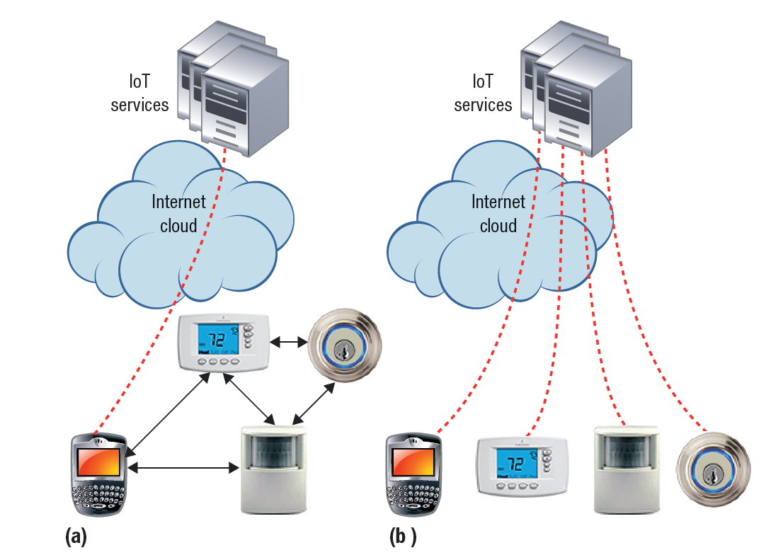
CLOUD COMPUTING VS PEER TO PEER
One of the long debates in computer field has been whether to build centralized systems or to make them fully distributed.
(a) Peer-to-peer, with gateway to an IoT service); and (b) centralized IoT service.

Slide 19
BENEFITS OF CLOUD COMPUTING
The computing world has shifted paradigms several times.
The computing industry is gravitating towards more centralized cloud services.
However, modern client devices are both capable and flexible.
Ex: Laptops, Smart Phones.
Option of running simple clients connected to powerful cloud services.
The decision comes down to our tolerance for tradeoffs in latency, security, privacy and cost.
Based on the observations, it seems like a good idea for IoT architecture to register every device with a cloud service and communicate with that service only.

Slide 20
BENEFITS OF PEER-TO-PEER
The requirements for full Internet communication might be too costly for simple low performance devices.
A bridging device that supports Wi-Fi and enables IoT devices to talk to the bridge.
Proximity sharing.
Sharing is achieved by protocols and data formats.
Ex: Integration of DLNA.
In the undefined IoT world, many standards and data formats are still up in the air.

Slide 21
HYBRID IoT SOLUTIONS
Approaches:
Edge computing
Moves some of the cloud processing closer to devices. It reduces number of network hops.
Ex: Cloudlet paradigm.
Achieved through a Virtual Machine(VM) running on a powerful nearby workstation.
When the task is complete, the resources can then be freed up, allowing a new VM, or multiple VMs to be instantiated on the cloudlet.
A cloudlet lets IoT devices interact in real time with cloud-like services.

Slide 22
WHAT THE IoT MEANS FOR THE APPS
Any new IoT product comes with a smartphone app to control it.
This approach creates problems as landscape of IoT grows and matures.
We need a richer extension of today’s web, allowing each smart device to broadcast a URL to its surrounding.
Extension of web for light weight approach for enabling devices to interact with eachother.

Slide 23
FUTURE OPPORTUNITIES AND CHALLENGES
Ubiquitous information:
Users often need help when they encounter an unfamiliar device.
Ex: Physical Web enables all products to transmit a wireless machine readable URL.
Context Sensing:
Context awareness.
Sensing what is around the host device.
Ex: Local Map Application.
Actions and control:
IoT offers ways to control the physical world through displays, actuators, and switches.
Anything with a display, actuator or switch can be controlled from a browser or through Web Service.
Ex: Web connected irrigation systems.
Privacy and Security:
The Physical Web can enable hackers to control our devices unless precautions are taken.
In addition to hacking, social threats can result when knowledge is leaked in unexpected ways.

Slide 24
CONCLUSION
Merging the virtual web with IoT will enable really smart devices, providing smarter automation and services.
A key enabler has the ability to discover proximate objects.
IoT feels like a big opportunity to improve the design and building of products.
There might be an overall shift in consumer perception about connected technology and demonstrates openness for adoption in the upcoming years.

Slide 25
REFERENCES
1. M. Satyanarayanan, “Pervasive Computing: Vision and Challenges,” IEEE Personal Comm., vol. 8, no. 4, 2001, pp. 10–17.
3. T. Kindberg et al., “People Places and Things: Web Presence for the Real World,” ACM J. Mobile Networks and Applications, vol. 7, no. 5, 2002, pp. 365–376.
4. R. Want et al., “Bridging the Physical and Virtual Worlds with Electronic Tags,” Proc. ACM SIGCHI, 1999, pp. 370–377.
5. S. Jain et al., “Exploiting Mobility for Energy Efficient Data Collection in Wireless Sensor Networks,” Mobile Networks and Applications, vol. 11,no. 3, 2006, pp. 327–339.
6. R. Want, “RFID: The Key to Automating Everything,” Scientific Am., Jan. 2004, pp. 56–65.
7. H. Kato and K.T. Tan, “Pervasive 2D Barcodes for Camera Phone Applications,”IEEE Pervasive Computing, vol. 6, no. 4, 2007, pp. 76–85.
8. R. Heydon, Bluetooth Low Energy, Prentice Hall, 2013.
9. B.N. Schilit and U. Sengupta, “Device Ensembles,” Computer, vol. 37, no. 12, 2004, pp. 56–64.
10. M. Satyanarayanan et al., “The Case for VM-Based Cloudlets in Mobile Computing,” IEEE Pervasive Computing, vol. 8, no. 4, 2009, pp. 14–23.

Slide 26
QUESTIONS….?

