Slide 1
VIDOO
YOUTUBE API RANKING SYSTEM
By,
Pradyumna Doddala
Manusha Reddy Bethelli
Sneha Lagandula
Dheeraj Reddy Bethi

Slide 2
Login Functionality
This web application is provided with a login page, where user can login to the system with their email address and pre-assigned password.
If the user forgets the password, he would be able to create a new password using the registered email address and security questions.
User is provided with a remember me option.

Slide 3
Search Functionality
Up on successful login to the system, user would be provided with a search field where the user can enter a keyword and the application retrieves a list of relevant videos along with their related metadata.
Also, there is an admin page, where the administrator can add new users.
A dash board is displayed where it shows the most popular users of youtube.

Slide 4
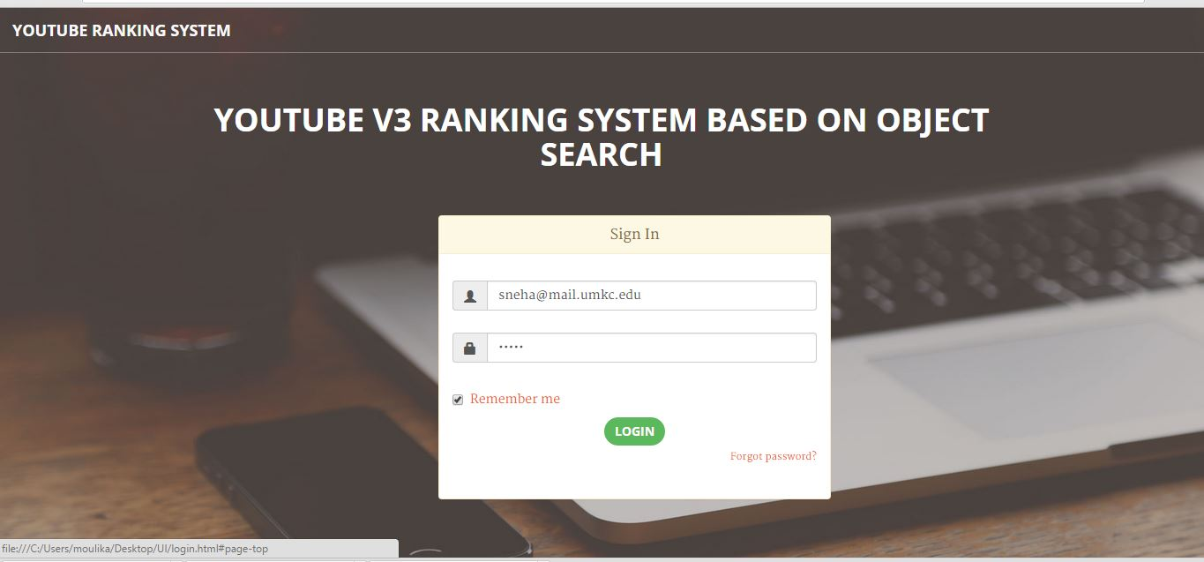
Login page with email and password

Slide 5
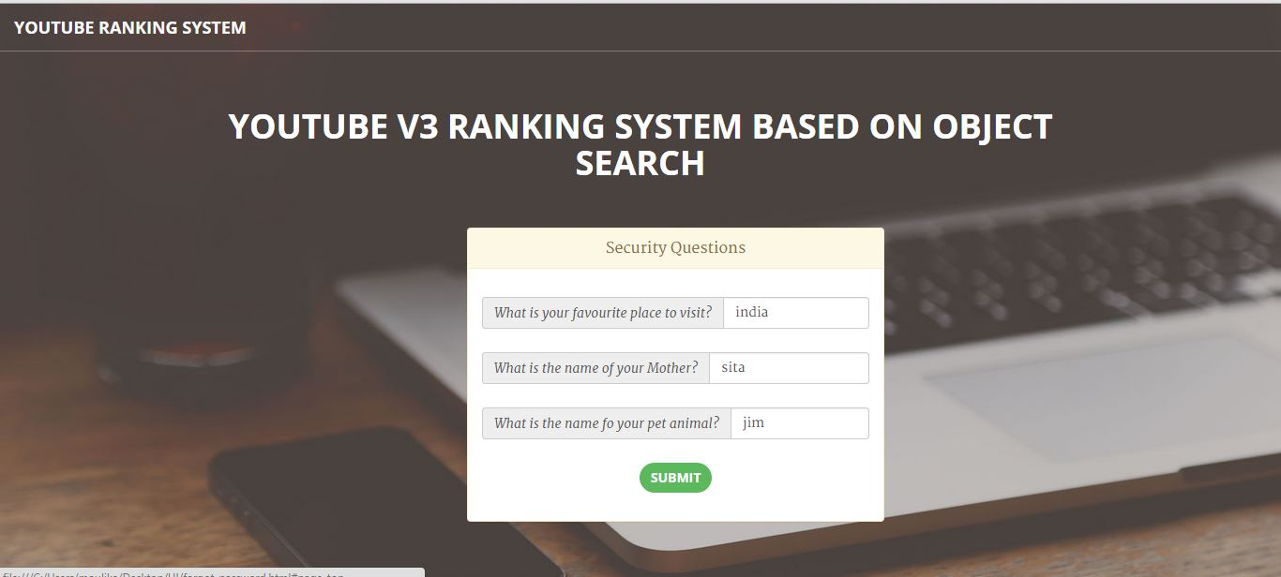
Password recovery

Slide 6

New password confirmation

Slide 7
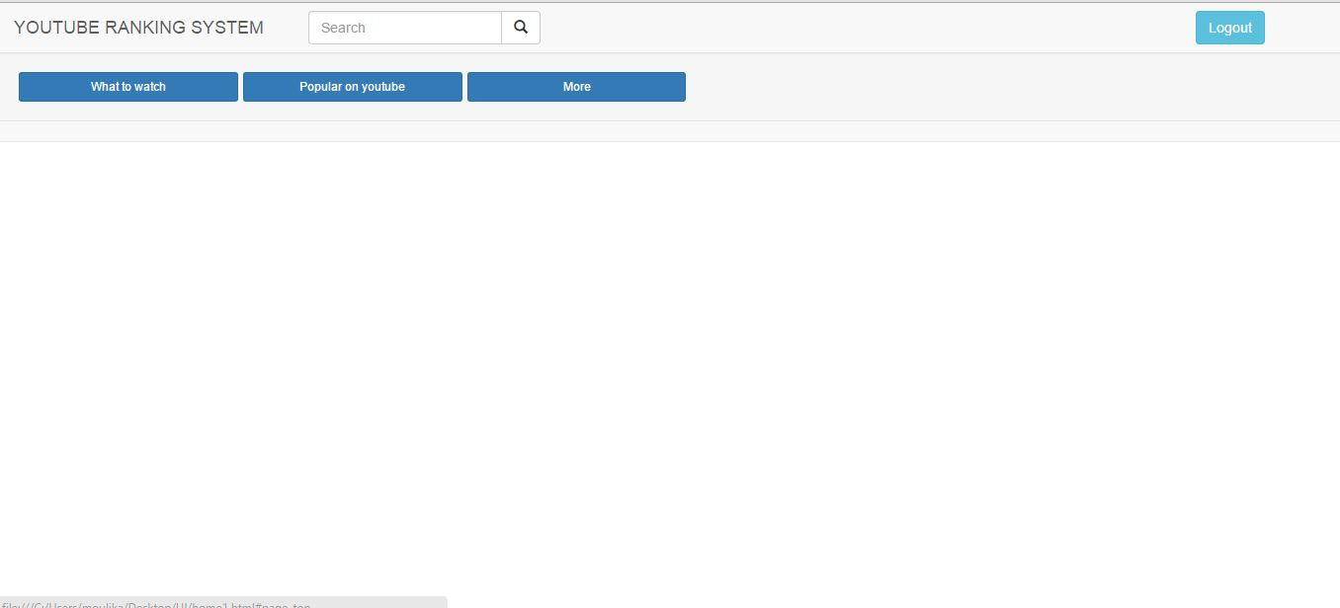
Search field upon successful login

Slide 8
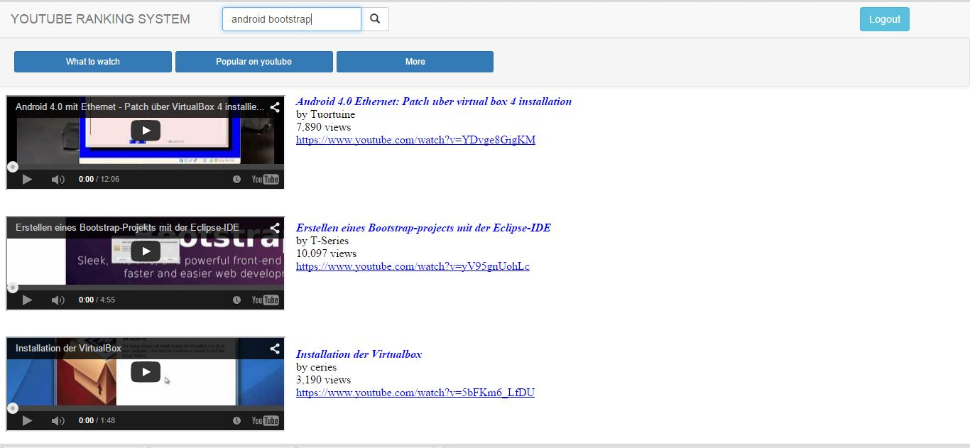
Videos retrieved upon search

Slide 9
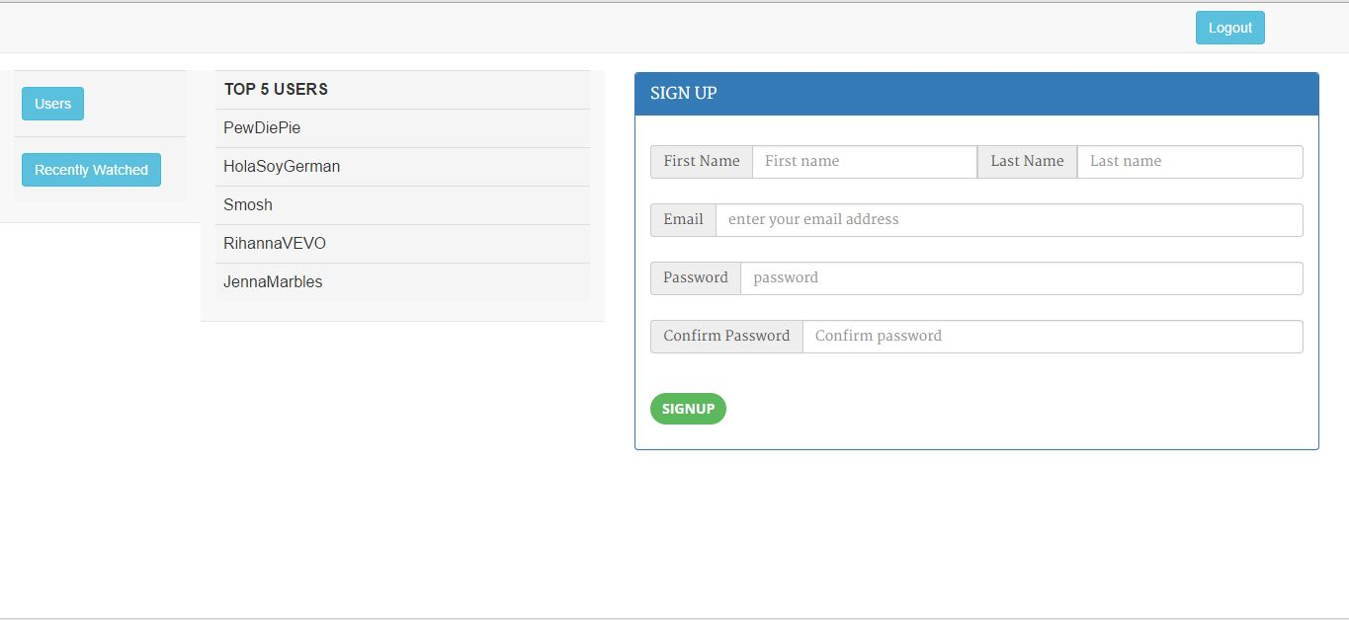
Admin page to sign up new users and a dashboard displaying top most users of youtube

